Slide 1
Notes on
2/19/2024

Slide 2
Roadmap
Neural AVH brainstorming.
What did Dan choose as the 1st experiment?
Trick: decoder forward = encoder backward.
Trick: backprop through RVQ.
Architecture: quantized questions and variational answers.

Slide 3

Sheet Image GT
Audio GT
Symbolic Music
$$z$$
Performance Actions
Audio

Slide 4
Potential contributions
Machine can learn music as the human does.
Better?
Score image to performance audio.
Learned z is the performance style. Sheet and/or z controllable?
Concept (symbolic music) discovery via SSL.
Emergent score.
Utilize unimodal data.
Via functional alignment?
Self free-play requires 集体潜意识 to actually learn anything.

Slide 5
Potential contributions
Decrypt sheet images using only unimodal data and an instrument.
Unified framework including multiple tasks.
Multi-task joint learning.
May surpass single-task learning.
Combine representation learning with reinforcement learning.

Slide 6
Guess
Which did Dan choose to be the 1st experiment?

Slide 7
Decrypt sheet images using only unimodal data and an instrument.
Given:
Audio dataset.
Sheet music image dataset.
Differentiable virtual instrument.
Trainable models:
Audio language model.
Performance model (Sheet -> instrument control).
Gus idea:
Audio LM is hard to train without symbolic abstraction. With the performance model pipeline, we can obtain symbolic bottleneck, which helps audio LM.
Motivation: the two tasks better help each other.

Slide 8
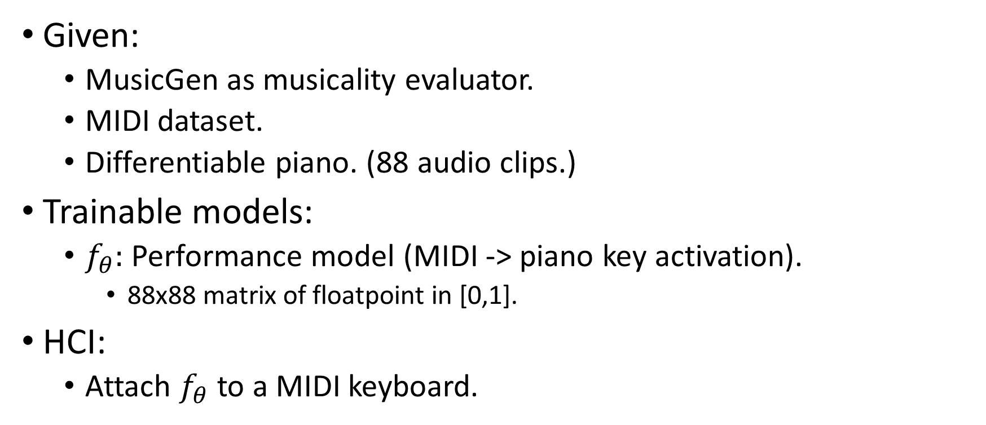
Simplify.
Given:
MusicGen as musicality evaluator.
MIDI dataset.
Differentiable piano. (88 audio clips.)
Trainable models:
$f_{θ}:$ Performance model (MIDI -> piano key activation).
88x88 matrix of floatpoint in [0,1].
HCI:
Attach $f_{θ}$ to a MIDI keyboard.

Slide 9







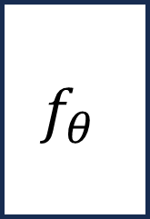
Trick: Decoder as encoder gradient
LM
$$ℒ$$
$$f_{θ}$$
$$E$$
$$D$$
$$y$$
$$x$$
$$z$$
$$\hat{x}$$

Slide 10



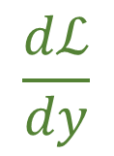


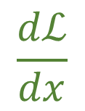

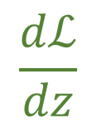

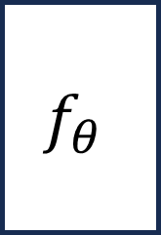
LM
$$ℒ$$
$$f_{θ}$$
$$E$$
$$D$$
$$y$$
$$x$$
$$z$$
$$\hat{x}$$
$$\frac{dℒ}{dy}$$
$$\frac{dℒ}{dx}$$
$$\frac{dℒ}{dz}$$

Slide 11
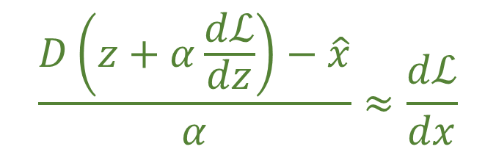
LM
$$ℒ$$
$$f_{θ}$$
$$E$$
$$D$$
$$y$$
$$x$$
$$z$$
$$\hat{x}$$
$$\frac{dℒ}{dy}$$
$$\frac{dℒ}{dx}$$
$$\frac{dℒ}{dz}$$
$$\frac{D\left(z+α\frac{dℒ}{dz}\right)−\hat{x}}{α}≈\frac{dℒ}{dx}$$

Slide 12




LM
$$ℒ$$
$$f_{θ}$$
$$E$$
$$D$$
$$y$$
$$x$$
$$z$$
$$\hat{x}$$
$$z=E\left(x\right)$$
$$z$$
$$x$$
$$\hat{x}=D\left(z\right)$$

Slide 13









Encodec + MusicGen
LM
$$e_{LM}$$
$$C_{LM}$$
$$i$$
$$E$$
$$Q$$
$$x$$
$$z$$
$$C⋅i^{T}=e$$
$$e$$

Slide 14

Trick: Backprop thru RVQ (Method 1: train a low-rank map)
LM
$$e_{LM}$$
$$C_{LM}$$
$$i$$
$$g_{θ}$$
$$E$$
$$Q$$
$$x$$
$$z$$
$$e$$

Slide 15

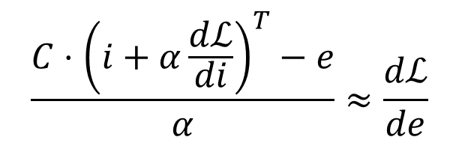
Trick: Backprop thru RVQ (Method 2: Finite Difference Approximation)
LM
$$e_{LM}$$
$$C_{LM}$$
$$C⋅i^{T}=e$$
$$i$$
$$E$$
$$Q$$
$$\frac{C⋅{\left(i+α\frac{dℒ}{di}\right)}^{T}−e}{α}≈\frac{dℒ}{de}$$
$$x$$
$$z$$
$$e$$

Slide 16








$$x_{1}$$
$$x_{2}$$
$$x_{3}$$
$$h_{1}^{l}$$
$$h_{2}^{l}$$
$$h_{3}^{l}$$
$$h_{3}^{l+1}$$
Problem: 多峰分布
$${\hat{x}}_{4}$$

Slide 17


$$x_{1}$$
$$x_{2}$$
$$x_{3}$$
$$x_{4}$$
$$h_{1}^{l}$$
$$h_{2}^{l}$$
$$h_{3}^{l}$$
Bottleneck
$$z_{4}$$
$$h_{3}^{l+1}$$
$${\hat{x}}_{4}$$

Slide 18
$$x_{4}$$
Condition
$$h_{3}^{l}$$
$$z_{4}$$
VAE
$${\hat{x}}_{4}$$

Slide 19
Questions
Frozen MusicGen on 1 GPU?
No problem.
Symbolic (monophonic) dataset?
Ziyu/JJY
URMP
Los angeles.
多峰分布问题 solutions: LM; VAE.
Existing quantized autoencoders for spectrogram.
Shiqi related work using VAE.

Slide 20
Office hour w/ liwei
unsupervised_symbolic_music_decipher.
HCI: play the performer.
有谁 了解/思考 过 对于一个 (R)VQ 的 LM, 怎么把梯度从 LM 传到 VQ encoder 那里？
TODO
Compare perplexity of musical and imusical audio rendered as in the setup.

