Slide 1
mar_12_2024_notes

Slide 2
Fit LM to data via CE
LM captures the distribution of the data.
0.6
0.4
C4
G4
E4?
F4?

Slide 3
Fit data to LM via CE
Data collapses to the mode, and doesn’t follow the distribution specified by the LM.
0.6
0.4
C4
G4
E4?
F4?

Slide 4
Fit performer to LM via CE
Performer will map both symbolic E4 and F5 to audio F4.
0.6
0.4
C4
G4
E4?
F4?

Slide 5
Optimize the language model…
Optimize the data…
… to maximize the likelihood of the data under the language model.

Slide 6
Optimize the language model… -> model captures data distribution.
Optimize the data… -> data collapses to model mode.
… to maximize the likelihood of the data under the language model.

Slide 7
Optimize the language model… -> model captures data distribution.
Optimize the data… -> data collapses to model mode.
… to maximize the likelihood of the data under the language model.
Classifier-guided input optimization: mode collapse.
GAN.

Slide 8
Conclusion:
We have to fit to the mode.
I can’t think of any alternative.
Let’s hope it’s Ok.
Abandon statistical interpretability.
We previously wanted to maximize the likelihood of the performed audio. Now, that has lost meaning.
Just make an ad hoc loss that makes qualitative sense.

Slide 9
Gus feedback
Solution to mode collapse (I think):
Cycle consistency / add “decoder”
To Gus this is a more intuitive methodology
Combine f: s2a and f^-1: a2s in one unified framework may solve both Monday issues and Thursday issues.

Slide 10
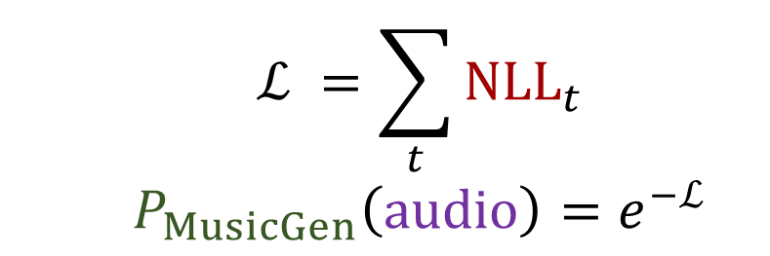

$$ℒ =\sum_{t}{{NLL}_{t}} \\ P_{MusicGen}\left(audio\right)=e^{−ℒ}$$
NLL
Logits
MusicGen
Tokens
Encodec
Encodec
Audio frames
$$t$$

Slide 11
$$ℒ =\sum_{t}{{NLL}_{t}} \\ P_{MusicGen}\left(audio\right)=e^{−ℒ}$$
Not important any more!
NLL
Logits
MusicGen
Tokens
Encodec
Encodec
Audio frames
$$t$$

Slide 12
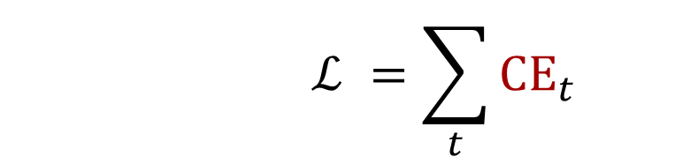
$$ℒ =\sum_{t}{{CE}_{t}}$$
CE
Logits
MusicGen
Tokens
Encodec
Encodec
Audio frames
$$t$$

Slide 13
Optimum instability
Consider the encodec tokens when the training nears the optimum. As the training continues, the one-hot tokens will alternate in and out from the optimum.
In this problem in VQ-VAE training already?
In fact a problem with straight-through estimation?

Slide 14
Piano is all you need
Previously: performer is MIDI pitch -> 88-hot piano key activation.
Now: performer is (MIDI program, MIDI pitch) -> 88-hot piano key activation.
Drum beats can be chords?
Black piano reduction.
(style transfer via constrained performing.)

Slide 15
New problem
Audio doesn’t pass gradients well
Encodec token as audio
加法器 on encodec reprs.

