Slide 1
mar_21_2024_notes

Slide 2
Dataset = Monophonic MIDI, piano-like.

Slide 3
Performer
Method 1: Performer(pitch) = logits_over_88_keys
Method 2: Performer(pitch, time_since_note_on) = logits_over_all_piano_tokens

Slide 4



Logits: piano key
$$ℝ^{88}$$
Interpreter
$$ℝ^{128×88}$$
MIDI pitch
$$[0, 1, …, 127]$$

Slide 5
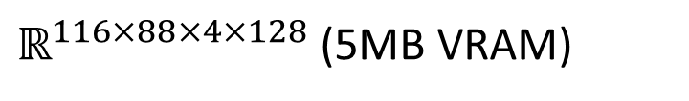


Encodec repr
$$ℝ^{4×128}$$
Piano
$ℝ^{116×88×4×128}$ (5MB VRAM)
Time since noteon, Piano key
$$\left[0, 1, …, 115\right]×ℝ_{onehot}^{88}$$

Slide 6
Encodec repr
Piano
Piano key
Sample
S2A
Logits: piano key
Interpreter
MIDI pitch
Time since noteon

Slide 7
Encodec repr
Piano
Straight-through estimation
Piano key
Sample
Logits: piano key
Interpreter
MIDI pitch
Time since noteon

Slide 8
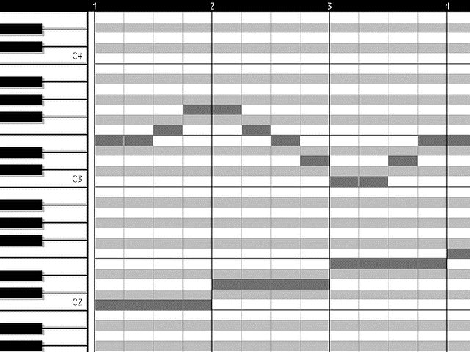


$$ℒ =\sum_{t}{{CE}_{t}}$$
CE
Logits
MusicGen
Tokens
S2A
Score
$$t$$

