Slide 1
mar_26_2024_notes

Slide 2
Dataset = Polyphonic MIDI, piano-like.

Slide 3
Interpreter
Interpreter(pitch) = logits_over_88_keys

Slide 4



Logits: piano key
$$ℝ^{88}$$
Interpreter
$$ℝ^{128×88}$$
MIDI pitch
$$[0, 1, …, 127]$$

Slide 5
Piano key
Note onset, velocity
Sample
S2P: Score to Performance
Logits: piano key
Interpreter
Note pitch
Note onset, velocity

Slide 6
Piano key
Note onset, velocity
Straight-through estimation
Sample
Logits: piano key
Interpreter
MIDI pitch
Note onset, velocity

Slide 7
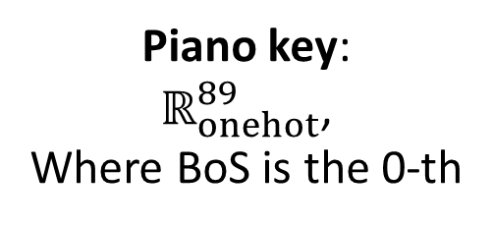

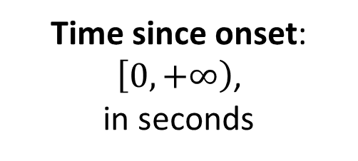

Key event embedding:
$$ℝ^{64}$$
Key event embedder
Time since onset:
$\left[0, +∞\right)$,
in seconds
Velocity:
$$\left[0, 1\right]$$
Piano key:
$ℝ_{onehot}^{89}$,
Where BoS is the 0-th

Slide 8


Encodec id
$$ℝ^{4×2048}$$
Transformer Piano
Key event embedding
$$ℝ^{64}$$
Learnable query

Slide 9
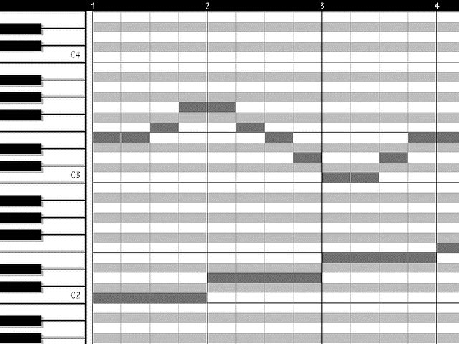
Encodec id
Transformer Piano
S2P
Score

Slide 10


$$ℒ =\sum_{t}{{CE}_{t}}$$
CE
Logits
MusicGen
Encodec id
$$t$$

Slide 11
Liwei conclusion
Make transformer apply to the entire song instead.

