Slide 1
mar_27_2024_notes

Slide 2
Dataset = Polyphonic MIDI, piano-like.

Slide 3
Interpreter
Interpreter(pitch) = logits_over_88_keys

Slide 4



Logits: piano key
$$ℝ^{88}$$
Interpreter
$$ℝ^{128×88}$$
MIDI pitch
$$[0, 1, …, 127]$$

Slide 5
Piano key
Note onset, velocity
Sample
S2P: Score to Performance
Logits: piano key
Interpreter
Note pitch
Note onset, velocity

Slide 6
Piano key
Note onset, velocity
Straight-through estimation
Sample
Logits: piano key
Interpreter
Note pitch
Note onset, velocity

Slide 7


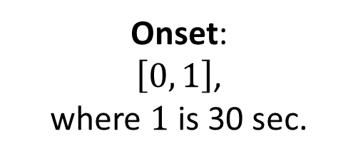

Key event embedding:
$$ℝ^{64}$$
Key event embedder
Onset:
$\left[0, 1\right]$,
where $1$ is 30 sec.
Velocity:
$$\left[0, 1\right]$$
Piano key:
$$ℝ_{onehot}^{88}$$

Slide 8
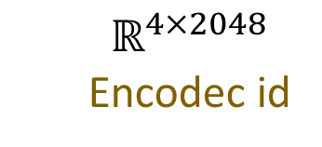
$$ℝ^{4×2048}$$ Encodec id
Transformer Piano
Key event embeddings
Positional encodings

Slide 9
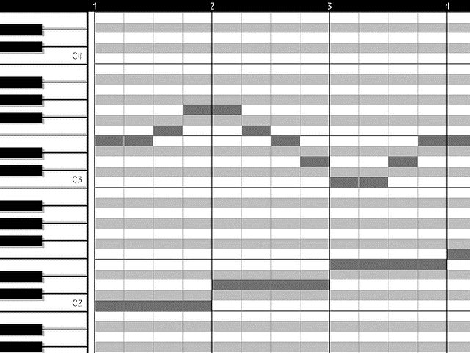
Encodec id
Transformer Piano
Key event embedder
S2P
Score

Slide 10


$$ℒ =\sum_{t}{{CE}_{t}}$$
CE
Logits
MusicGen
Encodec id
$$t$$

Slide 11
Evolutionary equilibrium
128 distributions on 88-choice selection vs 1 distribution on 128-to-88 matching
The former is problematic. Intuitively, selectors need to coordinate.
To implement the latter, later selectors will need to see the selection of previous selectors.
However, let’s use the former. No coordination. Let consensus emerge. The optimization is to find an evolutionary equilibrium.

