Slide 1
apr_6_2024_notes

Slide 2
Dataset = Polyphonic MIDI, piano-like.

Slide 3
Interpreter
Interpreter(pitch) = logits_over_88_keys

Slide 4



Logits: piano key
$$ℝ^{88}$$
Interpreter
$$ℝ^{128×88}$$
MIDI pitch
$$[0, 1, …, 127]$$

Slide 5
Piano key
Note onset, velocity
Sample
S2P: Score to Performance
Logits: piano key
Interpreter
Note pitch
Note onset, velocity

Slide 6
Piano key
Note onset, velocity
Straight-through estimation
Sample
Logits: piano key
Interpreter
Note pitch
Note onset, velocity

Slide 7
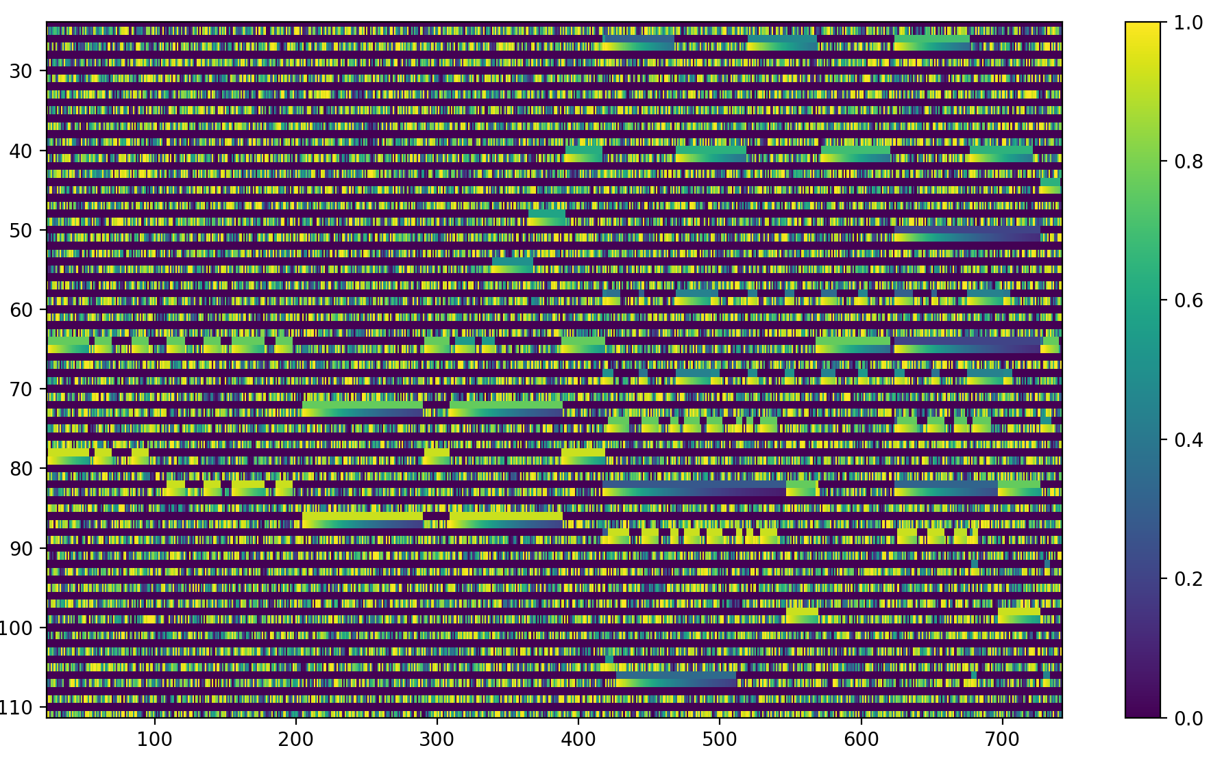
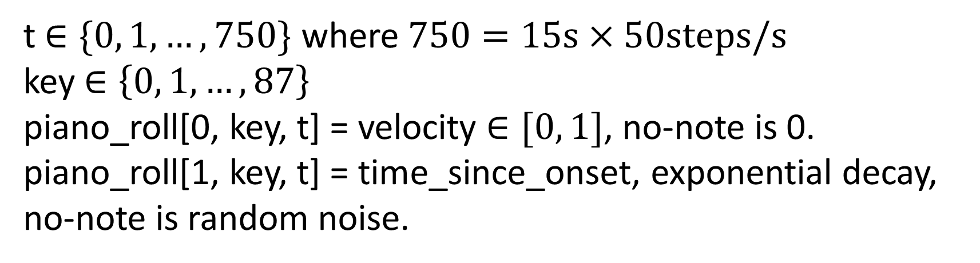
t $∈\{0, 1, …, 750\}$ where $750=15s×50steps/s$
key $∈\left\{0, 1, …, 87\right\}$
piano_roll[0, key, t] = velocity $∈[0, 1]$, no-note is 0.
piano_roll[1, key, t] = time_since_onset, exponential decay, no-note is random noise.

Slide 8
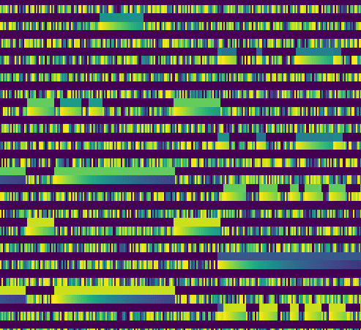

Slide 9
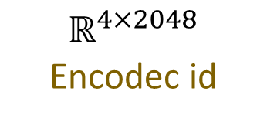
$$ℝ^{4×2048}$$
Encodec id
CNN Piano
Piano roll

Slide 10
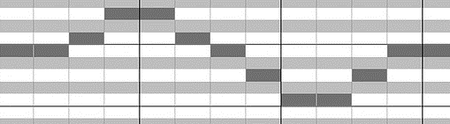
Encodec id
CNN Piano
S2P
Score

Slide 11


$$ℒ =\sum_{t}{{CE}_{t}}$$
CE
Logits
MusicGen
Encodec id
$$t$$

Slide 12
Evolutionary equilibrium
128 distributions on 88-choice selection vs 1 distribution on 128-to-88 matching
The former is problematic. Intuitively, selectors need to coordinate.
To implement the latter, later selectors will need to see the selection of previous selectors.
However, let’s use the former. No coordination. Let consensus emerge. The optimization is to find an evolutionary equilibrium.

