Slide 1
2024_04_11_notes_present

Slide 2
Unsupervised symbolic music decipher
Given
Music audio
Music sheets
A piano
Find
An interpretation of the music sheets.

Slide 3
Musicality
MusicGen
Encodec tokens
Encodec encoder
Spectrogram
Piano (rule-based)
Performance (Key events)
Interpreter
Score (Note events)

Slide 4
Musicality
MusicGen
Encodec tokens
Encodec encoder
Waveform
Piano (rule-based)
Performance (Key events)
Interpreter
Score (Note events)

Slide 5
Musicality
MusicGen
Encodec tokens
Piano (trained)
Performance (Key events)
Interpreter
Score (Note events)

Slide 6
I’m working on: the piano.
A neural synthesizer from piano control to Encodec tokens.
Performance as
A set of key events.
Use transformer.
A piano roll.
Use CNN.

Slide 7
Dataset
Dataset = Polyphonic MIDI, piano-like.
Los Angeles MIDI.

Slide 8
Interpreter
Interpreter(pitch) = logits_over_88_keys

Slide 9
Logits: piano key
$$ℝ^{88}$$
Interpreter
$$ℝ^{128×88}$$
MIDI pitch
$$[0, 1, …, 127]$$

Slide 10
Piano key
Note onset, velocity
Sample
S2P: Score to Performance
Logits: piano key
Interpreter
Note pitch
Note onset, velocity

Slide 11
Piano key
Note onset, velocity
Straight-through estimation
Sample
Logits: piano key
Interpreter
Note pitch
Note onset, velocity

Slide 12


Key event embedding:
$$ℝ^{256}$$
Key event embedder
Onset:
Positional encoding.
Velocity:
Two-hot.
Piano key:
$$\text{Two}\text{-}\text{hot}\text{.}$$

Slide 13
$$ℝ^{4×2048}$$ Encodec id
Transformer Piano
Key event embeddings
Positional encodings

Slide 14
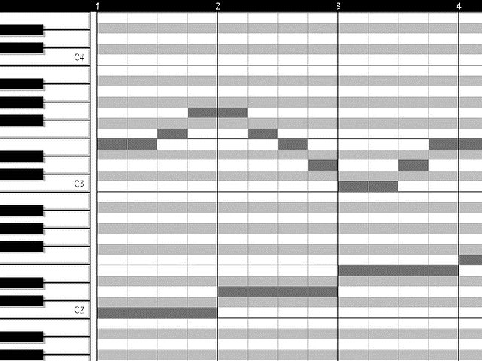
Encodec id
Transformer Piano
Key event embedder
S2P
Score

Slide 15
$$ℒ =\sum_{t}{{CE}_{t}}$$
CE
Logits
MusicGen
Encodec id
$$t$$

Slide 16
Results
If insisting it to be one-pass,
Decoder(positional_encoding, cross=…) = tokens
Result: Doesn’t train.
If autoregressive,
Decoder(tokens[-1:T-1], cross=…) = tokens[0:T]
Result: Trains very well.
However, backprop thru the piano would require unrolling.

Slide 17
Conclusion
Colleagues
suggested against using cross-attn for backprop.
recommended the input and output to be time-aligned.
Next step: use piano roll with CNN.

Slide 18
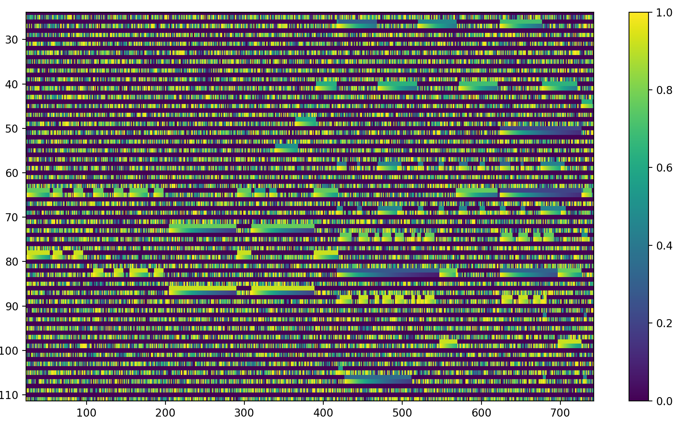
t $∈\{0, 1, …, 750\}$ where $750=15s×50steps/s$
key $∈\left\{0, 1, …, 87\right\}$
piano_roll[0, key, t] = velocity $∈[0, 1]$, no-note is 0.
piano_roll[1, key, t] = time_since_onset, exponential decay, no-note is random noise.

Slide 19
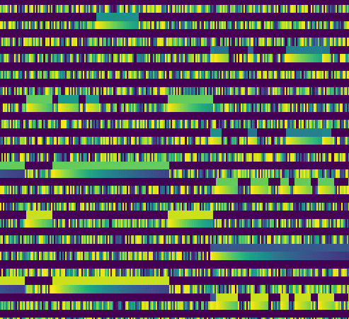

Slide 20
$$ℝ^{4×2048}$$
Encodec id
CNN Piano
Piano roll

Slide 21
Results
Doesn’t train well.

