Slide 1
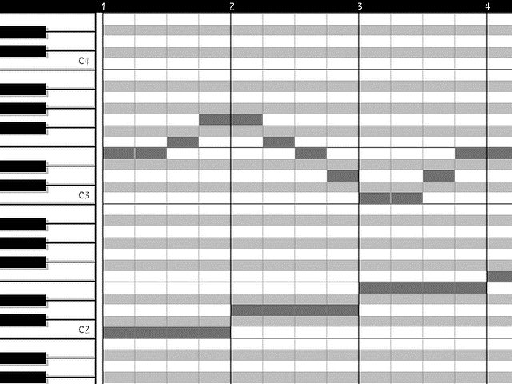
Encodec id
Virtual piano
Interpreter: note pitch -> piano key
Score

Slide 2

$$ℒ =\sum_{t}{{loss}_{t}}$$
loss
Logits
MusicGen
Encodec id
$$t$$

Slide 3
Loss
Logits p = piano(interpreter(score)).
sample(.) is logit -> onehot, with a straight-through backward.
Let s = sample(p).
Let logits t = MusicGenTFDecoder(s).
Loss += CE(t, s.argmax()), where argmax stops grad.
Loss += (p.softmax() * sample(t).detach()).sum()

Slide 4
Evolutionary equilibrium
128 distributions on 88-choice selection vs 1 distribution on 128-to-88 matching
The former is problematic. Intuitively, selectors need to coordinate.
To implement the latter, later selectors will need to see the selection of previous selectors.
However, let’s use the former. No coordination. Let consensus emerge. The optimization is to find an evolutionary equilibrium.

Slide 5
Did you know?
Encodec self-recon quality. Let’s take a look!

