Slide 1
Econ, Wages, Thanos
Daniel Chin

Slide 2
Terminology that I may accidentally use
Per capita
Local minima

Slide 3
Von Neumann’s Econ Model
Goods and Processes
Processes aim to maximize production
Prices: no positive excess demand
Notes:
Maximize production -> defines demand
Exponential homogeneous growth/shrink

Slide 4
Labor as Good
The price of labor is wages
Notes:
Economists do this all the time. It’s not just me. So don’t judge me
Supply and demand
Good thing: we can model wages now

Slide 5
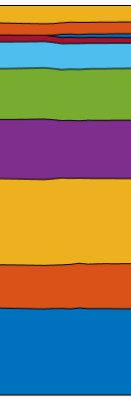
Labor as Good
The price of labor is wages

Slide 6
What happens to wages when...
The economy grows?

Slide 7
What happens to wages when...
The economy grows?
Contraception technology breakthrough?

Slide 8

What happens to wages when...
The economy grows?
Contraception technology breakthrough?
Thanos kills half of the population?

Slide 9

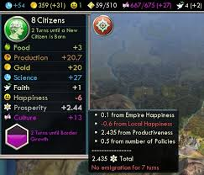
Happiness = - Population + other terms…
Notes:
Reason behind
Problems? First of all, no friends.
Second, Not averaging the people who died. It’s like a survivor bias

Slide 10
Challenge 1: model static population
Notes:
Problem
How do we solve the problem?
Well, there’s a trick. Turns our we don’t even need to change the model

Slide 11




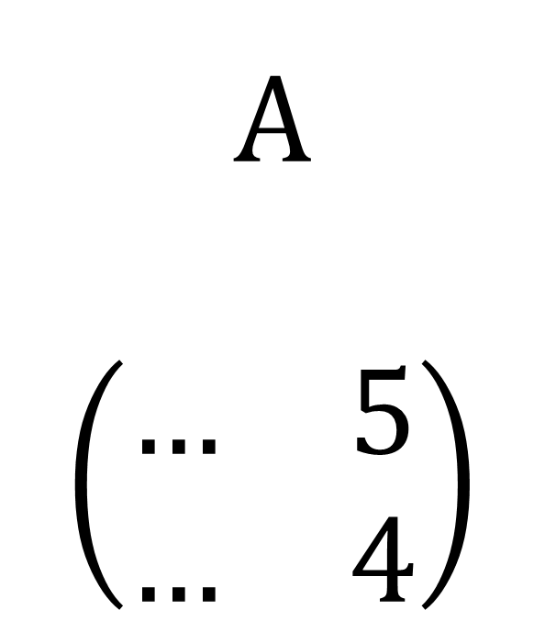
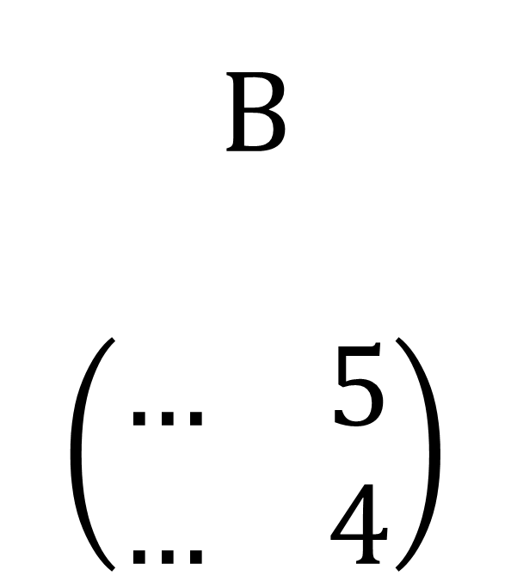
Challenge 1: model static population
A
$$\left(\begin{matrix}… & 5 \\ … & 4\end{matrix}\right)$$
B
$$\left(\begin{matrix}… & 5 \\ … & 4\end{matrix}\right)$$
Notes:
Conservation
Require but not consume
But there’s one caveat here. Does anyone see?
Have we achieved conservation of labor?

Slide 12
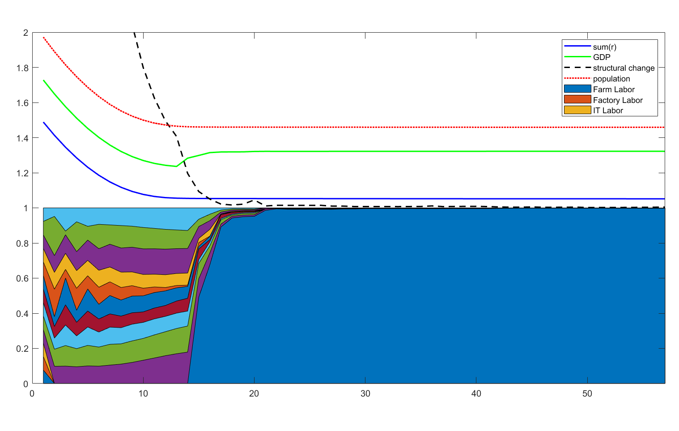
Notes:
Explain legends
Log scale, y space
Oscillation
Prices
Ice and water
Then, economy realized population is the only finite things here
Pity: value of human life, too late

Slide 13
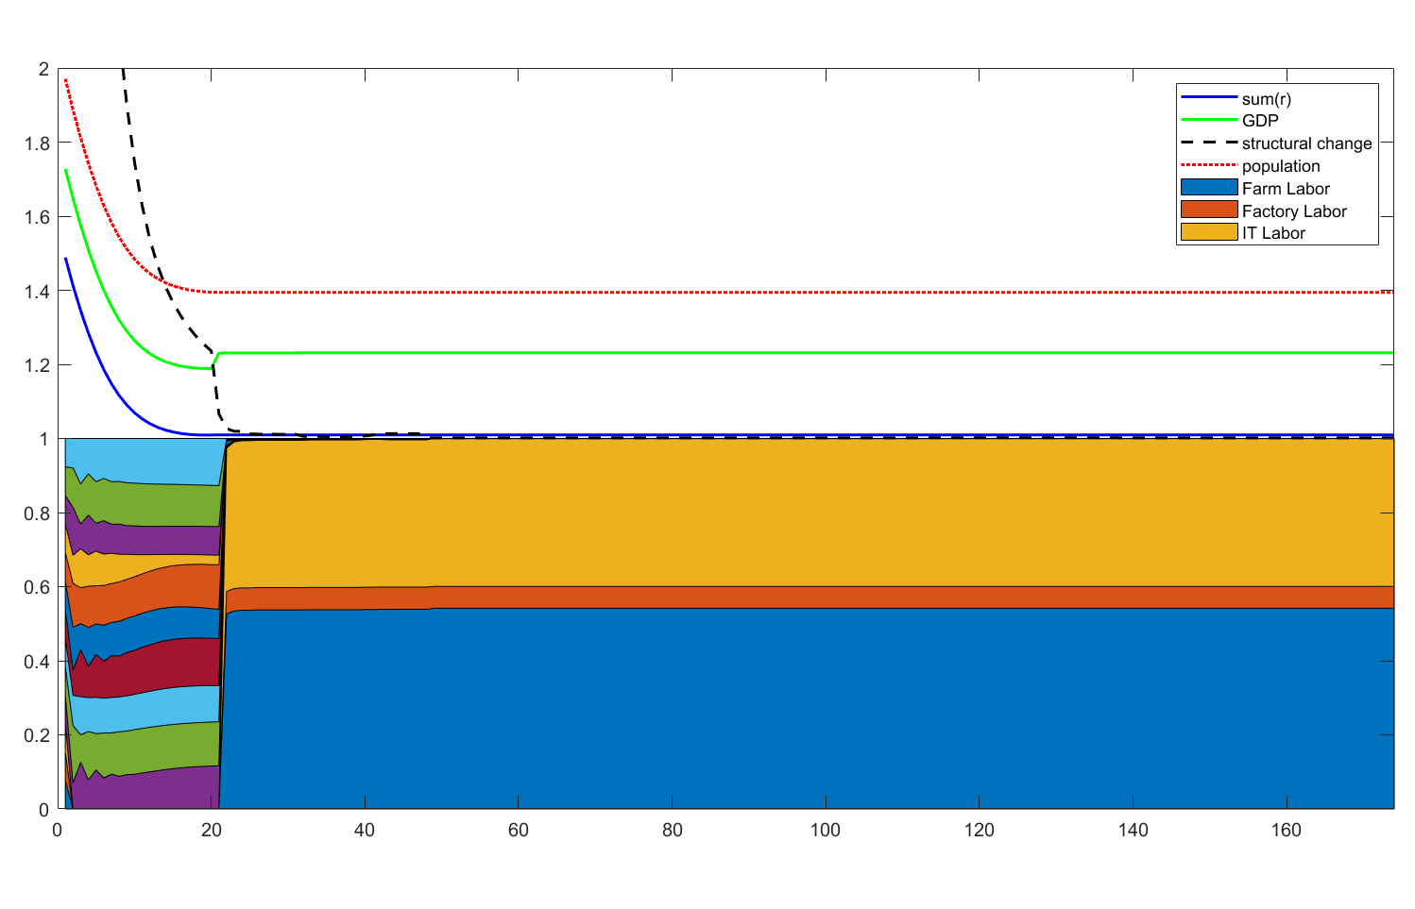

Slide 14
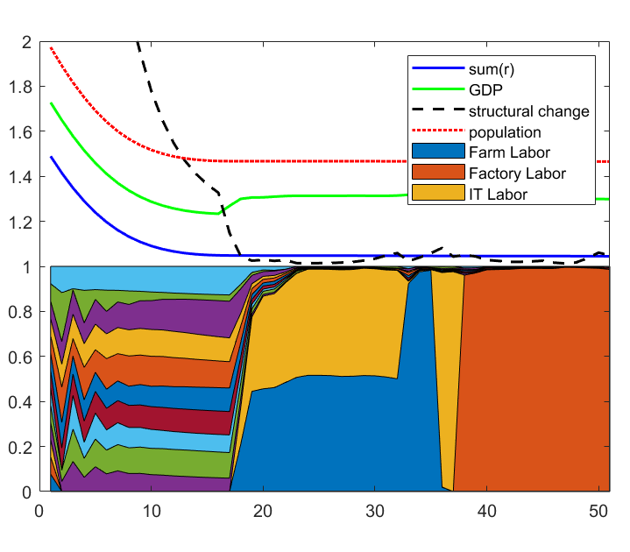

Slide 15
Challenge 2: model growing population

Slide 16
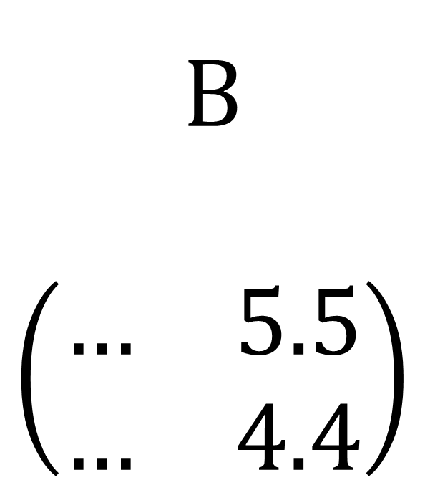
Challenge 2: model growing population
A
$$\left(\begin{matrix}… & 5 \\ … & 4\end{matrix}\right)$$
B
$$\left(\begin{matrix}… & 5.5 \\ … & 4.4\end{matrix}\right)$$

Slide 17
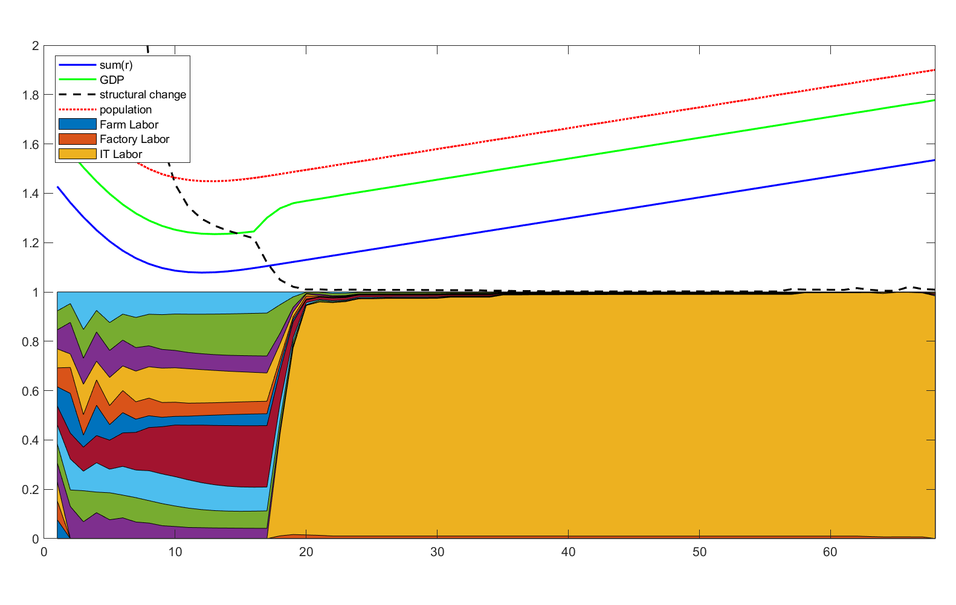

Slide 18
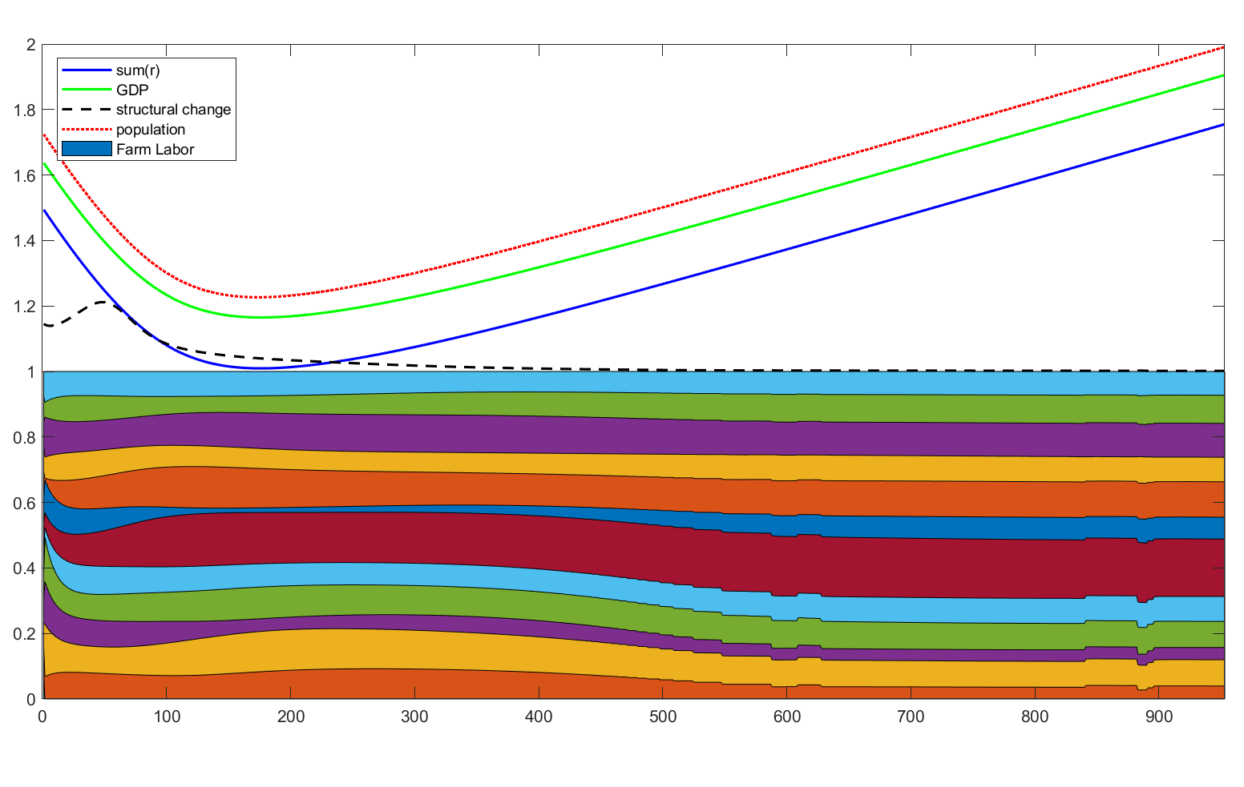

Slide 19
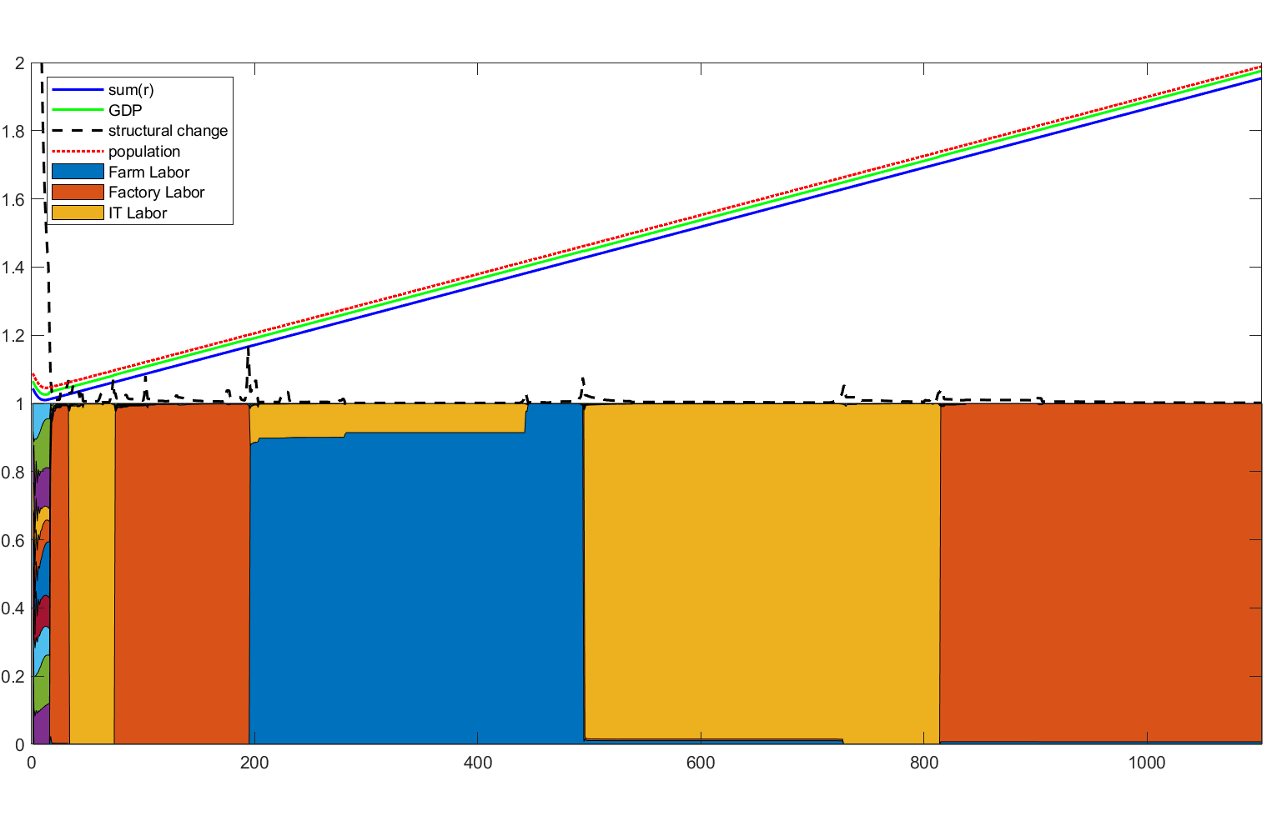
Notes:
Why is everything free? Because only labor is finite. Homogeneous expon growth; introduce finite labor; labor is the only valuable thing.
Real life Finite. Natural resources, land…
Free good. Why even exist?
Blue green algae

Slide 20
Challenge 3: model contraception tech

Slide 21
Challenge 3: model contraception tech
A
$$\left(\begin{matrix}… & 5 \\ … & 4\end{matrix}\right)$$
B
$$\left(\begin{matrix}… & 5.5 \\ … & 4.4\end{matrix}\right)$$

Slide 22
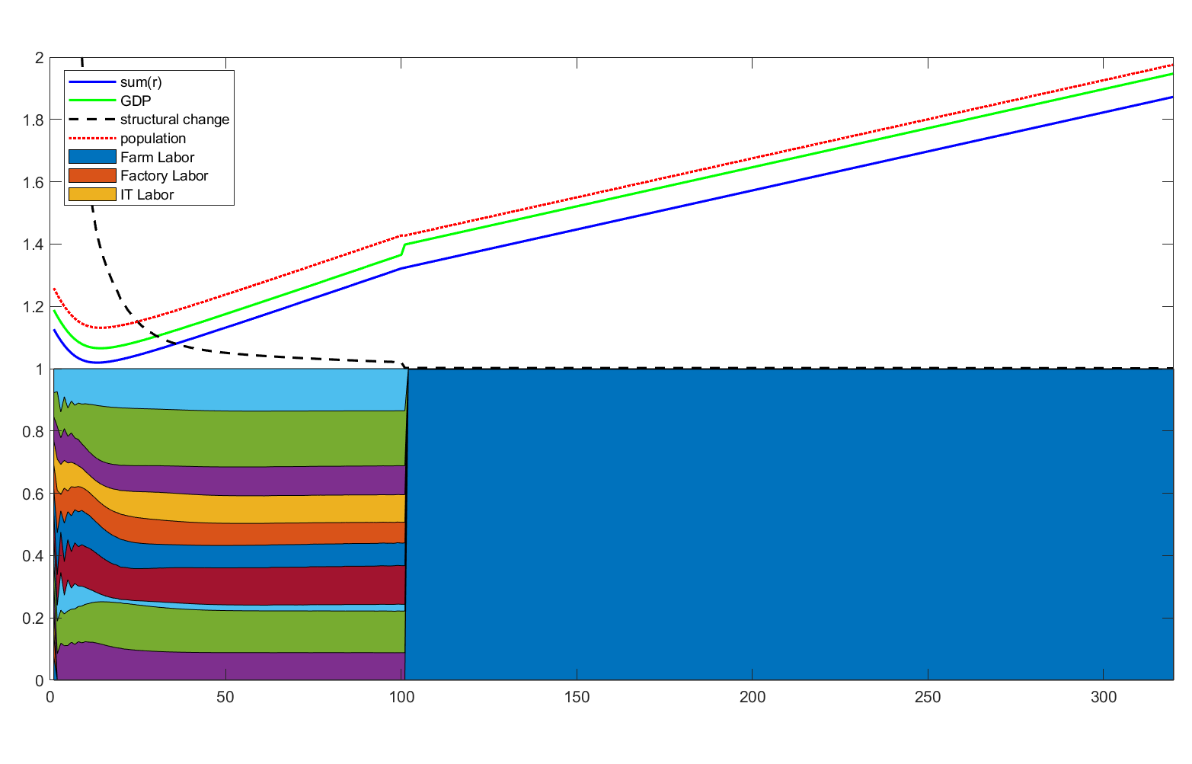
Notes:
Why is everything free? Because only labor is finite. Homogeneous expon growth; introduce finite labor; labor is the only valuable thing.
Real life Finite. Natural resources, land…
Free good. Why even exist?
Blue green algae

Slide 23
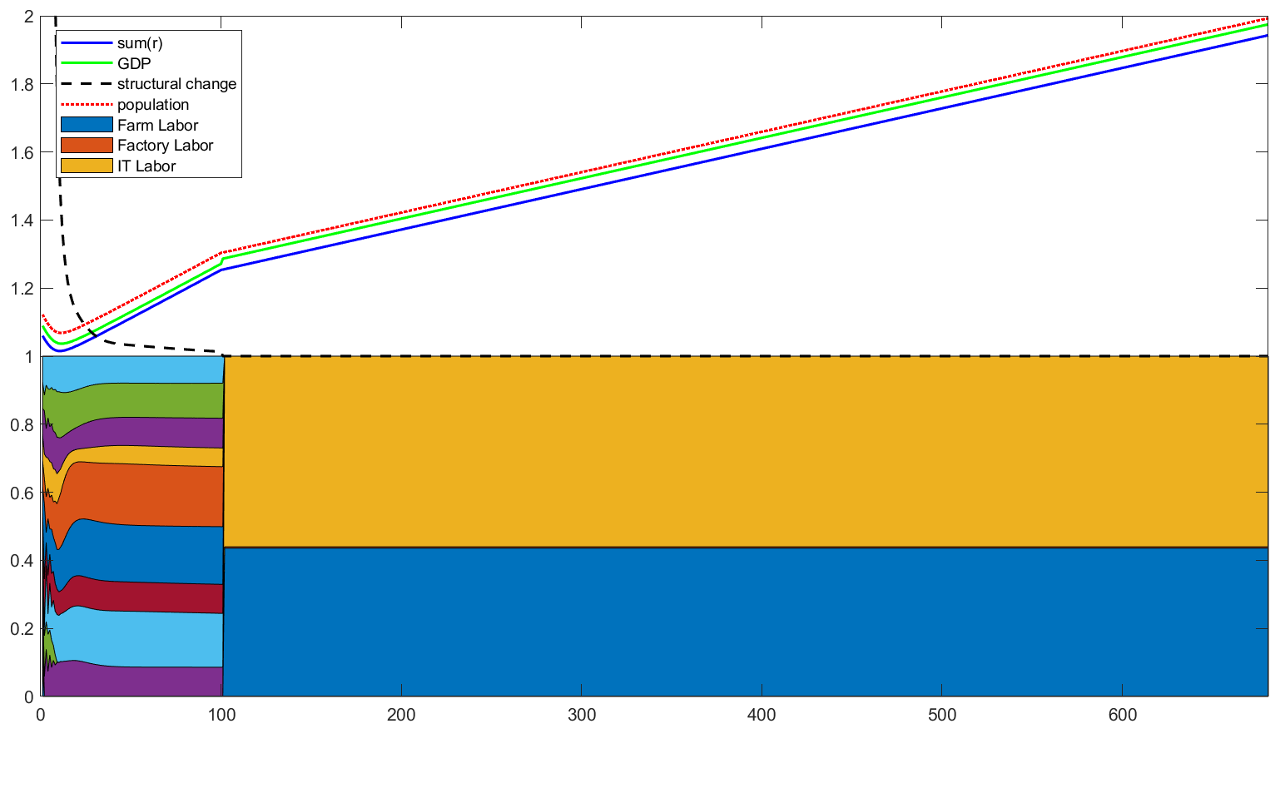

Slide 24
Challenge 4:
Notes:
Problem
How do we solve the problem?
Well, there’s a trick. Turns our we don’t even need to change the model

Slide 25
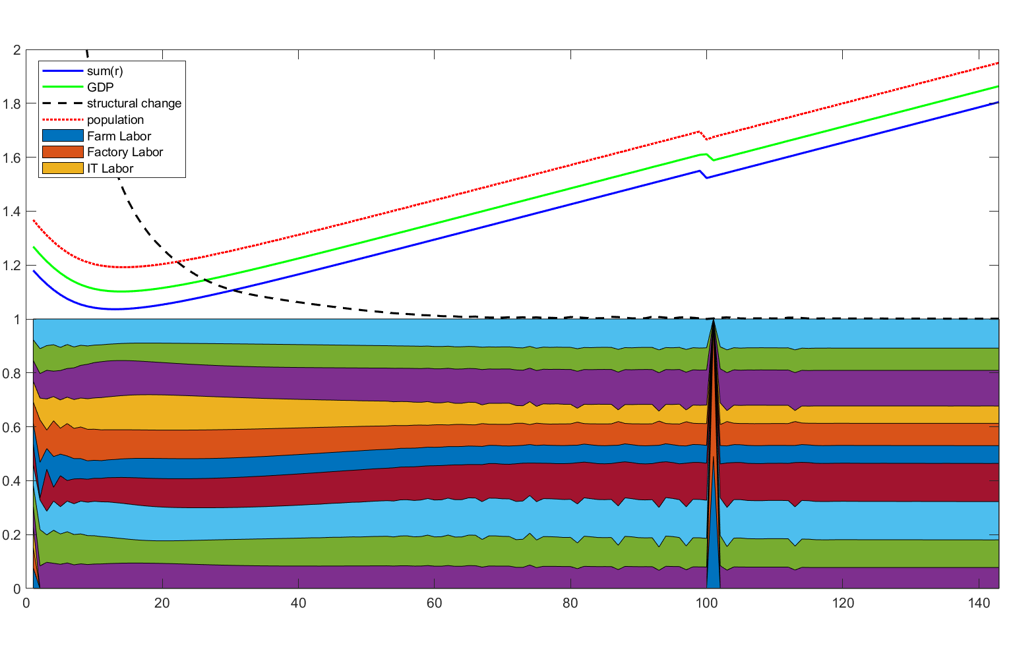

Slide 26
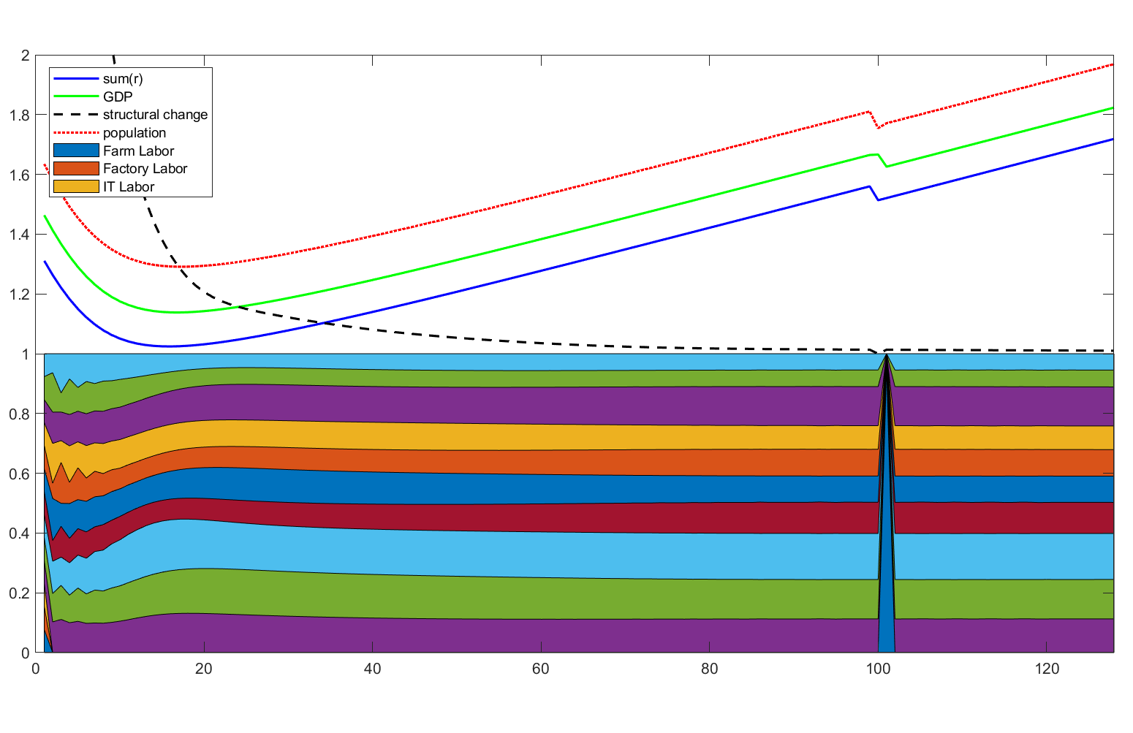

Slide 27
More fun things to mention

Slide 28
Invisible Hand Method
Replaces: Gradient Descend
Incentive: Walras’s Law loses effectiveness
Problem: Convergence is not proved

Slide 29
Invisible Hand Method: 1st algorithm
Let p move in the direction of excess_demand
If a good turns from excess supply to excess demand, that's a fail. Otherwise, success.
if success, Stride length *= 1.1
if fail, Stride length *= 0.5
if fail, The stride is NOT taken
Result:
Does not work.
Algorithm can be stuck with 2 goods competing.
Good A excess_demand = 0, Good B excess_demand > 0,
but raising the price of B will increase good A excess_demand.
Analogy: tilted “V” valley

Slide 30
Invisible Hand Method: 2nd algorithm
Modification:
if fail, The stride IS TAKEN
Result:
Success!!! (for a while)
This is just equation 16 in Professor Peskin’s Notes.

Slide 31
Invisible Hand Method: 3nd algorithm
Modification:
detect loop
if loop detected, randomize p
result:
3rd algorithm fails whenever 2nd algorithm fails
and it's always the same loop no matter how you randomize.

Slide 32
Invisible Hand Method: RIP
Talking to Sun directly rescued the project.
Model labor as a conserved good.
Welcome back, Walras’s Law.

Slide 33
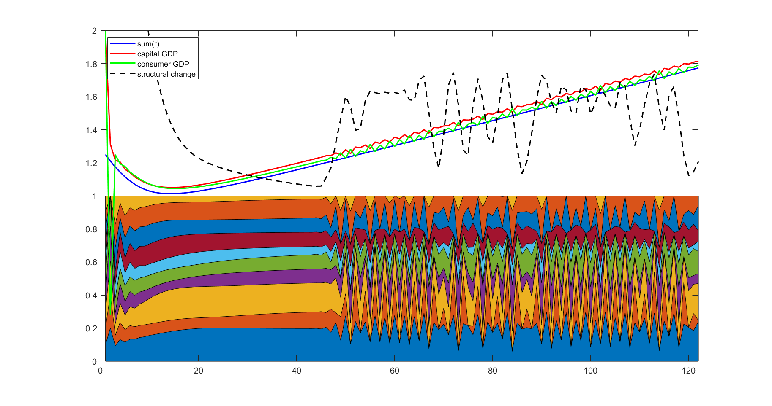
Stiffness:

Slide 34
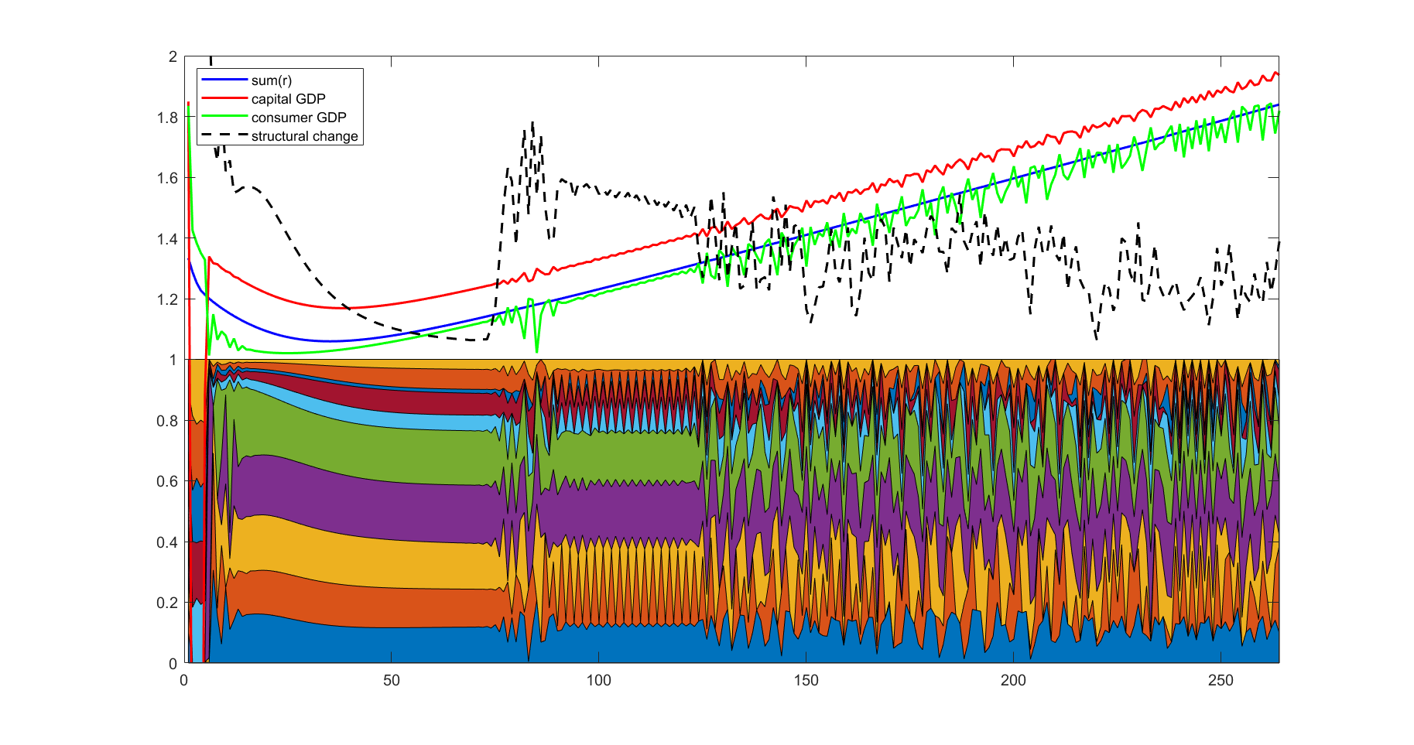
Stiffness: phases

Slide 35
“Counter-cyclical measures”: Sticky r
old_r = r;
marketDay();
r = [old_r, r] * [0.5; 0.5];

Slide 36
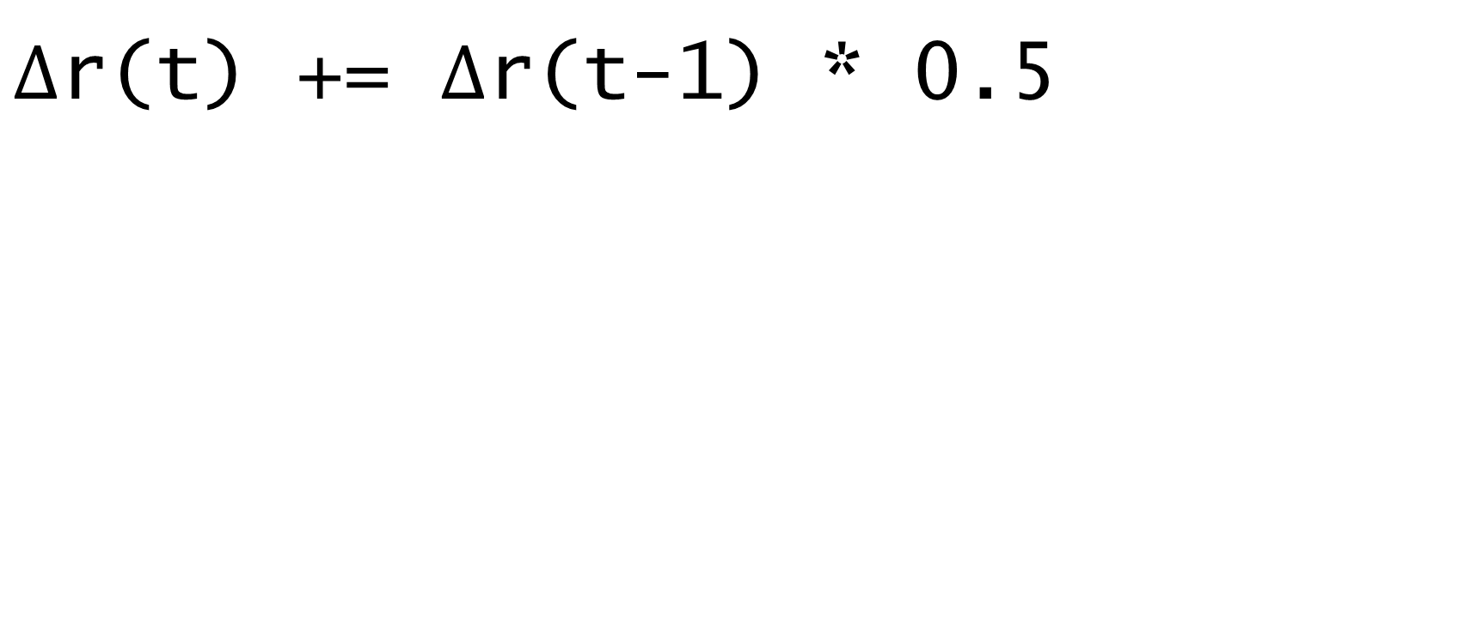
“Counter-cyclical measures”: damping
$Δ$r(t) += $Δ$r(t-1) * 0.5

Slide 37
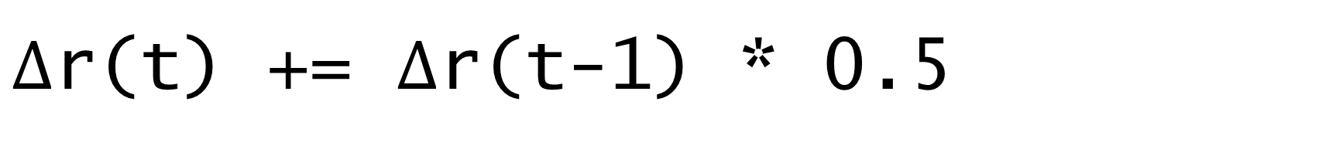
“Counter-cyclical measures”: damping
$Δ$r(t) += $Δ$r(t-1) * 0.5
Wait… Isn’t this momentum?

Slide 38
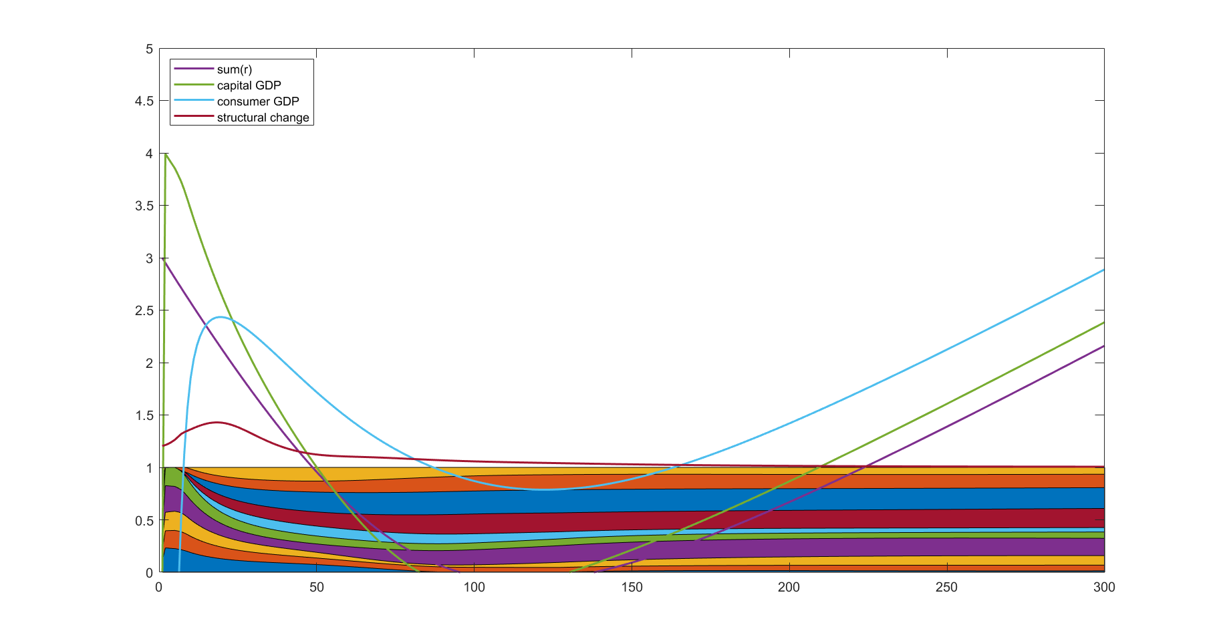
Perstare et Praestare

Slide 39
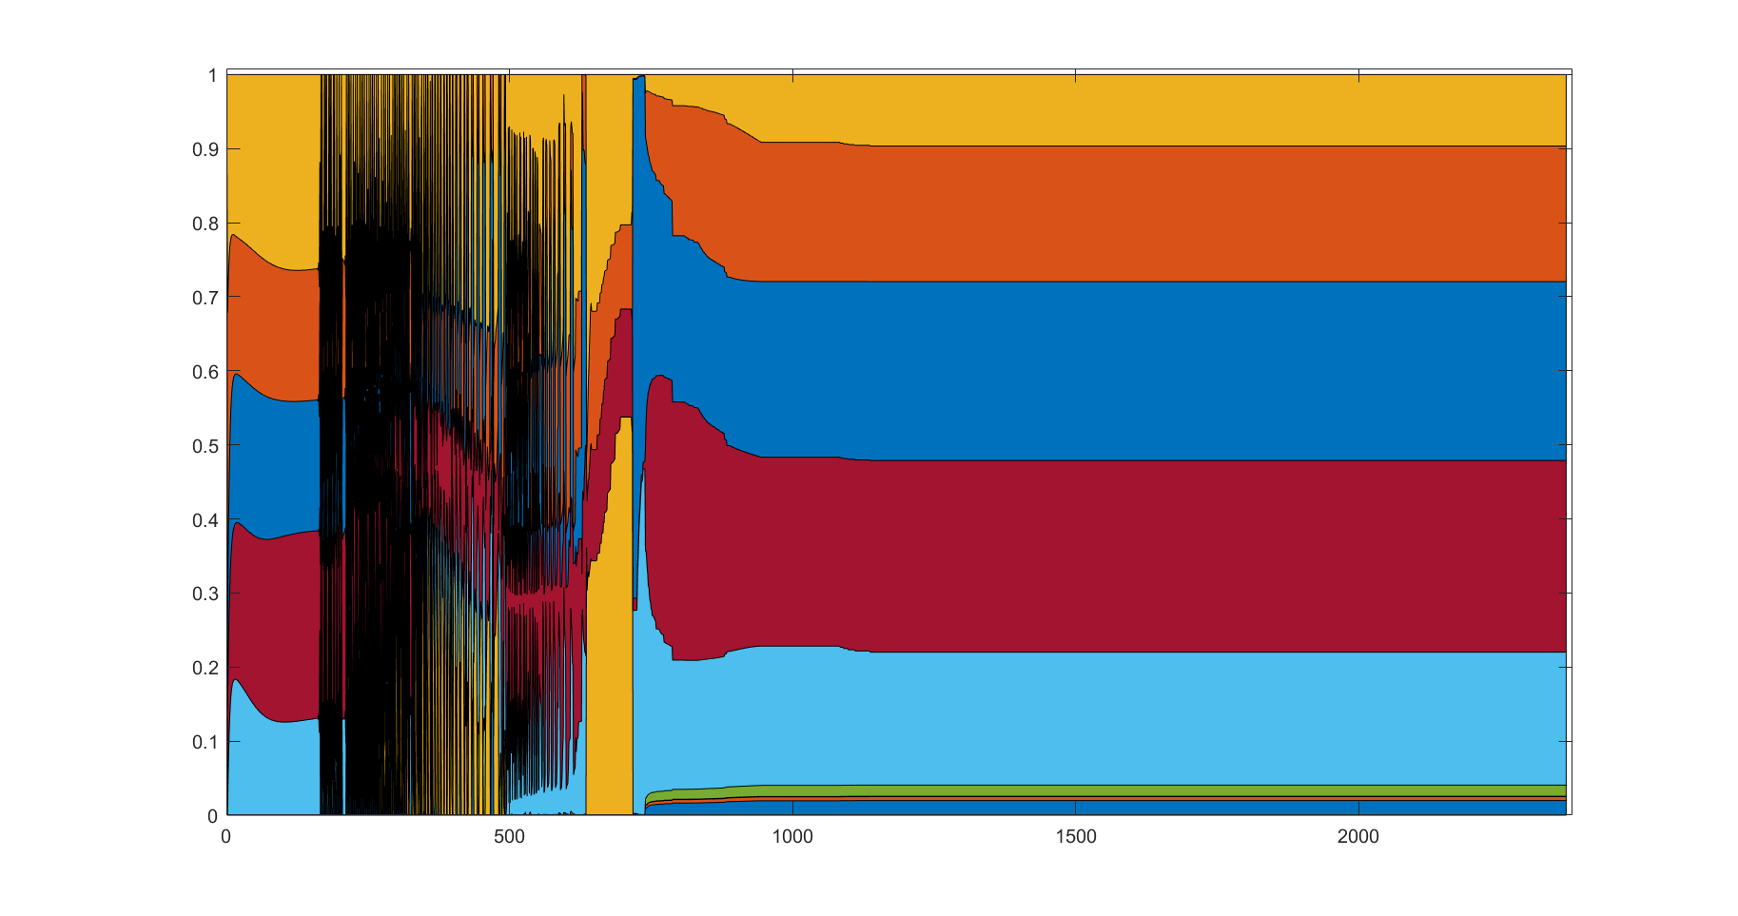
I wonder what’s happening

Slide 40
Trying negative prices
Incentive: Reduce stiffness?
Result: Variables go to Inf and gradient descend cannot continue…
Analysis: Cost of a process can be $0 when prices are right!

Slide 41
One last fun thing
Always encounter more local minima when t > 100…

Slide 42
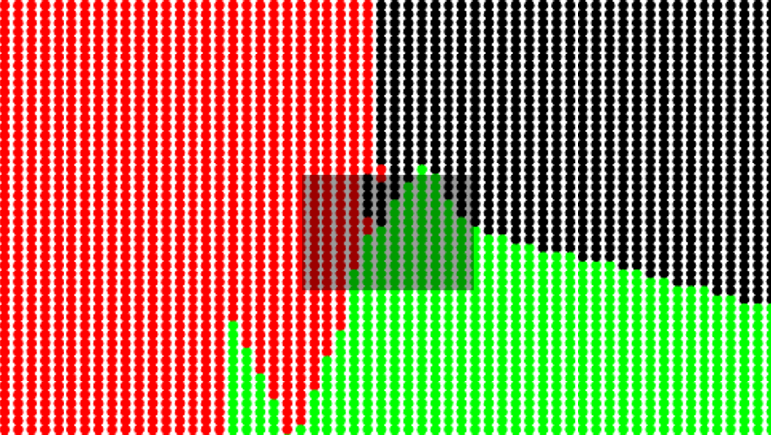
One last fun thing
Always encounter more local minima when t > 100…

Slide 43
One last fun thing
Always encounter more local minima when t > 100…
The simulated world becomes conscious and fights back the creator???

Slide 44

One last fun thing
Always encounter more local minima when t > 100…
Ah! Because loss is proportional to ${\left|\left|r\right|\right|}^{2}$ !!!

Slide 45
Thank you
Q+A time

