Slide 1




Moving Droplets on a Wall
Daniel Chin New York University Shanghai Campus
Michael Li New York University
Charles Puelz Baylor College of Medicine
Pejman Sanaei New York Institute of Technology
Aug. 12, 2020

Slide 2
demo_big_chase_small

Slide 3
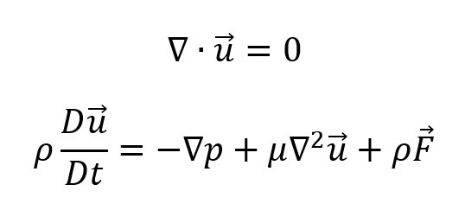
Overview
.
.
We focus on modelling of the external forces with Immersed Boundary Method.

Slide 4
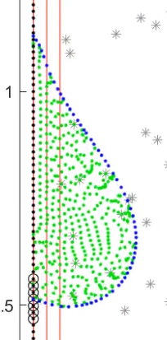
Overview
Wall: The solid surface, no-flux.
Interface: the liquid-gas interface.
Variable density [Kim, Peskin. 2007].
Techniques we propose:
Dynamic slipping.
Interface resampling.
Interface splicing.

Slide 5
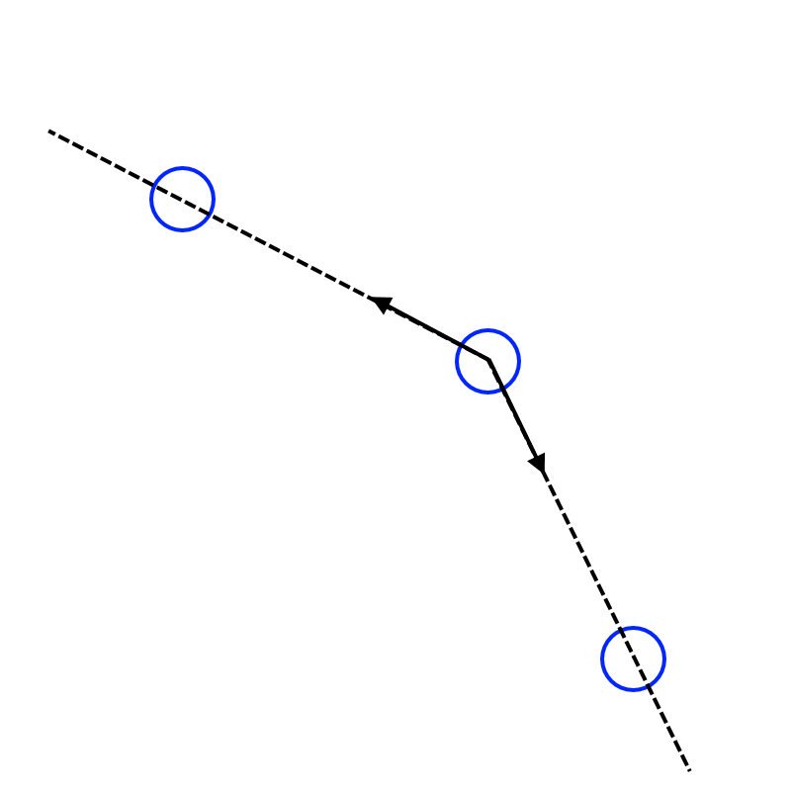
Tension force
Each interface marker is pulled by its two neighbors at constant magnitude.
Note that the total force on one marker is always normal to the interface.

Slide 6
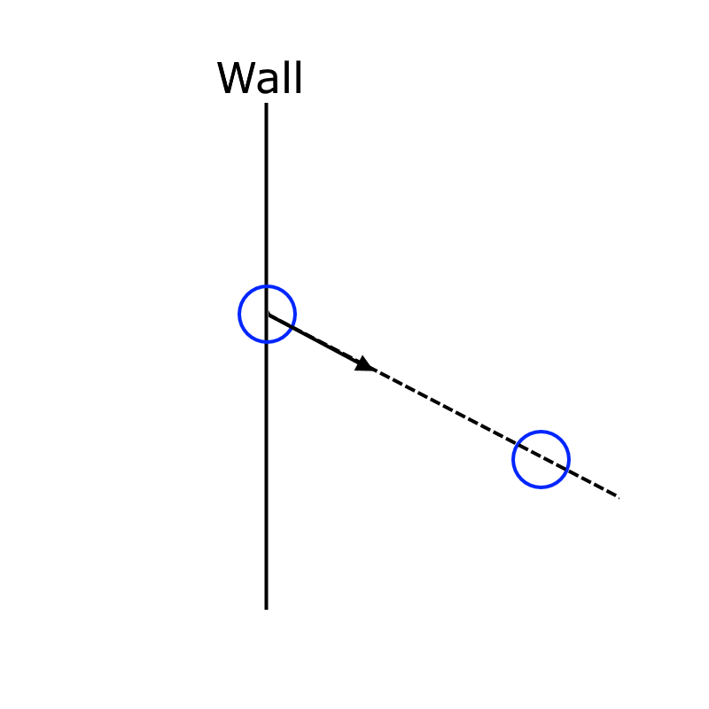
Natural extension: Young’s force
The same logic also simulates the unbalanced Young’s force at a contact point.

Slide 7
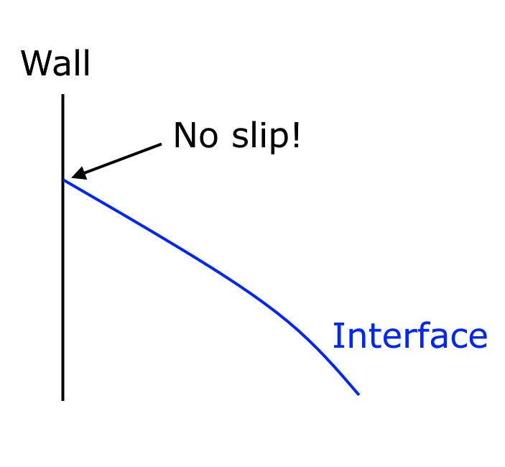
No-slip friction balances Young’s force
No-slip simply means that this friction force is a reactive force, always balancing the sum of active forces at this location in the vertical direction.

Slide 8
Dynamic Slipping
We have thoroughly looked at no-slip. Now we are ready to look at the dynamic slipping scheme.

Slide 9
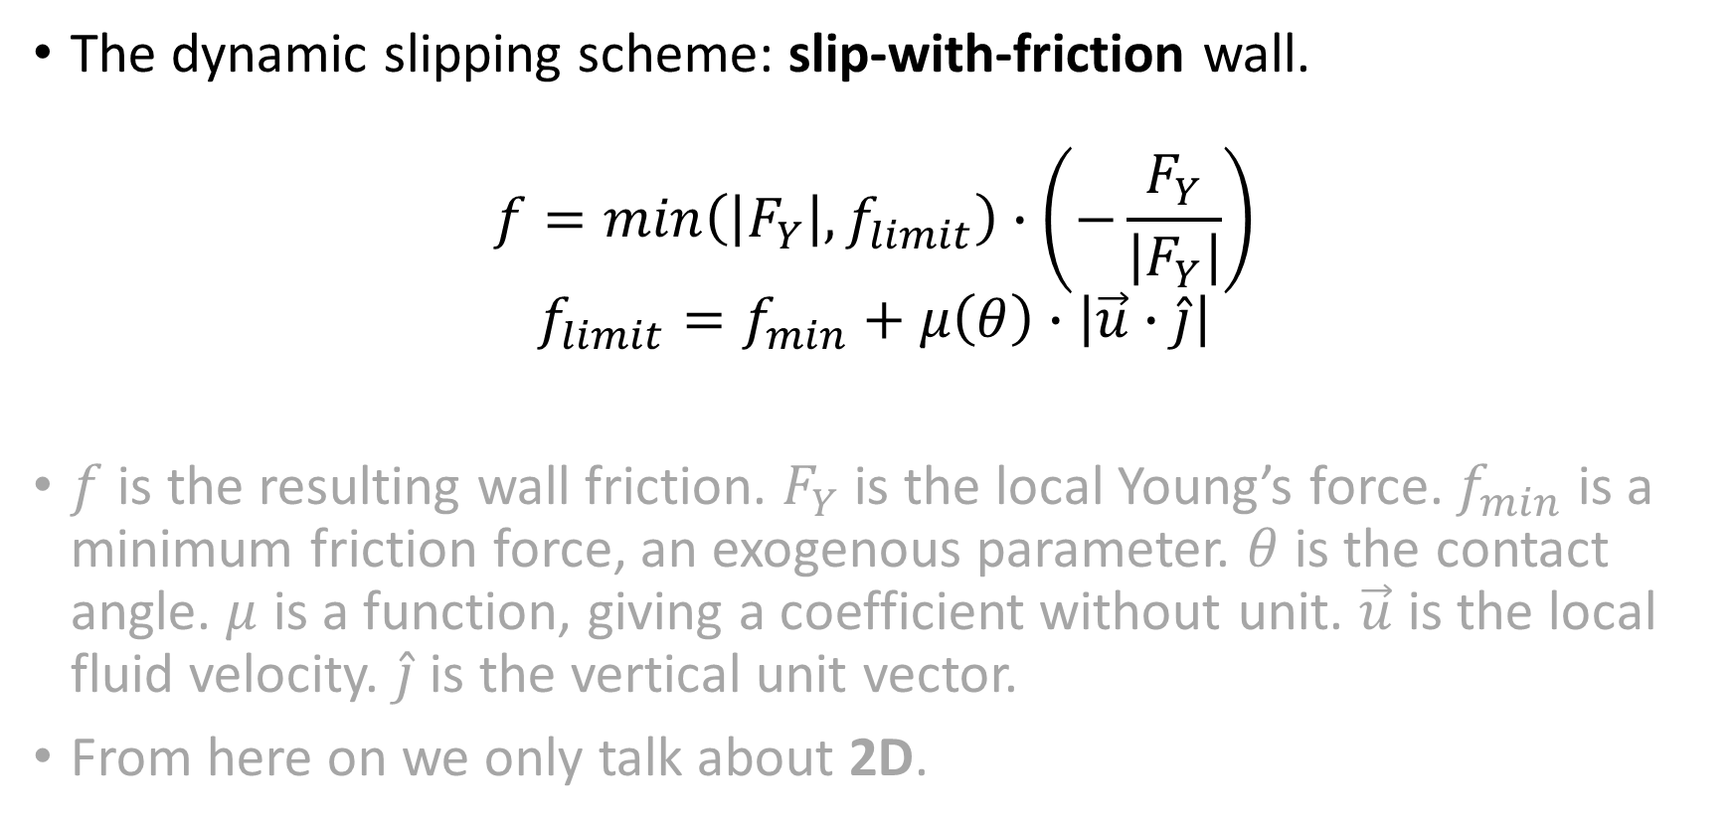
The macroscopic model
The dynamic slipping scheme: slip-with-friction wall.
$$f=min\left(\left|F_{Y}\right|, f_{limit}\right)∙\left(−\frac{F_{Y}}{\left|F_{Y}\right|}\right)$$
$$f_{limit}=f_{min}+μ\left(θ\right)∙\left|\vec{u}∙\hat{j}\right|$$
$f$ is the resulting wall friction. $F_{Y}$ is the local Young’s force. $f_{min}$ is a minimum friction force, an exogenous parameter. $θ$ is the contact angle. $μ$ is a function, giving a coefficient without unit. $\vec{u}$ is the local fluid velocity. $\hat{j}$ is the vertical unit vector.
From here on we only talk about 2D.

Slide 10
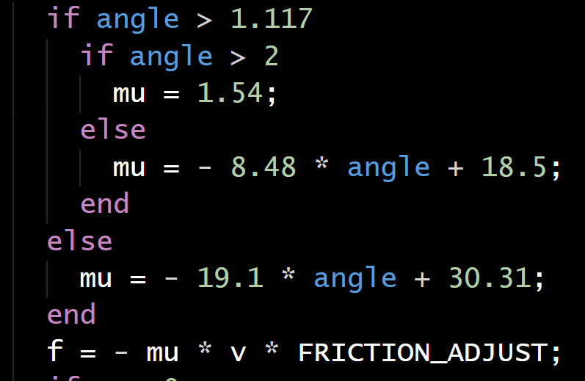
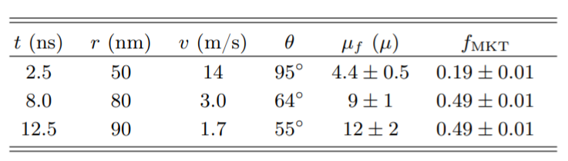

$$μ\left(θ\right)$$
This function computes the friction coefficient given the contact angle.
It is based on a regression of the 2018 molecular study.
Regression
[Johansson and Hess. 2018]

Slide 11
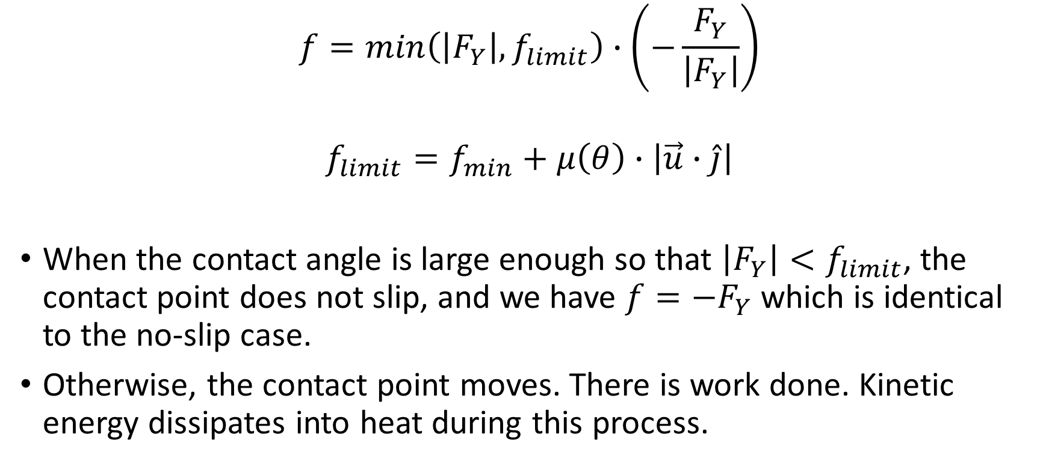
Macroscopic behaviors
$$f=min\left(\left|F_{Y}\right|, f_{limit}\right)∙\left(−\frac{F_{Y}}{\left|F_{Y}\right|}\right)$$
$$f_{limit}=f_{min}+μ\left(θ\right)∙\left|\vec{u}∙\hat{j}\right|$$
When the contact angle is large enough so that $\left|F_{Y}\right|<f_{limit}$, the contact point does not slip, and we have $f=−F_{Y}$ which is identical to the no-slip case.
Otherwise, the contact point moves. There is work done. Kinetic energy dissipates into heat during this process.

Slide 12
The corresponding numerical method
It is well known that a no-slip wall can be simulated as an array of markers using the penalty method.
To simulate a dynamic slipping wall, we use what we call the incur-redeem-dismiss penalty method. In this view, the baseline penalty method would be an incur-redeem penalty method.
 | Used for | Incur? | Redeem? | Dismiss?
Baseline penalty method | No-flux no-slip wall | Yes | Yes | No
Ours | No-flux slip-with-friction wall | Yes | Yes | Yes

Slide 13
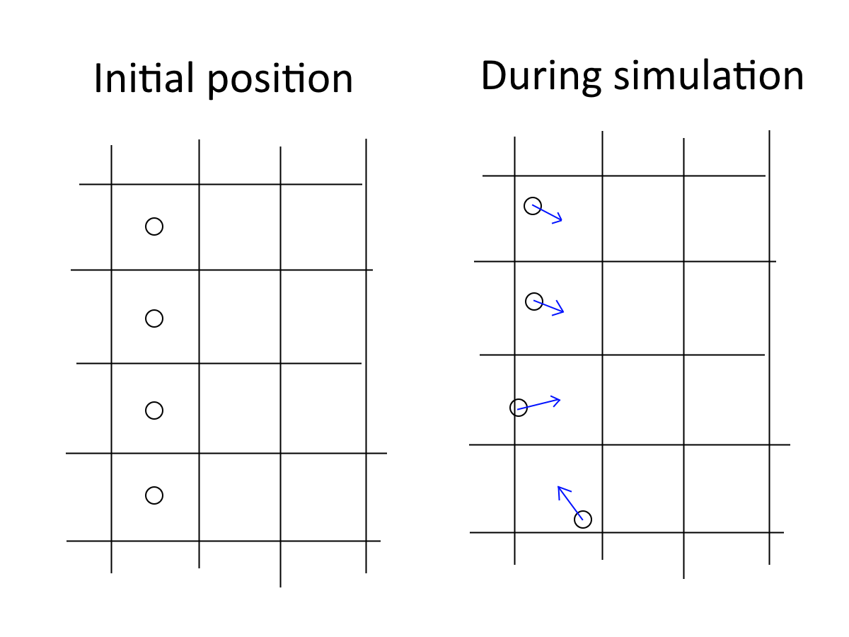
Baseline penalty method for no-slip wall
Fluid flow incurs penalty.
A penalty force is applied onto the fluid.
Fluid flow redeems penalty.

Slide 14
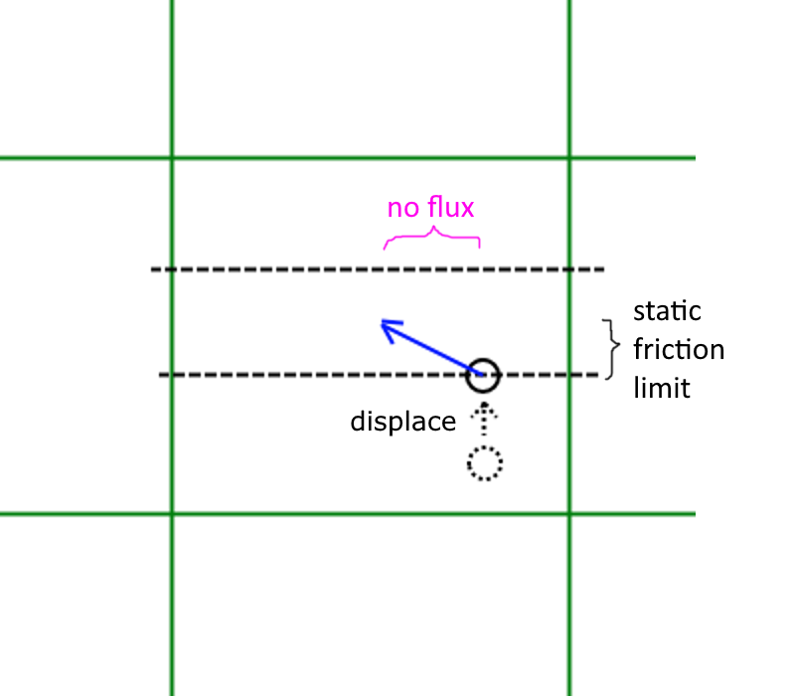
Incur-redeem-dismiss
Now we introduce another way penalty can decrease: dismissal.
Penalty is instantly decreased within a timestep by displacing the marker.

Slide 15
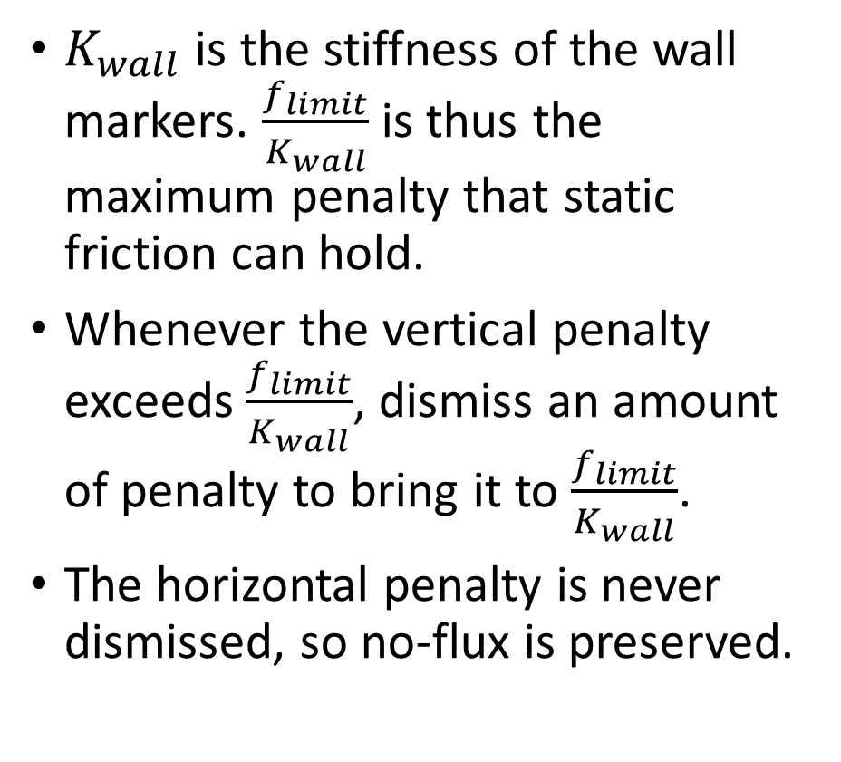
Incur-redeem-dismiss
$K_{wall}$ is the stiffness of the wall markers. $\frac{f_{limit}}{K_{wall}}$ is thus the maximum penalty that static friction can hold.
Whenever the vertical penalty exceeds $\frac{f_{limit}}{K_{wall}}$, dismiss an amount of penalty to bring it to $\frac{f_{limit}}{K_{wall}}$.
The horizontal penalty is never dismissed, so no-flux is preserved.

Slide 16
compare_droplet_size
conv_drop_slide_3x3

Slide 17
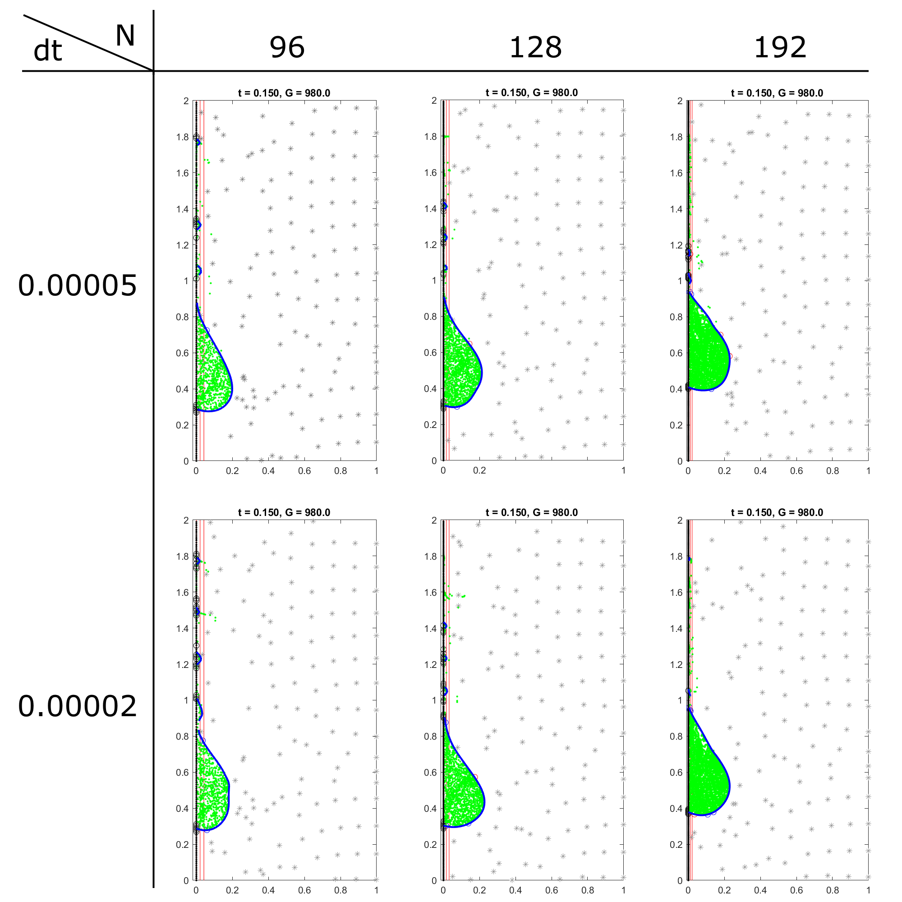
t = 0.15

Slide 18
t = 0.15

Slide 19
Step-wise Interface Resampling

Slide 20
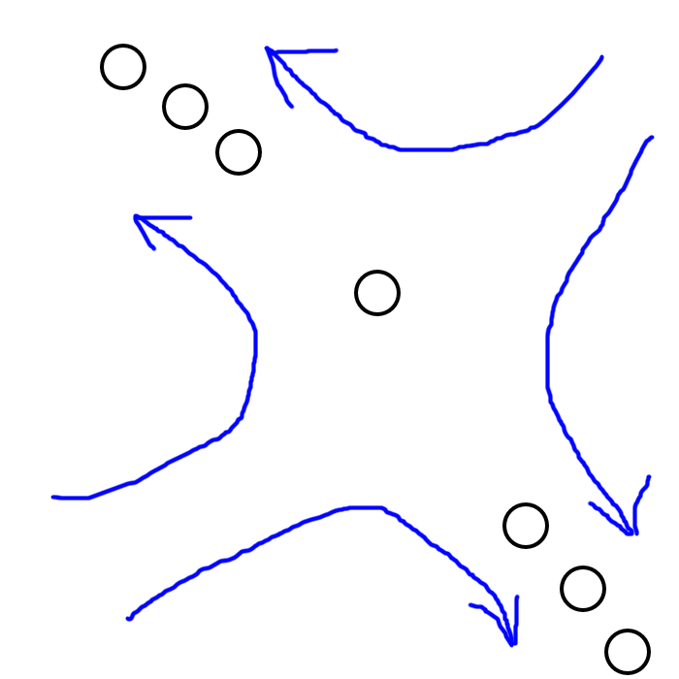
Interface resampling
Problem:
Surface tension is always normal to the interface.
No tangent component → nothing ensures the markers stay uniformly distributed.

Slide 21
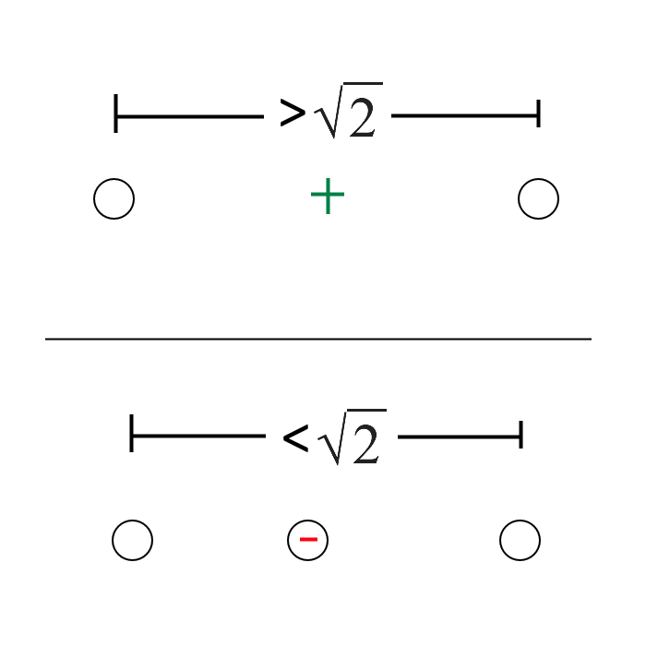
Interface resampling

Slide 22
compare_resample

Slide 23
Interface Splicing
Droplets can now coalesce, split up, attach to, and detach from the wall.

Slide 24
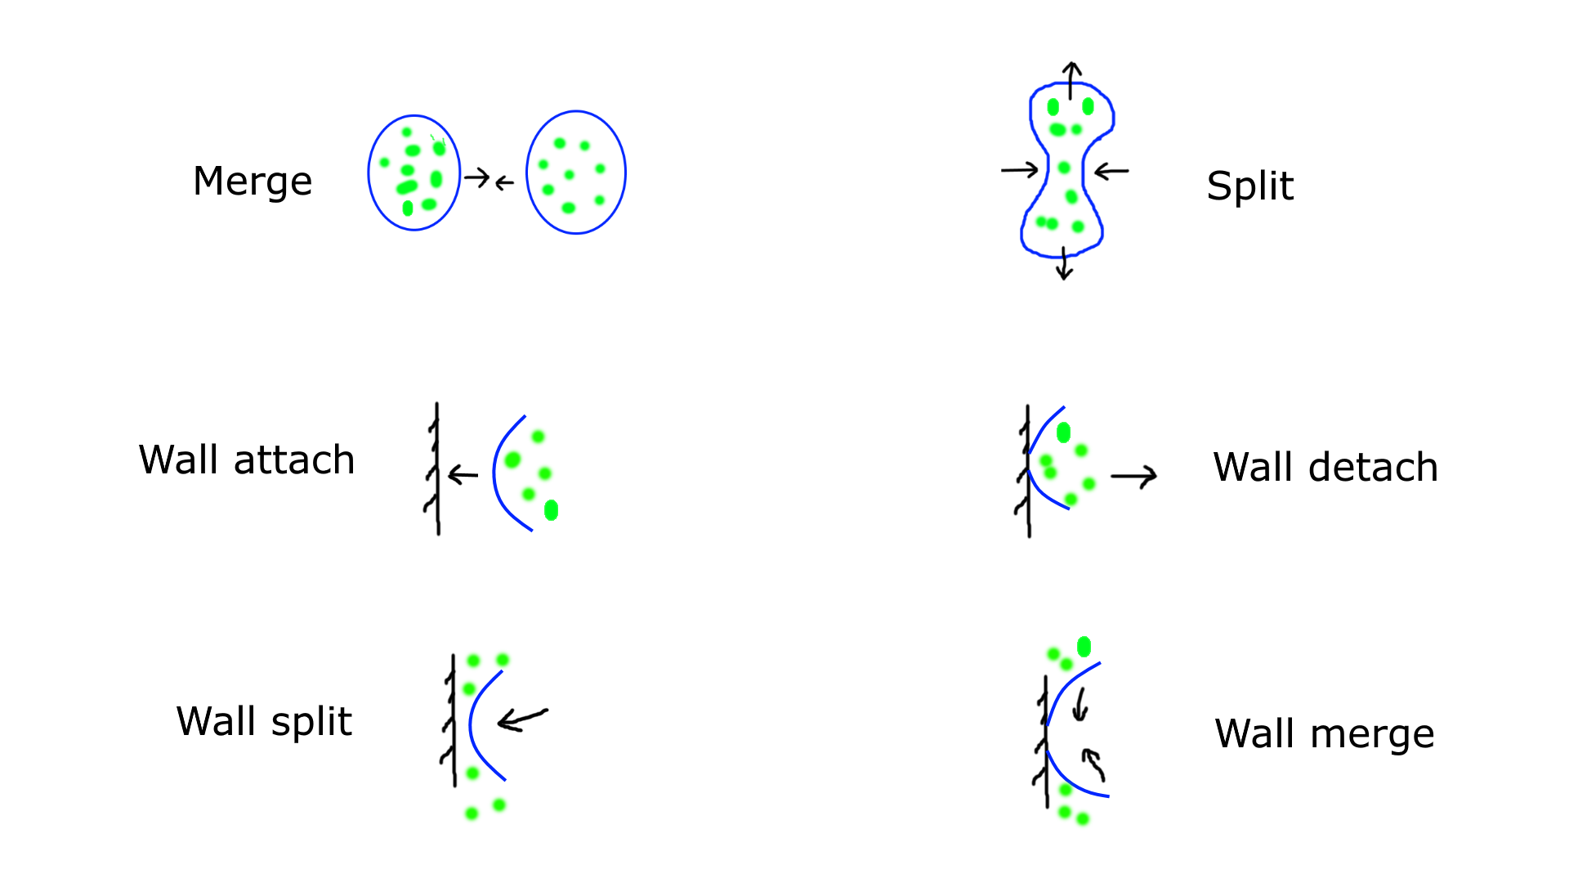

Slide 25
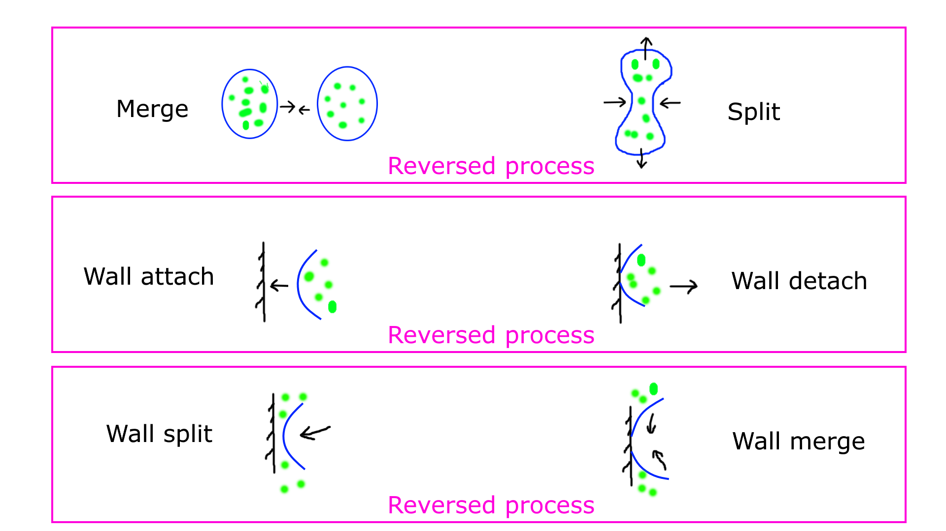

Slide 26
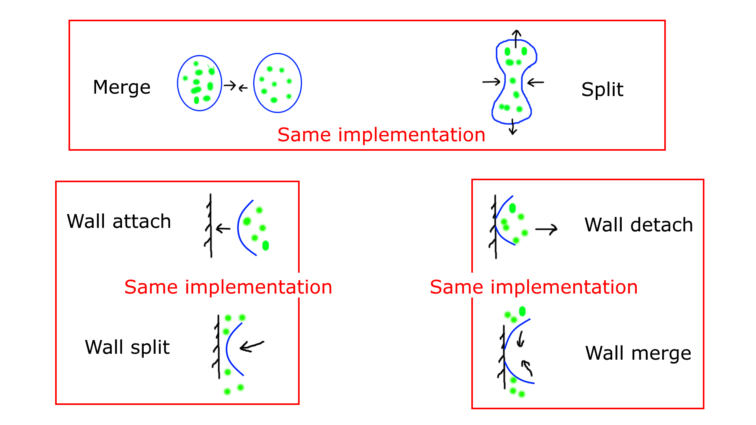

Slide 27
conv_merge_two
conv_merge_six_new

Slide 28
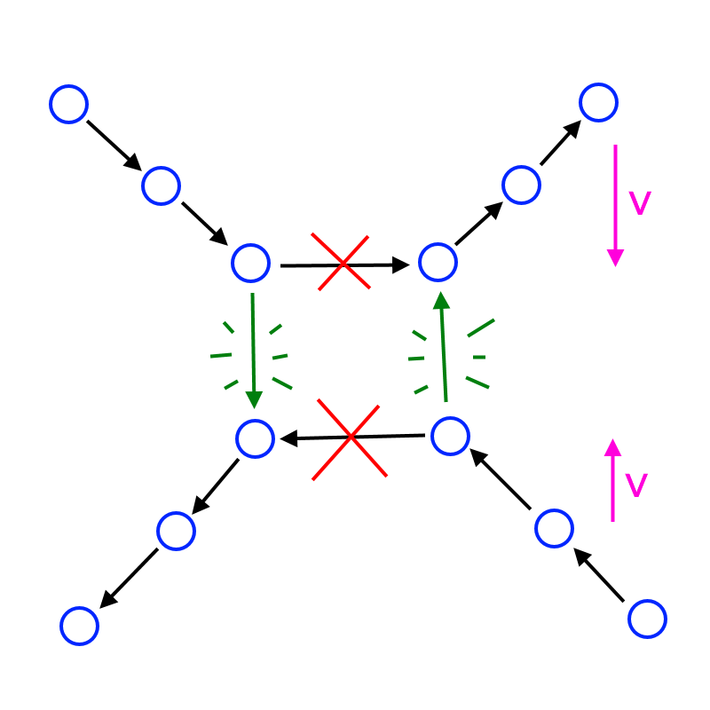
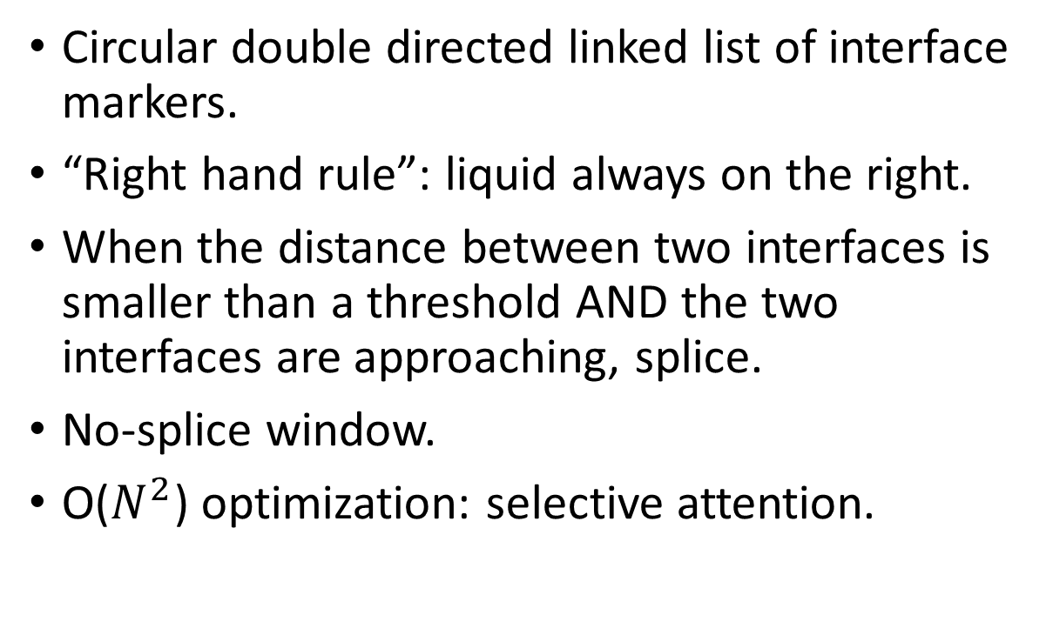
Splicing method
Circular double directed linked list of interface markers.
“Right hand rule”: liquid always on the right.
When the distance between two interfaces is smaller than a threshold AND the two interfaces are approaching, splice.
No-splice window.
O($N^{2}$) optimization: selective attention.

Slide 29
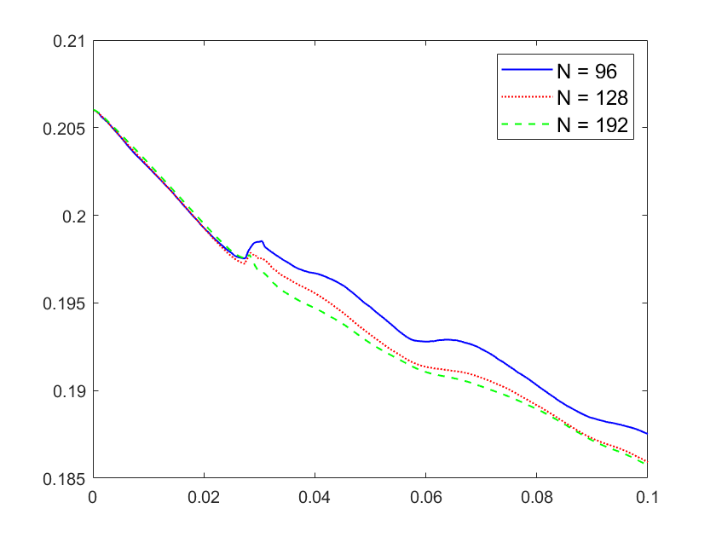
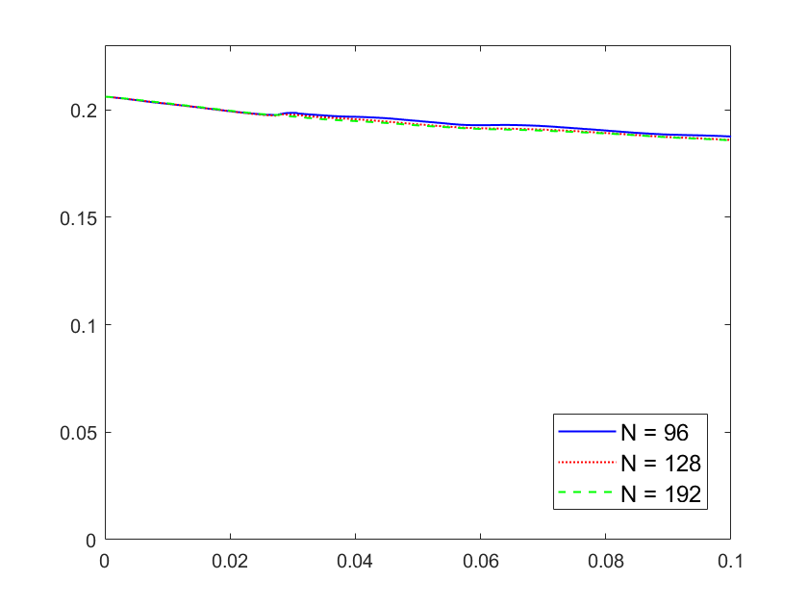
Two droplets merging
Area inside boundary
Y axis: zoomed in
Area inside boundary
Y axis: from zero

Slide 30
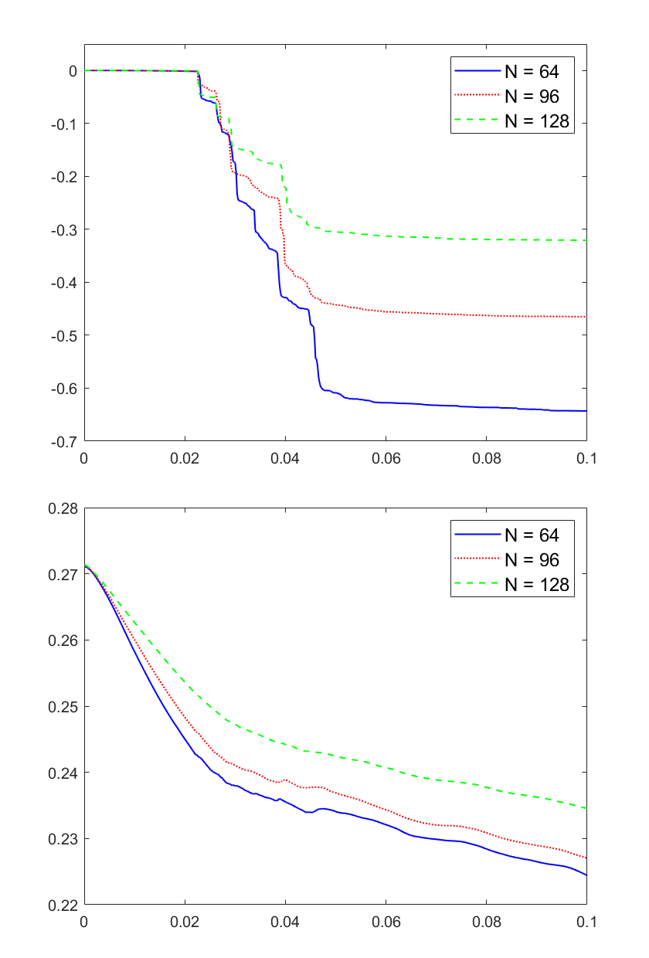
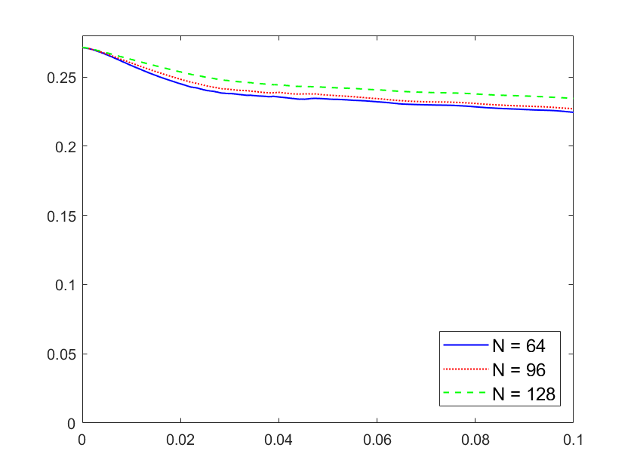
Six droplets merging
Accumulated energy error due to resampling
Area inside boundary
Y axis: from zero
Area inside boundary
Y axis: zoomed in

Slide 31
Benchmark: Rising Bubble
video

Slide 32
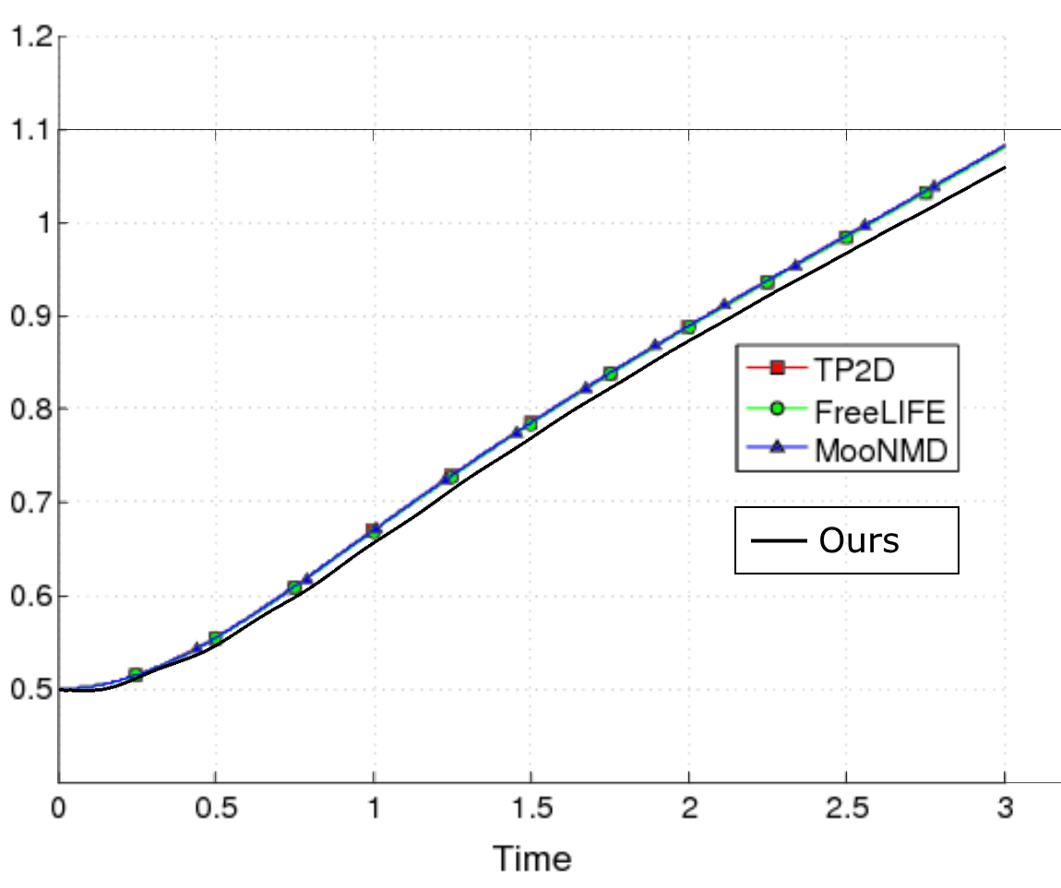
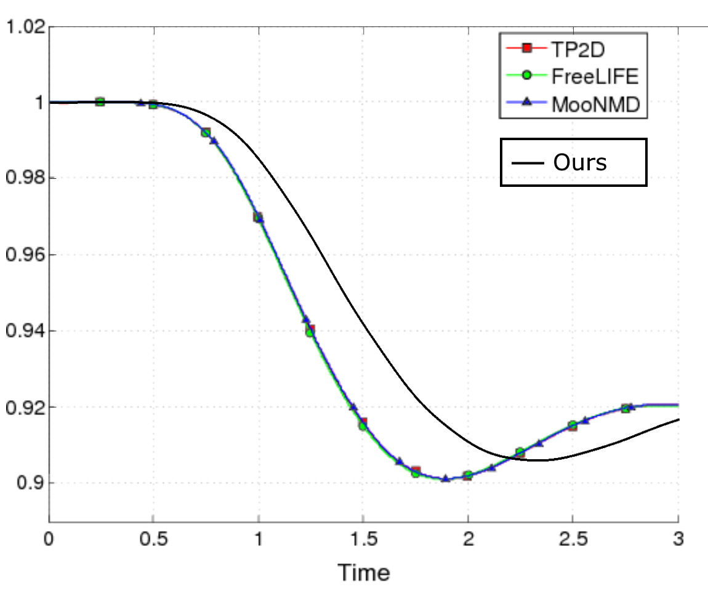
Benchmark: Rising Bubble
Circularity index
Center of mass

Slide 33
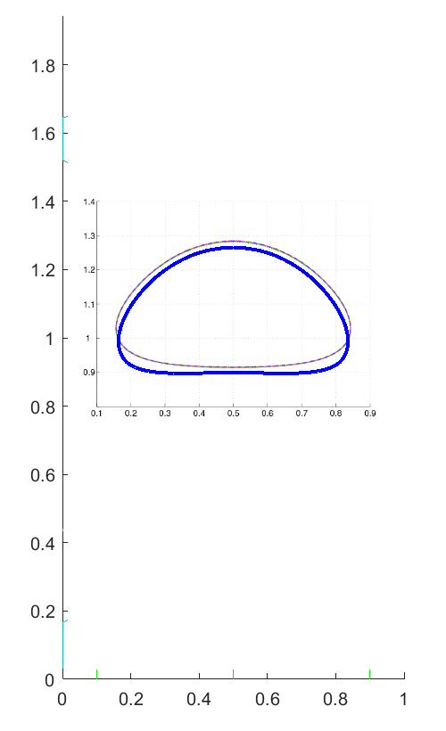
Benchmark: Rising Bubble
Final shape

Slide 34
Conclusion
Techniques we propose:
Dynamic slipping.
Frame-wise Interface resampling.
Interface splicing.
Limitations
No variable viscosity.
No adaptive mesh refinement.
Density markers progressively less uniform.

Slide 35
References
Contact me at
daniel.chin@nyu.edu
Radu Cimpeanu, Yousef Daneshbod, Qingxia Li, Pejman Sanaei, Pavel Dubovski, Ali Nadim, Marina Chugunova. Final Report: Motion of Liquid Droplets/Film in the Gas.
Y. D. Shikhmurzaev. The Moving Contact Line on a Smooth Solid Surface.
Petter Johansson and Berk Hess. Molecular Origin of Contact Line Friction in Dynamic Wetting. 2018.
P. Johansson, A. Carlson, and B. Hess, “Water–substrate physico-chemistry in wetting dynamics,” J. Fluid Mech. 781, 695–711. 2015.
Peskin. IBM lecture notes. www.math.nyu.edu/faculty/peskin/ib_lecture_notes/index.html
IBM2D code annotated by Guanhua. github.com/ModelingSimulation/IB-MATLAB.
Yongsam Kim, Charles S. Peskin. Numerical study of incompressible fluid dynamics with nonuniform density by the immersed boundary method. 2007.
Rising Bubble Benchmark. www.featflow.de/en/benchmarks/cfdbenchmarking/bubble/bubble_configurations.html

