Slide 1

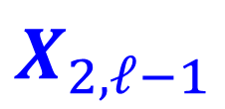


IS
$$X_{2, ℓ}$$
$$X_{2,ℓ+1}$$
MP
$$X_{2,ℓ−1}$$
$$X_{2,ℓ+2}$$

