Slide 1

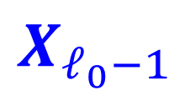


IX
$$X_{ℓ_{0}}$$
$$X_{ℓ_{0}+1}$$
MP
$$X_{ℓ_{0}−1}$$
$$X_{ℓ_{0}+2}$$

