Slide 1


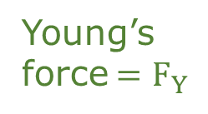
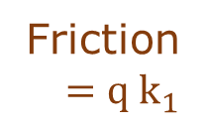
Gas
Gas
0
0
Friction $=∞$
Friction $={q k}_{1}$
Young’s force $=∞$
Young’s force $=F_{Y}$
0
0
0
0
0
0
Solid
Liquid
Solid
Liquid
(a) 1D force densities
(B) 0D force densities

