Slide 1



Moving Droplets on a Wall
Daniel Chin New York University Shanghai Campus
Michael Li New York University
Charles Puelz Baylor College of Medicine
Pejman Sanaei New York Institute of Technology
Aug. 12, 2020

Slide 2
demo_big_chase_small

Slide 3
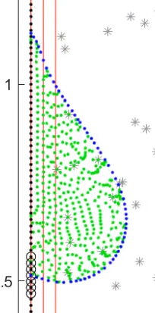
Overview
Immersed Boundary Method
Wall: The solid surface, no-flux.
Interface: the liquid-gas interface.
Variable density [Kim, Peskin. 2007]
Techniques we propose:
Dynamic slipping
Interface resampling
Interface splicing

Slide 4
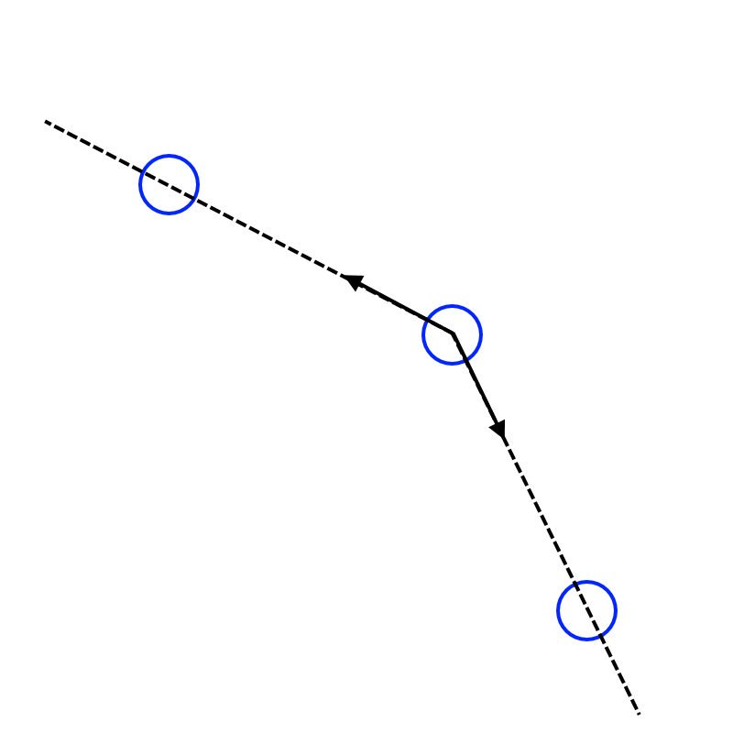
Our numerical method for tension force
Each interface marker is pulled by its two neighbors at constant magnitude.
Notice that the total force on one marker is always normal to the interface.

Slide 5
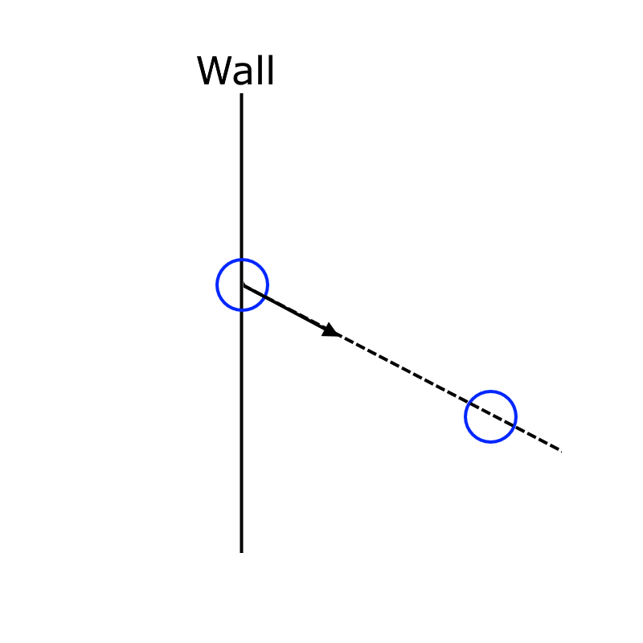
Natural extension: Young’s force
The same logic also simulates the unbalanced Young’s force at a contact point.

Slide 6
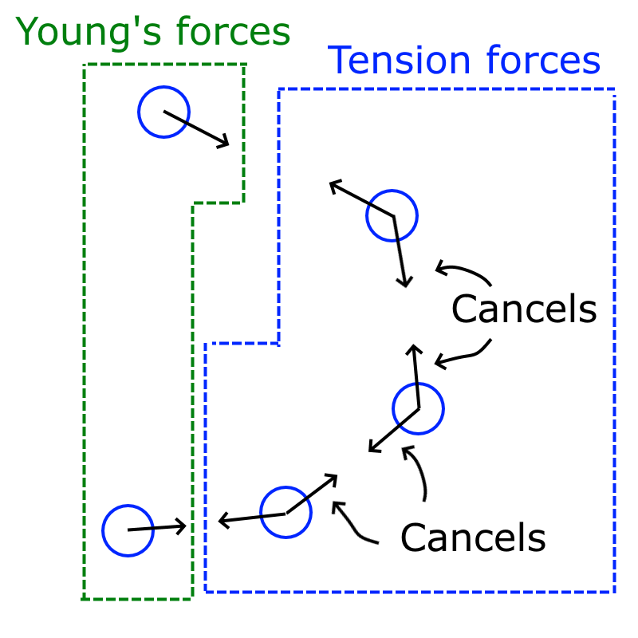
Beautiful fact
Notice that the sum of the tension force on all markers is exactly the sum of Young’s force on the two markers, just inverted in direction.
This way, we can view tension force and Young’s force as a pair of action-reaction forces.

Slide 7
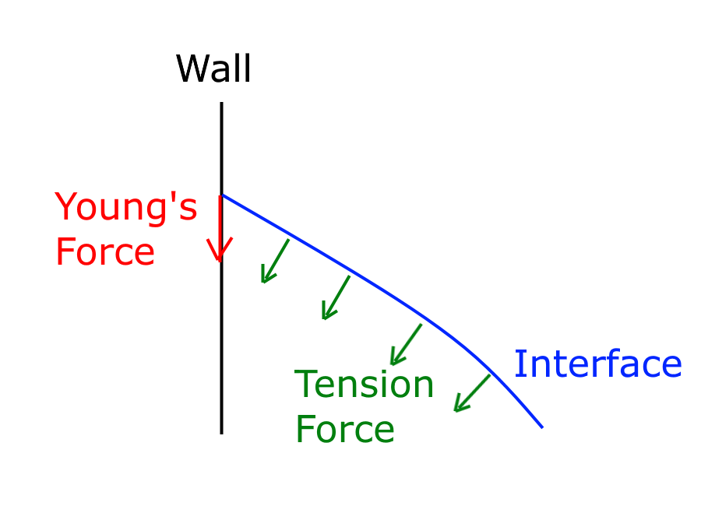
The two forces at the contact point
Young’s force is tangent to the wall.
The tension force is normal to the interface.

Slide 8
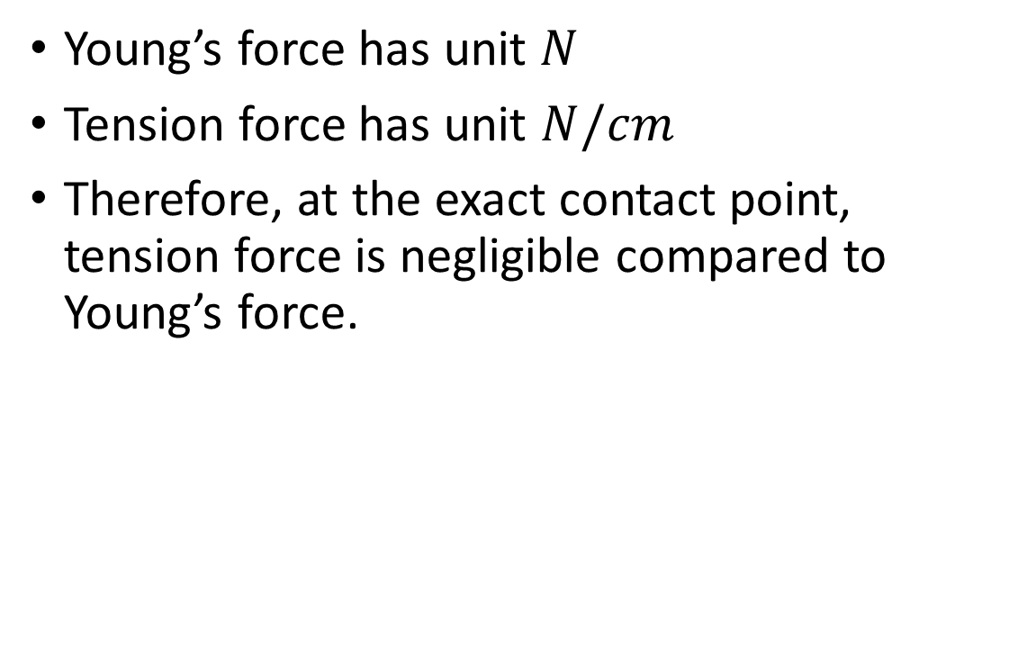
The two forces at the contact point
Young’s force has unit $N$
Tension force has unit $N/cm$
Therefore, at the exact contact point, tension force is negligible compared to Young’s force.

Slide 9
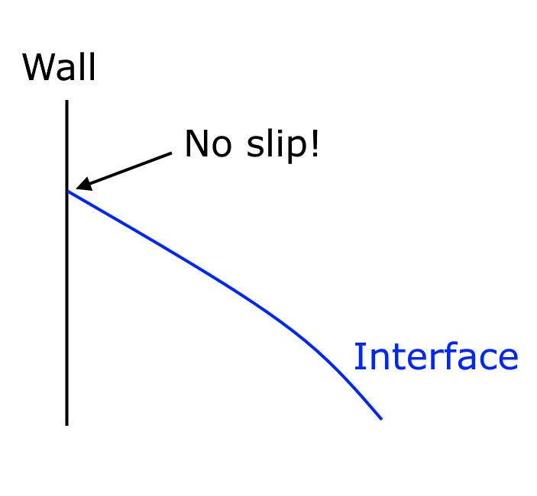
No-slip friction balances Young’s force
No-slip simply means that this friction force is a reactive force, always balancing the sum of active forces at this location in the vertical direction.

Slide 10
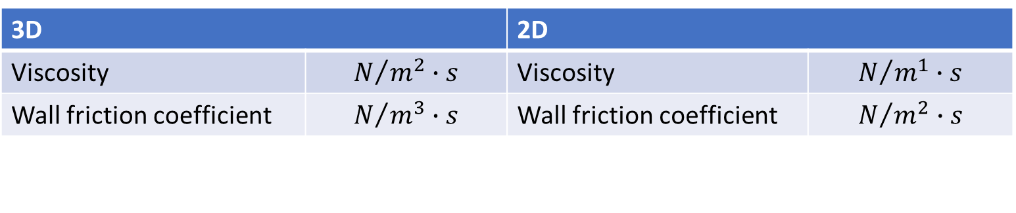
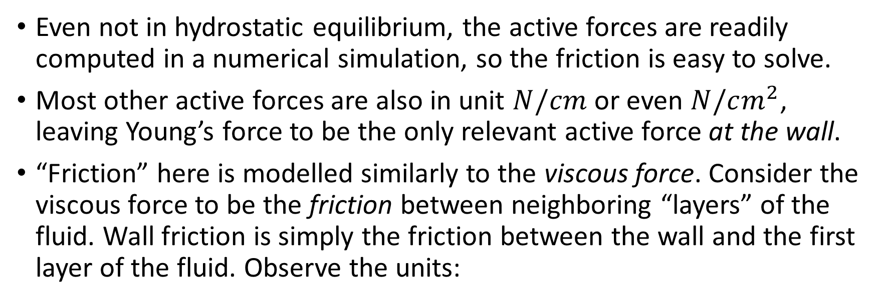
Clarifications
Even not in hydrostatic equilibrium, the active forces are readily computed in a numerical simulation, so the friction is easy to solve.
Most other active forces are also in unit $N/cm$ or even $N/cm^{2}$, leaving Young’s force to be the only relevant active force at the wall.
“Friction” here is modelled similarly to the viscous force. Consider the viscous force to be the friction between neighboring “layers” of the fluid. Wall friction is simply the friction between the wall and the first layer of the fluid. Observe the units:
3D |  | 2D
Viscosity | $$N/{m^{2}}∙s$$ | Viscosity | $$N/{m^{1}}∙s$$
Wall friction coefficient | $$N/{m^{3}}∙s$$ | Wall friction coefficient | $$N/{m^{2}}∙s$$

Slide 11
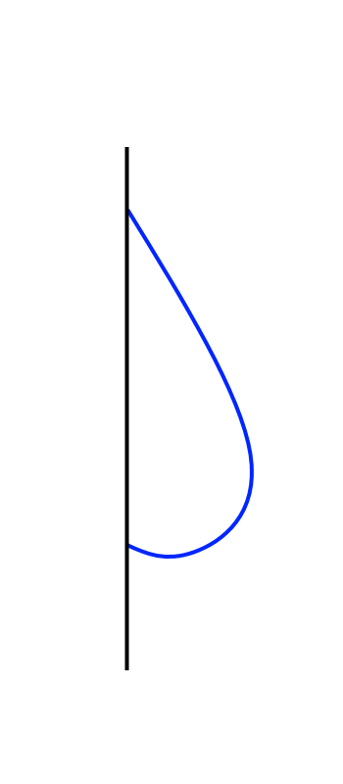
Dynamic slipping: we are changing these
Force | Exerted on | Supplied by | Direction | Pair of action-reaction forces? | Pair of balanced forces?
Gravity | Earth | Fluid | Up | Yes
Gravity | Fluid | Earth | Down |  | Yes
Total Tension | Fluid | Interface | Up | Yes
Young’s | Interface | Fluid | Down |  | Yes
Friction | Interface | Wall | Up | Yes
Friction | Wall | Interface | Down

Slide 12
Dynamic Slipping
We have thoroughly looked at no-slip. Now we are ready to look at the dynamic slipping scheme.

Slide 13
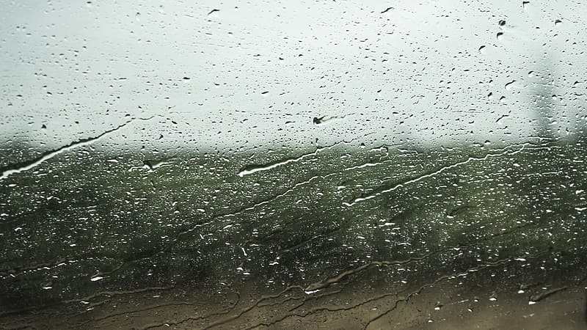
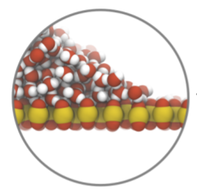
Motivations
In real life, we observe that small droplets stay on the wall as if no-slip, while bigger droplets roll down the wall.
A 2018 molecular simulation study has partially revealed the microscopic model for water-hydrophilic surface interaction.

Slide 14
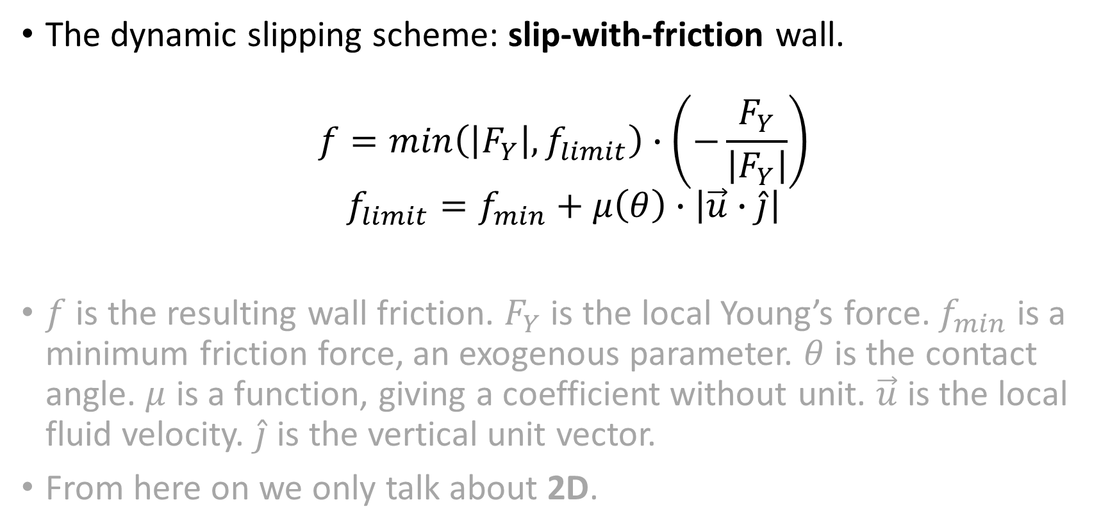
The macroscopic model
The dynamic slipping scheme: slip-with-friction wall.
$$f=min\left(\left|F_{Y}\right|, f_{limit}\right)∙\left(−\frac{F_{Y}}{\left|F_{Y}\right|}\right)$$
$$f_{limit}=f_{min}+μ\left(θ\right)∙\left|\vec{u}∙\hat{j}\right|$$
$f$ is the resulting wall friction. $F_{Y}$ is the local Young’s force. $f_{min}$ is a minimum friction force, an exogenous parameter. $θ$ is the contact angle. $μ$ is a function, giving a coefficient without unit. $\vec{u}$ is the local fluid velocity. $\hat{j}$ is the vertical unit vector.
From here on we only talk about 2D.

Slide 15
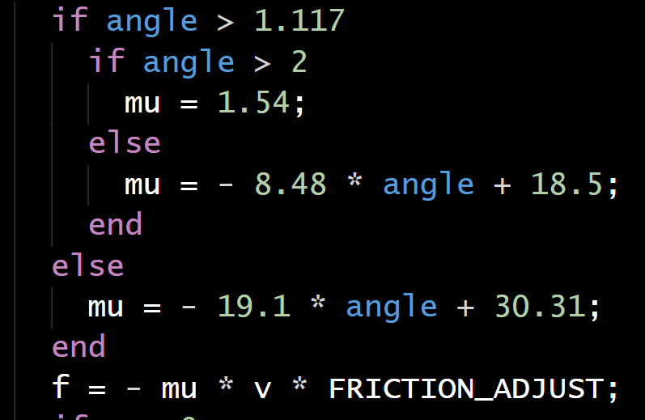
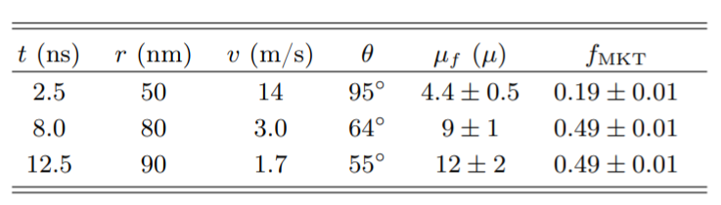

$$μ\left(θ\right)$$
This function computes the friction coefficient given the contact angle.
It is based on a regression of the 2018 molecular study.
Regression
[Johansson and Hess. 2018]

Slide 16
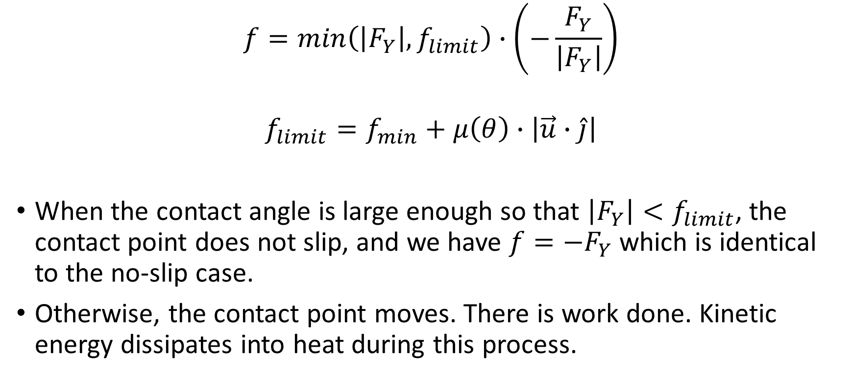
Macroscopic behaviors
$$f=min\left(\left|F_{Y}\right|, f_{limit}\right)∙\left(−\frac{F_{Y}}{\left|F_{Y}\right|}\right)$$
$$f_{limit}=f_{min}+μ\left(θ\right)∙\left|\vec{u}∙\hat{j}\right|$$
When the contact angle is large enough so that $\left|F_{Y}\right|<f_{limit}$, the contact point does not slip, and we have $f=−F_{Y}$ which is identical to the no-slip case.
Otherwise, the contact point moves. There is work done. Kinetic energy dissipates into heat during this process.

Slide 17
The corresponding numerical method
It is well known that a no-slip wall can be simulated as an array of markers using the penalty method.
To simulate a dynamic slipping wall, we use what we call the incur-redeem-dismiss penalty method. In this view, the baseline penalty method would be an incur-redeem penalty method.
 | Used for | Incur? | Redeem? | Dismiss?
Baseline penalty method | No-flux no-slip wall | Yes | Yes | No
Ours | No-flux slip-with-friction wall | Yes | Yes | Yes

Slide 18
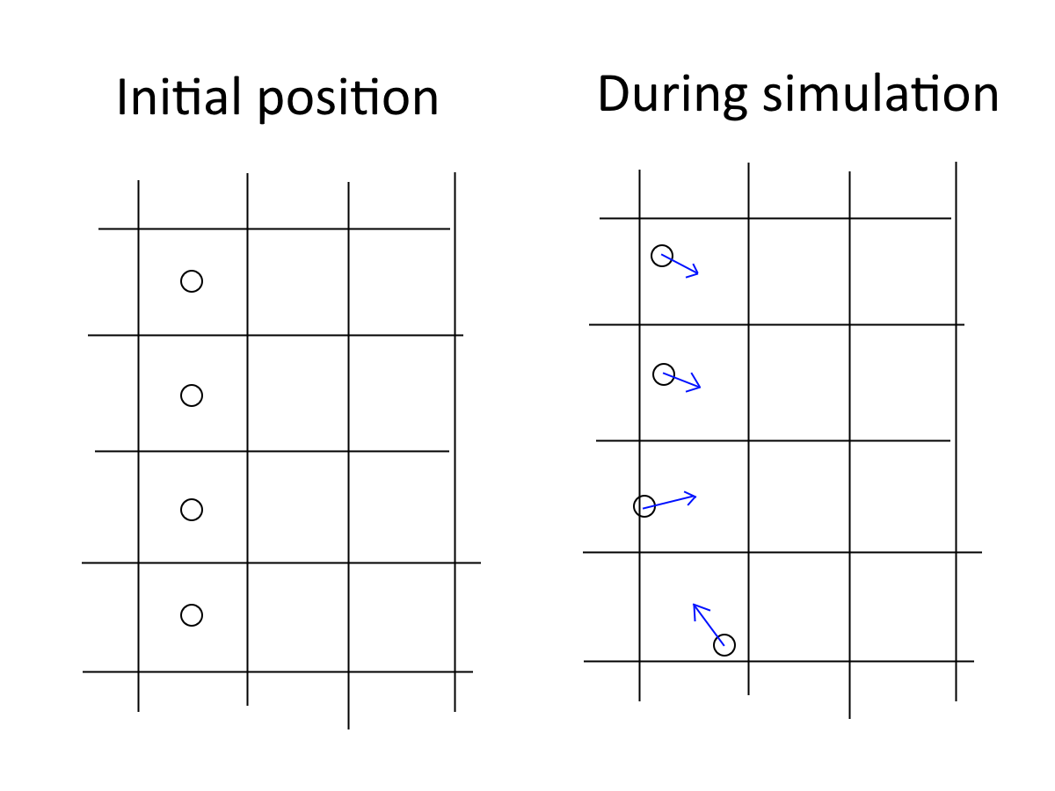
Baseline penalty method for no-slip wall
Fluid flow incurs penalty.
A penalty force is applied onto the fluid.
Fluid flow redeems penalty.

Slide 19
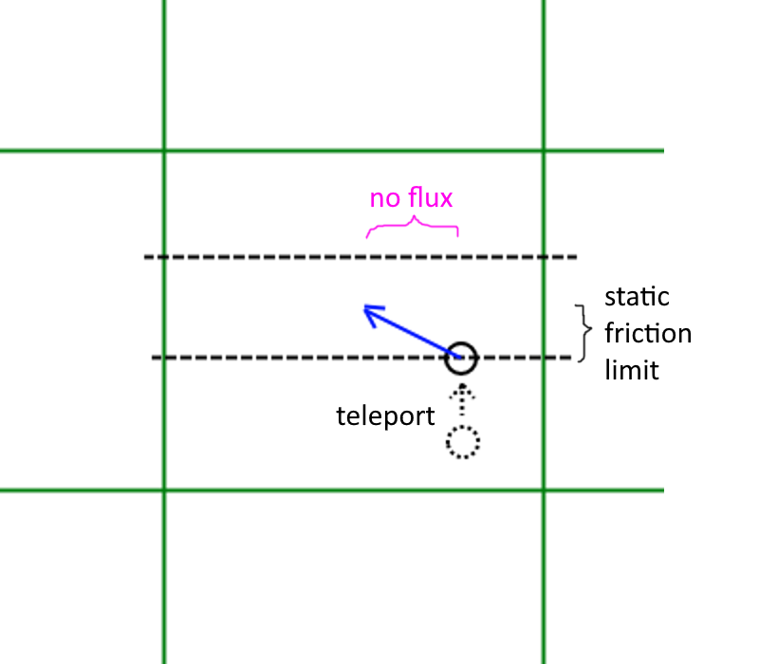
Incur-redeem-dismiss
Now we introduce another way penalty can decrease: dismissal.
Penalty is instantly decreased within a timestep by “teleporting” the marker.

Slide 20
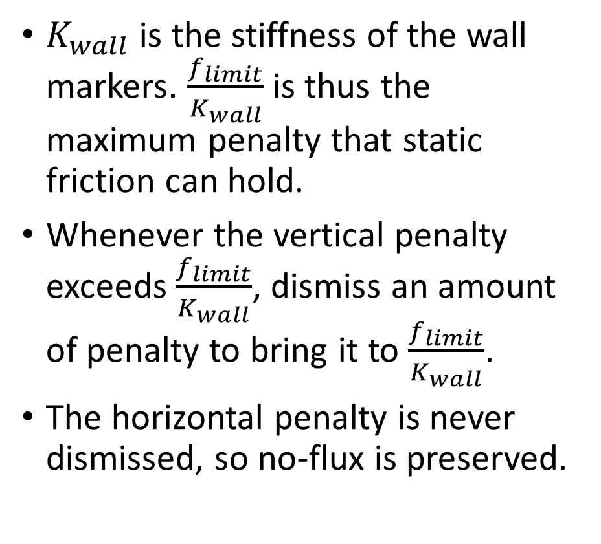
Incur-redeem-dismiss
$K_{wall}$ is the stiffness of the wall markers. $\frac{f_{limit}}{K_{wall}}$ is thus the maximum penalty that static friction can hold.
Whenever the vertical penalty exceeds $\frac{f_{limit}}{K_{wall}}$, dismiss an amount of penalty to bring it to $\frac{f_{limit}}{K_{wall}}$.
The horizontal penalty is never dismissed, so no-flux is preserved.

Slide 21
compare_droplet_size
conv_drop_slide_3x3

Slide 22
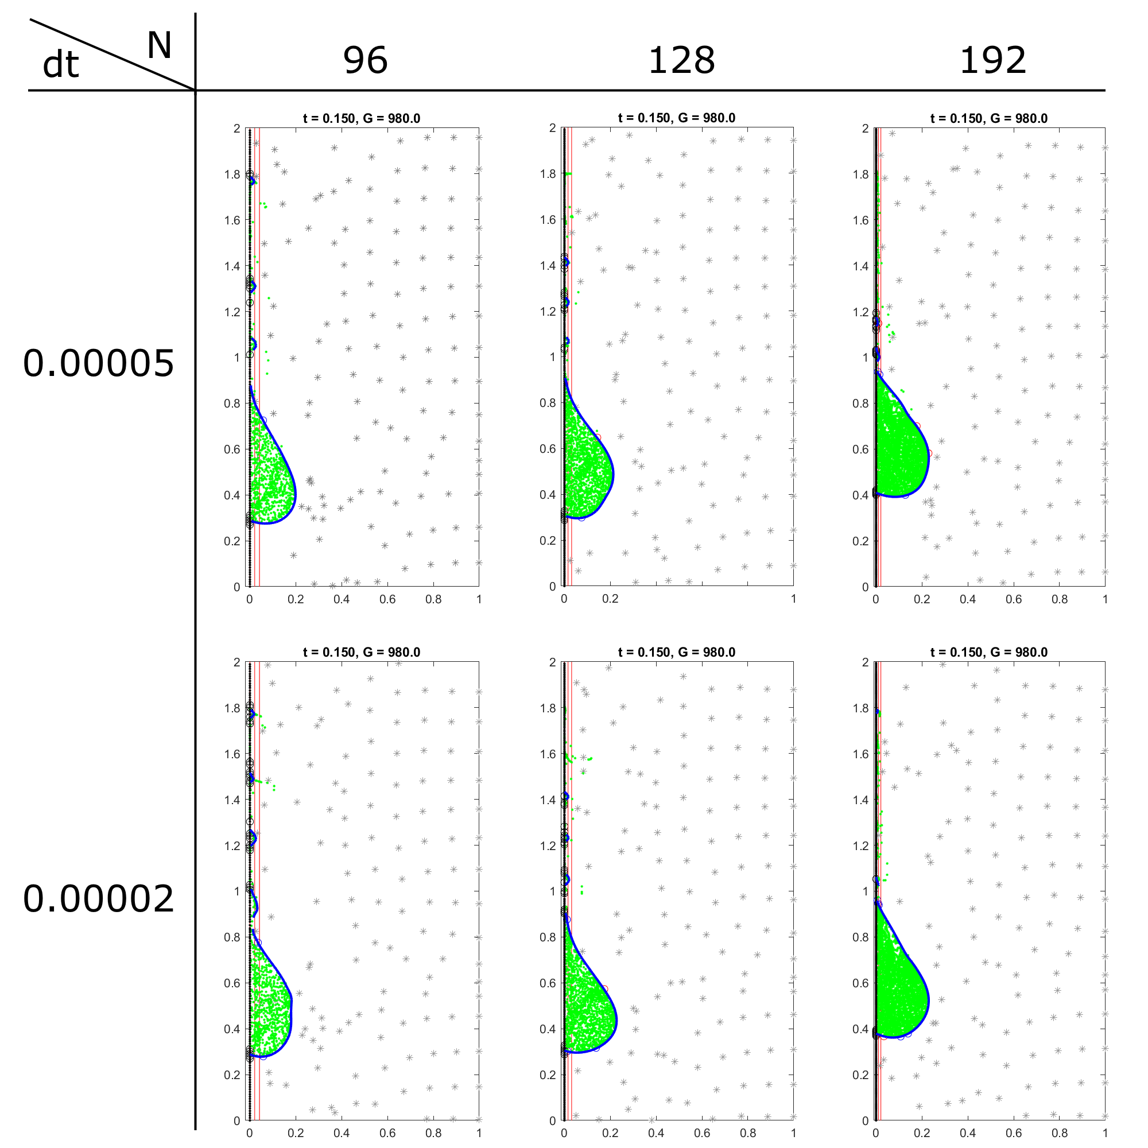
t = 0.15

Slide 23
t = 0.15

Slide 24
Problems
Volume conservation

Slide 25
Step-wise Interface Resampling

Slide 26
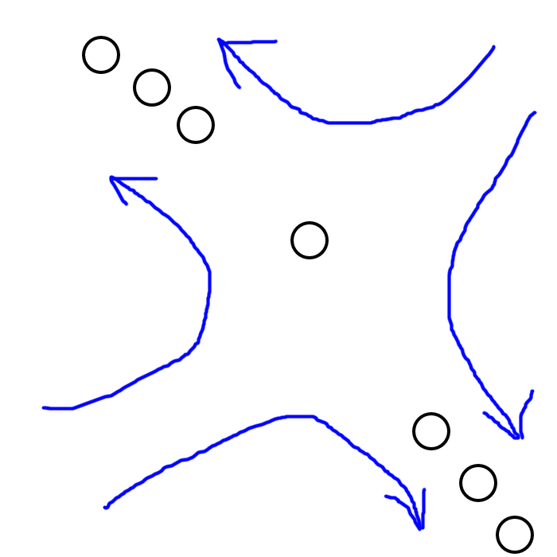
Interface resampling
Problem:
Surface tension is always normal to the interface
No tangent component → nothing ensures the markers stay uniformly distributed.

Slide 27
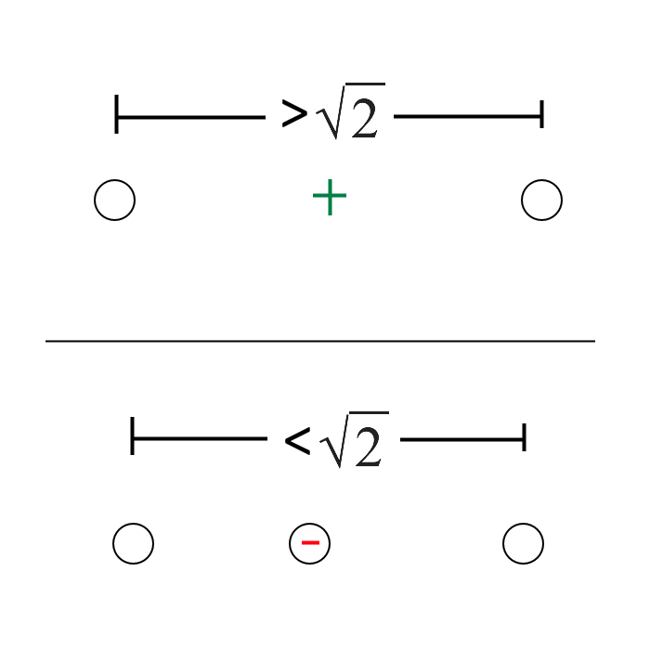
Interface resampling

Slide 28
compare_resample

Slide 29
Limitations
3D equivalence is much more complicated
Area conservation problem

Slide 30
Shrink.mp4

Slide 31
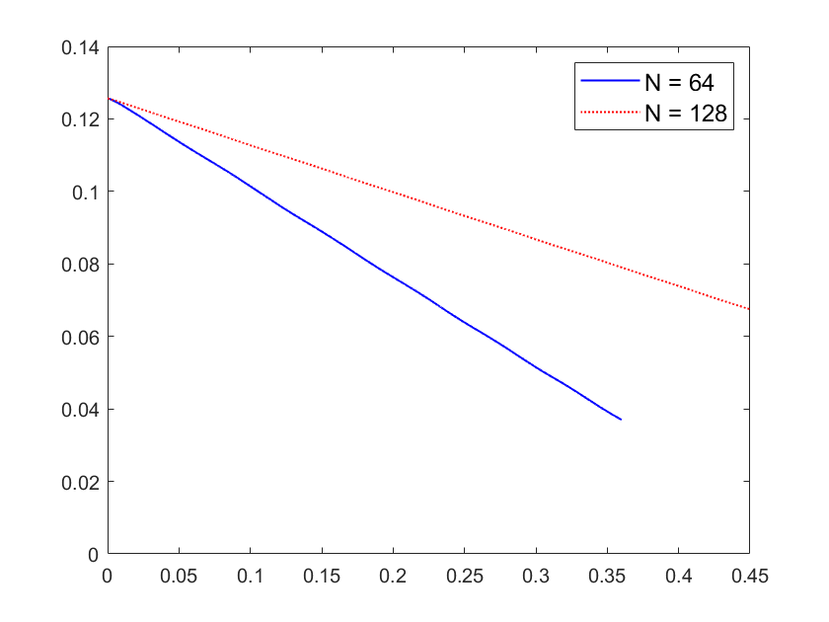
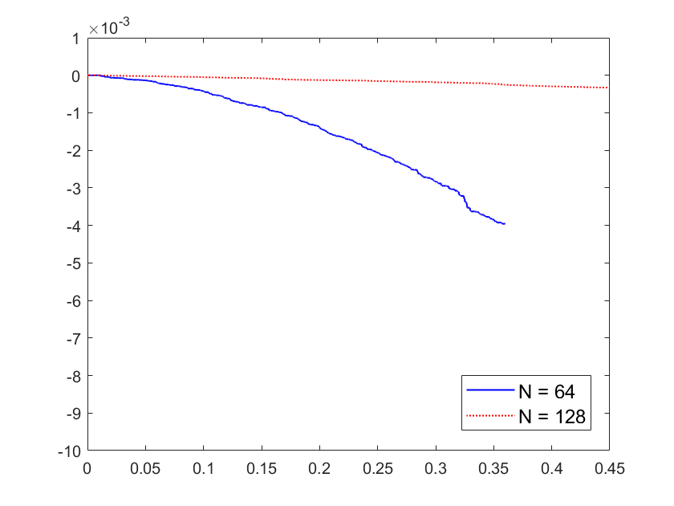
Area inside boundary
Accumulated surface energy error due to resampling

Slide 32
Interface Splicing
Droplets can now coalesce, split up, attach to, and detach from the wall

Slide 33
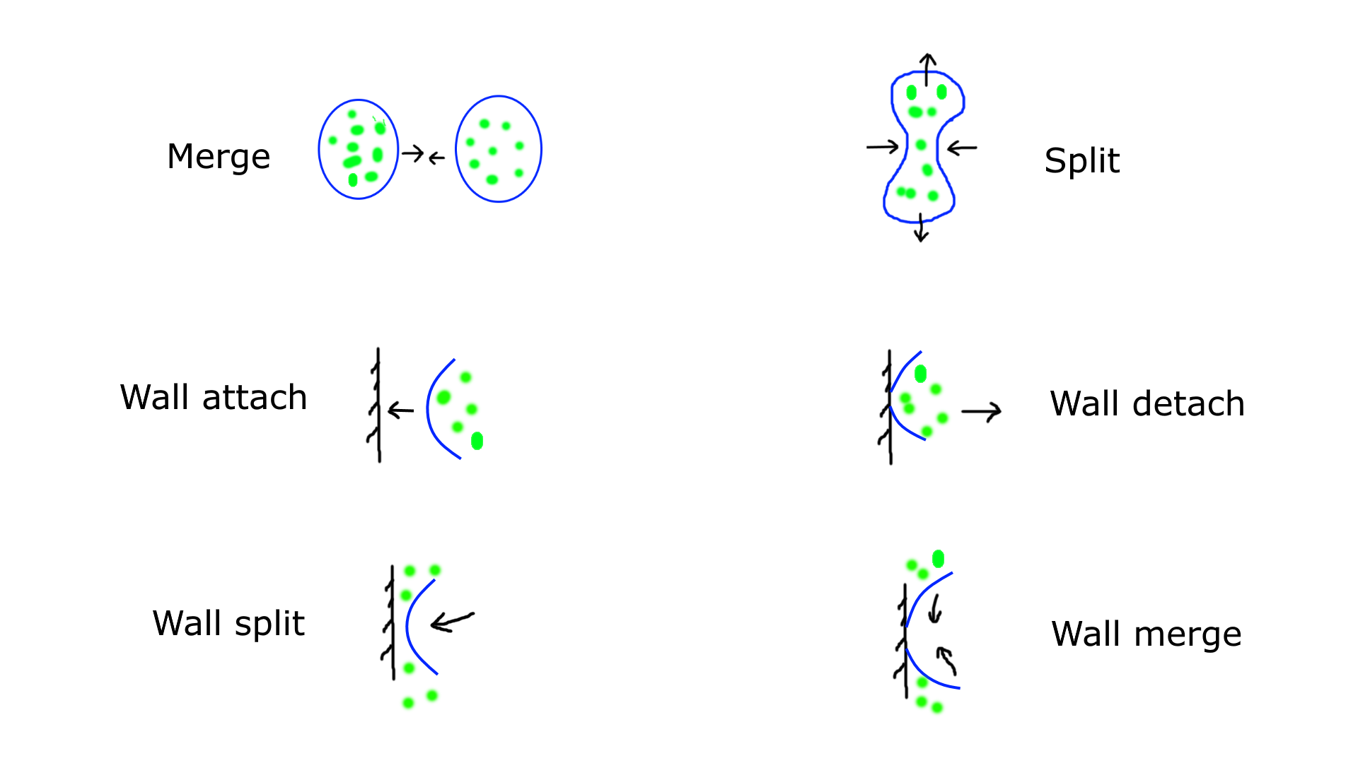

Slide 34
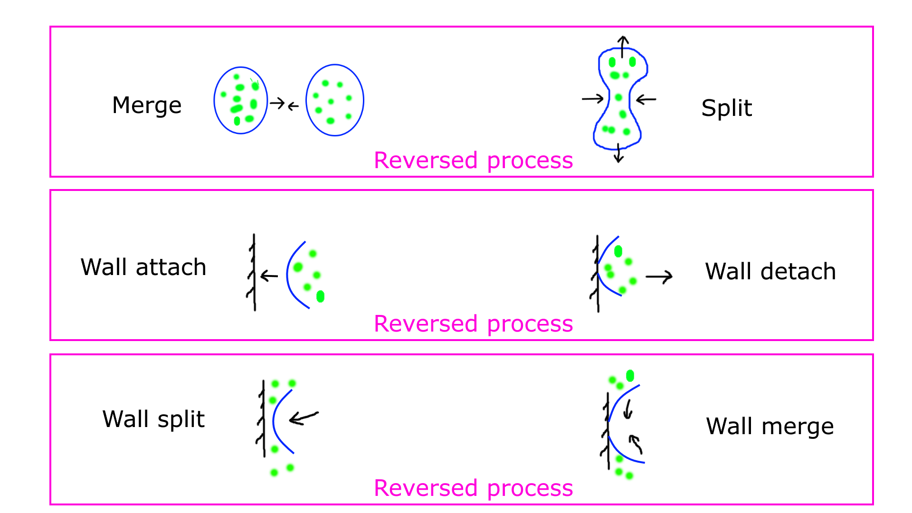

Slide 35
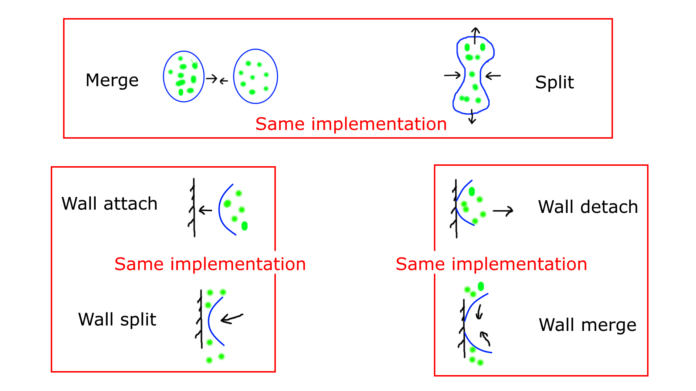

Slide 36
conv_merge_two
conv_merge_six_new

Slide 37
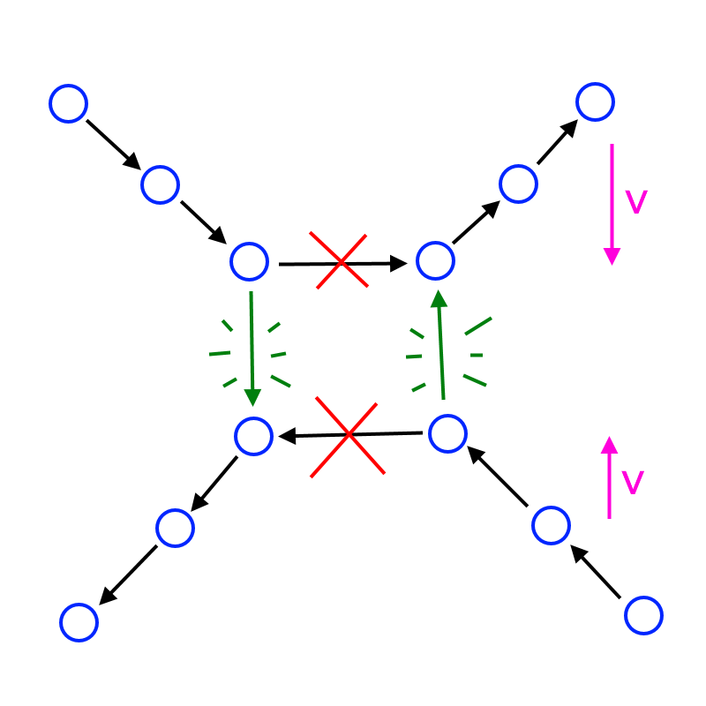
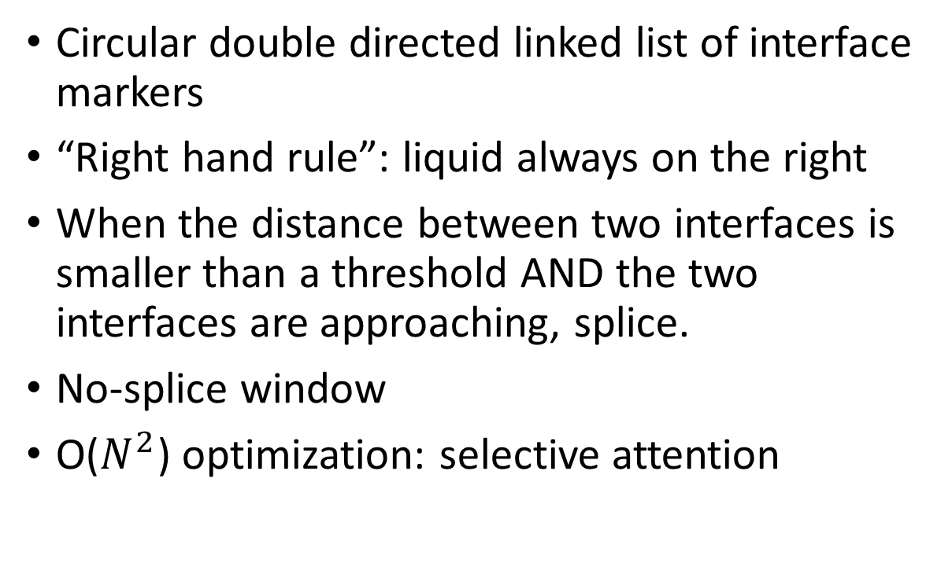
Splicing method
Circular double directed linked list of interface markers
“Right hand rule”: liquid always on the right
When the distance between two interfaces is smaller than a threshold AND the two interfaces are approaching, splice.
No-splice window
O($N^{2}$) optimization: selective attention

Slide 38
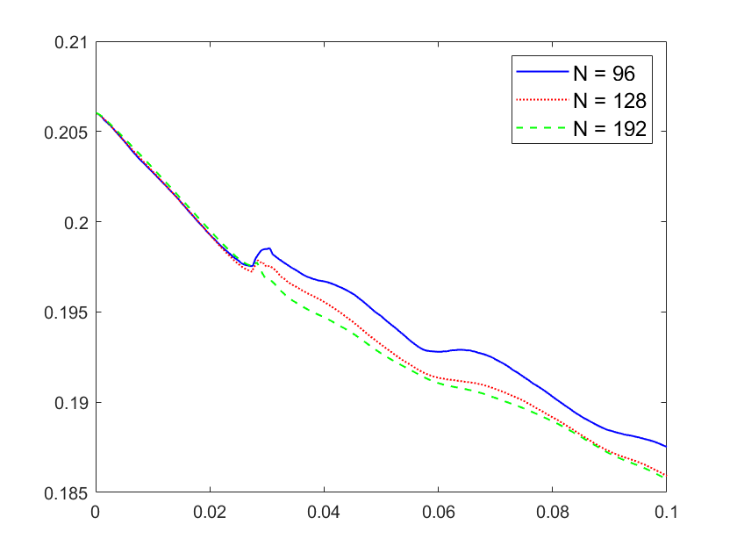
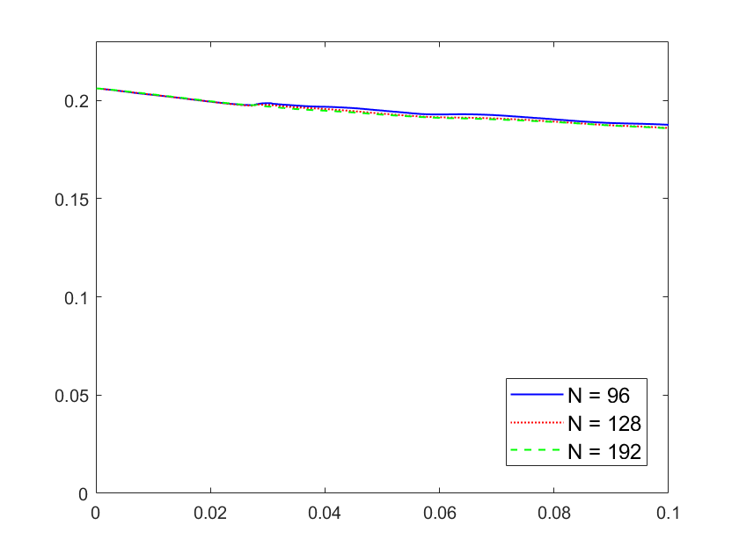
Two droplets merging
Area inside boundary
Y axis: zoomed in
Area inside boundary
Y axis: from zero

Slide 39
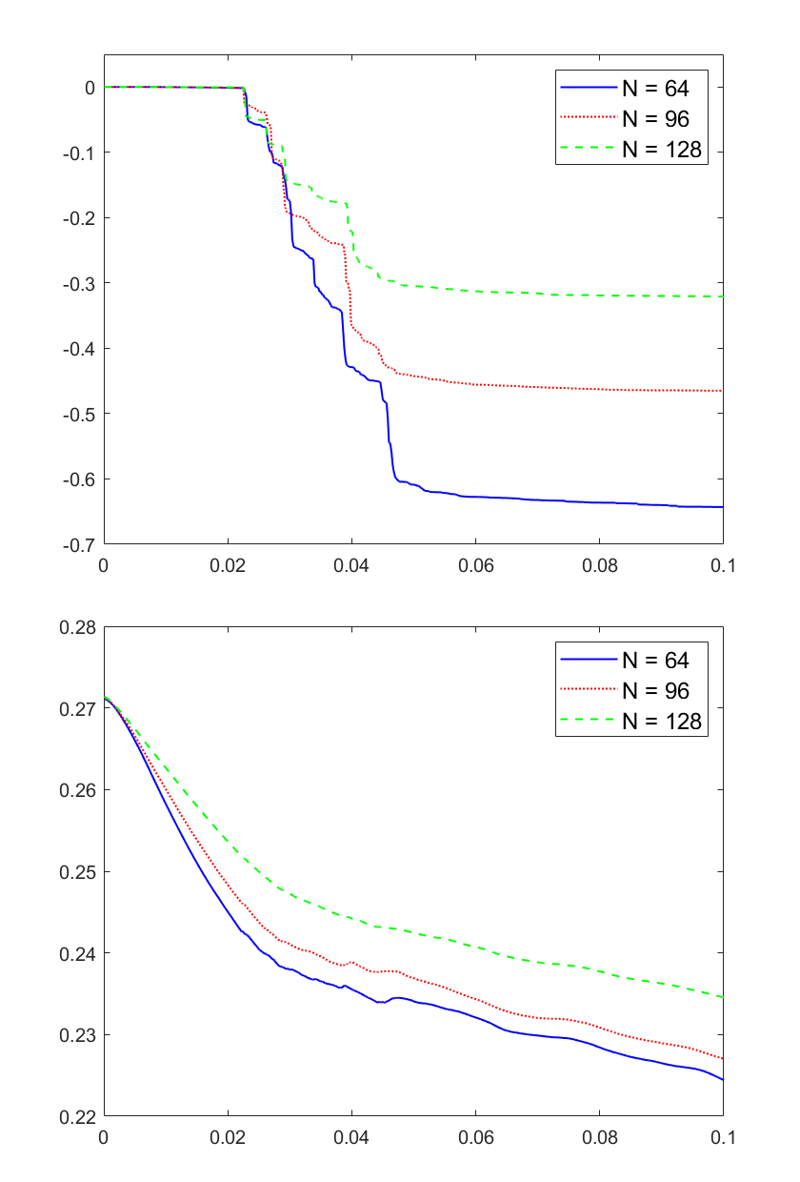
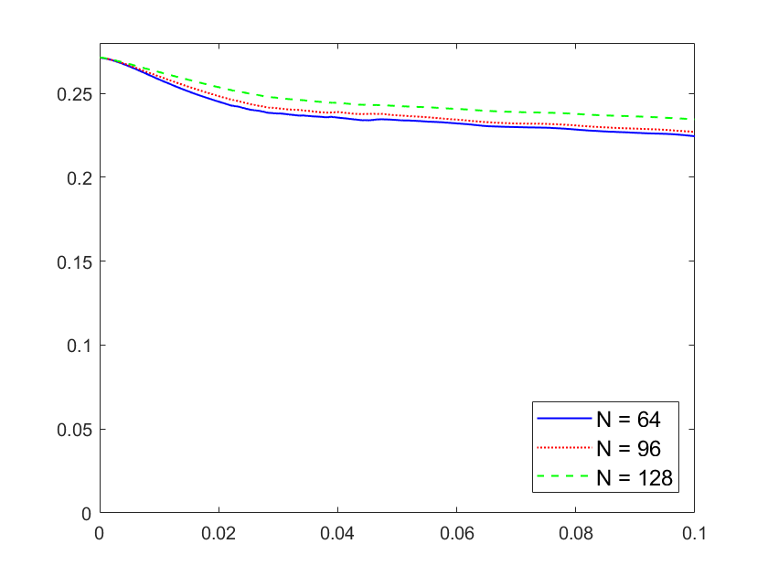
Six droplets merging
Accumulated energy error due to resampling
Area inside boundary
Y axis: from zero
Area inside boundary
Y axis: zoomed in

Slide 40
Benchmark: Rising Bubble
video

Slide 41
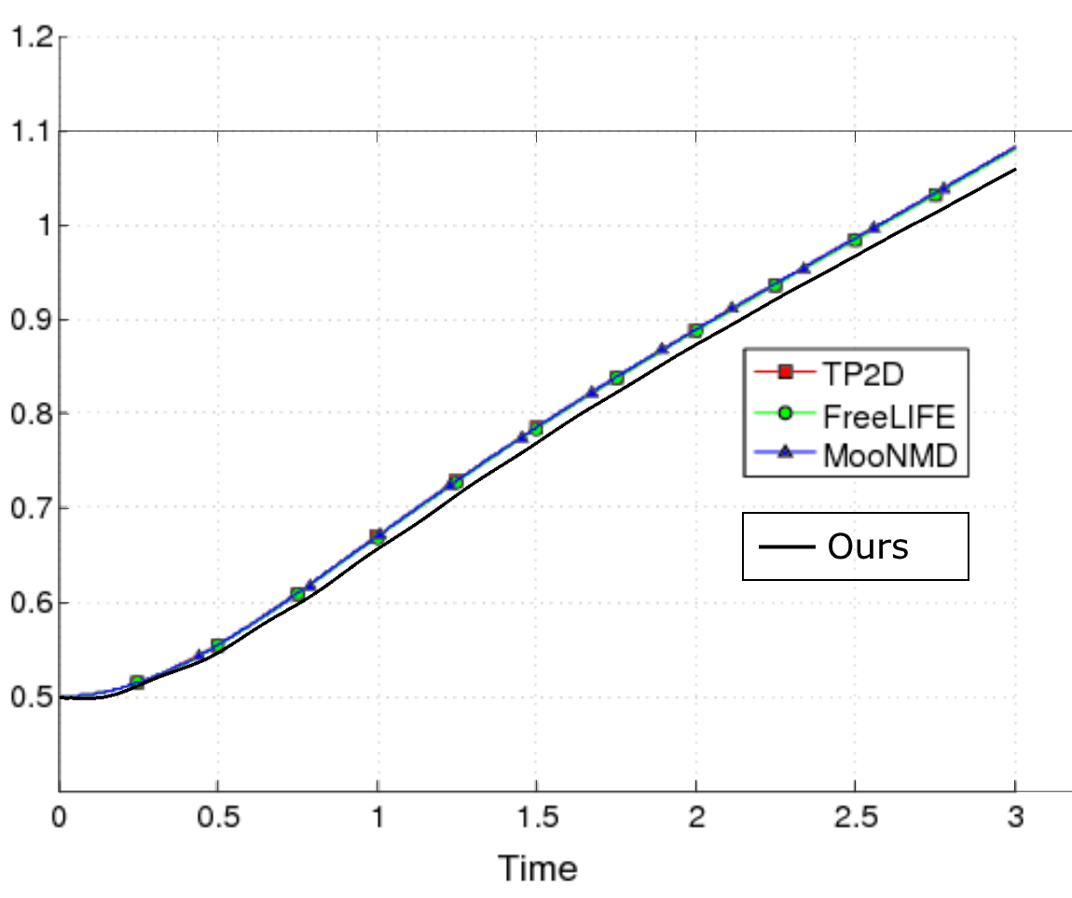
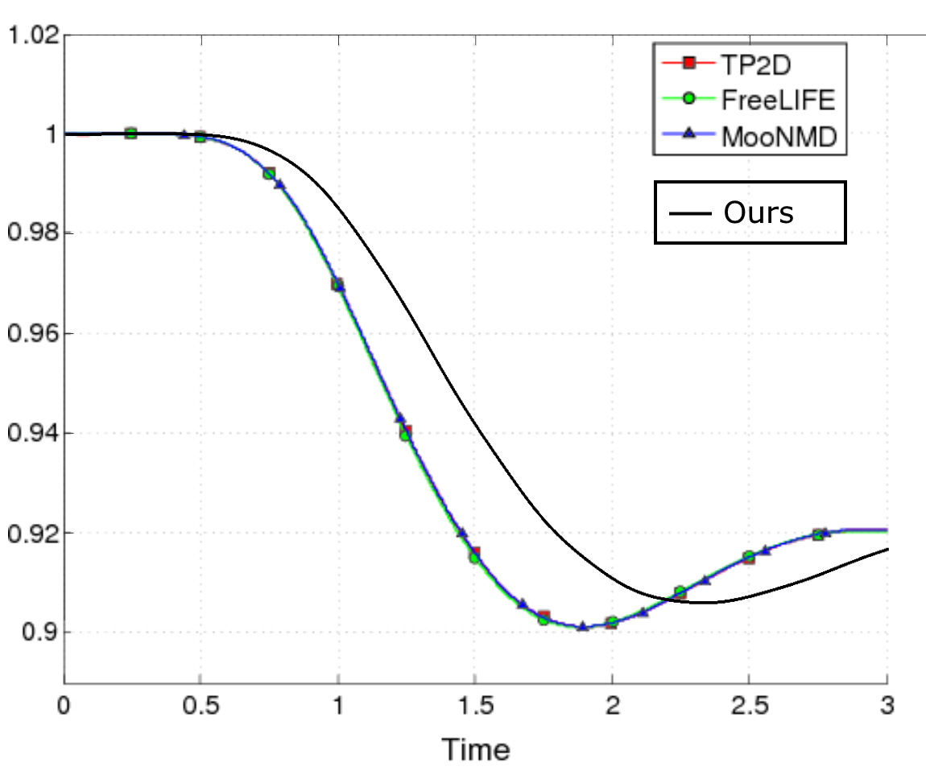
Benchmark: Rising Bubble
Circularity index
Center of mass

Slide 42
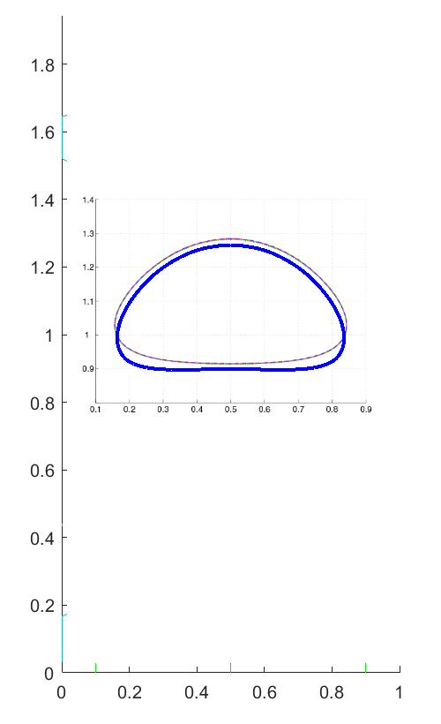
Benchmark: Rising Bubble
Final shape

Slide 43
Conclusion
Techniques we propose:
Dynamic slipping
Frame-wise Interface resampling
Interface splicing
Limitations
No variable viscosity
No adaptive mesh refinement
Questionable volume (area) conservation
Density markers progressively less uniform

Slide 44
References
Radu Cimpeanu, Yousef Daneshbod, Qingxia Li, Pejman Sanaei, Pavel Dubovski, Ali Nadim, Marina Chugunova. Final Report: Motion of Liquid Droplets/Film in the Gas.
Y. D. Shikhmurzaev. The Moving Contact Line on a Smooth Solid Surface.
Petter Johansson and Berk Hess. Molecular Origin of Contact Line Friction in Dynamic Wetting. 2018.
P. Johansson, A. Carlson, and B. Hess, “Water–substrate physico-chemistry in wetting dynamics,” J. Fluid Mech. 781, 695–711. 2015.
Peskin. IBM lecture notes. www.math.nyu.edu/faculty/peskin/ib_lecture_notes/index.html
IBM2D code annotated by Guanhua. github.com/ModelingSimulation/IB-MATLAB.
Yongsam Kim, Charles S. Peskin. Numerical study of incompressible fluid dynamics with nonuniform density by the immersed boundary method. 2007.

