Slide 1
Dynamic Slipping
Oct 2020

Slide 2
Purpose of this ppt
This is an outline for the dynamic slipping part of the report.
Michael: if you have time, you may start writing based on this ppt.

Slide 3
Terminology clarification
Wall: The solid surface, usually no-flux.
Interface: the liquid-gas interface.

Slide 4
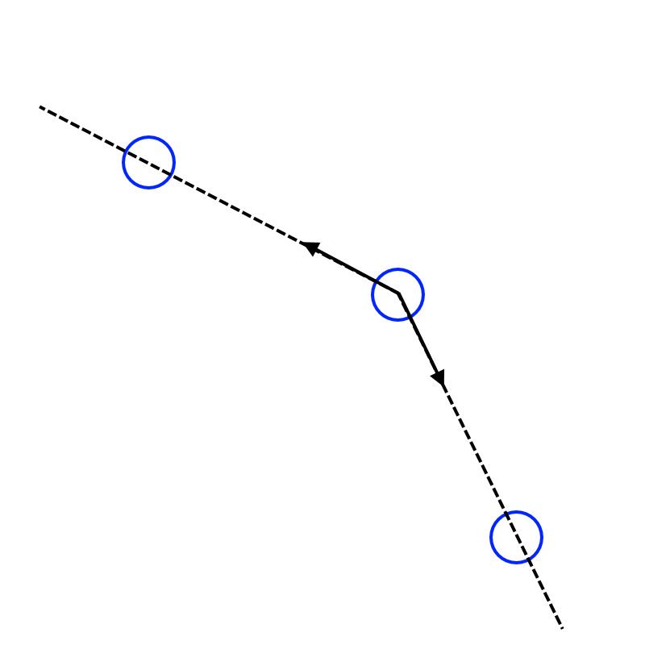
Our numerical method for tension force
Each interface marker is pulled by its two neighbors at constant magnitude.
Force is the gradient of energy. The 2D tension energy is proportional to the interface length. View that as the sum of all line segments. An attractive force with constant magnitude is precisely the gradient of the length of one line segment.
Notice that the total force on a marker is always normal to the interface.

Slide 5
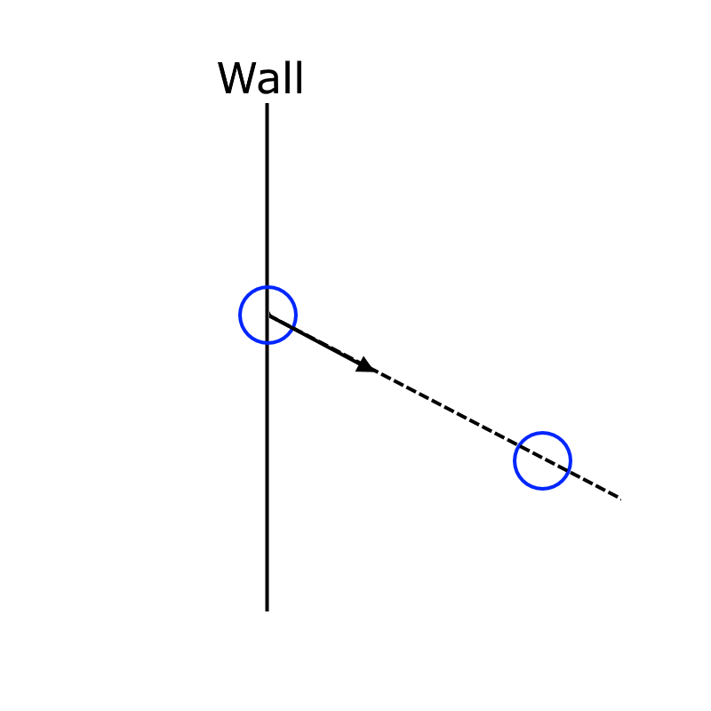
Natural extension: Young’s force
The same logic also simulates the unbalanced Young’s force at a contact point.
At the wall, there is one marker that has only one neighbor. The total force on this marker becomes tangent to the interface.
However, its horizontal component is balanced by the no-flux force provided by the wall.
Its vertical component turns out to equal the Young’s force.

Slide 6
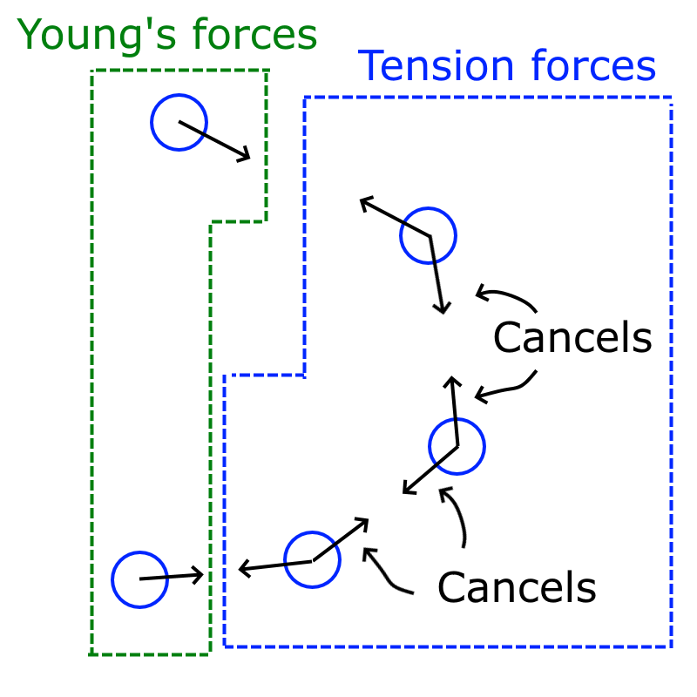
Beautiful fact
Notice that the sum of the tension force on all markers is exactly the sum of Young’s force on the two markers, just inverted in direction.
We can view tension force and Young’s force as a pair of action-reaction forces this way.

Slide 7
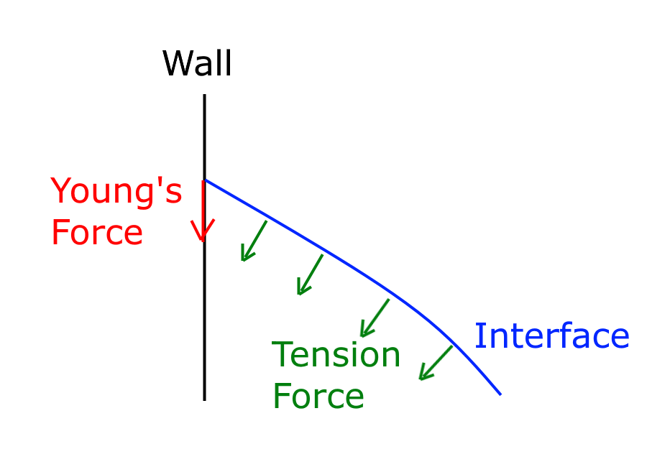
The two forces at the contact point
Young’s force is tangent to the wall.
The tension force is normal to the interface.

Slide 8
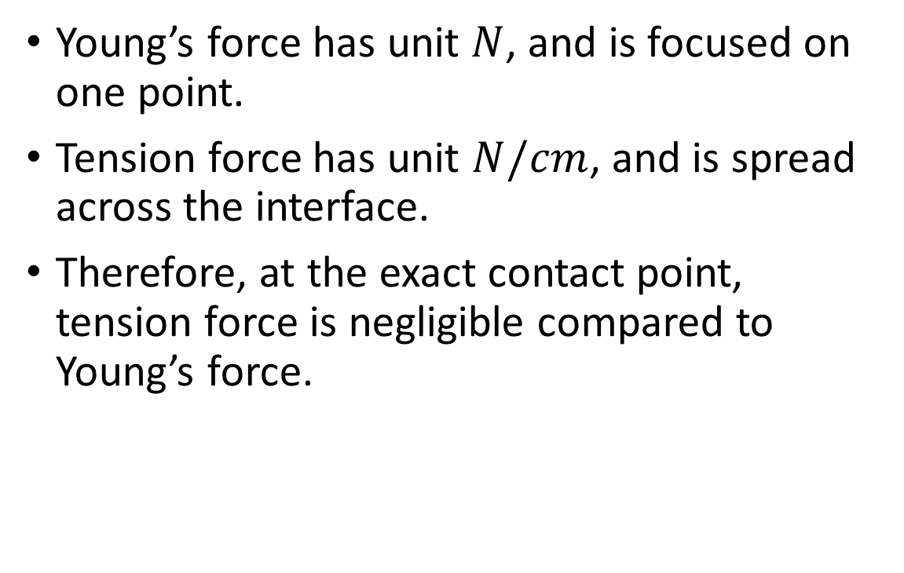
The two forces at the contact point
Young’s force has unit $N$, and is focused on one point.
Tension force has unit $N/cm$, and is spread across the interface.
Therefore, at the exact contact point, tension force is negligible compared to Young’s force.

Slide 9
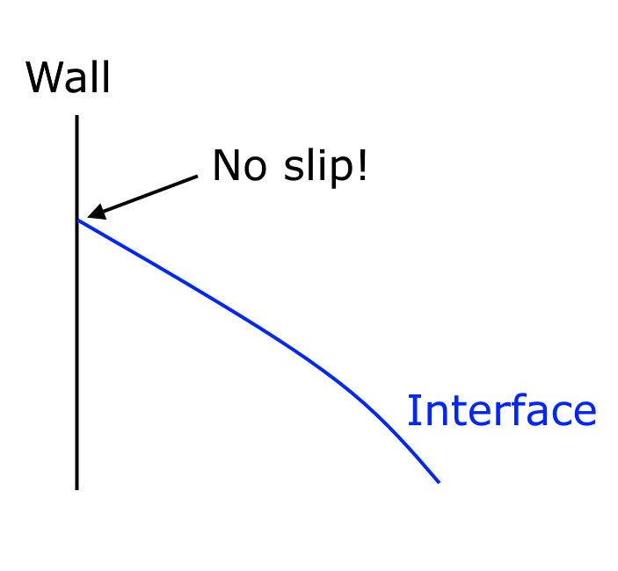
No-slip friction balances Young’s force
Now, view the no-slip boundary condition as a friction force, provided by the wall, exerted onto the fluid.
No-slip simply means that this friction force is a reactive force, always balancing the sum of active forces at this location in the vertical direction.
The only active force at the wall is Young’s force. Therefore, the wall friction, if no-slip, equals the Young’s force inverted in direction.

Slide 10
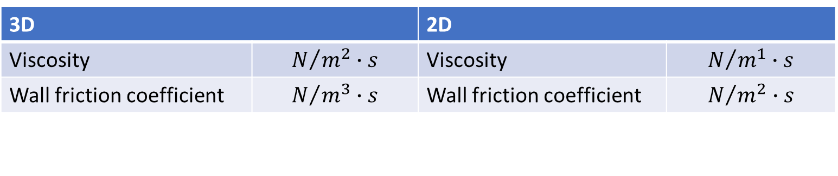
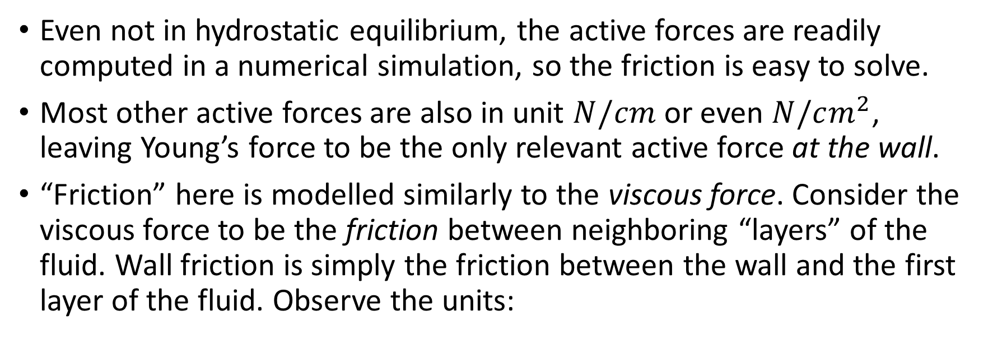
Clarifications about the last page
Even not in hydrostatic equilibrium, the active forces are readily computed in a numerical simulation, so the friction is easy to solve.
Most other active forces are also in unit $N/cm$ or even $N/cm^{2}$, leaving Young’s force to be the only relevant active force at the wall.
“Friction” here is modelled similarly to the viscous force. Consider the viscous force to be the friction between neighboring “layers” of the fluid. Wall friction is simply the friction between the wall and the first layer of the fluid. Observe the units:
3D |  | 2D
Viscosity | $$N/{m^{2}}∙s$$ | Viscosity | $$N/{m^{1}}∙s$$
Wall friction coefficient | $$N/{m^{3}}∙s$$ | Wall friction coefficient | $$N/{m^{2}}∙s$$

Slide 11
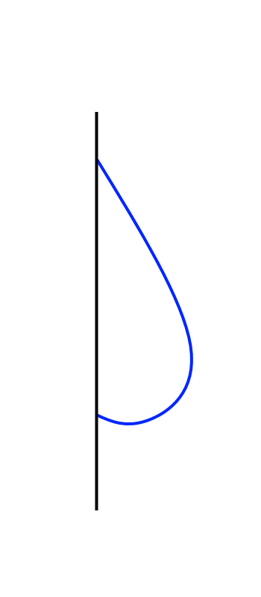
Deep dive into how the hell a droplet can stay on a wall
Force | Exerted on | Supplied by | Direction | Pair of action-reaction forces? | Pair of balanced forces?
Gravity | Earth | Fluid | Up | Yes
Gravity | Fluid | Earth | Down |  | Yes
Total Tension | Fluid | Interface | Up | Yes
Young’s | Interface | Fluid | Down |  | Yes
Friction | Interface | Wall | Up | Yes
Friction | Wall | Interface | Down

Slide 12
Dynamic slipping: we are changing these
Force | Exerted on | Supplied by | Direction | Pair of action-reaction forces? | Pair of balanced forces?
Gravity | Earth | Fluid | Up | Yes
Gravity | Fluid | Earth | Down |  | Yes
Total Tension | Fluid | Interface | Up | Yes
Young’s | Interface | Fluid | Down |  | Yes
Friction | Interface | Wall | Up | Yes
Friction | Wall | Interface | Down

Slide 13
Dynamic Slipping
We have thoroughly looked at no-slip. Now we are ready to look at the dynamic slipping scheme.

Slide 14

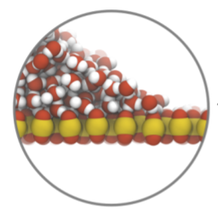
Motivations
In real life, we observe that small droplets stay on the wall as if no-slip, while bigger droplets roll down the wall.
A 2018 molecular simulation study has partially revealed the microscopic model for water-hydrophilic surface interaction.

Slide 15
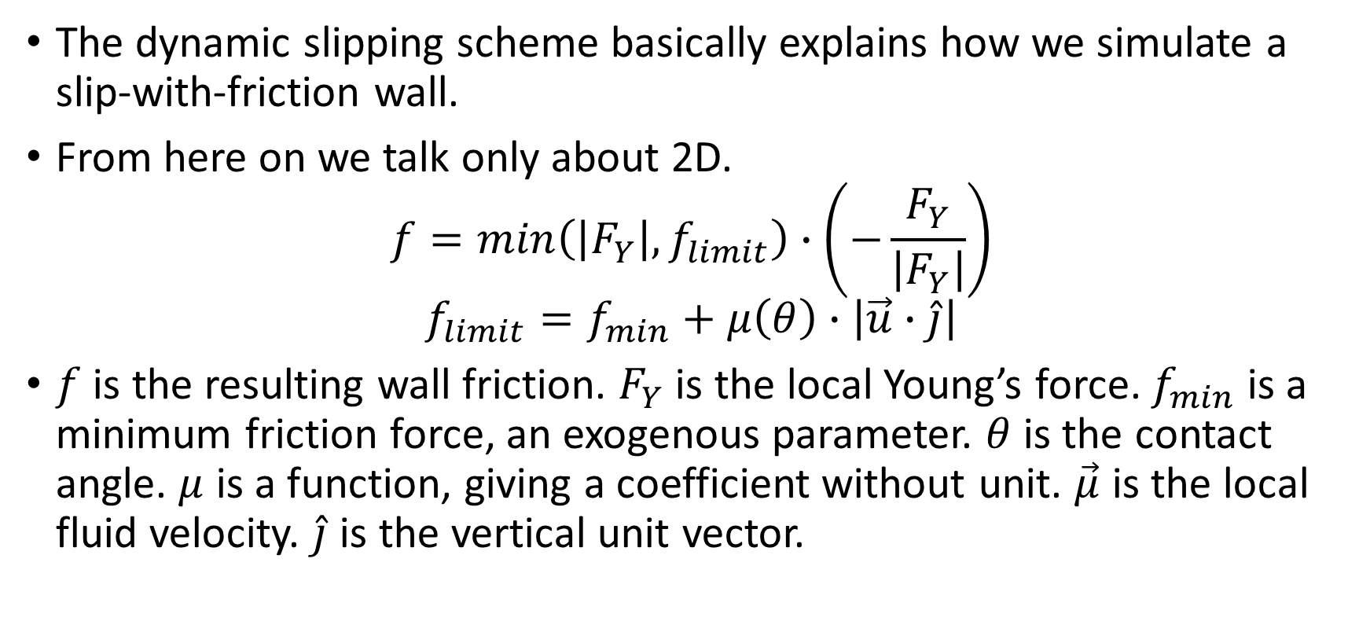
The macroscopic model
The dynamic slipping scheme basically explains how we simulate a slip-with-friction wall.
From here on we talk only about 2D.
$$f=min\left(\left|F_{Y}\right|, f_{limit}\right)∙\left(−\frac{F_{Y}}{\left|F_{Y}\right|}\right)$$
$$f_{limit}=f_{min}+μ\left(θ\right)∙\left|\vec{u}∙\hat{j}\right|$$
$f$ is the resulting wall friction. $F_{Y}$ is the local Young’s force. $f_{min}$ is a minimum friction force, an exogenous parameter. $θ$ is the contact angle. $μ$ is a function, giving a coefficient without unit. $\vec{μ}$ is the local fluid velocity. $\hat{j}$ is the vertical unit vector.

Slide 16
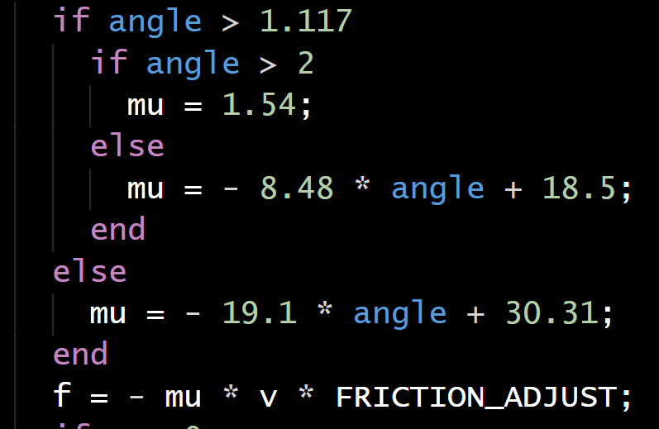
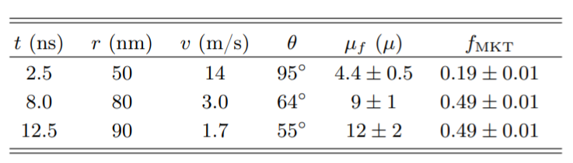

$$μ\left(θ\right)$$
This function computes the friction coefficient given the contact angle.
It is based on a regression of results yielded in the 2018 molecular simulations.

Slide 17
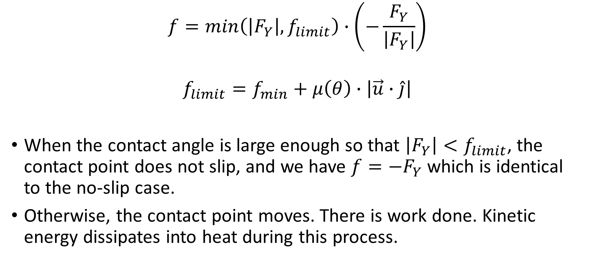
Macroscopic behaviors
$$f=min\left(\left|F_{Y}\right|, f_{limit}\right)∙\left(−\frac{F_{Y}}{\left|F_{Y}\right|}\right)$$
$$f_{limit}=f_{min}+μ\left(θ\right)∙\left|\vec{u}∙\hat{j}\right|$$
When the contact angle is large enough so that $\left|F_{Y}\right|<f_{limit}$, the contact point does not slip, and we have $f=−F_{Y}$ which is identical to the no-slip case.
Otherwise, the contact point moves. There is work done. Kinetic energy dissipates into heat during this process.

Slide 18
The corresponding numerical method
It is well known that a no-slip wall can be simulated as an array of markers with the penalty method.
To simulate a dynamic slipping wall, we use what we call the incur-redeem-dismiss penalty method. In this view, the baseline penalty method would be an incur-redeem penalty method.
 | Used for | Incur? | Redeem? | Dismiss?
Baseline penalty method | No-flux no-slip wall | Yes | Yes | No
Ours | No-flux slip-with-friction wall | Yes | Yes | Yes

Slide 19
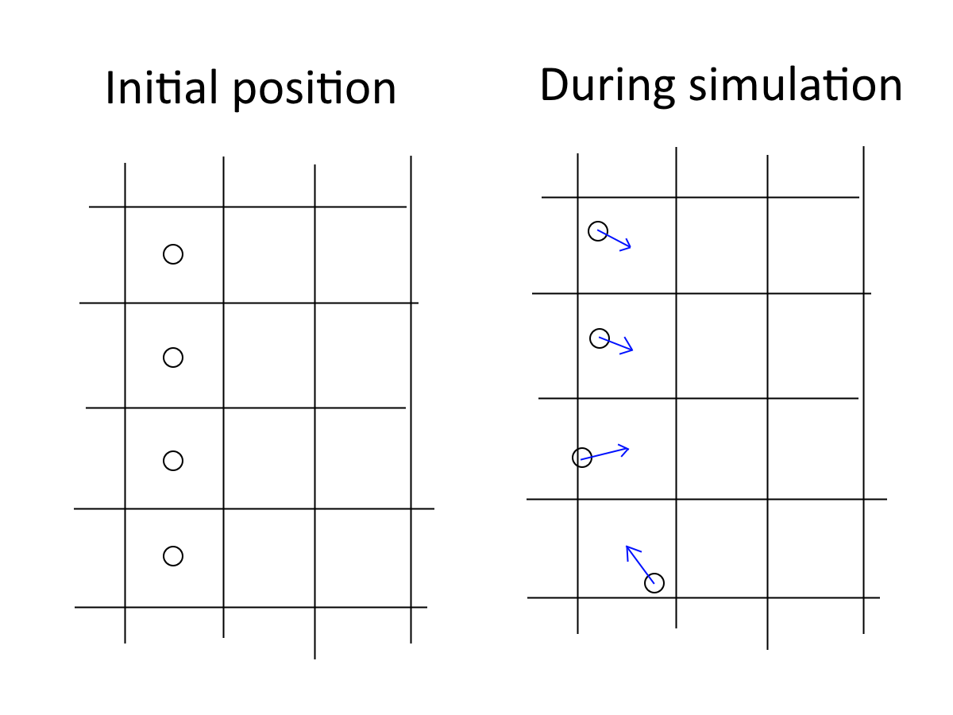
Baseline penalty method for no-slip wall
Represent the wall with an array of markers. They follow the fluid flow.
As they move away from their initial location, penalty is incurred.
A penalty force is applied.
The penalty will never be fully redeemed until a marker return to its correct location.
This guarantees no-flux and no-slip.

Slide 20
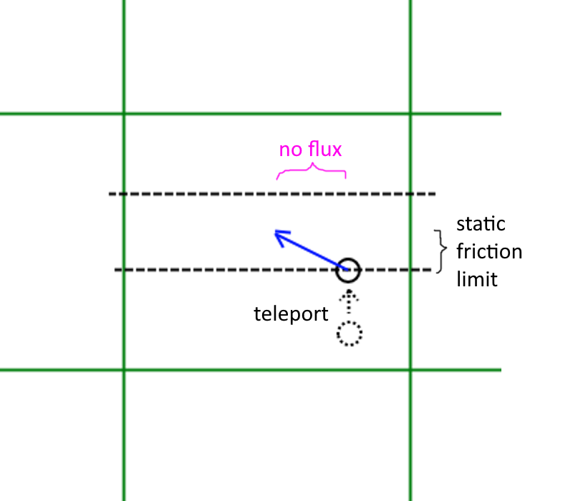
Incur-redeem-dismiss
Previously: Fluid flow incurs penalty. Fluid flow redeems penalty.
Now we introduce another way penalty can decrease: dismissal. No fluid flow is involved. Penalty is instantly decreased within a timestep by “teleporting” the marker.
The amount of penalty dismissed, multiplied by friction force, gives the work done, i.e. the amount of heat dissipation.

Slide 21
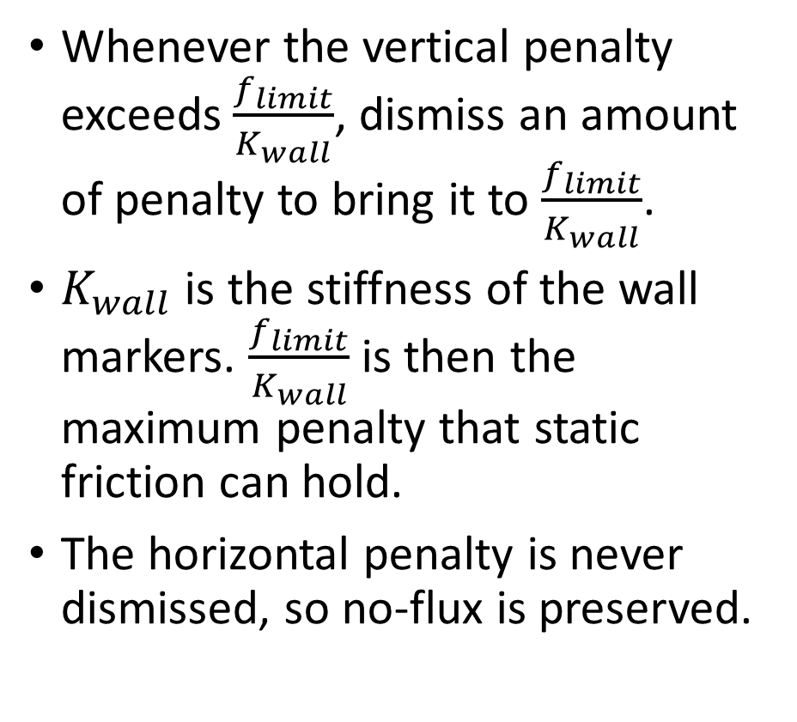
Incur-redeem-dismiss
Whenever the vertical penalty exceeds $\frac{f_{limit}}{K_{wall}}$, dismiss an amount of penalty to bring it to $\frac{f_{limit}}{K_{wall}}$.
$K_{wall}$ is the stiffness of the wall markers. $\frac{f_{limit}}{K_{wall}}$ is then the maximum penalty that static friction can hold.
The horizontal penalty is never dismissed, so no-flux is preserved.

Slide 22
[put pseudo code into paper here?]

Slide 23
Results
Show some plots.
Wait for Daniel to make those.

Slide 24
Problems
Volume conservation

Slide 25
References for this ppt
Molecular Origin of Contact Line Friction in Dynamic Wetting. Johansson and Hess. 2018.

