Slide 1
Joint Embedding Predictive Architecture?
Dan, 4/16/2022

Slide 2
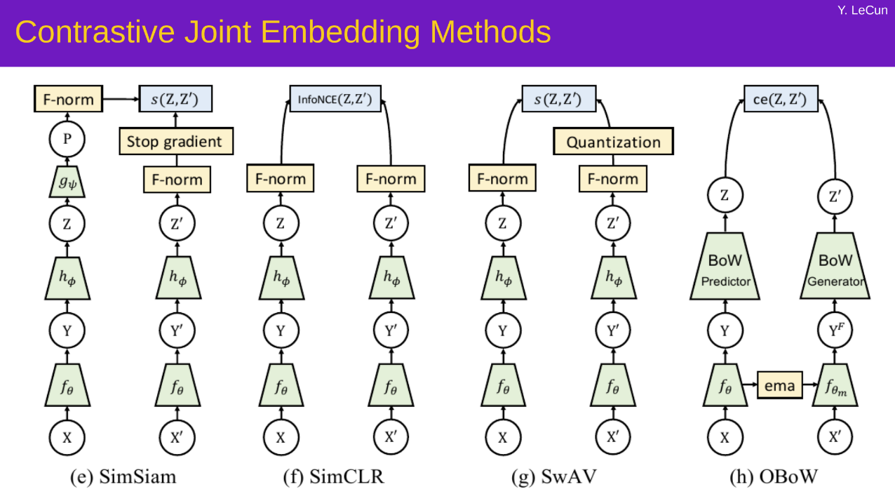
Slide stolen from Yann
Today we focus on time sequence.

Slide 3
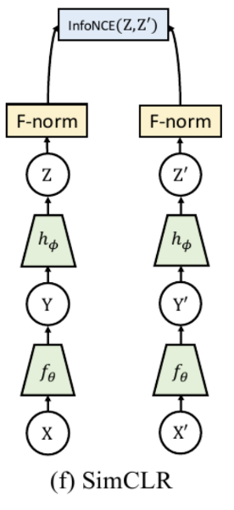
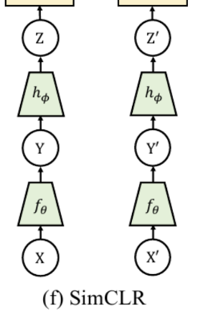
Slide stolen from Yann
Reconstruct x
(目前的小球实验)
Contrastive JEM
JEPA

Slide 4
Why JEM instead of reconstruction?
No need to reconstruct irrelevant details.
When there are two balls, which one is which?
If you want to predict z, this question needs to be answered.
However, JEM does not need to answer this question.
(ball A, ball B) - (ball B, ball A) can have low energy.
JEM 的 critic 的输入可以是整体序列。“最小作用量” principle of least action

Slide 5
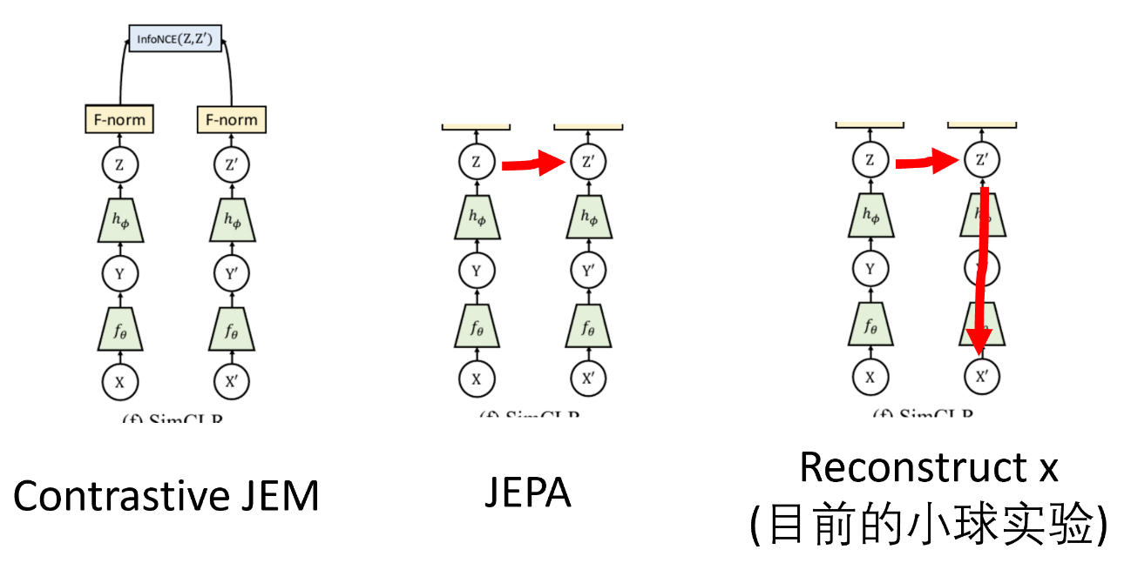
Prevent collapse?
Negative z pairs or z sequences.
Draw from dataset
GAN
Predict z, and
Reconstruct x
VICREG
Adversarial VAE (Dan’s proposal)

Slide 6
Negative pairs
Good negative pairs are hard to generate, and in high dimensions they can’t fill the ideally-high-energy space.
Yann: We want to avoid having to rely on negative pairs. Regularized JEM is better than contrastive JEM.

Slide 7
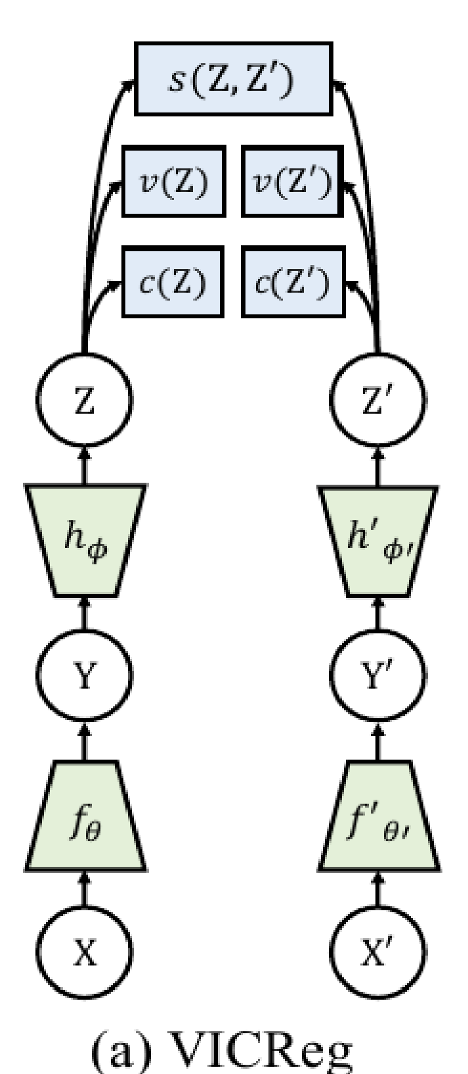
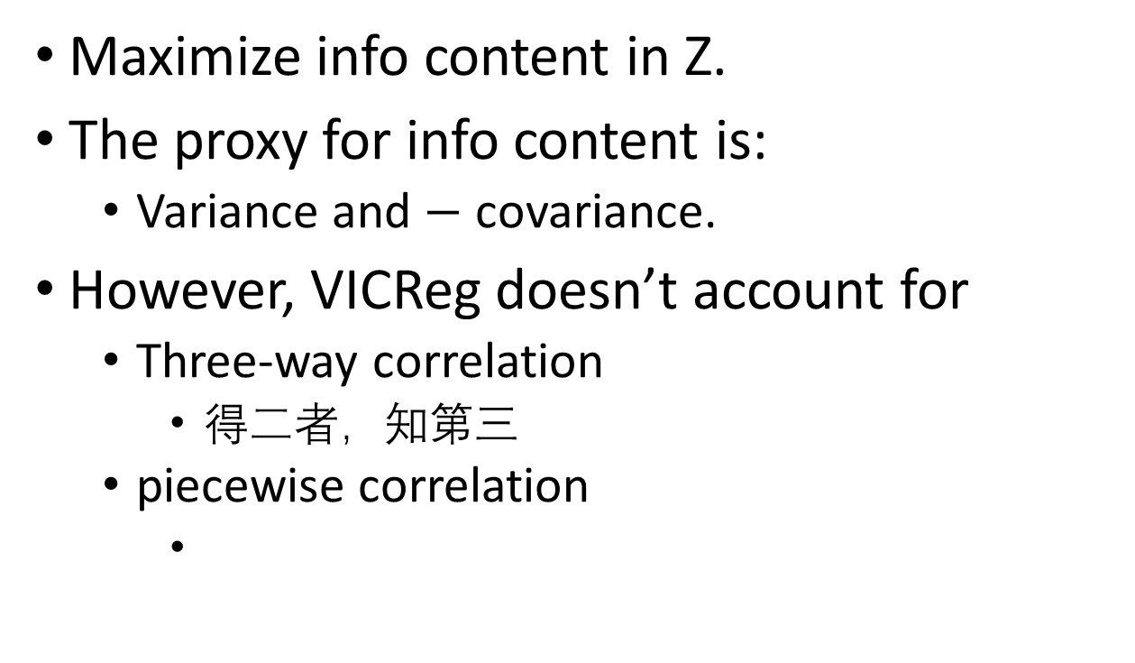
VICReg
Maximize info content in Z.
The proxy for info content is:
Variance and $−$ covariance.
However, VICReg doesn’t account for
Three-way correlation
得二者，知第三
piecewise correlation

Slide 8
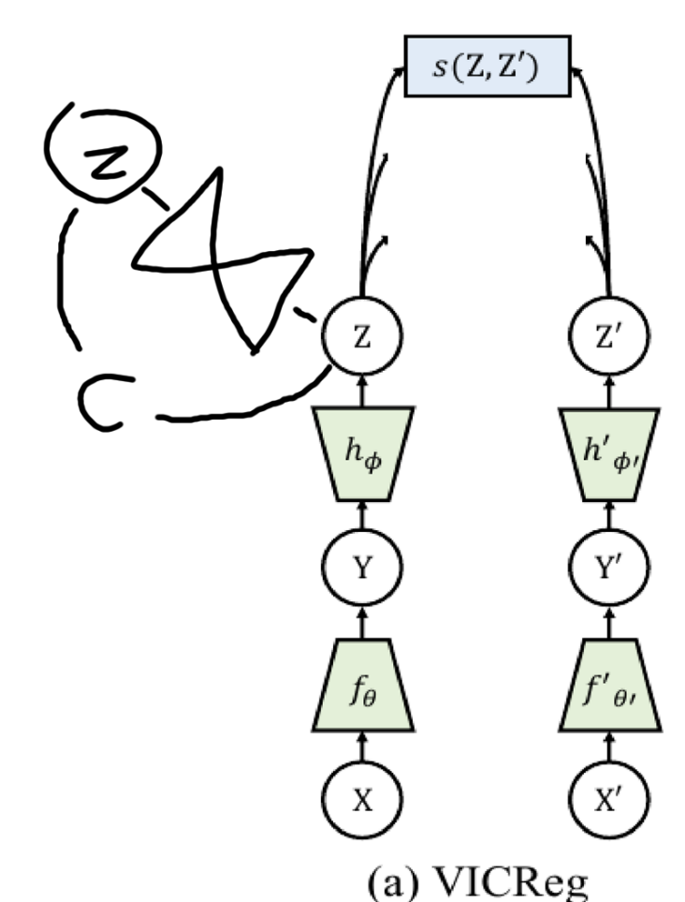
Adversarial VAE
Train a VAE to encode z. VAE’s loss is c.
Add - c to the loss of the x encoder!
Objective: to let z contain at least as much information as the VAE’s bottleneck.
解决的是 three-way 和 piece-wise. 初衷是： NN 作弊只能由 NN 监视解决。

Slide 9
Notes from the future
如果要用作用量进行试验， negative example 先用 random z seq from Gaussian 就好。 说不定加了对称性就能 work. 不然，再加 GAN 等等。

