Slide 1
Joint embedding?
Dan, 4/16/2022

Slide 2
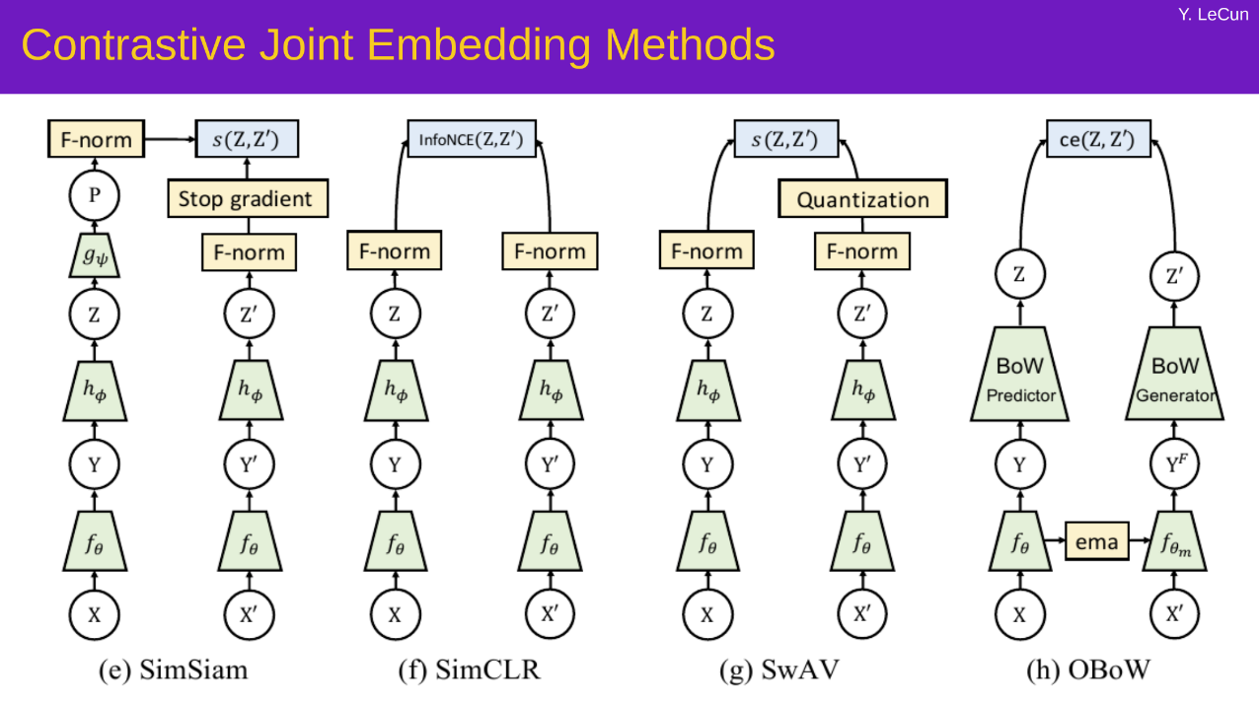
Slide stolen from Yann

Slide 3
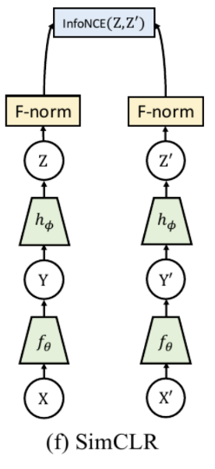
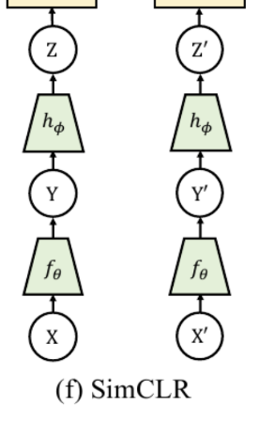
Slide stolen from Yann
Reconstruct x
(目前的小球实验)
JEM
Predict z

Slide 4
Why JEM instead of reconstruction?
No need to reconstruct irrelevant details.
When there are two balls, which one is which?
If you want to predict z, this question needs to be answered.
However, JEM does not need to answer this question.
(ball A, ball B) - (ball B, ball A) can have low energy.
JEM 的 critic 的输入可以是整体序列，或者跳步。“最小量纲”

Slide 5
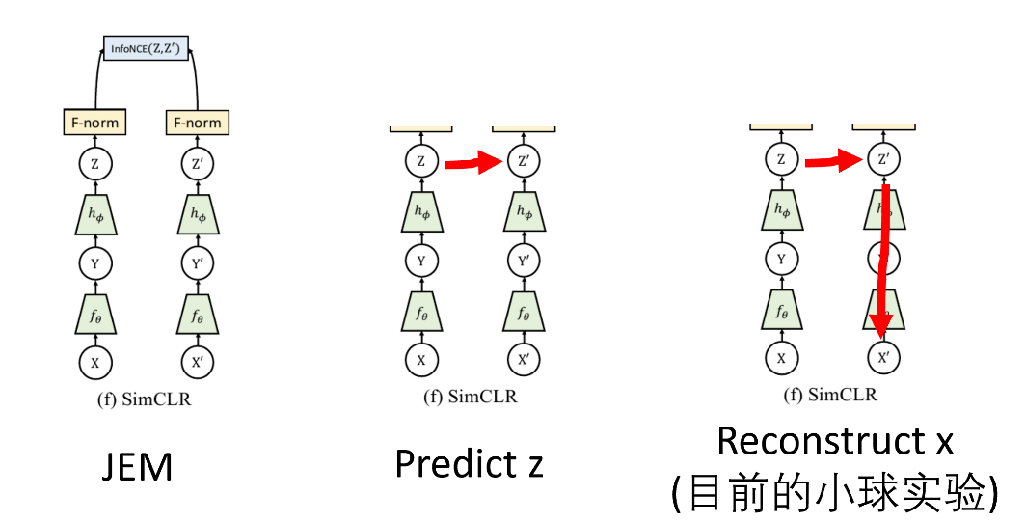
Predict z?
Don’t predict z.
We will need negative pairs of z.
Predict z.
Keep RNN.
How to prevent collapse?
Reconstruct x
GAN
VICREG
Adversarial VAE (Dan’s proposal)

Slide 6
Negative pairs
Good negative pairs are hard to generate, and in high dimensions they may not fill the ideally-high-energy space.
Yann: We want to avoid having to rely on negative pairs. Regularized JEM is better than contrastive JEM.

Slide 7
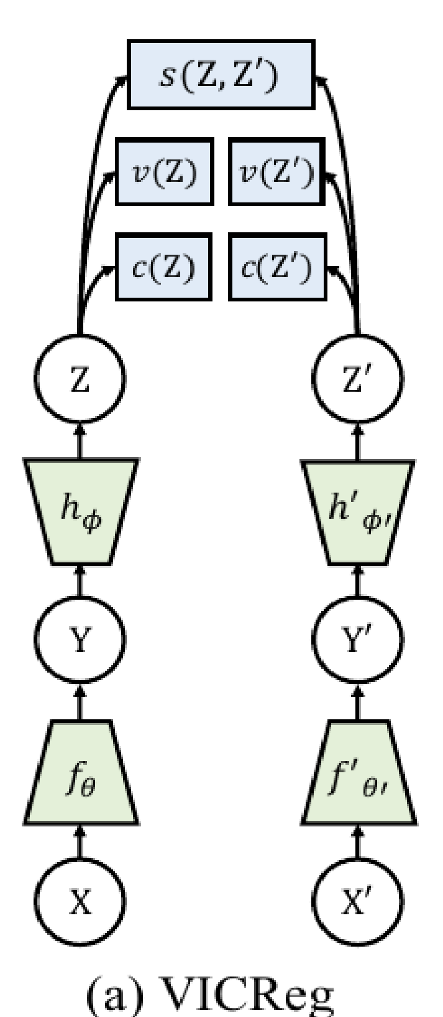
VICReg
Maximize info content in Z.
The proxy for info content is:
variance – covariance.
However, VICReg doesn’t account for
Three-way correlation
piecewise correlation

Slide 8
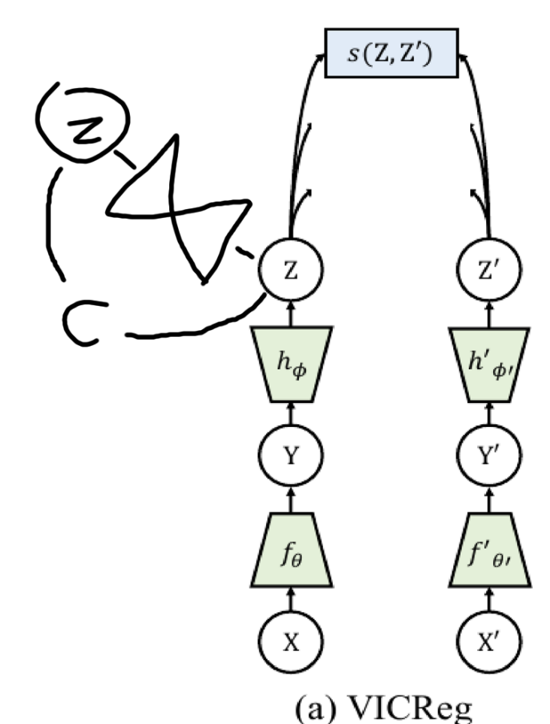
Adversarial VAE
Trian a VAE to encode z. VAE’s loss is c.
Add - c to the loss of the x encoder!

