Slide 1
PROJECT GRAPHICS & BENCHMARK METRICS: WIRELESS V2I COMMUNICATION PROTOCOLS FOR DRIVER ASSISTANCE
INCLUDES: BLOCK DIAGRAM & FLOW CHART
BY: CONOR POWER, DANIEL COLLINS., SCOUT CASE, JAMES TOMPKINS

Slide 2

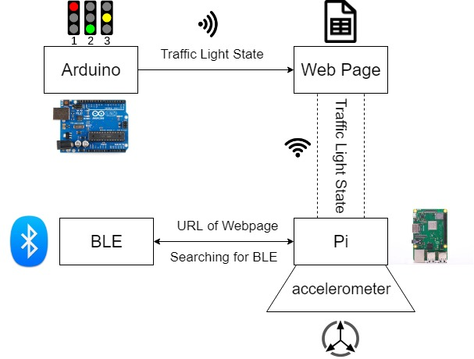
BLOCK DIAGRAM:
The Arduino pushes the traffic light state to a web page via Wi-Fi.
The Raspberry Pi, connected to the vehicle, reads the state from the web page.
BLE on traffic light establishes a connection with the Pi and sends URL of web page.
Pi and accelerometer communicate to decide on action to take i.e. slow down, stop or continue ahead.

Slide 3

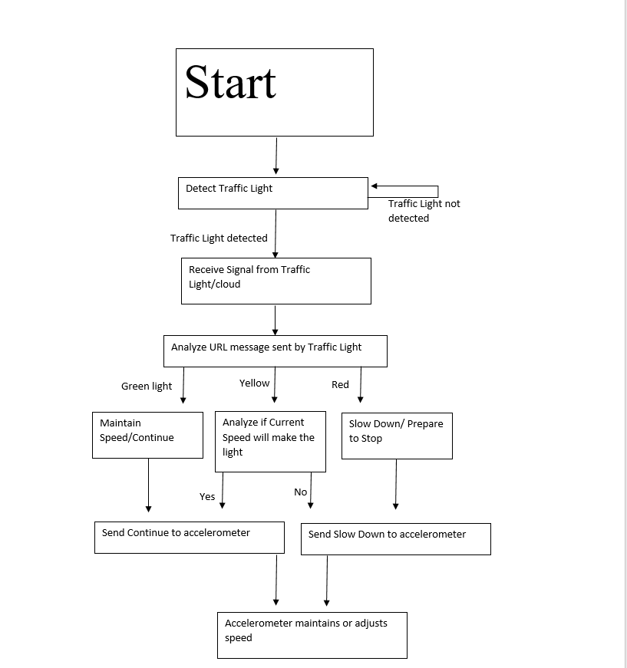
FLOWCHART:
If traffic light is not detected, Raspberry Pi keeps searching.
When signal is detected, Raspberry Pi reads website URL from BLE beacon.
Depending on traffic light state and vehicle speed, the vehicle will slow down/stop or continue ahead.
An accelerometer will be used to maintain or adjust the vehicle speed.

Slide 4
BENCHMARK METRICS: EVALUATION OF SUCCESS/FAILURE
Success and/or failure of this project will be evaluated by our ability to achieve our set goals and our ability to overcome our anticipated challenges.
Our goals are to: (i) Evaluate the usefulness of Bluetooth as a V2I communication protocol and to highlight its strengths and weaknesses, (ii) To limit the time taken to complete the handshake protocol and (iii) To implement an accelerometer onboard an RC car which will measure acceleration and the signal motors depending on what action is needed.
Our anticipated challenges are: (i) Designing the Arduino circuit, (ii) Hosting the traffic light state data on a live web page, (iii) Sending beacons containing the URL to the Pi, (iv) Interpreting the data from the web page on the Raspberry Pi, (v) Constructing an RC car with motors and an accelerometer and (vi) Using the data to send messages to the driver and stop or slow down the motors if necessary.

Slide 5

EVALUATING OUR GOALS:
Our first and second goals, evaluating the usefulness of Bluetooth as a V2I communication protocol and to circumvent or limit the time-consuming effect of the handshake protocol, can be evaluated as a success or failure by the ability of our Raspberry Pi to first establish a connection and lastly to connect to the web page.

Slide 6

EVALUATING OUR GOALS:
Our final goal, to successfully implement an accelerometer onboard an RC car which will measure the acceleration of the vehicle and to then slow down or stop the motors in the RC car in accordance with the state of the traffic lights, is a more complex additional goal. The success of this goal can be evaluated by our ability to create a link between the motors, accelerometer and Raspberry Pi. This link should allow the accelerometer to feed data to the Pi and allow the Pi to signal the motors to stop or slow down.

Slide 7

EVALUATING OUR ANTICIPATED CHALLENGES:
Designing our Arduino circuit – We must design an Arduino programme that acts as a traffic light changing periodically between red, amber and green states.
Hosting the traffic light state data on a live web page – The data from the traffic light programme on the Arduino must be sent to a live web page and hosted there for future reading by the Raspberry Pi onboard the vehicle.

Slide 8
EVALUATING OUR ANTICIPATED CHALLENGES:
Send beacons containing the URL to the Pi – Depending on the beacon protocol used the amount of bytes sent in the beacon will vary. The URL will be embedded into the beacon which is constantly searching for a recipient. The Pi will simultaneously search for a Bluetooth device and try to load the URL if it receives the Bluetooth beacon.
Interpreting the data from the web page on the Raspberry Pi – Once the connection is established, our next challenge will be to automate the process of the Pi reading and interpreting the traffic light data hosted on the web page.

Slide 9
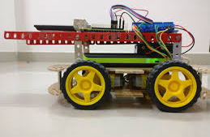
EVALUATING OUR ANTICIPATED CHALLENGES:
Constructing an RC car with motors and an accelerometer – In order to test if the rest of our project works we will attempt to construct a sample vehicle with motors to move it and an accelerometer measuring acceleration. The motors will be signaled to act depending on the state of the traffic light.
Using the data to send messages to the driver and stop or slow down the motors if necessary – The challenge here will be to inform the driver of what is happening or and then stop the motors safely.

