Slide 1
Secure Data Hiding in Image Using Steganography
CAPSTONE PROJECT
Presented By:
Student Name : DANIEL JABARAJ V
College Name & Department : As-Salam College of Engineering and Technology & CSE

Slide 2
OUTLINE
Problem Statement
Technology used
Wow factor
End users
Result
Conclusion
Git-hub Link
Future scope

Slide 3
Problem Statement
In today's digital age, the need for secure communication and data protection is paramount. Traditional encryption methods, while effective, are often easily detectable. There is a growing demand for techniques that ensure data confidentiality without raising suspicion. The objective of this project is to develop a secure method for hiding sensitive data within digital images using steganography, making the existence of the hidden data undetectable to unauthorized individuals.

Slide 4
Technology used
Programming Language: Python
Libraries:
OpenCV library for image processing.
os library in Python provides a way to interact with the operating system.
string library provides useful tools for handling and manipulating strings.
Algorithms:
Least Significant Bit (LSB) for embedding data into images.
Advanced Encryption Standard (AES) for data encryption before embedding.
Tools:
Integrated Development Environment (IDE): PyCharm/Visual Studio Code/Spyder( Use in this project ).
Version Control: GitHub.

Slide 5
Wow factors
Invisibility: The hidden data is imperceptible to the human eye, maintaining the visual integrity of the cover image.
Double Security: Combines encryption and steganography, ensuring data remains secure even if detected.
Cross-Platform: Compatible with multiple operating systems (Windows, macOS, Linux).

Slide 6
End users
This project targets individuals and organizations that require confidential communication, such as:
Journalists working in hostile environments.
Government agencies needing secure data exchange.
Corporate sectors safeguarding trade secrets.
Individuals concerned about personal privacy.

Slide 7
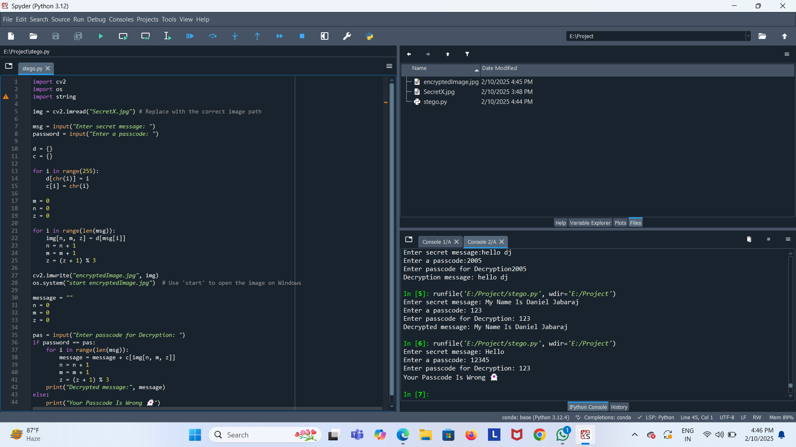

Results

Slide 8
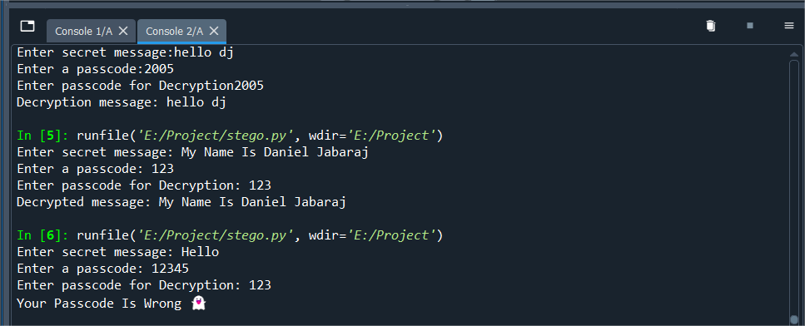
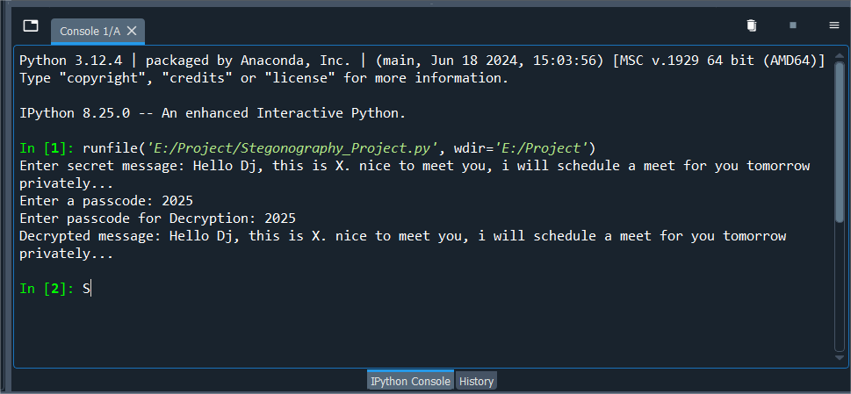
oUTPUt

Slide 9


Original image & Encrypted Image

Slide 10
Conclusion
The "Secure Data Hiding in Images Using Steganography" project successfully addresses the need for covert data protection in the digital realm. By combining steganography with encryption, the project provides a robust solution for secure communication without arousing suspicion.

Slide 11
GitHub Link
Click to View Project in Github: Daniel-Cva/Cyber-Security-Project

Slide 12
Future scope
Enhanced Algorithms: Research and implement more advanced steganographic techniques to increase data capacity and security.
Integration with Cloud Storage: Enable secure storage and retrieval of steganographic images in cloud services.
Real-Time Communication: Develop real-time secure communication systems using steganography.
Mobile Application: Create mobile applications to allow users to hide and retrieve data on-the-go.
Machine Learning: Employ machine learning to detect and prevent unauthorized steganographic attempts.

Slide 13
THANK YOU

