Slide 1
Background
This section of the PowerPoint presentation will introduce the different available datasets and basic things we can tell about Eigg from them

Slide 2
Food webs (2015+ data) & locations
Here is some simple analysis from the Eigg ecological dataset

Slide 3
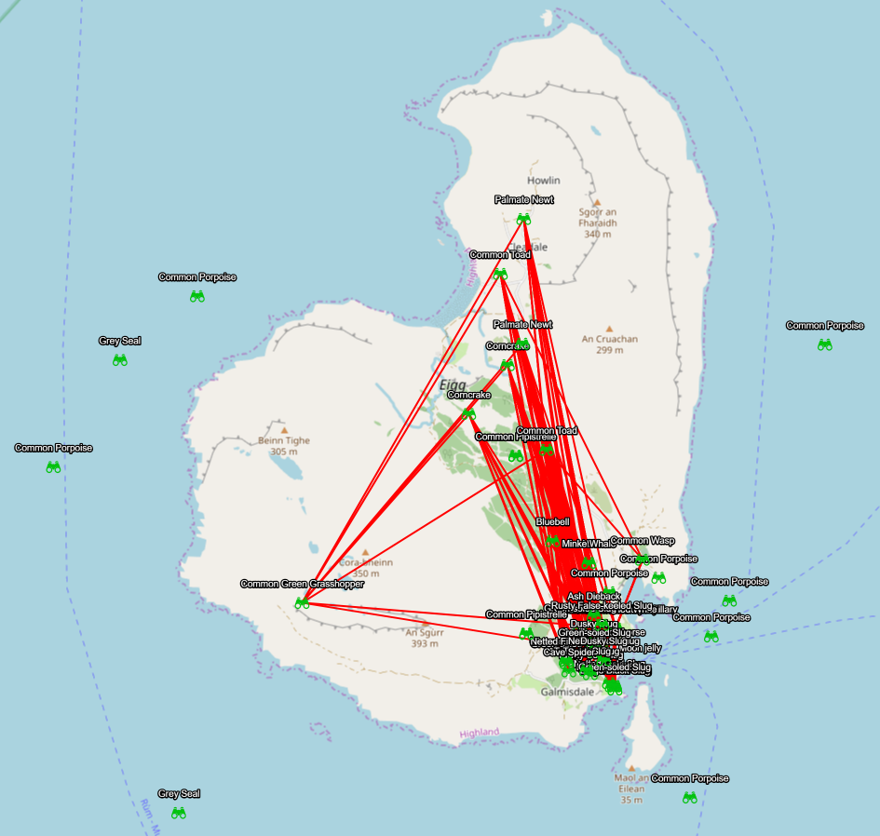
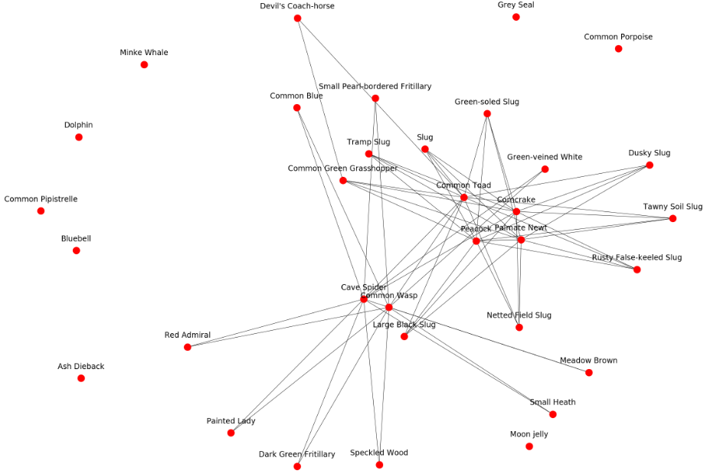
Thresholded values from 2015+, plotted as a food web

Slide 4
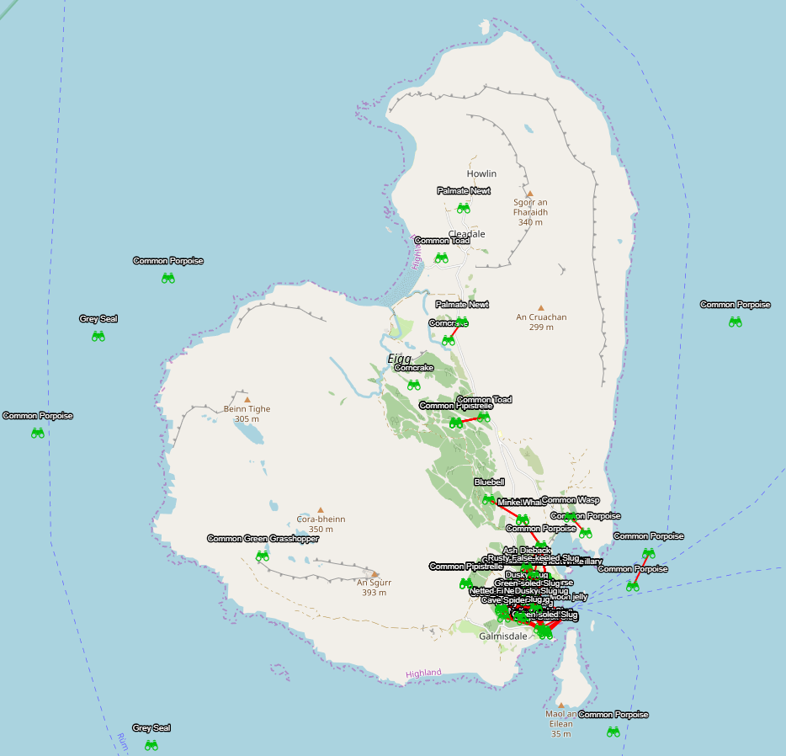
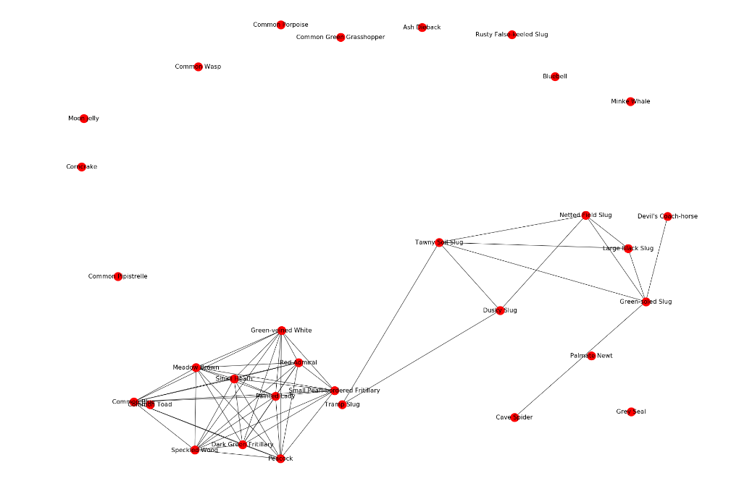
Thresholded values from 2015+, plotted on proximity

Slide 5
Clustering on observations
Where are the observations themselves being made? Idea is to reveal popular points for observation of species on Eigg.

Slide 6
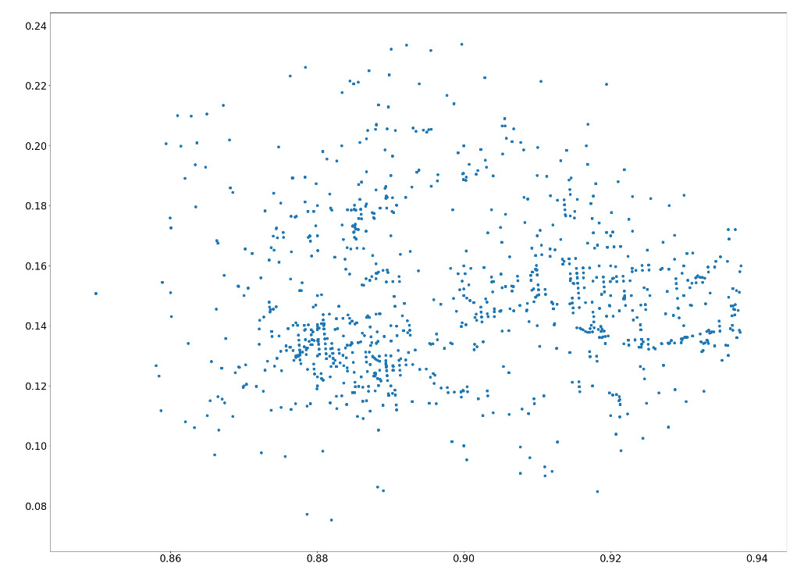
Lat/Lon coordinates (Normalised)

Slide 7
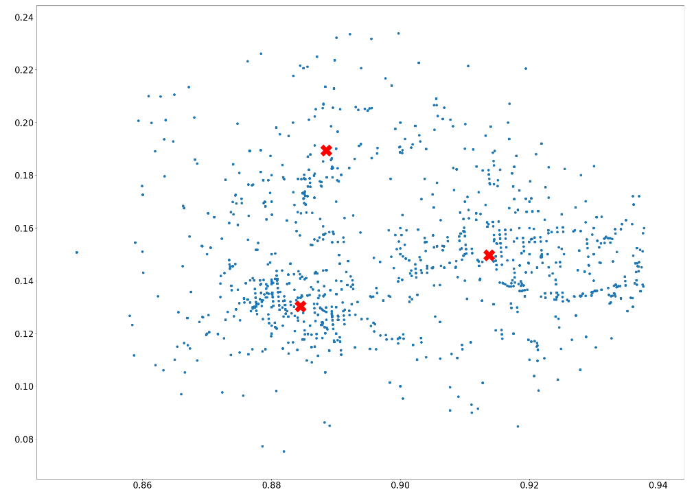
Kind of looks like 3 clusters…

Slide 8
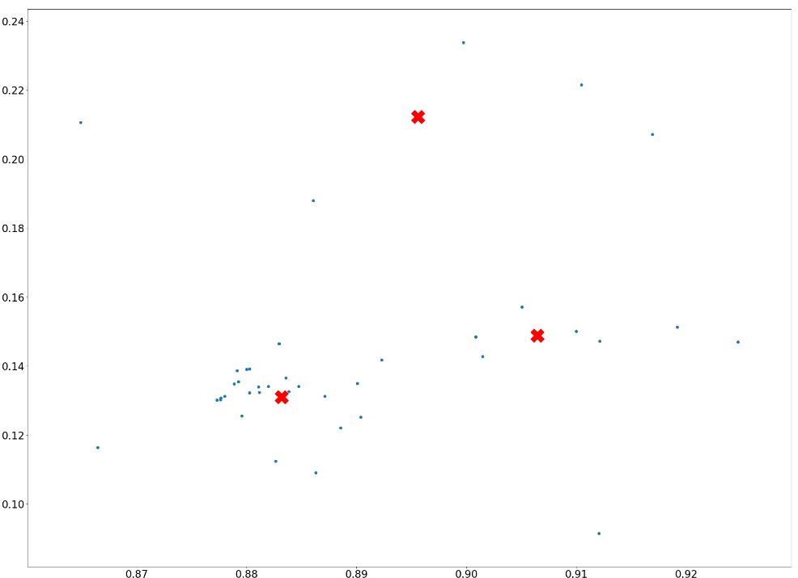
These clusters appear whenever in time you look

Slide 9
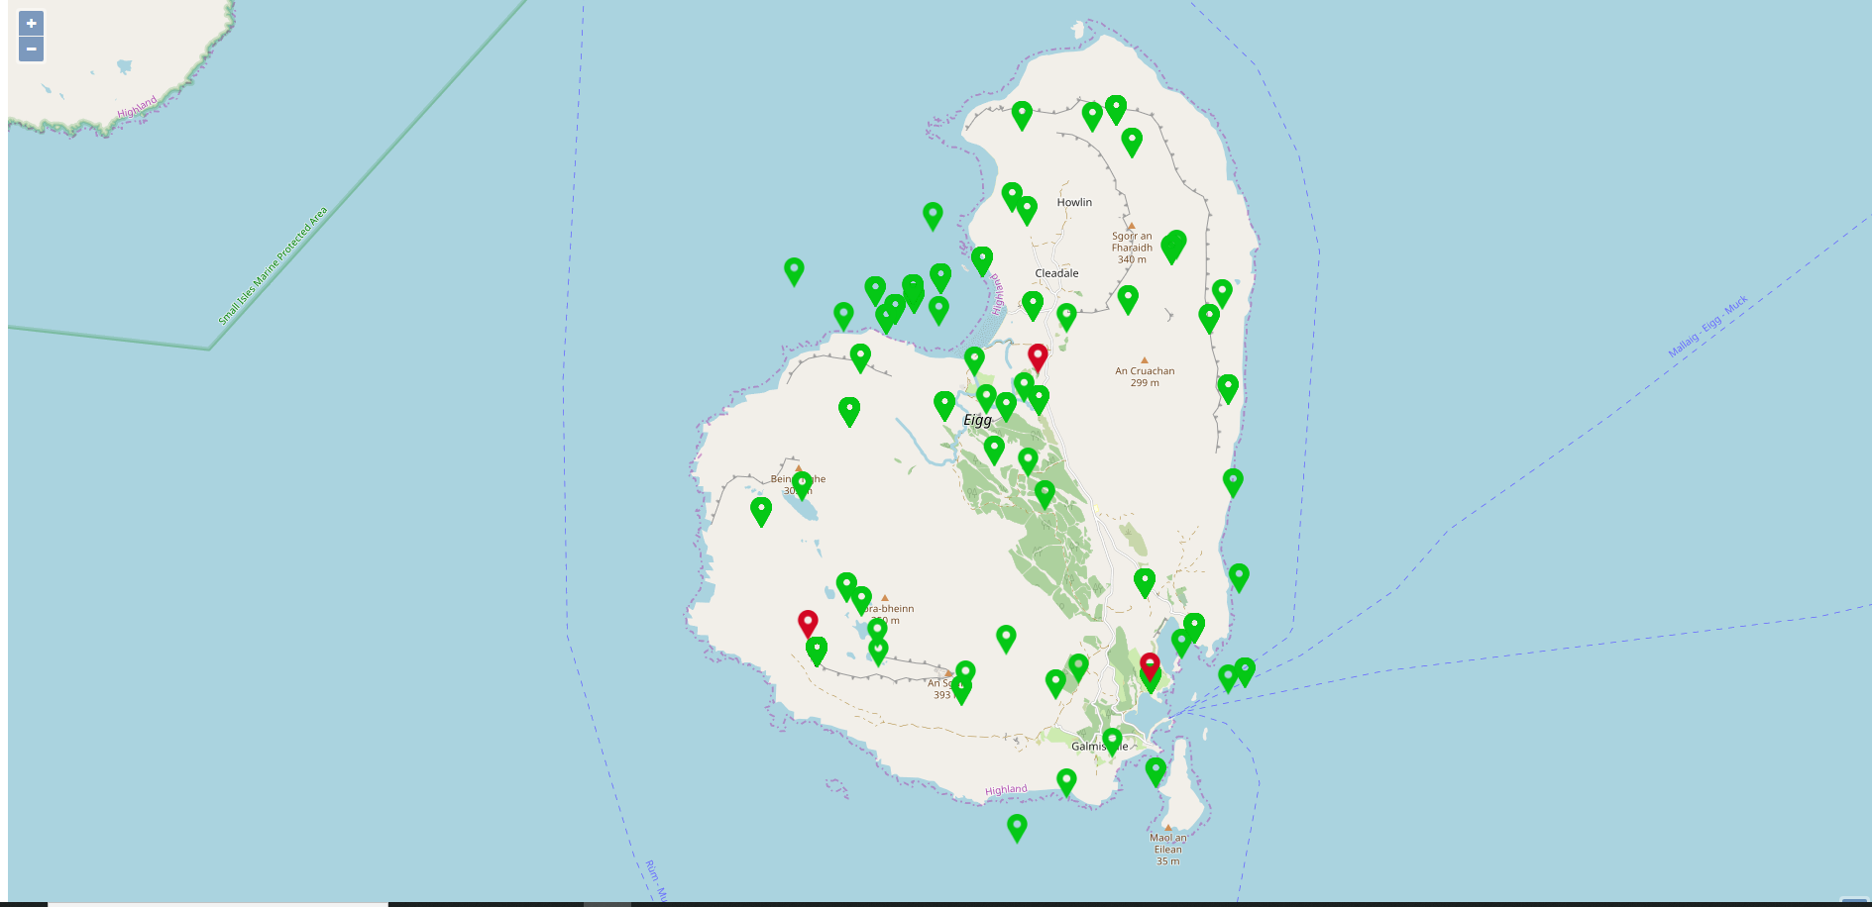
These are the corresponding points of the clusters

Slide 10
Eigg Observers (2015+)
Is there any useful information in who is making the observations?

Slide 11
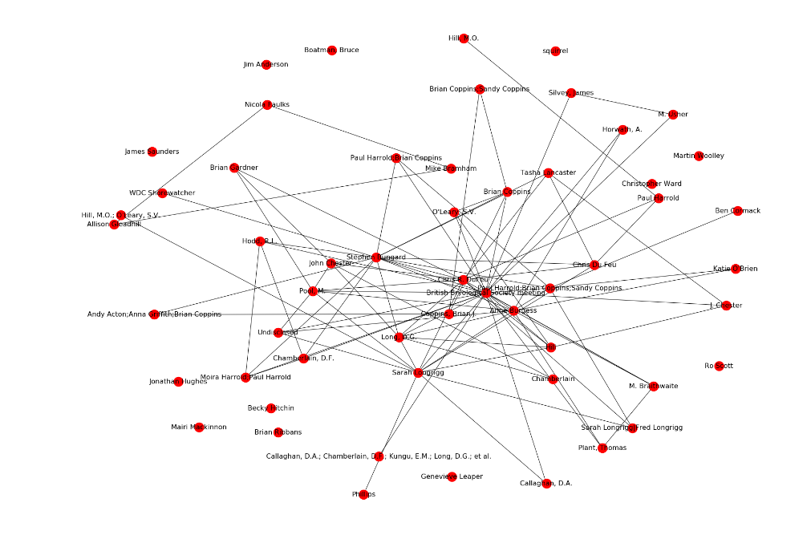
Plots the names in the observations together; an edge represents the names being at a close proximity (100 metres). This is also thresholded for 2010+
{'simon helliwell', 'marie carr’,
'mairi mckinnon’,
'alex boden’,
'stuart millar’,
'katrin bach’,
'john booth’,
'neil robertson', 'kenneth kean’,
'stuart fergusson', 'pascal carr’,
'colin carr’,
'eddie scott'}
The above names are those who are also resident on Eigg. The residents of Eigg contributed to 0% of observatios prior to buyout and to 1% of observations after the buyout.

Slide 12
Hotels & Ratings

Slide 13
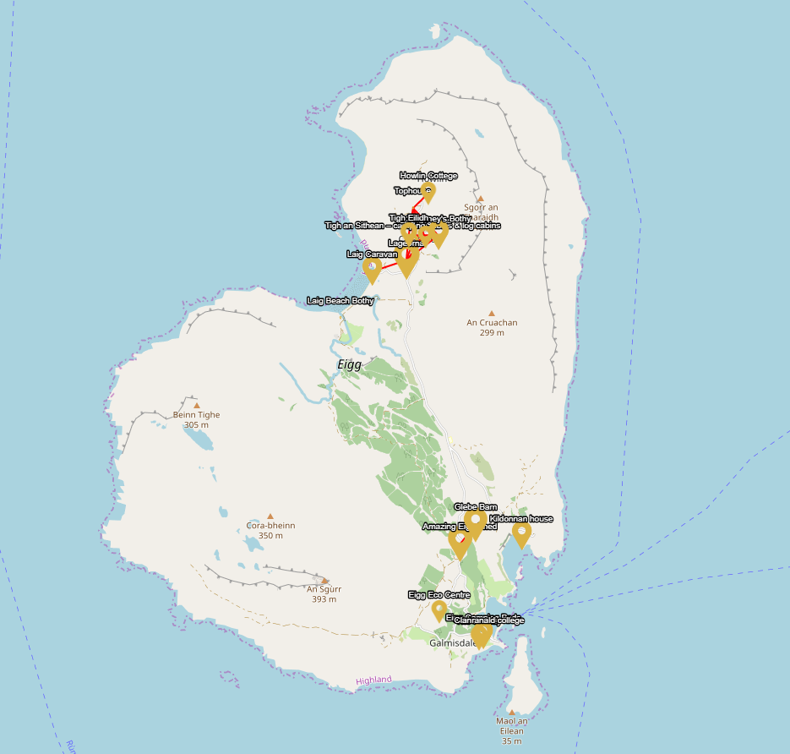
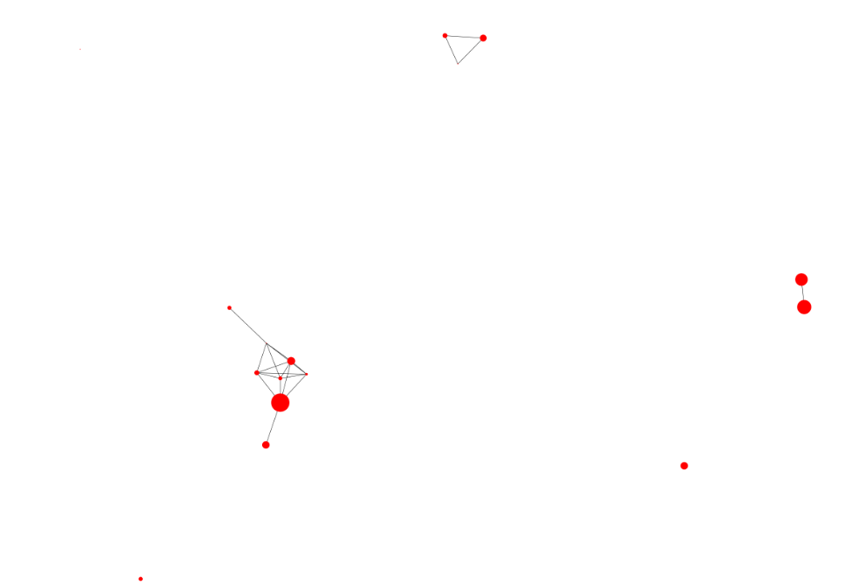
This is more for future reference: soon I will run a model that will give a value on this network as to how the nodal attribute on a hotel, in this case a mixture of ratings from [TripAdvisor, Google Reviews, # Facebook Likes], affects the probability of a link forming => answers whether the best rated hotels cluster together. They clearly don’t on Eigg but potentially in larger cities they would.

Slide 14
Hotels vs Points of Interest
A very “urban planning” question of how well the hotels are serving the points of interest on the island

Slide 15
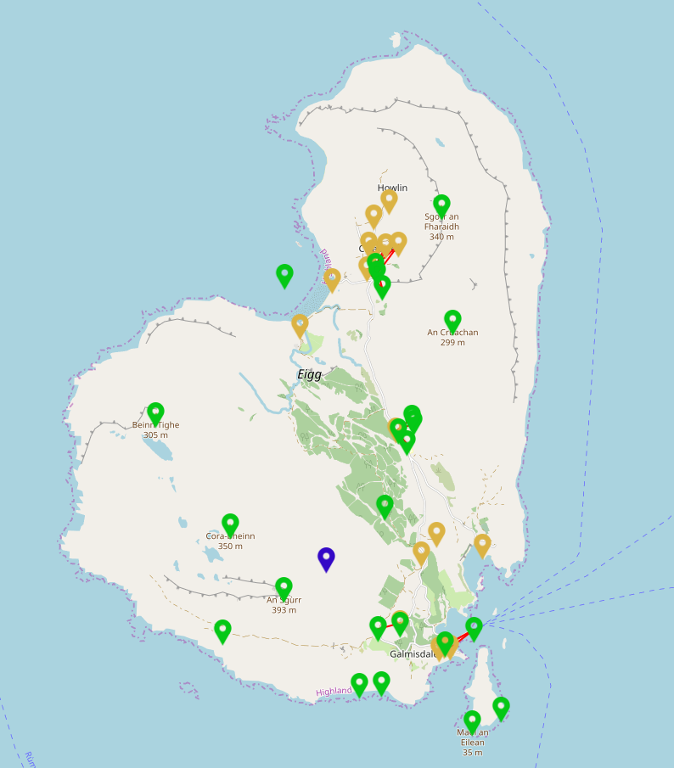
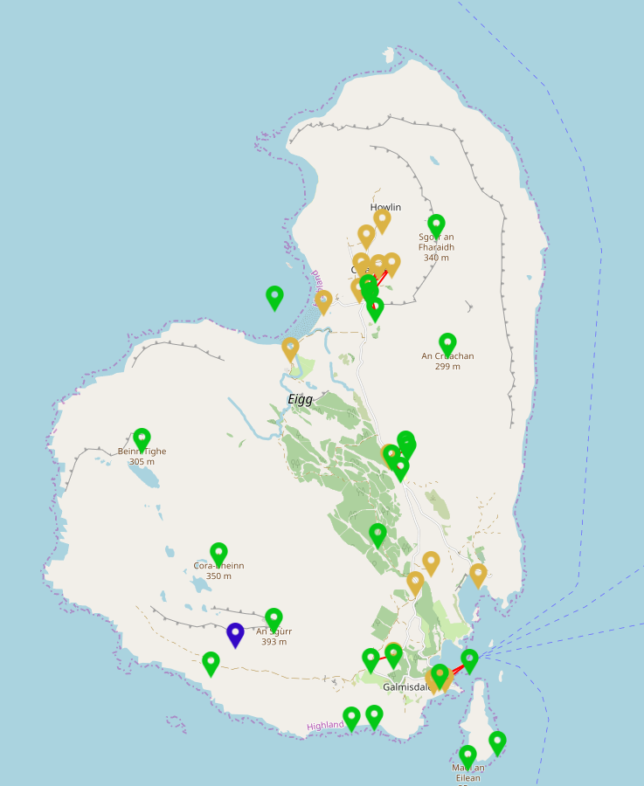
The optimal location is in blue for a new hotel that would minimise distance to unconnected points
The hotel that serves the most possible points directly

Slide 16
Residences vs Hotels
How well do hotels and residences correlate in terms of proximity?

Slide 17
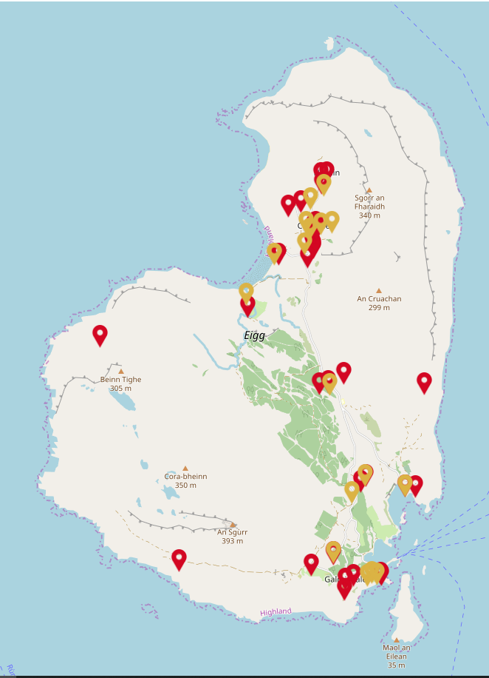
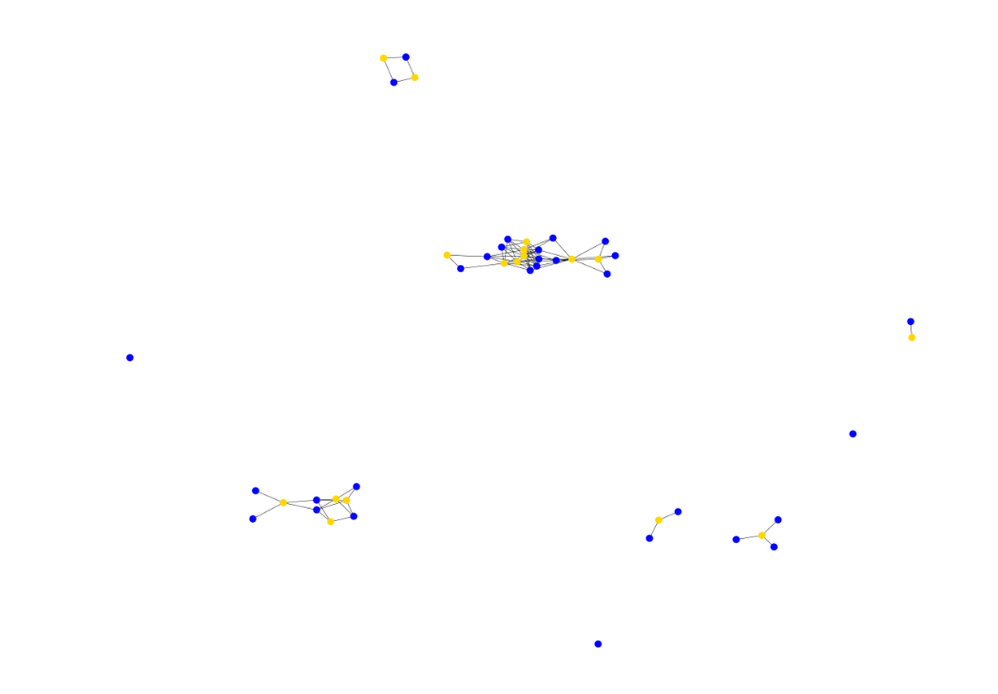
Main 2 clusters correspond to the small towns- Cleadale and Galmisdale

Slide 18
Proximity/density of observations vs residences
How close are the residences to the observations? Do they cluster enough to be problematic to the nature?

Slide 19
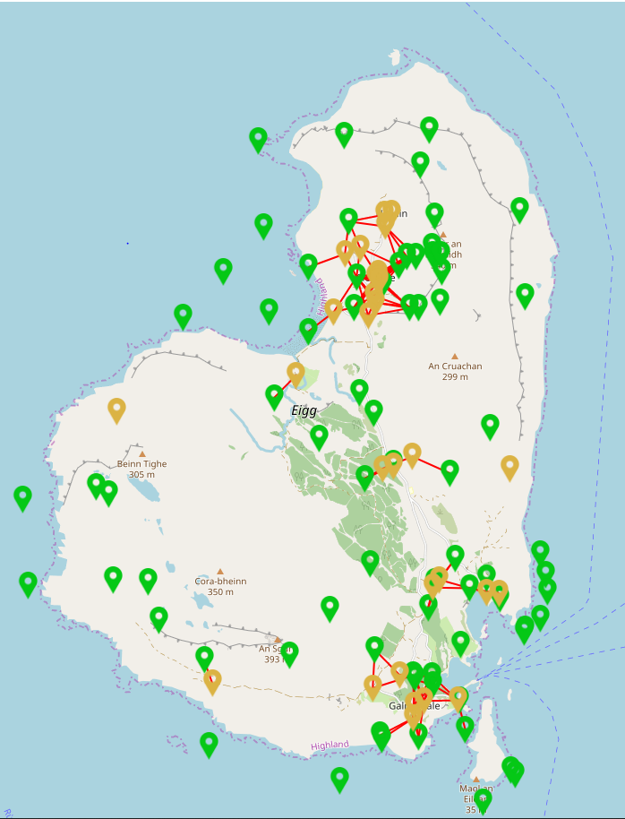
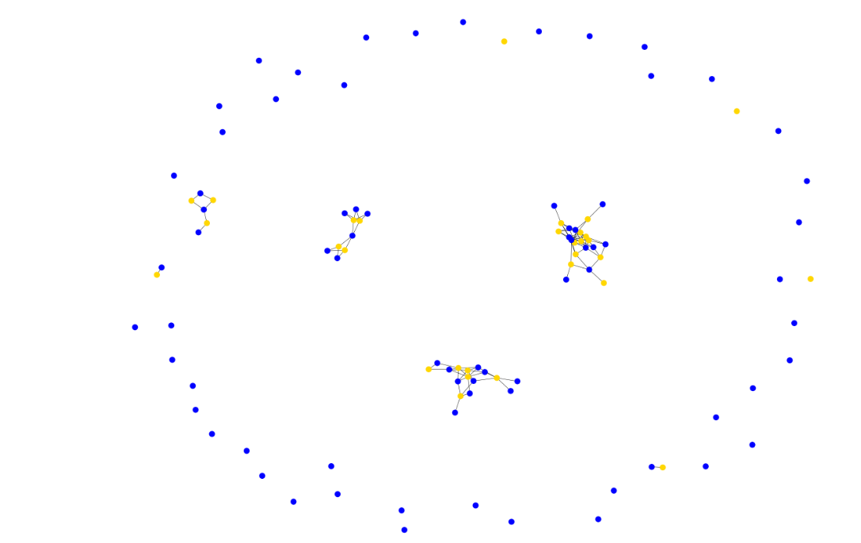
There is a lot of nature that is not in a reasonable proximity of the residences.

Slide 20
Business Ties
The below business network is defined as follows:
Node => Eigg Resident
Edge => Are involved in some kind of mutual business

Slide 21
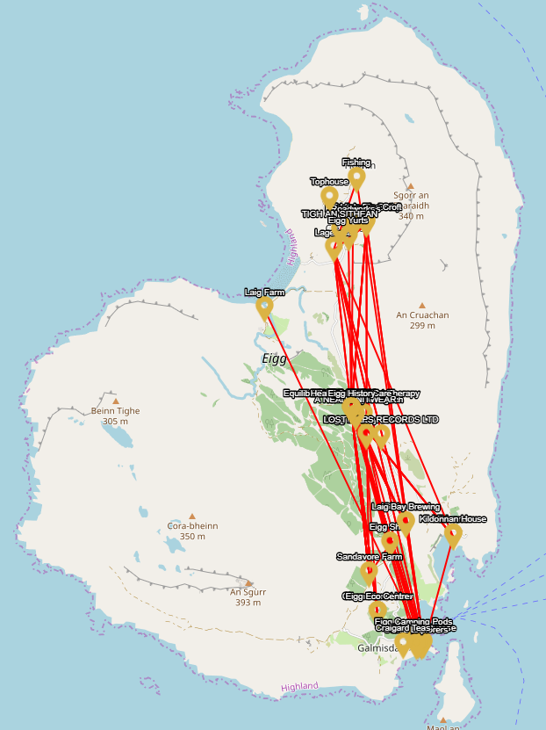
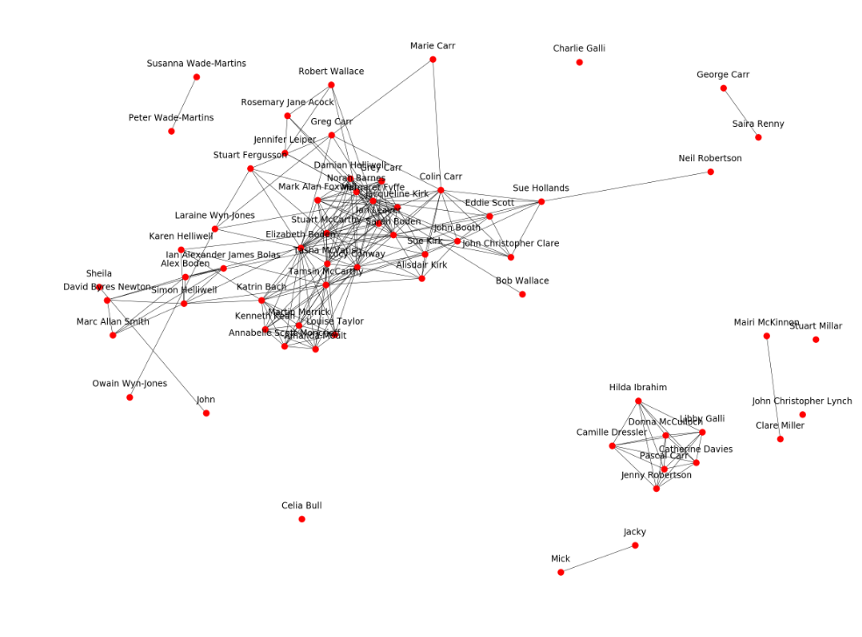
Notice the ~10 key players in the network that are responsible for causing the large component, and the smaller component to the right (essentially people running the craft shop)

Slide 22
Business vs Eco
An example of correlating 2 networks together on the map

Slide 23
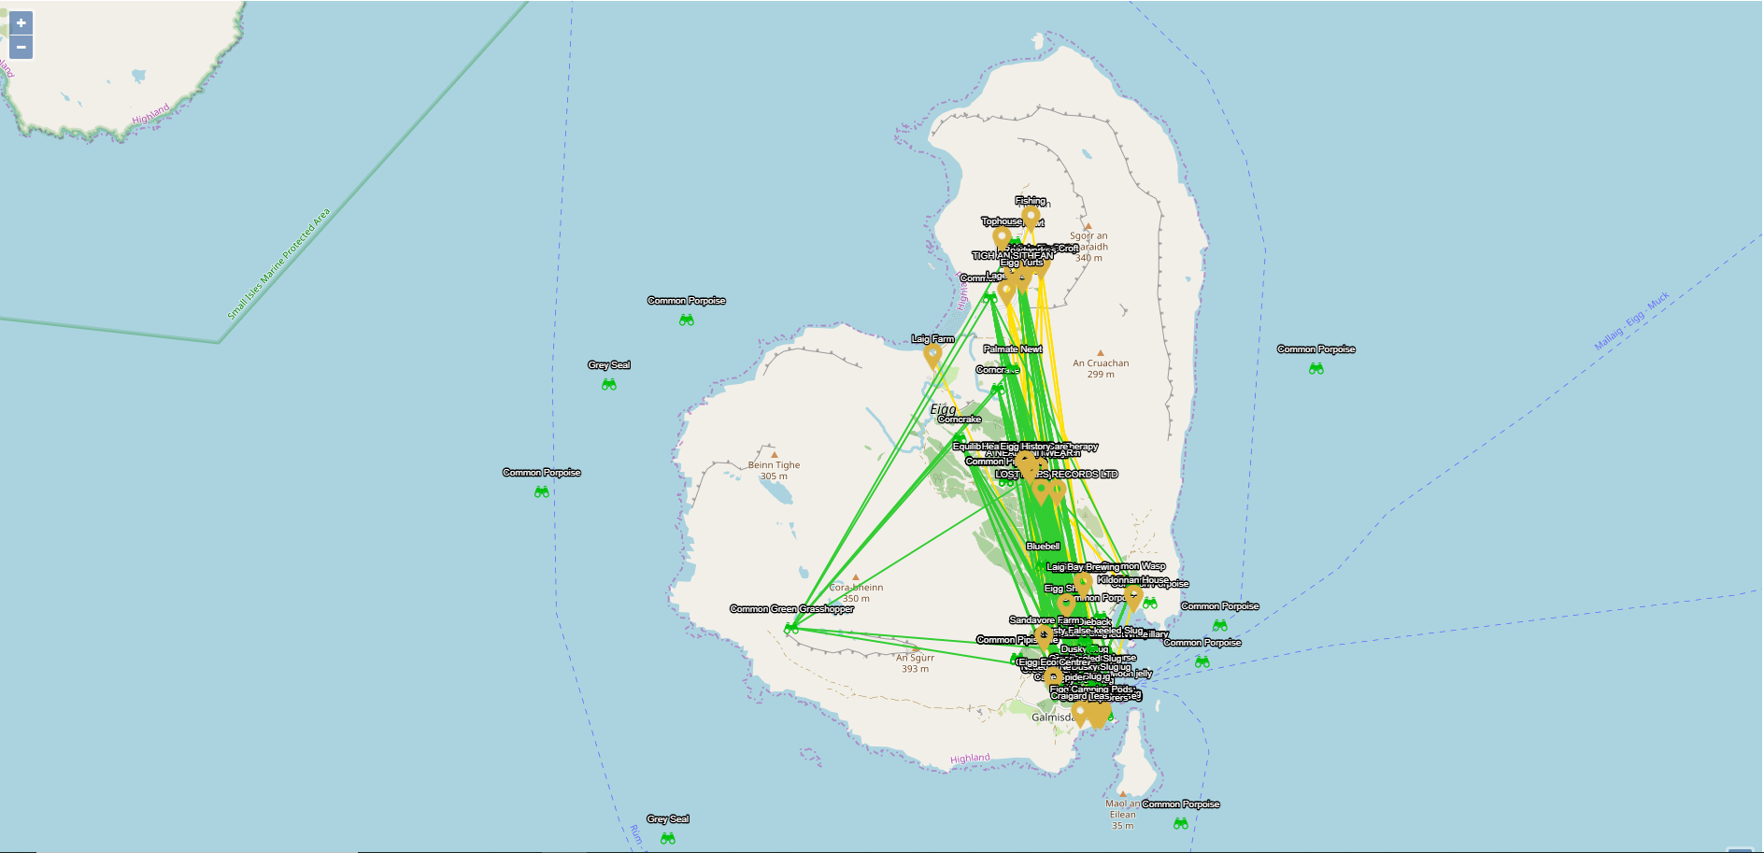
The most interesting thing this chart shows us that most (recent) observations are in the towns, as are all the businesses (as we’d expect)

Slide 24
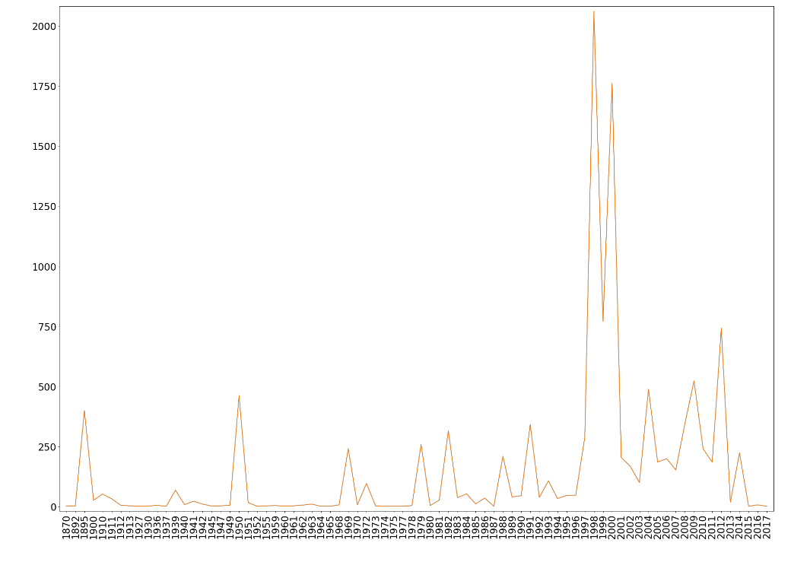
Investigate this?
As per Jane’s suggestion, I will investigate the impact on number of recorded species made by the spike at 1997, and any reasons I can find for it

Slide 25
Modelling
Some preliminary models and inference from the data

Slide 26
Power Grid as a tourist attraction?
How well do hotels and residences correlate in terms of proximity?

Slide 27
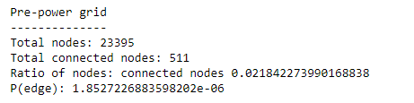
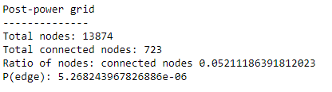
The two text blocks show some quick statistics for observations near the power grids
=> Did building the power grid provide some kind of tourism value, aka, are a significant number of people going down the paths used for power grid maiantenance to make observations?

Slide 28
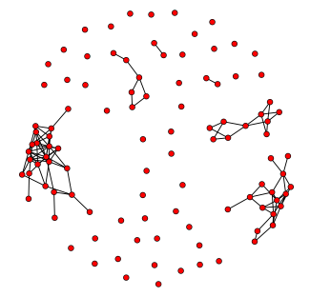
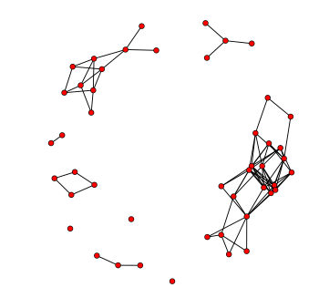
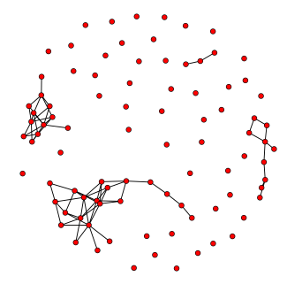
Density on structures vs observations
Ecological vs Hotels
P(edge) = 0.017
Ecological vs Residences
P(edge) = 0.019
Residentials vs Hotels
P(edge) = 0.07
Here is the output of the ERGMs to calculate density (only) of the following networks: Ecological vs Hotels, Ecological vs Residential, and Residential vs Hotels. Idea is that we can show the connections between these man-made structures are much closer than any structure to the ecological world, and hence, that building on Eigg is staying reasonable far away from the nature.

Slide 29
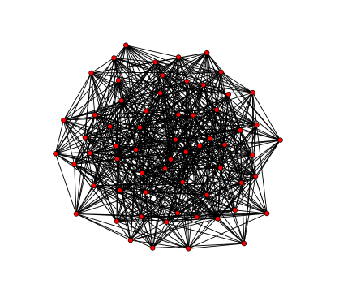
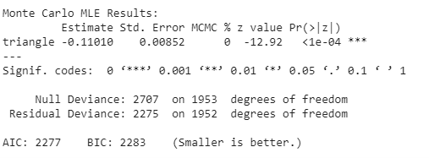
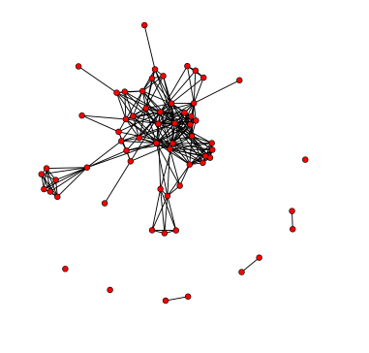
Business Network Analysis (Named)
Now we try to reconstruct the business network presented earlier with ERGM models
Triangles
The simulated model network
P (involvement in triad) = 0.47
First attempt: how well does a model in which triangles are dominant reproduce our business network?
=> Not very well. Also as pointed out by Angela, using one term in the ERGM is not normal practice.
(The original business network)

Slide 30
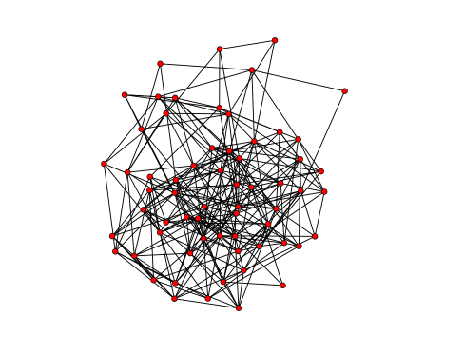
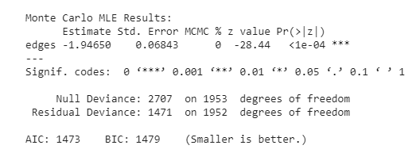
Edges
The network rebuilt with independent edge probabilities instead
P(edge) = 0.1249
This model simply simulated what would happen if each edge is independently drawn with some probability P (in this case, the model calculated it as 0.1249)
(The original business network)

Slide 31
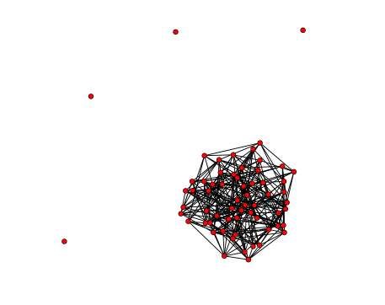
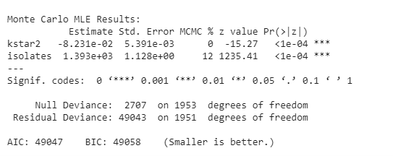
The model (2-stars, isolates)
This result is the best to replicate the original business network- but I will continue to interpret the network in different ways, for example as Angela suggested, splitting the business network into co-ownership and exchange networks.
P(involved in 2 star) = 0.47
P(isolates) = …
This model shows what would happen if we assumed the business network is formed with 2-stars and isolates => 2 stars reflecting centrality, and isolates indicating people not involved with the main component of the network
(The original business network)

