Slide 1
Crime and Unemployment
By: Daniel DeLuca

Slide 2
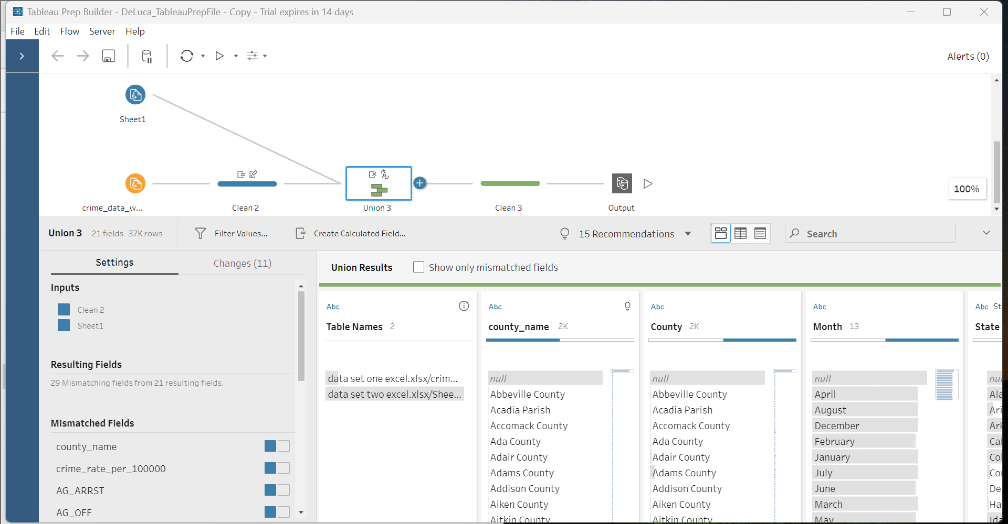
Tableau Prep Builder
Data preparation involved several cleaning steps to make the data uniform and a union of two datasets in Tableau Prep Builder

Slide 3
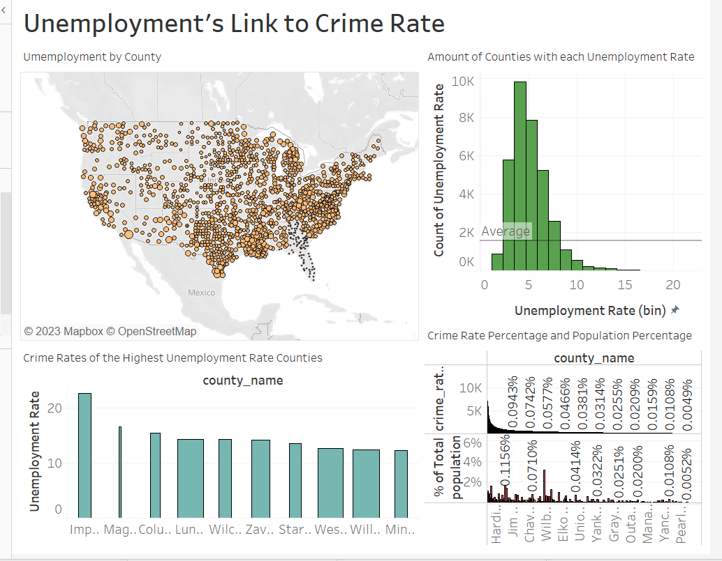
Dashboard
This Dashboard shows some of the visualizations I have made after cleaning up the data in Tableau Prep Builder. These visualizations were made in hopes of answering questions about crime and unemployment data. These visualizations will be explained in the following slides.

Slide 4
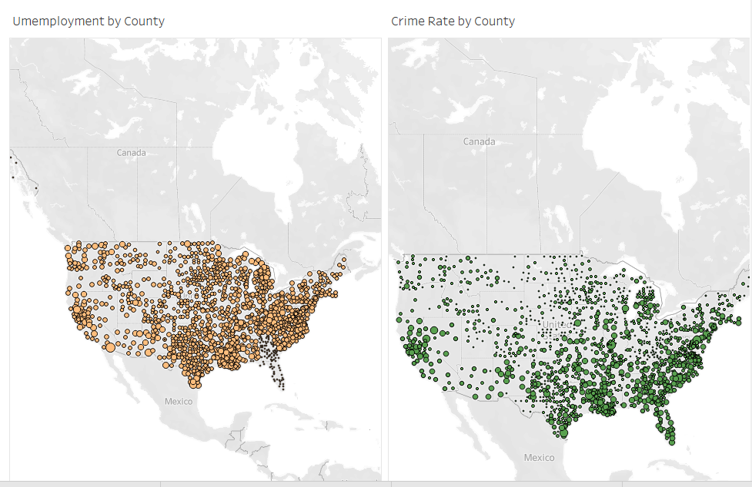
Question 1: Does high unemployment rate correlate to high crime rate in a county?
Yes, there seems to be a correlation shown by the areas in the map having high densities of unemployment also having high densities of crime.

Slide 5
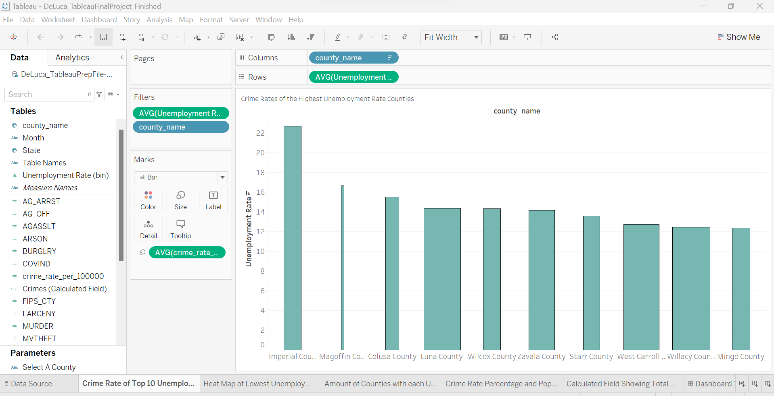
Question 2: What county has the largest crime rate and does this match with the county with the highest unemployment rate?
Imperial County has the highest unemployment rate and a large crime rate, shown by the width of the bar, but not the highest crime rate.

Slide 6
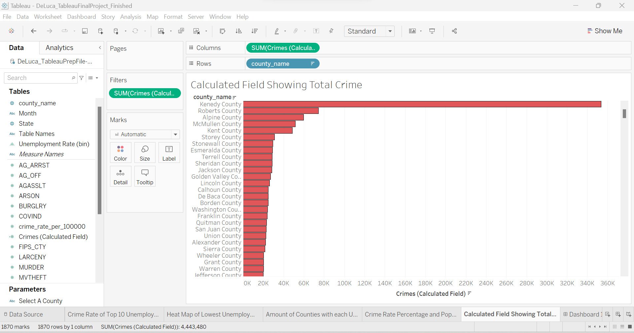
Question 3: What county had the highest total number of crimes?
Kennedy County had the largest number of total crimes by a large margin.

Slide 7
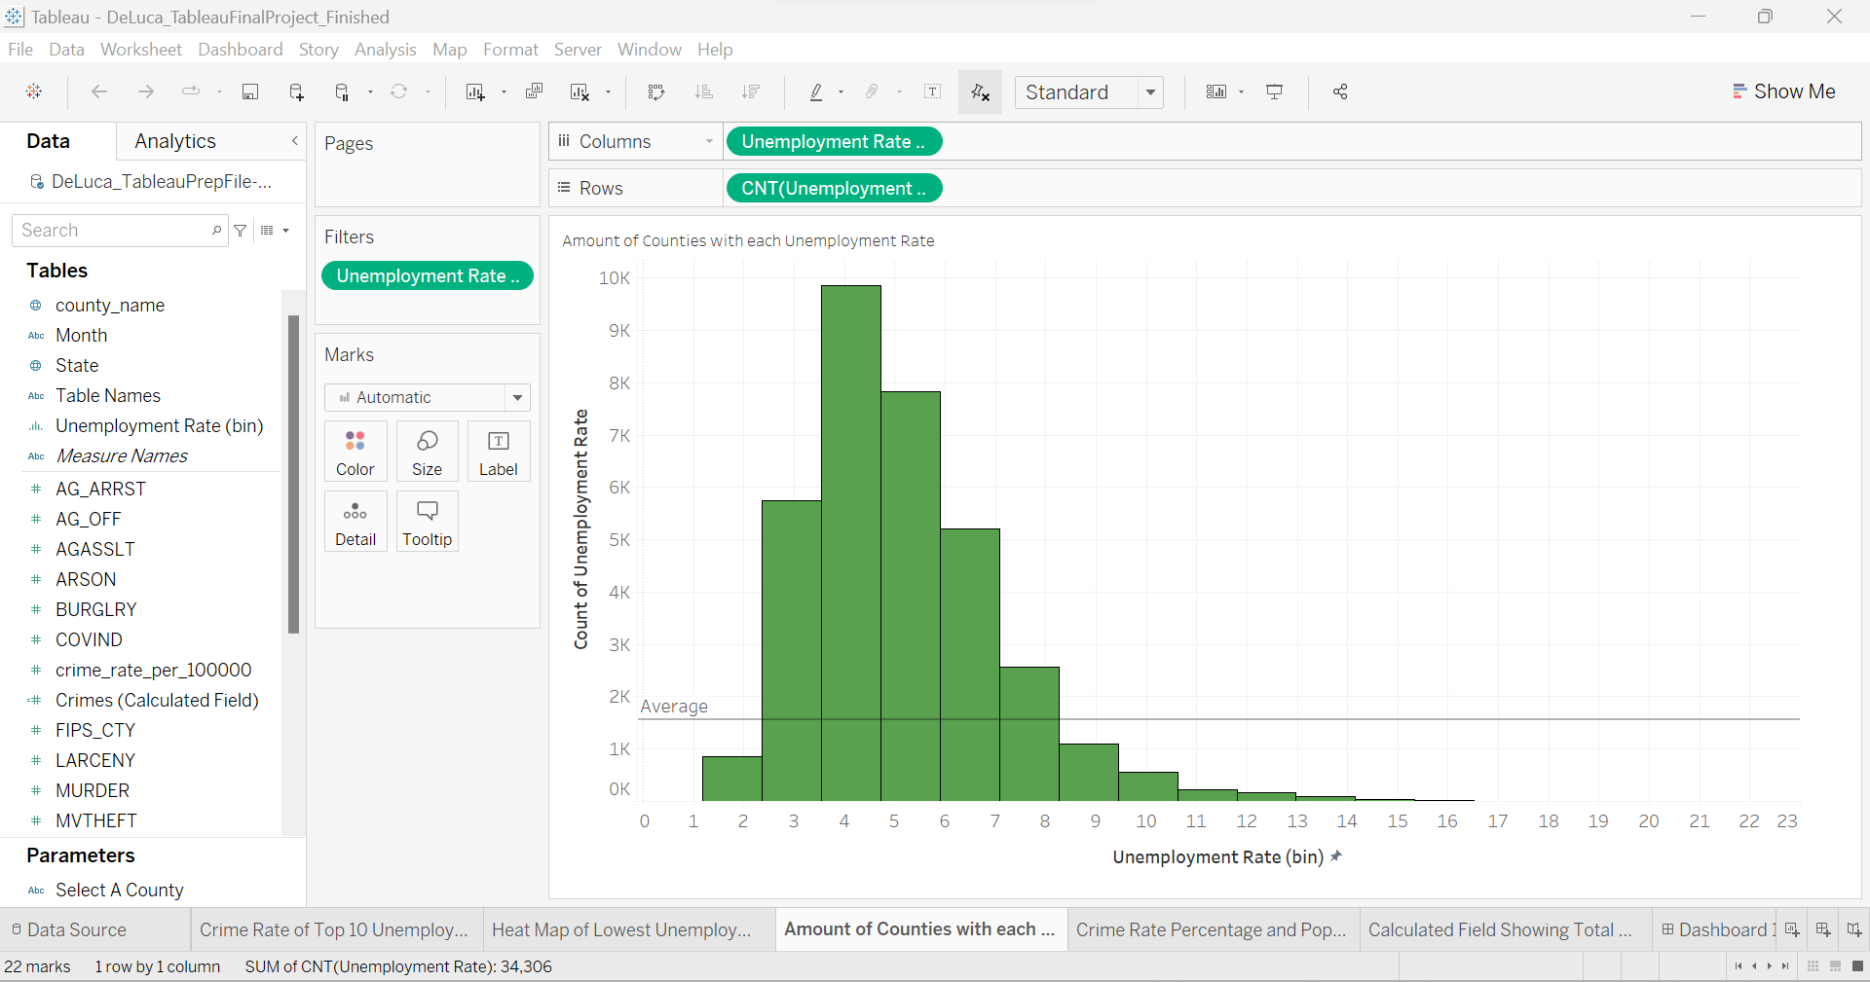
Question 4: What is the dispersion of unemployment between counties?
Most counties fall within 3% to 7% unemployment. Some outliers reach up to 16%

