Slide 1
MI-462 Final Project
Daniel DeLuca, Colin Rehnert, Matt Granato

Slide 2
Outline
Project Overview
Variables in the Dataset
Microsoft Azure Context
Power BI Context
Comparison of Azure and Power BI
Question 1 in Azure and Power BI
Question 2 in Azure and Power BI
Question 3 in Azure and Power BI
Question 4 in Azure and Power BI
Question 5 in Azure and Power BI
Question 6 on Data Ethics
Conclusion

Slide 3
Project Overview
For our project, we decided to work on a dataset that involves shipping goods with different modes of transportation.
The dataset is called Train.csv
We are using Azure Data Explorer to make SQL/KQL Queries and Visualizations to answer our questions.
We are also using PowerBI to create visualizations with Python script to help make our data more understandable.

Slide 4
Variables in Our Dataset
ID
Warehouse_block (A,B,C,D,E,F)
Mode_of_Shipment (Flight, Road, Ship)
Customer_care_calls (2,3,4,5,6,7)
Customer_rating (1,2,3,4,5)
Cost_of_the_Product (range)
Prior_purchases (range)
Product_importance (low, medium, high)
Gender (M,F)
Discount_offered (range)
Weight_in_gms (range)
Reached.on.Time_Y.N (1= ‘Yes’, 0=’No’)

Slide 5
Microsoft Azure
Our team decided to use Microsoft Azure to analyze and create visualizations for our dataset. We started our process in Azure by creating an Azure data explorer cluster. We then linked the URI of this cluster with Azure Data Explorer. The next step was to ingest our data set so we could start to perform SQL/KQL queries on it. Once we ingest our data we formulated a list of questions about our dataset we wanted to answer. We then answered these questions using Chat GPT to write our code.

Slide 6
Power BI
After creating some visualizations and working with the data in Azure, we realized that we wanted to explore using another program to compare the two and learn new skills. We decided that Power BI would be the best option as it uses Python code instead of SQL/KQL. We downloaded Power BI to our individual computers and we able to upload our data set through Power BI. Following that process we built our the visualizations by dropping in the columns that we wanted to compare.

Slide 7
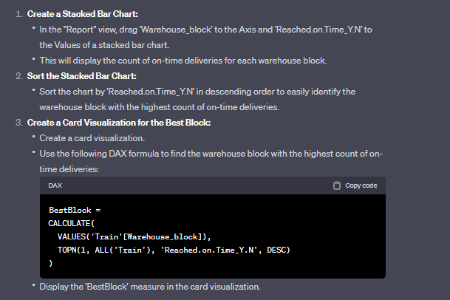
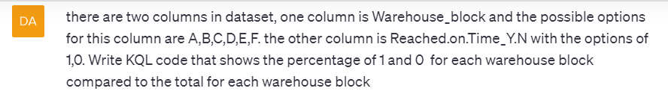
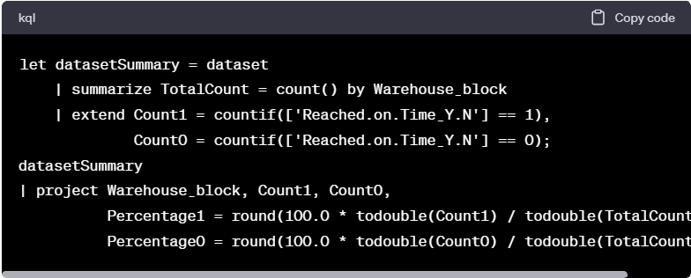
Comparison of Code Generation with Power BI (Python) and Azure (SQL/KQL)
Chat GPT was able to easily generate Python Code and give detailed directions for how to use Power BI.
Chat GPT would struggle to create code compatible with Azure. It needed a detailed description of the data and would usually need to be modified several times before it was compatible with Azure.

Slide 8
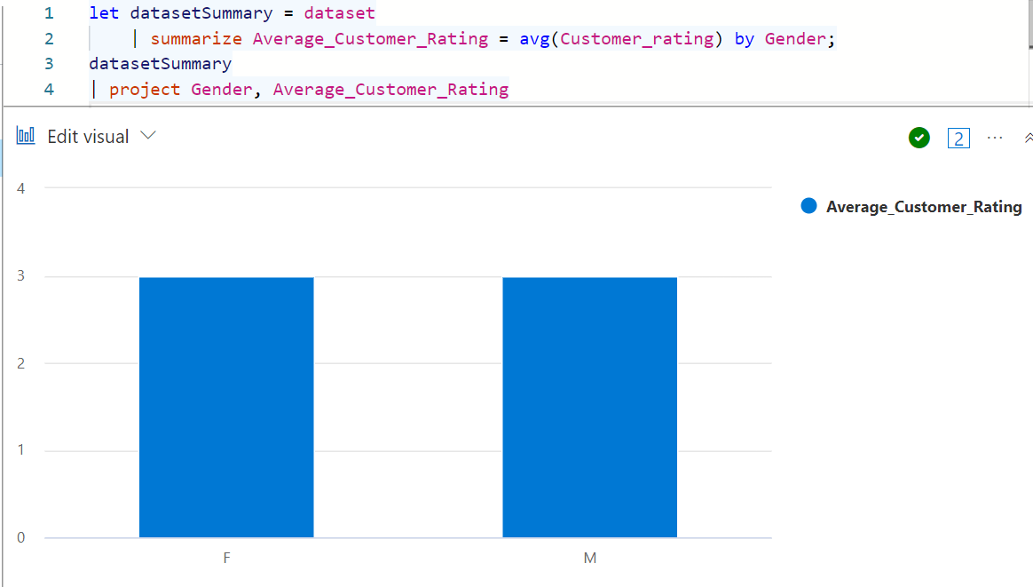
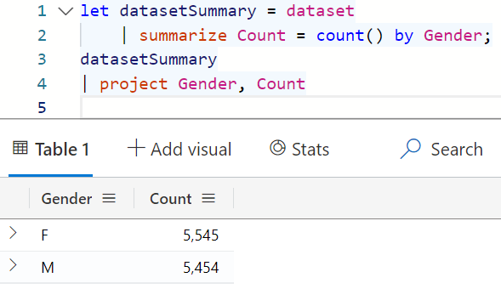
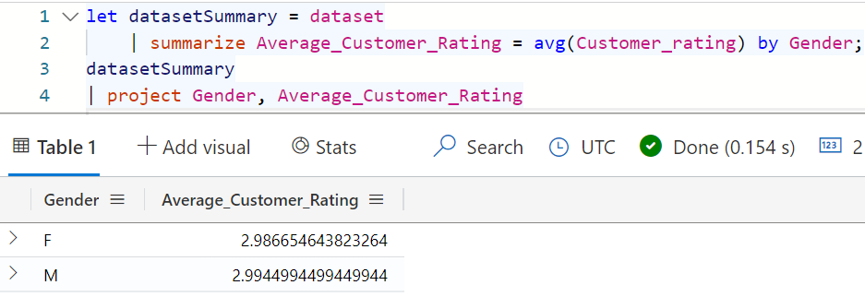
Question 1: What is the gender distribution and are there any differences in customer rating between males and females? (Azure)
Conclusion:
The gender distribution is 5545 females and 5454 males. There seems to be almost no difference in customer rating based on gender.

Slide 9
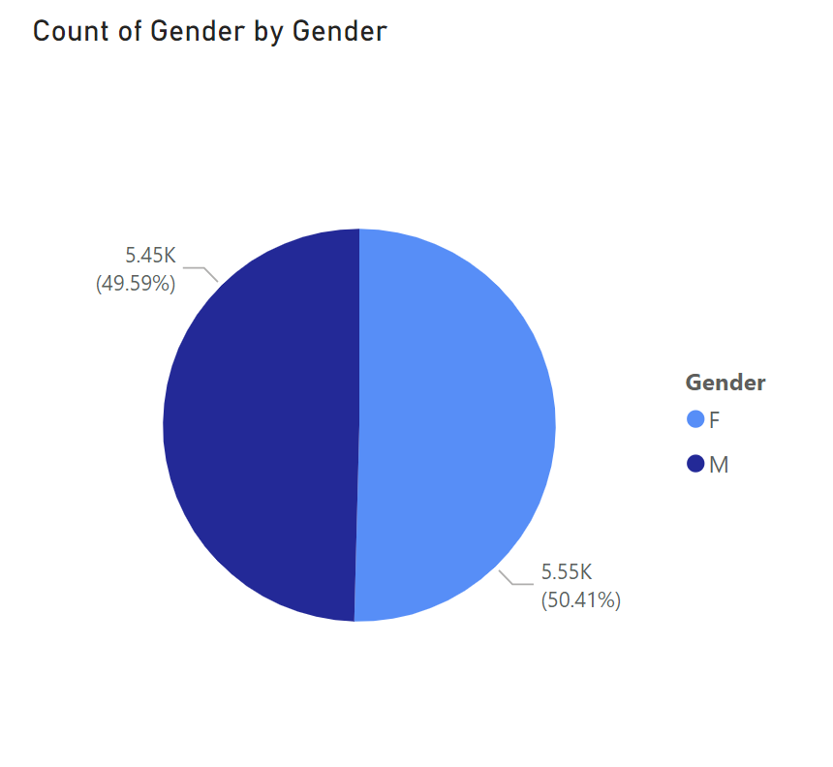
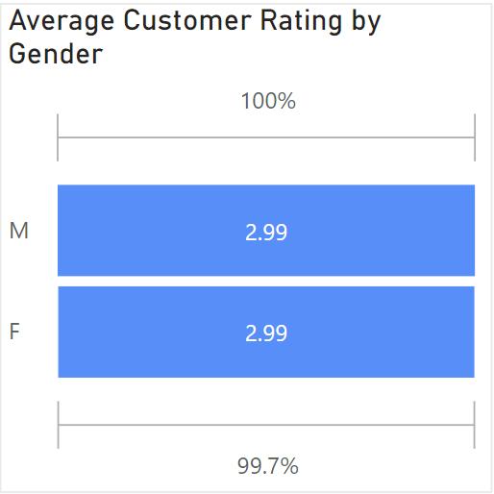
Question 1: What is the gender distribution and are there any differences in customer rating between males and females? (Power BI)
Count of Gender:
Female: 5,545
Female %: 50.41%
Male: 5,454
Male %: 49.59%
Avg. Customer Rating:
Female avg: 2.99
Male avg: 2.99
Conclusions:
Slightly larger population of females over males
Avg. customer rating was not different between males and females

Slide 10
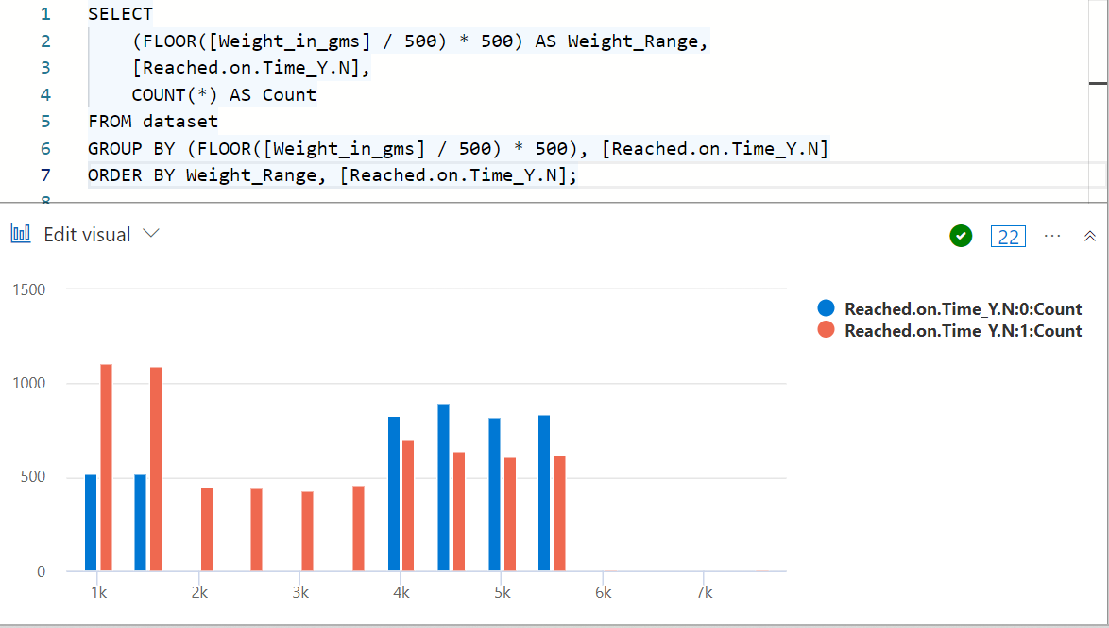
Question 2: Does the weight of a product affect on time status? (Azure)
Conclusion: As the weight of the product increased, the chance of the product not being on time increased.

Slide 11
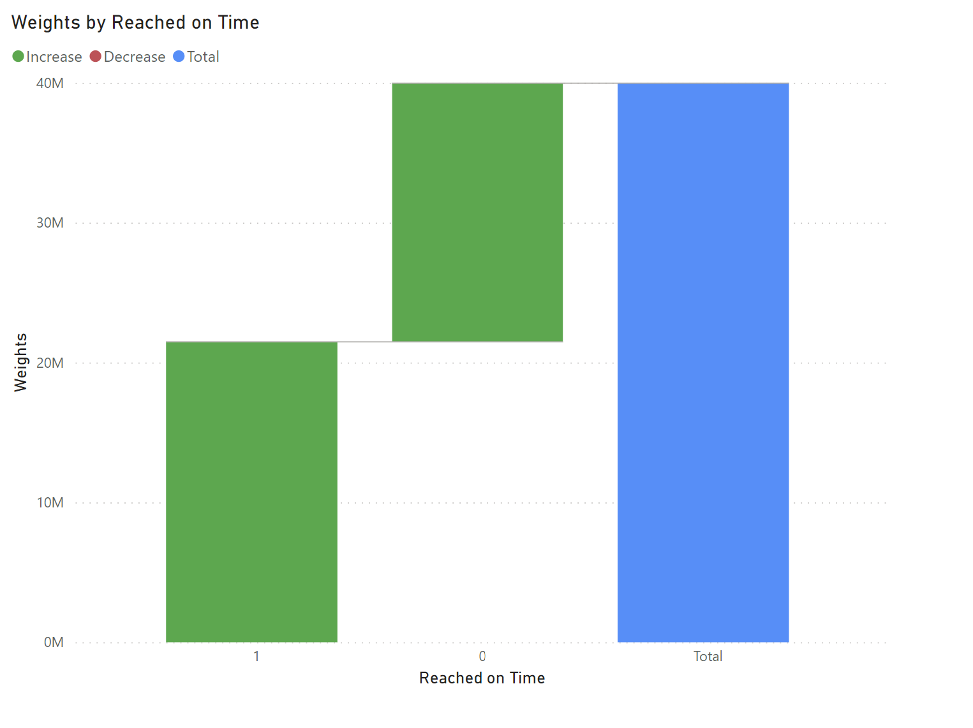
Question 2: Does the weight of a product affect on time status? (Power BI)
Weights v. Reached on Time:
On time: 1
Late: 0
Weight:
0-40 million grams
Conclusion:
The shipments that weigh more
than 21 million grams tend to be later
than those less than 21 million grams

Slide 12
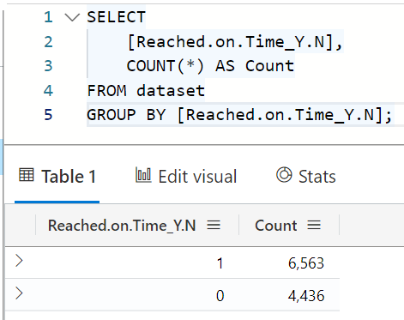
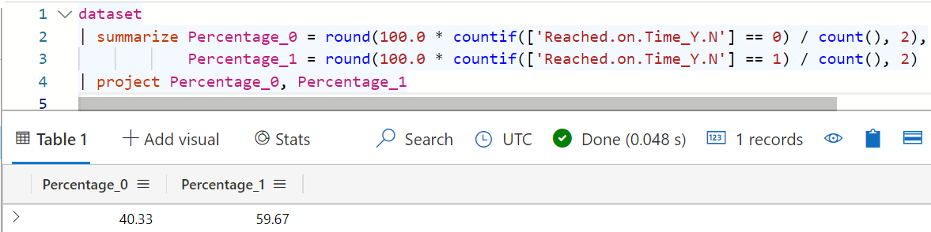
Question 3: What percentage of deliveries are on time? What is the most common mode of transportation? (Azure)
Conclusion: There are 6,563 on time deliveries or 59.67% of total deliveries, and 4,436 not on time deliveries or 40.33% of total deliveries.

Slide 13
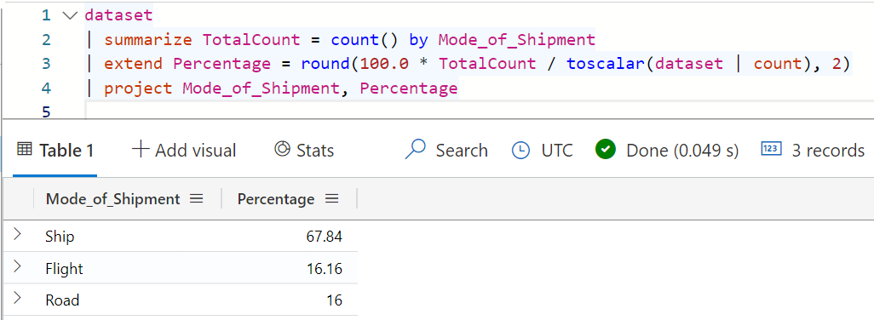
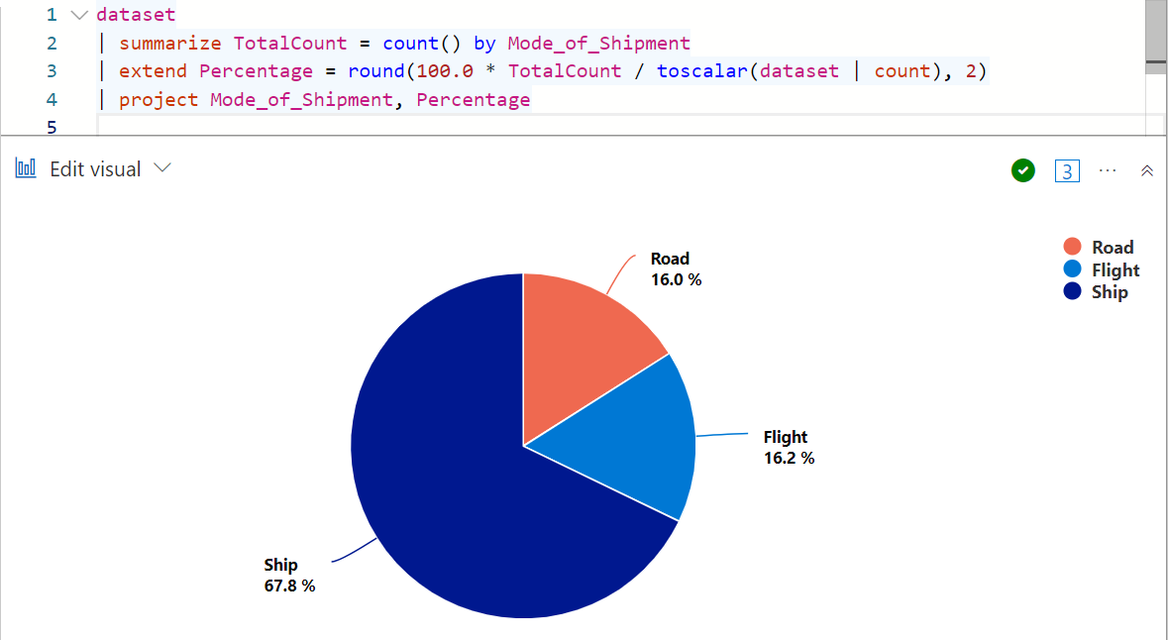
Question 3 (2): What percentage of deliveries are on time? What is the most common mode of transportation? (Azure)
Conclusion: The most common type of delivery is Ship with 67.8% followed by Flight with 16.2% and then least common delivery type Road at 16%.

Slide 14
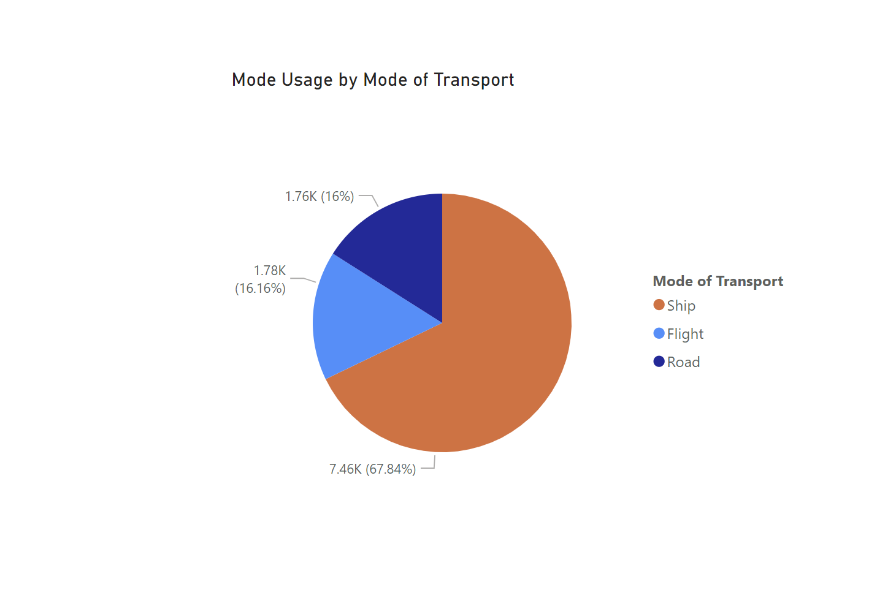
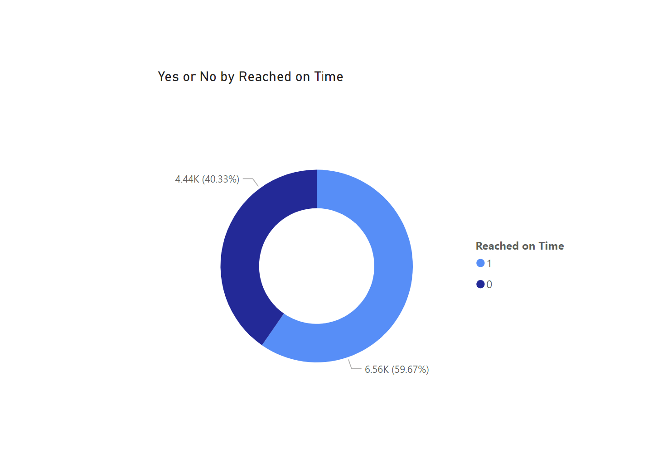
Question 3: What percentage of deliveries are on time? What is the most common mode of transportation? (Power BI)
Deliveries Y/N: (Y=1), (N=0)
Y %: 59.67%
N %: 40.33%
Modes of Transport:
(In order of usage)
Ship: 67.84%
Flight: 16.16%
Road: 16%
Conclusions:
Shipping is the most dominant form of transportation despite being the slowest
The gap between deliveries being on schedule or not on schedule is smaller than we originally expected when looking at the data

Slide 15
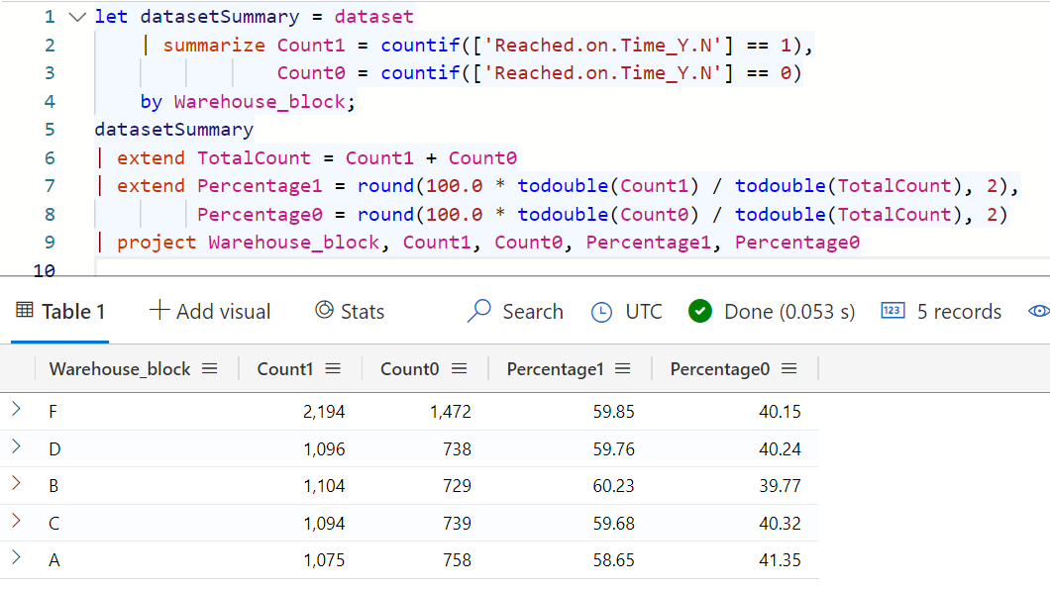
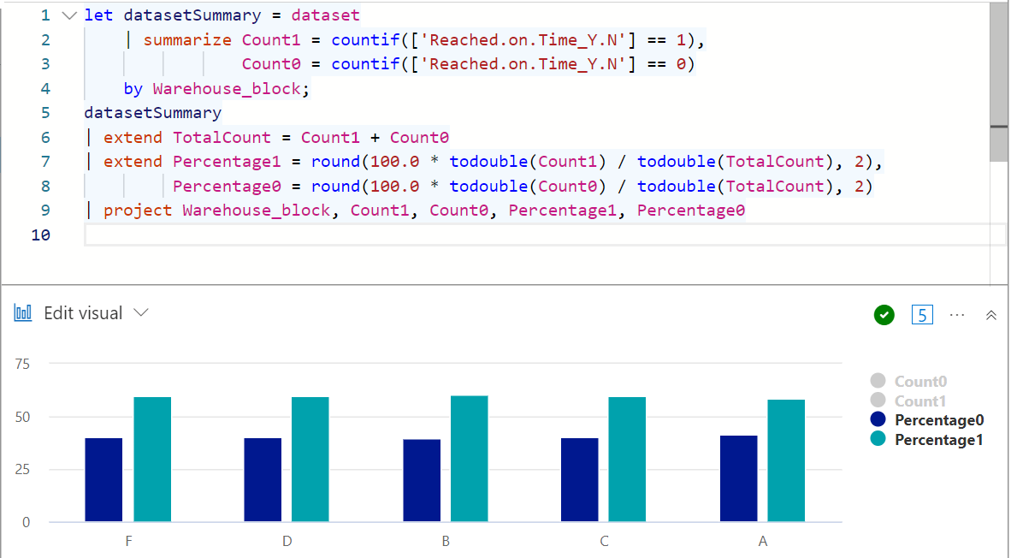
Question 4: Which is each warehouse block’s percentage of on time delivery, which warehouse block is the best? (Azure)
Conclusion: The Warehouse Block with the best on time delivery is B at 60.23%. In descending order the rest are F at 59.85%, D at 59.76%, C at 59.68%, and A at 58.65%.

Slide 16

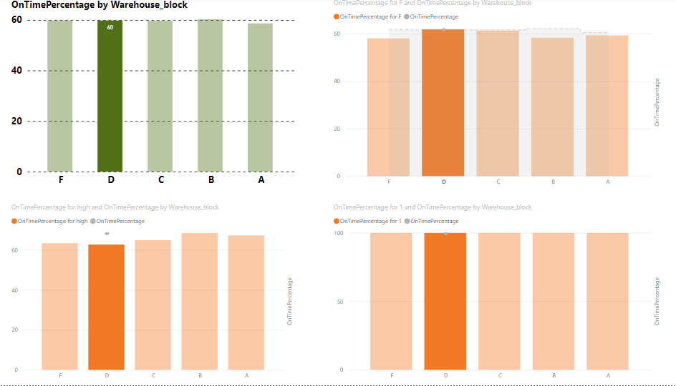
Question 4: Which is each warehouse block’s percentage of on time delivery, which warehouse block is the best? (Power BI)
Visualization 1 (Top Left)
Shows the Percentage of Packages arriving on time based on what Warehouse Block It came from.
Visualization 2 (Top Right)
Compares Warehouse Block F to the rest of the warehouse blocks.
Visualization 3 (Bottom Left)
Compares product_importance high to the arrival on time percentage at all warehouse blocks in the system.
Visualization 4 (Bottom Right)
Compares 1= yes which is if the package arrived on time to the rest of the warehouse blocks.

Slide 17
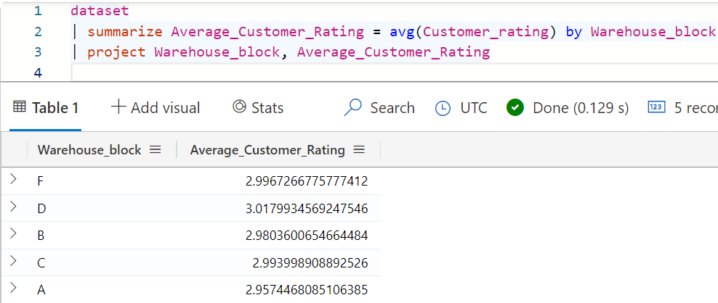
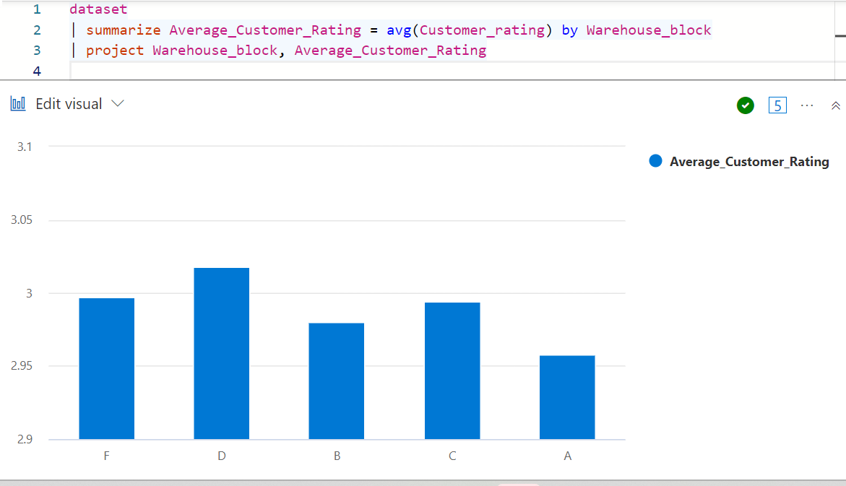
Question 5: What is the average customer rating for each warehouse block? (Azure)
Conclusion: The average customer rating for each warehouse block is very similar. The highest rating is D with and average of 3.017, then F with and average of 2.996, then C with and average of 2.993, then B and average of with 2.980, then A with and average of 2.957.

Slide 18
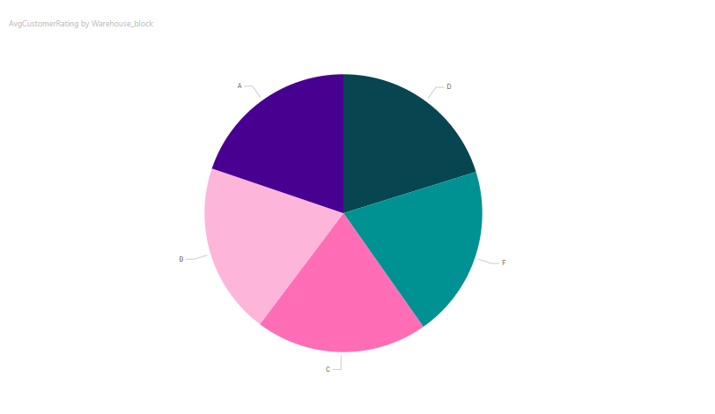
Question 5: What is the average customer rating for each warehouse block? (Power BI)
Conclusion:
The highest average customer rating is D followed by F, followed by C, followed by B, followed by A

Slide 19
Question 6: What ethical considerations should E-Commerce businesses consider when using customer data?
Data is important for showing how customers shop, their experience shopping, and the potential pain points in the shopping process. These factors make data one of the major backbones of E-Commerce business. Because of the necessity of data in E-Commerce business using that data in an ethical way becomes far more important. There are several guidelines an E-Commerce business should incorporate to ensure the ethical use of data. One guildine is transparency. This guideline in a data policy shows what data is being collected and the purpose of why it is being collected. Another guildine is honesty. This guildine in a data policy ensures the company is honest with what data they collect and the purpose of collection. Another guildine is relevancy. This guideline in a data policy ensures only relevant data is collected to provide less risk for the customer. The final guideline is security. This is the most important factor in data ethics. Unsafe security of data can lead to disruptions of a customer’s life. When considering ethics in E-Commerce business security should be the first priority.

Slide 20
Conclusion
This project provided our group with new information about Microsoft Azure, Power BI, and Chat GPT. We learned how to use the natural language model of Chat GPT to generate multiple different kinds of code for use in Azure or Power BI to produce the desired results in our dataset. We learned the major strengths and weaknesses of each program and in what circumstances it would be appropriate to use each program. Finally, we further educated ourselves on ethical data practices and the importance of it.

Slide 21
References
https://www.kaggle.com/datasets/prachi13/customer-analytics
https://www.paymentsjournal.com/ethical-guidelines-for-the-use-of-e-commerce-data/
https://chat.openai.com/
https://azure.microsoft.com/en-us
https://dataexplorer.azure.com/
https://powerbi.microsoft.com/en-us/

