Slide 1

Building LLMs From Scratch: Workshop 2
Working with Text Data
Full-Stack AI Researcher (FAIR) Working Group
Spring 2026
Center for Neurocomputation and Machine Intelligence
Wu Tsai Institute
Yale University

Slide 2
Contents
Getting Started (5 min.)
[2.1] Intro to Embeddings (5 min.)
Tokenization (30 min.)
[2.2] Tokenization Basics (10 min.)
[2.3] Token IDs (10 min.)
[2.4] Special Tokens (5 min.)
[2.5] Byte Pair Encoding (5 min.)
[2.6] Sliding Window Data Loader (15 min.)
Embedding Vectors (10 min.)
[2.7] Token Embeddings (5 min.)
[2.8] Positional Embeddings (5 min.)

Slide 3
Getting Started

Slide 4
Resources
This workshop adapts Chapter 2 of Build a Large Language Model (From Scratch) (Raschka 2024)
Access the reference Jupyter Notebook here.
The other contents of the ch02 folder are available as supplementary learning for your own enrichment.
We will be running this Notebook directly, but I encourage you to make modifications to experiment with your understanding.

Slide 5
Setup: Environment
Activate your virtual environment from last workshop:
Conda: conda activate llms-venv
venv: source llms-venv/bin/activate (Mac/Linux)
venv: llms-venv\Scripts\activate (Windows)
Then install dependencies (CHOOSE ONE):
pip install jupyterlab torch==2.5.1 tiktoken
pip lets you install multiple packages at once
Apparently newer versions of PyTorch on Macs don’t work for this repo
Alternatively, download requirements.txt from GitHub and run pip install –r requirements.txt to download all packages for the entire series
Once jupyterlab is installed, you can start it by typing jupyter lab. This should start the web server, which you can access via http://localhost:8888/lab

Slide 6
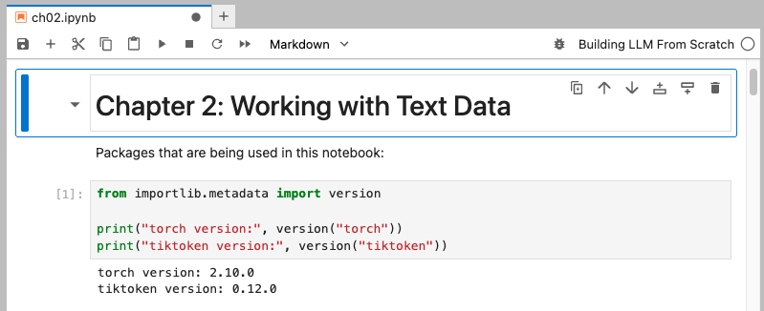
Setup: Jupyter Notebook
Jupyter Notebook is a way to interactively run Python code.
Supports plain text, Markdown, and code cells..
Switch between code & Markdown
Restart & Run all cells
Add new cell
Switch kernel
Double click to edit cell
Shift click to run cell

Slide 7
Setup: Jupyter Kernels
Did the first cell produce an error? This means the notebook cannot “see” the dependencies you installed.
You can fix this by registering your venv as a kernel.
pip install ipykernel
python -m ipykernel install --user --name llms-env --display-name ”Building LLMs From Scratch”
Restart Jupyter Lab (File>Shut Down on localhost, then run jupyter lab again)
Then on the top right, change the kernel to your new kernel. Now the first cell should run. You are good to go!

Slide 8
Introduction to Embeddings
How Machines Work With Natural Language

Slide 9
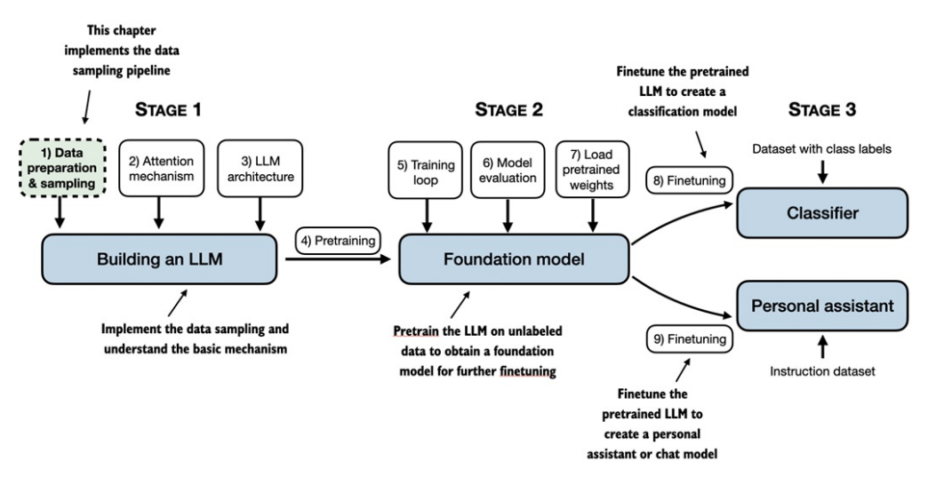
Context
(Source: Textbook)

Slide 10


How Do Neural Nets Work?
AI models like neural networks deal with numbers grouped together into vectors. Given some input numbers, it will transform them in complex ways to get output numbers.
We need to get our natural-language text into a numerical form
(not necessarily same shape)
Input:
Output:
$$\left[\begin{matrix}−0.4 \\ \begin{aligned}1.3 \\ ⋮ \\ −0.4 \\ −0.1\end{aligned}\end{matrix}\right]$$
AI Model
$$\left[\begin{matrix}−0.7 \\ \begin{aligned}2.8 \\ ⋮ \\ 1.5 \\ −1.9\end{aligned}\end{matrix}\right]$$

Slide 11
Embeddings
The process of taking something non-numeric like text, image, video, or audio, and representing it as a collection of numbers, is called embedding (as we embed them into a numerical vector space)
LLMs work with word embeddings: each word/token is mapped to a vector, and a document is an ordered list of words.
For other use cases, you could also generate embeddings for characters, sentences, or paragraphs.

Slide 12
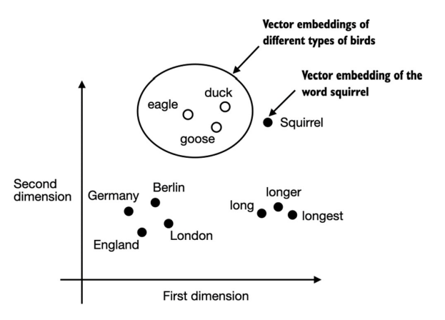
Word Embeddings
(Source: Textbook)
Word embeddings try to encode semantic data
Relationships: king – man = queen – woman
Groupings: synonyms may have similar embeddings
These embeddings usually have high dimension (hundreds, thousands, or more)
Can generate with pretrained embedding models like word2vec, but for more accuracy for specific use cases, many language models train their own

Slide 13
Tokenization

Slide 14
What Is Tokenization?
Tokenization is the process of splitting a large section of text into tokens.
Each token maps to a single embedding.
There are different algorithms to tokenize text
Most LLMs define tokens by identifying common character sequences. This is called Byte Pair Encoding, and we will explore it later (sec. 2.5)
We will start by isolating words and punctuation marks.

Slide 15
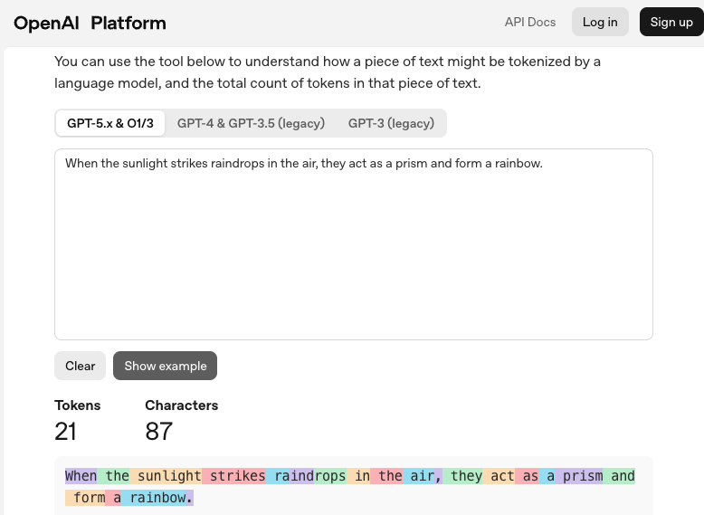
Tokenization Example
ChatGPT’s tokenizer
https://platform.openai.com/tokenizer

Slide 16
Activity (5 minutes)
[Work on section 2.2 of the notebook]
We will use Python’s regular expressions to tokenize our input text, “The Verdict” by Edith Wharton.
Regular expressions (regex) are a very powerful tool for parsing text.
You give the regex engine a specification of a pattern, as a string in Python’s regular expression syntax.
We will use the split functionality to split over certain characters.
Because whitespace and punctuation are semantically important, they should remain in the tokenization.
“Once upon a time…” -> [“Once”, “␣”, “upon”, “␣”, “a”, “␣”, “time”, “…”]

Slide 17
Vocabularies and Token IDs
The vocabulary contains all tokens you can possibly see in the dataset.
Each token in the vocabulary maps to a unique ID.
If we store the embeddings for all tokens in an array or matrix, then use ID to identify the specific embedding.

Slide 18
Token IDs from Vocab
Note: Eventually we will want 2 data structures, one for each direction
String -> ID (process input)
ID -> String (produce output)
(Source: Textbook)

Slide 19
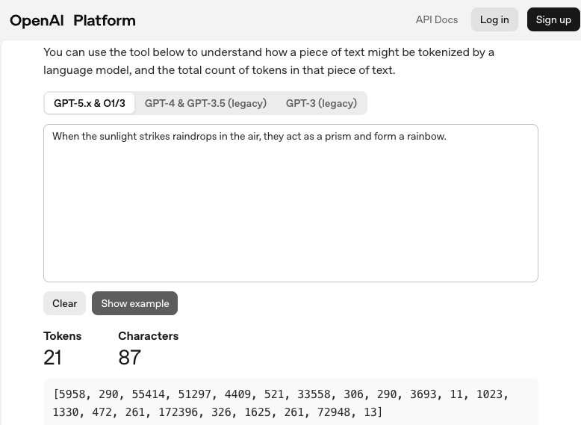

Slide 20
Activity (5 minutes)
[Work on section 2.3 of the notebook]
Create IDs for our vocabulary
Sort tokens
Assign each token an ID in sorted order
Break down a new piece of text into token IDs
Note: Some text will give you a “KeyError” — this means that the token we want is not in the vocabulary. We will look at one way to deal with this in the next section.

Slide 21
Special Tokens
Sometimes we want special tokens to represent information that is not directly included in the text data.
Padding tokens, to normalize the length of text batches
Mask tokens, to hide text we don’t want the model to see
Tokens to label start and end of a chat turn for chat-tuned models
Tokens to label the end of a training document
Unknown word token we map any word not in vocab

Slide 22
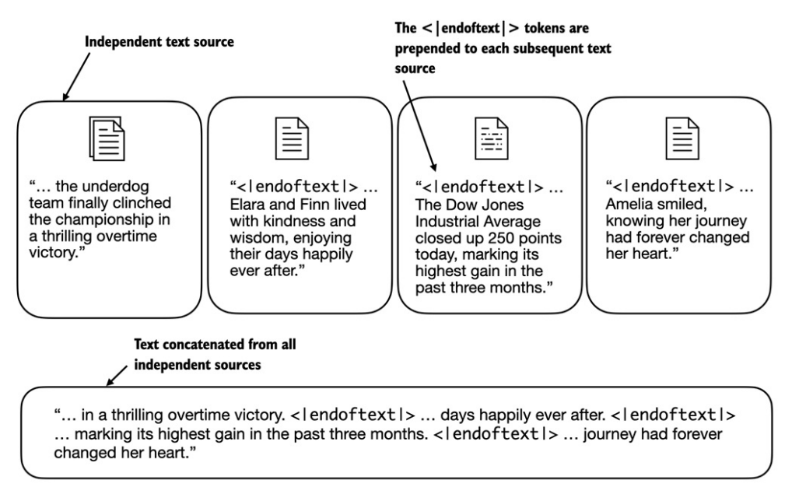
Activity (5 minutes)
[Work on section 2.4 of the notebook]
Implement <|endoftext|> and <|unk|> special tokens
(Source: Textbook)

Slide 23
Byte Pair Encoding
Byte pair encoding (BPE) is an algorithm to automatically generate tokens from text based on the most common combinations of characters.
Every character/byte starts out as a token. (This also means we won’t need <|unk|> tokens, as everything can be decomposed to bytes.)
In the training data count the frequency of each pair of tokens appearing sequentially. (e.g. (“t”, “h”) pair). Then every time you see this pair, replace it with a single token (“th”).
Repeat until you reach the desired vocabulary size. (“th”, “e”)->(“the”)
This procedure ends up grouping words into a few subword tokens. Commonly used words are their own token.

Slide 24
Activity (5 minutes)
[Work on section 2.5 of the notebook]
We will not be implementing byte pair encoding ourselves. Instead we will use a library called tiktoken.
Let’s explore GPT-2’s encodings.

Slide 25
Sliding Window Data Loader

Slide 26
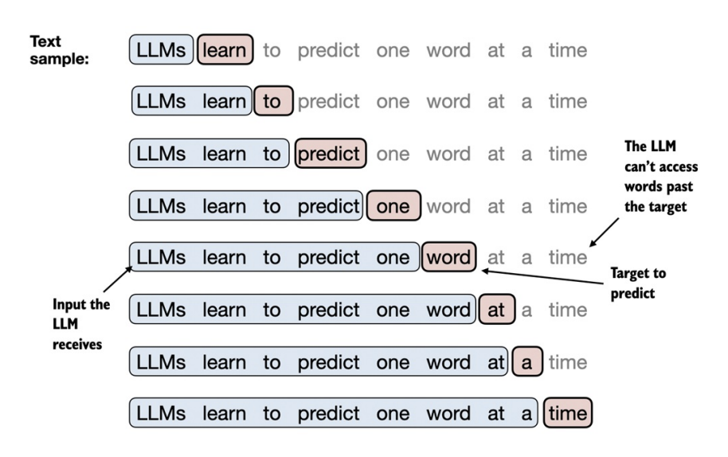
Input-Output Pairs
When training an LLM, we predict one word at a time.
Input: Tokens coming before the word
Output: The next word that the LLM should predict
(Source: Textbook)

Slide 27
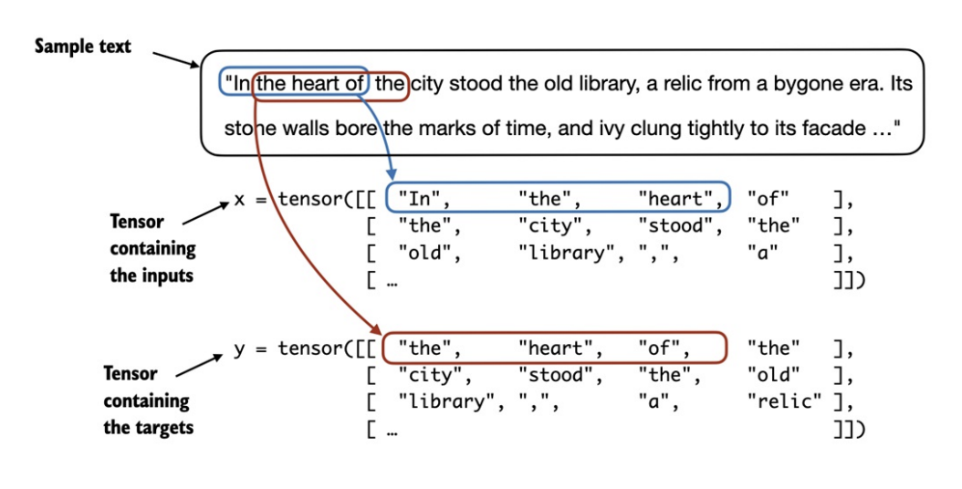
PyTorch Data Loader
Goal: produce an efficient data loader that takes text and turns it into a PyTorch tensor of inputs and targets.
Here we batch every 4 tokens; usually you batch hundreds at once.
The sliding window does not cross batch boundaries.
This allows parallel computation with minimal overhead.
In the heart
In the heart of
In
In the
(Source: Textbook)

Slide 28
Activity (10 min.)
First explore sliding window
Then we will implement the Dataset and DataLoader

Slide 29
Embedding Vectors

Slide 30
Embeddings as a Map from ID to Vector
Each token ID corresponds with an embedding vector.
As discussed previously, vectors embed semantic information about tokens’ meaning.
Today, we will work with randomized embeddings, focusing only on the lookup portion.
We will use torch.nn.Embedding.
We will train these embeddings at the same time as the main language model in Pretraining (Dongyu – 4/7).

Slide 31
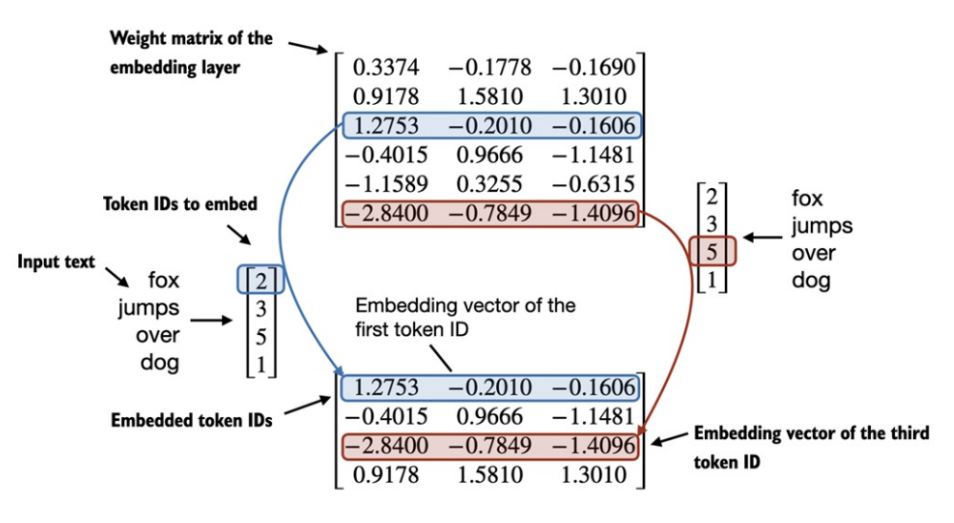
Activity (5 min.)
See how embeddings map ID to vector.
Lookup: each row is an embedding vector
“fox” -> ID=2 -> [1.2753 -0.2010 -0.1606]
0 1 2 3 4 5
2 3 5 1
Each row of this tensor is the embedding of each token in the input “fox jumps over dog”
(token ID [2, 3, 5, 1]) in order
(Source: Textbook)

Slide 32
Positional Encodings (1/2)
Self-attention (next workshop, Yue) does not consider position or token order. So we need a way to encode this information in the embedding itself.

Slide 33
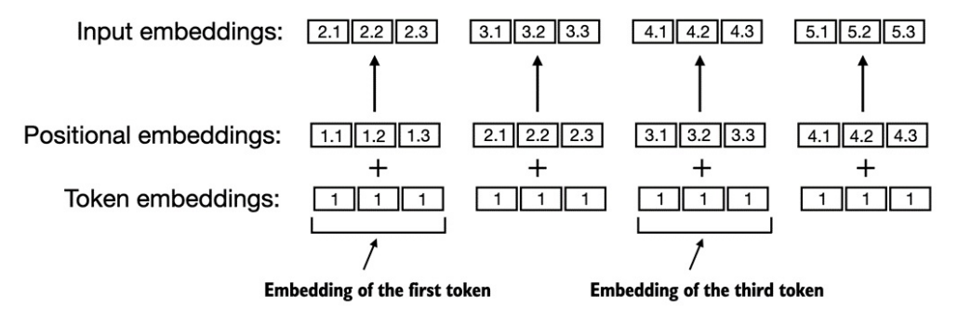
Positional Encodings (2/2)
Absolute positional embeddings include the direct location of the token.
Relative positional embeddings encode the relative distance between tokens. This could generalize better.
Positional encodings can also be trained during pretraining.
(Source: Textbook)

Slide 34
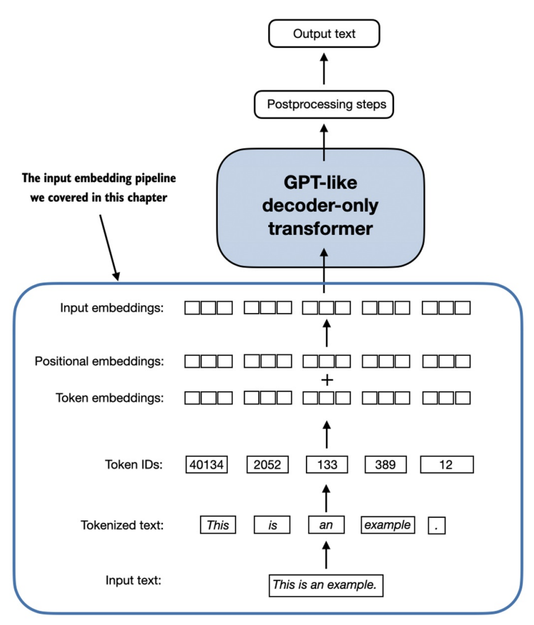
Final Activity (5 min.)
Show how input embeddings are a sum of token and positional embeddings.
Our positional embeddings are absolute and pretrained (same as GPT)
This is why our final input embedding is the sum of two neural embedding layers — both token and position meanings can be encoded as vectors

Slide 35
Thank You!

