Slide 1

Building LLMs From Scratch Overview and Setup
Full-Stack AI Researcher (FAIR) Working Group
Fall 2026
Center for Neurocomputation and Machine Intelligence
Wu Tsai Institute
Yale University

Slide 2

Outline
Overview of LLM coding stages
Environment setup

Slide 3
What is LLM
Deep neural network designed to understand, generate, and respond to human-like text

Slide 4
Why build LLM from ground up
Excellent exercise to understand LLMs
Gain knowledge to pre-train and fine-tune open-source LLMs
Custom LLMs provide multiple advantages
Better performance for specific tasks or domains
Secure, compliant handling of sensitive data
Local deployment on personal devices
Complete control over your model

Slide 5
Three coding stages
Stage 1: Implement the LLM architecture
Embeddings
attention mechanism
transformer blocks
Stage 2: Pre-training: train the LLM on a large set of text data (raw, unlabeled) to generate a foundation model
Stage 3: Fine-tuning: fine-tune the foundation model on labeled dataset for specific tasks or domains
Instruction fine-tuning: teach the model how to respond to instructions
Classification fine-tuning: teach the model how to label inputs

Slide 6
Three coding stages

Slide 7
Timeline of study
Mar 3:
coding attention mechanism
Mar 24: implementing a GPT model from scratch to generate text
Feb 17: working with text data
Apr 21: fine-tuning on classification dataset
Apr 7: pretraining on unlabeled data
May 5: fine-tuning on instruction dataset

Slide 8
Environment Setup
Local computer
Virtual environment for Python
Conda environment
VSCode
Jupyter
HPC cluster

Slide 9
Virtual environment on local machine
git clone https://github.com/rasbt/LLMs-from-scratch
python –m venv llms-venv
source llms-venv/bin/activate
pip install -r LLMs-from-scratch/requirements.txt

Slide 10
Conda environment on local machine
mkdir $HOME/FAIR/miniconda3
curl https://repo.anaconda.com/miniconda/Miniconda3-latest-MacOSX-arm64.sh \ -o $HOME/FAIR/miniconda3/miniconda.sh
cd $HOME/FAIR/miniconda3
chmod 755 miniconda.sh
./miniconda.sh -b -u -p .
export PATH=$HOME/FAIR/miniconda3/bin:$PATH
# you can run ‘conda init’ to initialize conda in .bashrc.
source $HOME/FAIR/miniconda3/etc/profile.d/conda.sh
conda create -p $HOME/FAIR/llms_env python=3.10
conda activate $HOME/FAIR/llms_env
pip install -r LLMs-from-scratch/requirements.tx

Slide 11
VSCode
Install extensions
Specify python
Open command palette
Search “Python: Select Interpreter”

Slide 12
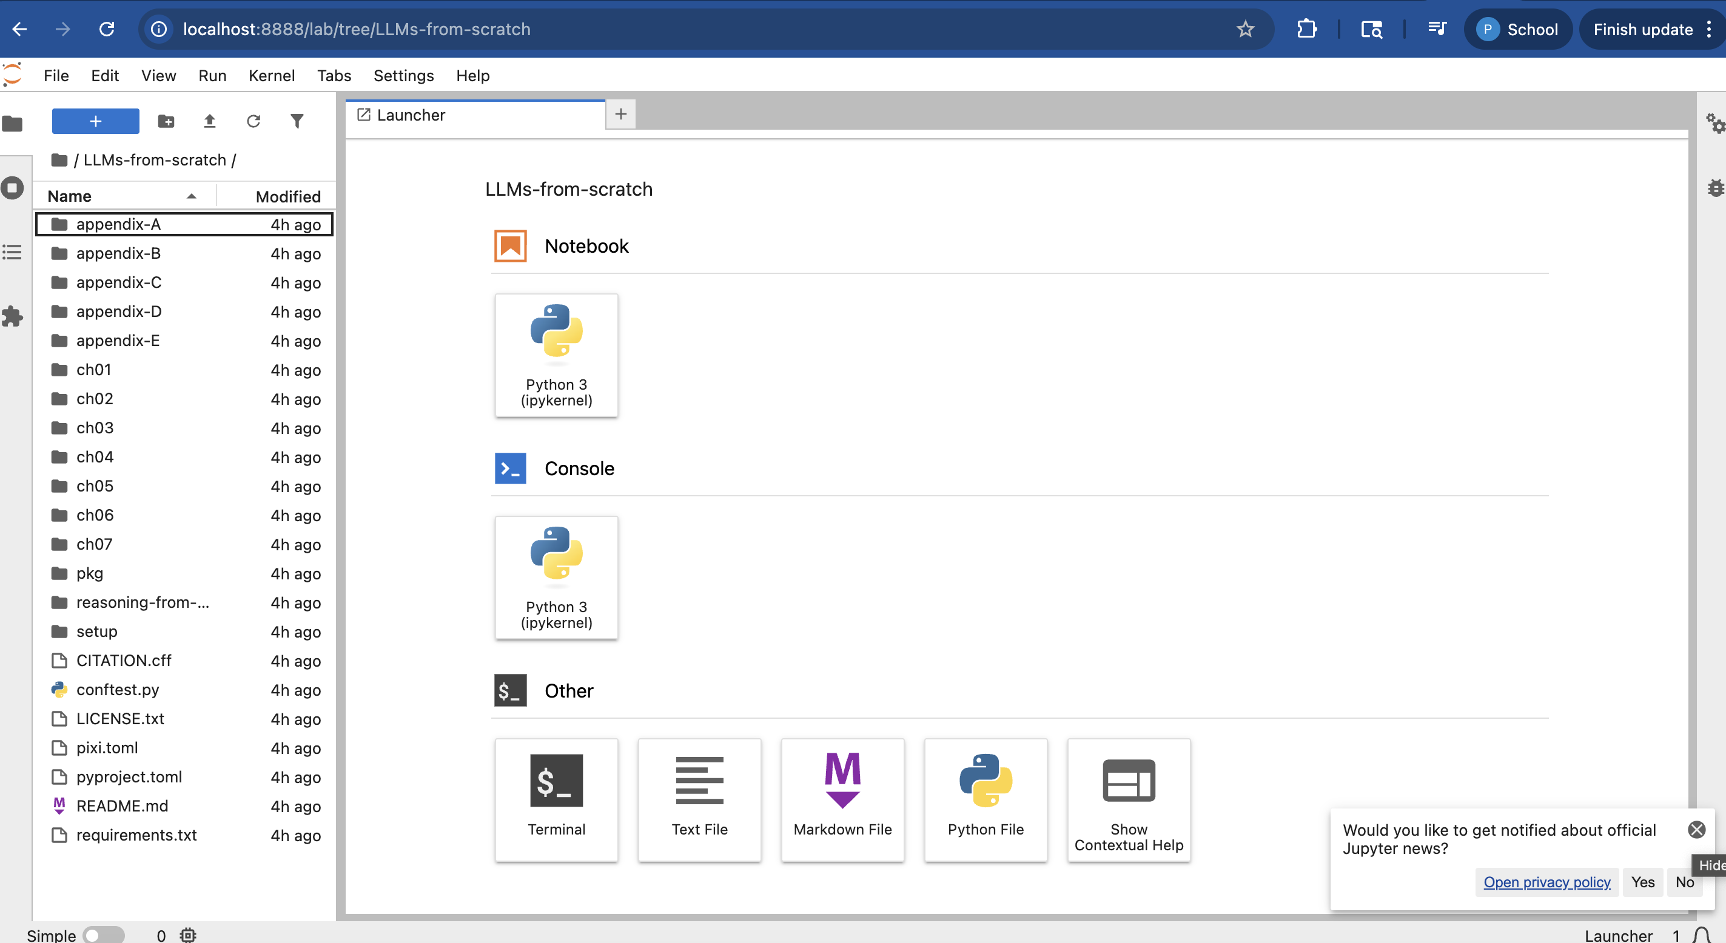
Jupyter
jupyter lab

Slide 13
HPC Cluster
salloc -n 1 -c 2 --mem=30g -p day
module load miniconda
conda create -p $(pwd)/llms_env python=3.10
conda activate /gpfs/radev/home/pl543/FAIR/llms_env
git clone https://github.com/rasbt/LLMs-from-scratch
pip install -r LLMs-from-scratch/requirements.txt

Slide 14
https://github.com/Daniel-Gong/LLM-Workshop-Materials

Slide 15
Q&A

