Slide 1
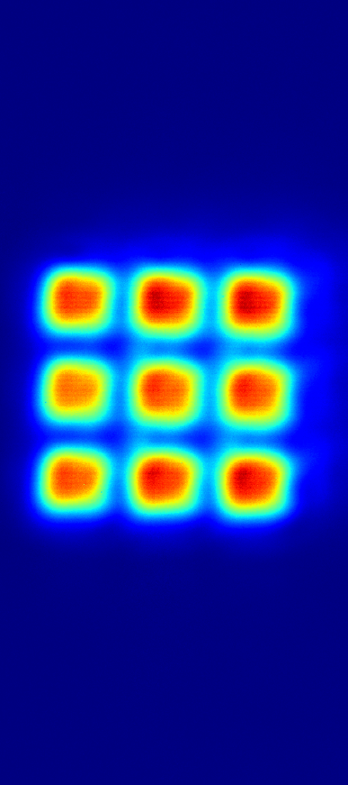

Shaping of uniform intensity profiles for single-site addressing of ${}_{}^{85}{Rb}$ atoms
Master thesis by Daniel Hagn
Supervised by:
Prof. Dr. Gerhard Birkl
Lukas Sturm
Notes:
Thank you for introduction
Right: Laser system
Left: Frequenzshift board by Simon B.

Slide 2
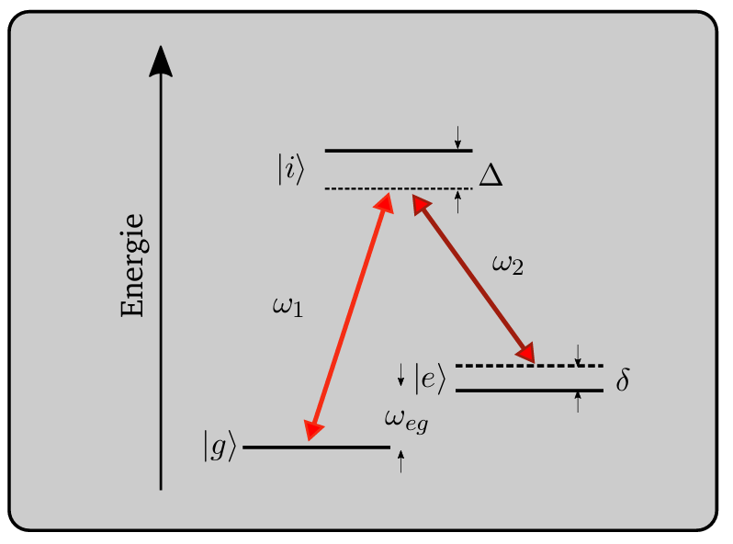
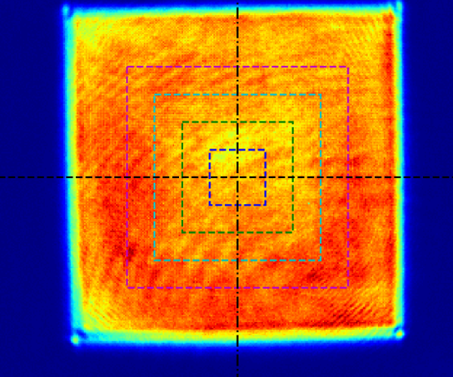
Motivation
Quantum information processing
    Single qubit gate operations
Two photon raman transitions
Global and local addressing
  Uniform intensity profile
    Whole atomic grid
    Single site addressing AOD
Master thesis, Simon B.
Bachelor thesis Carlo B.
Notes:
Quips Cs next goal: Single qubit gate operations
Excitation of 0 to1 with 3,035GHz frequency-> Microwave not possible for local excitation
Old system: 2 ECDLs built by Max Werner and used by Timon Scheiber, Tobias Schreiber-> Sucessfull operations
New system: Higher power 10mW->400 mW
Sapphire groß?
Kein Replacement, neuer Ansatz
8W weg

Slide 3
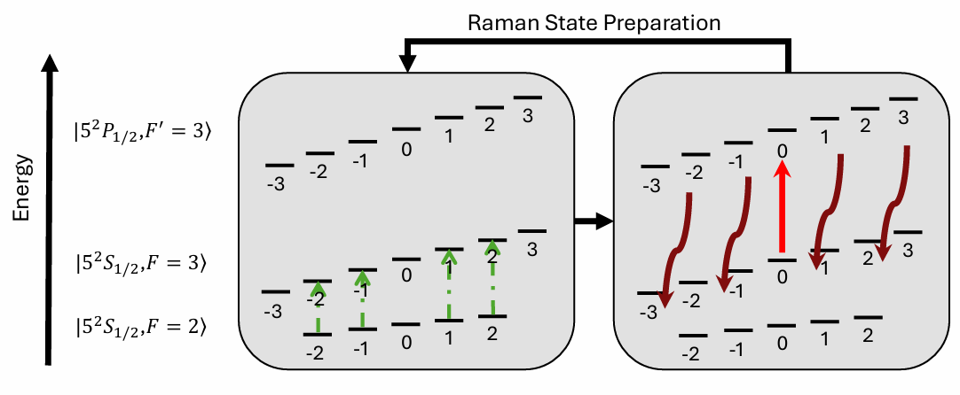
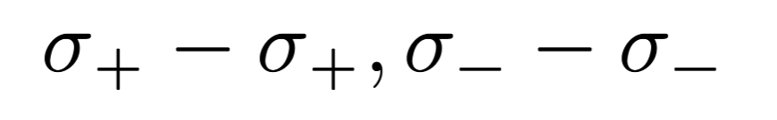
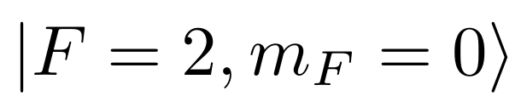
Raman-Assisted pumping
Coarse pump
Dissipative decay
2 Photon raman pulse
Preparation in
EOM/AOM not usable
Master thesis, Timon S..
Notes:
What else can be done with a raman laser system?
Werte weg
Nacheinander jeden mf gepumpt
Nacheinander schritt für schritt die Frequenz moduliert
Altes Pumpschema als Vergleich nennen
Vergleich Pump-effizienzen
Cavity bei EOM schift neu locken doof

Slide 4
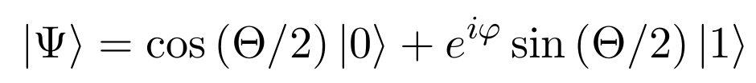
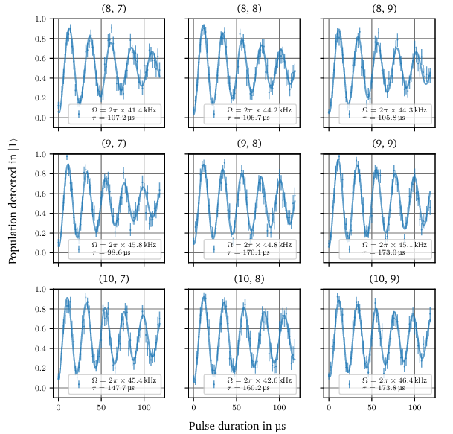
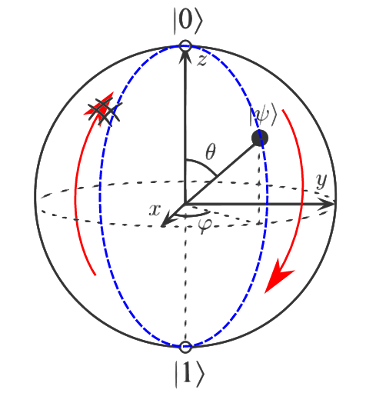
Outlook
Master-Thesis Moritz D.
Dissertation Tobias S.
Notes:
Vorher Präparation nennen, evtl Pumpschema bild dazuu
First global Rabii oscillations for determining Rabi frequency-> Intensity and pulse length
Then global gate operations

Slide 5
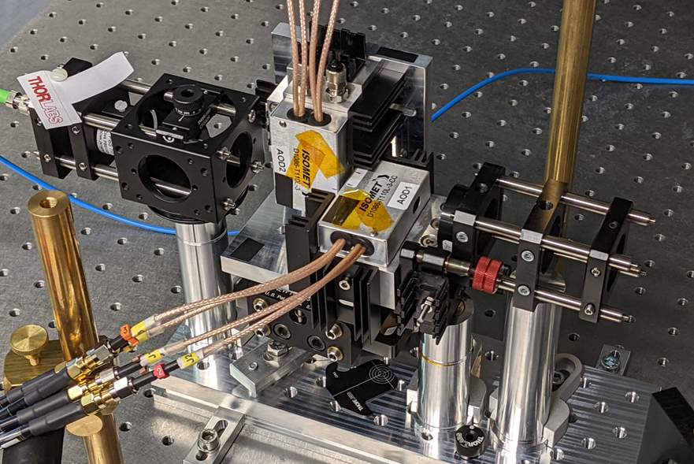
Outlook
Master-Thesis, Jan L.
Notes:
Building al local Raman laser system board for addressing the atoms with multitone AODs
Moritz Domack hat neuere Version

Slide 6
Outlook
Dissertation Tobias S.
Bachelor-Thesis Carlo B.
Master thesis, Jan L.

Slide 7
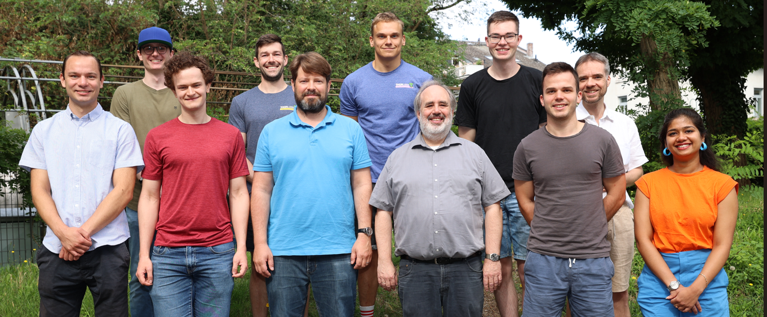
Thank you for your attention

Slide 8
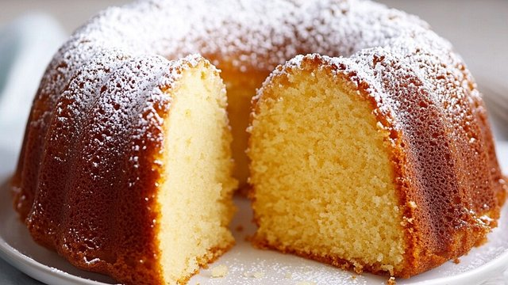
Thank you for your attention

Slide 9
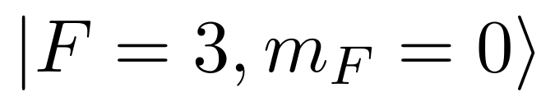
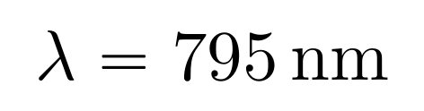
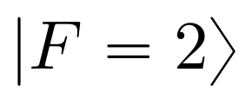
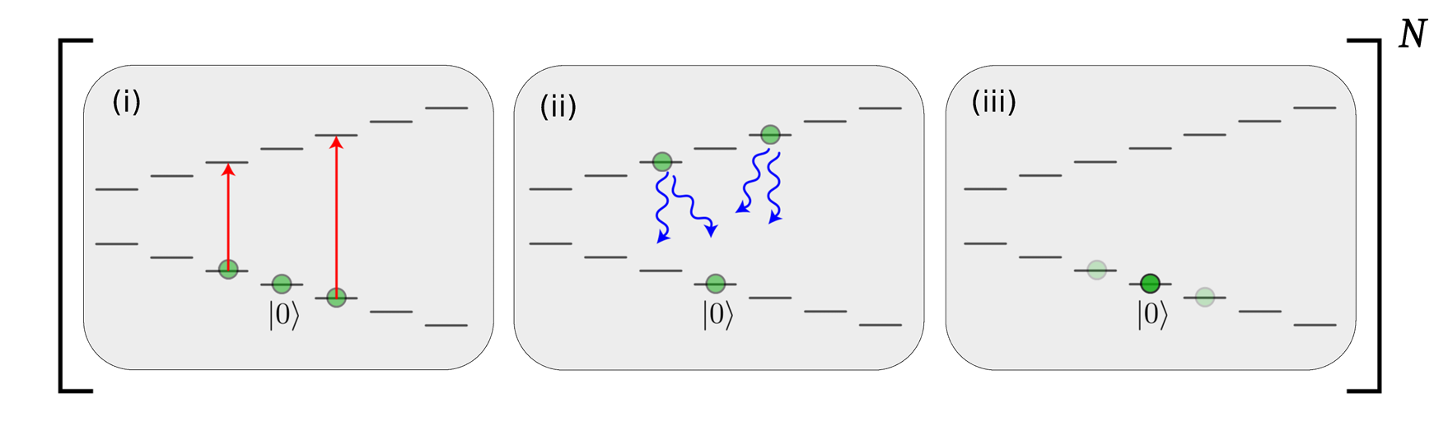
Initialization in a known state
Preparation in the dark state
Pumping with a coarse pump
Dissipative decay
Decay in
    Repump laser
Bachelor-Thesis Carlo B.

Slide 10
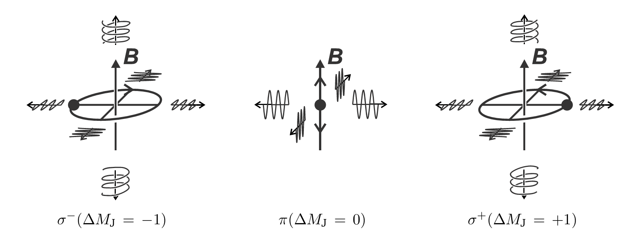
More

