Slide 1
Presentation Recording Google Drive Link
https://drive.google.com/file/d/1dwS7-YjPyWFCC3Y51wifHs7blYteeKzh/view?usp=sharing

Slide 2
Project 1
The effect of Covid 19 on Adobe from the perspective of Microeconomics and Macroeconomics
Group Members
K Daniel, Astha Gupta, Vinod V H, Lalit Soni

Slide 3
Introduction
The tech company chosen by our group is Adobe. The COVID-19 pandemic brought about profound changes for Adobe, resulting in notable macroeconomic and microeconomic shifts. At the macro level, the organization capitalized on the transition to remote work and the rapid digital transformation occurring across various sectors. On the micro level, Adobe modified its business strategy to enhance customer engagement, emphasize cloud services, and innovate its product offerings to align with the evolving demands of the workforce and the economy. Despite facing challenges stemming from economic uncertainty and fluctuating customer behaviors, Adobe's adaptable subscription model, along with its dominance in creative software, positioned the company favorably for success in a post-pandemic environment.

Slide 4
About Adobe Inc.
Adobe is a popular American multinational company that is specialized in software development for graphics design, photo and video editing including animation and print. One of the most popular products of Adobe is Adobe Photoshop which is a widely used photo editing software for multimedia and illustration of motion graphics.
In the year 2021, the company reported a revenue of $15.78 billion dollars.
Adobe Inc. is especially known for its amazing software for content creation, editing, photo, and video editing. It has developed software for a wide range of graphic designing and video rendering and editing. Adobe Photoshop which is the most popular photo editing software in the world, Adobe Acrobat Reader is among the most used application for portable document format (PDF), and Adobe Illustrator is considered to be the best illustration software for vector-based diagrams.

Slide 5
Supply and Demand Curves

Slide 6
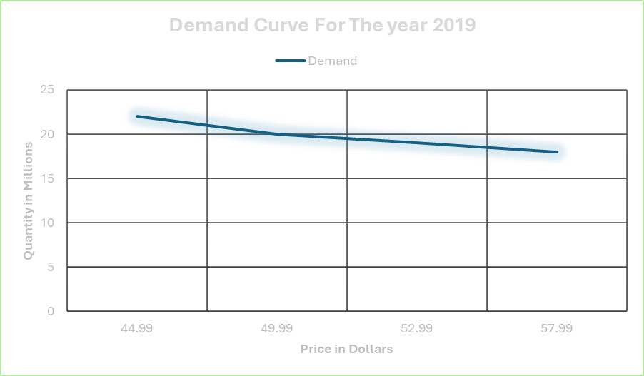
In the year 2019 the demand of quantity is continuously decreasing when price is increasing.

Slide 7
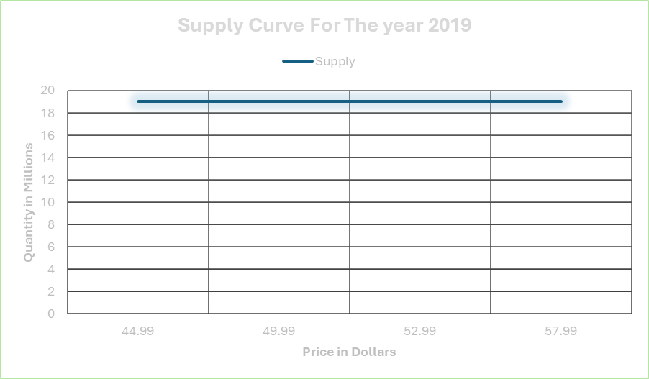
Supply is constant over the year which is 23 million of quantity with the prices tag from 44.99$ to 57.99$.

Slide 8
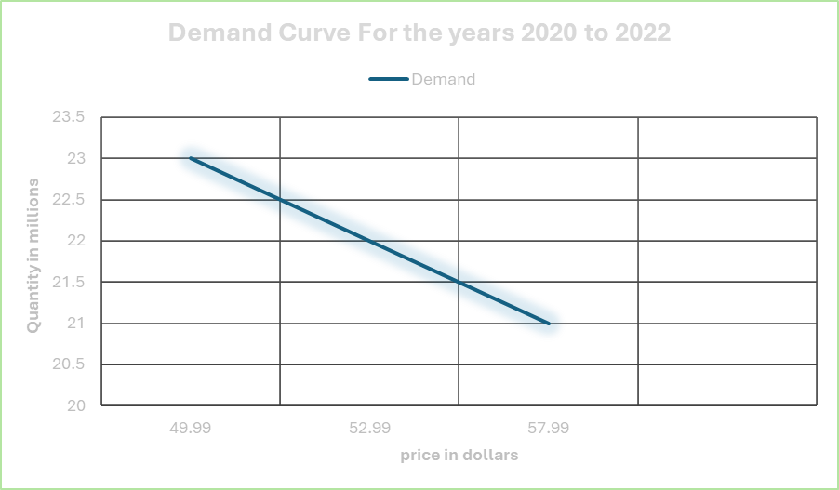
In the period of 2 years from 2020 to 2022 the demand for Adobe is declining whereas price is inclining.

Slide 9
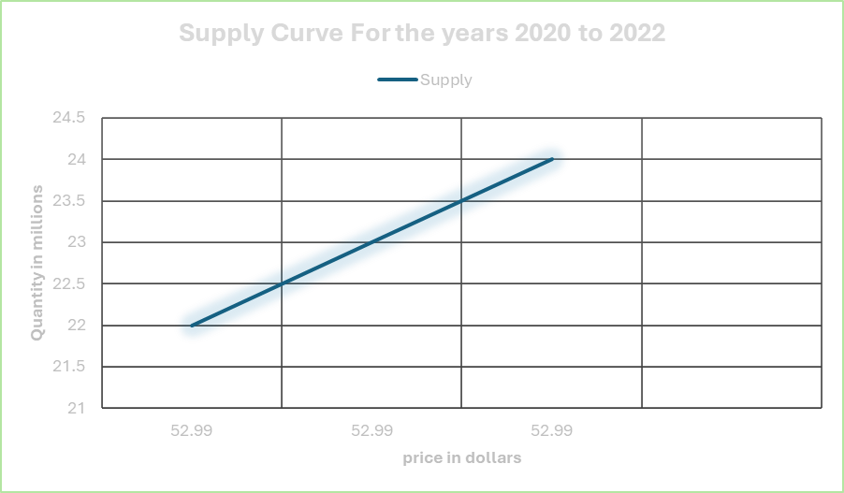
Supply is inclining with the time, but price is constant.

Slide 10
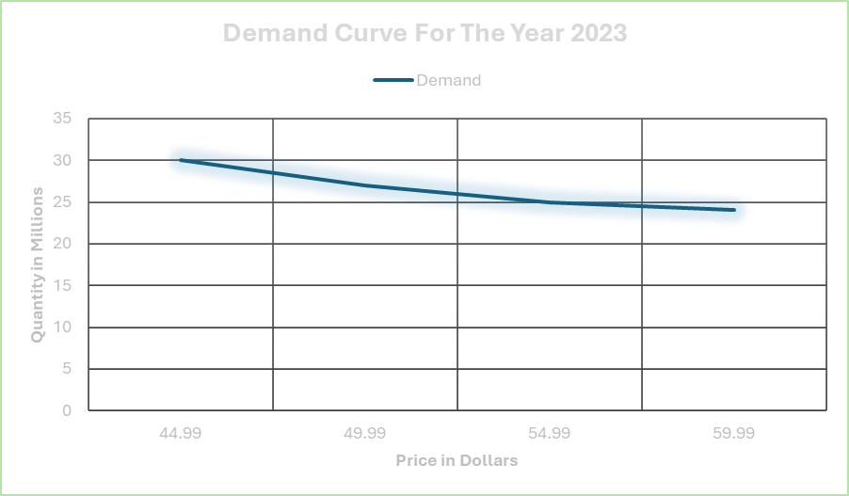
Demand for Adobe is decreased when price increases in the year 2023.

Slide 11
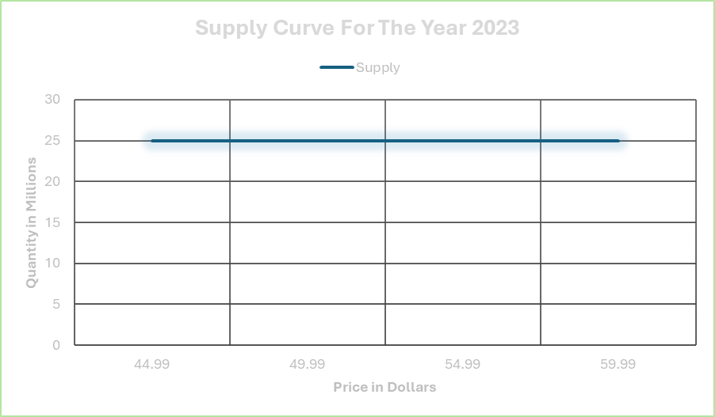
The supply for Adobe is constant which is 25 million quantities, in 2023 but price of the product is fluctuated.

Slide 12
Shift in Demand and Supply curve of Adobe

Slide 13
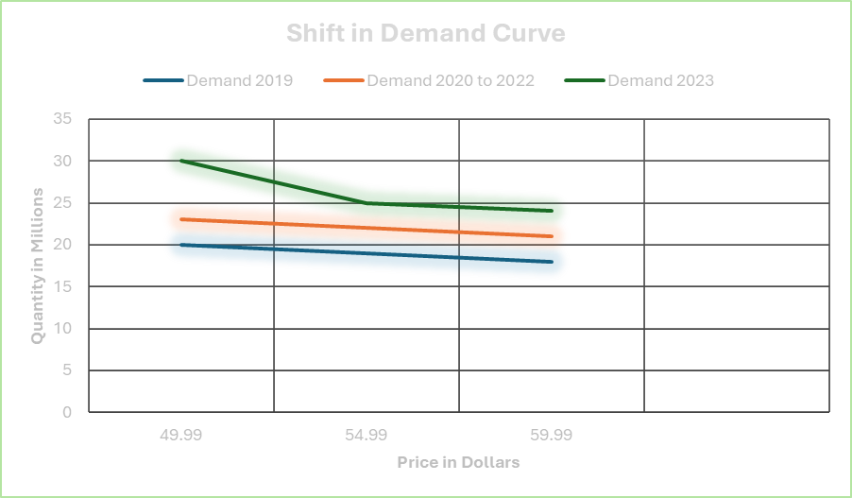
In the above graph, the demand is continuously increasing over the period from 2019 to 2023 where in 2019 and 2020 to 2022 the demand is continuously decreasing when price is growing whereas, there is drastic change in 2023.

Slide 14
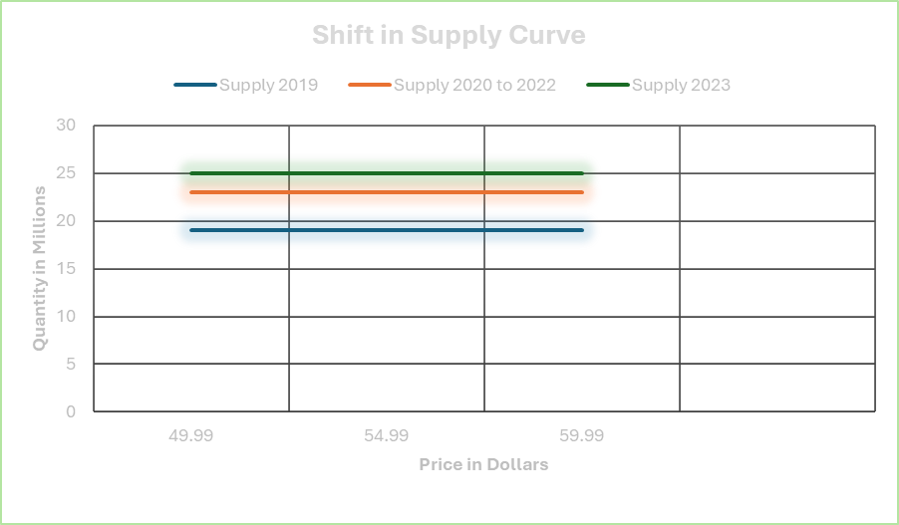
The above line graph of Adobe has constant number of supplies over the period.

Slide 15
Equlibriuim Price for Adobe Inc.

Slide 16
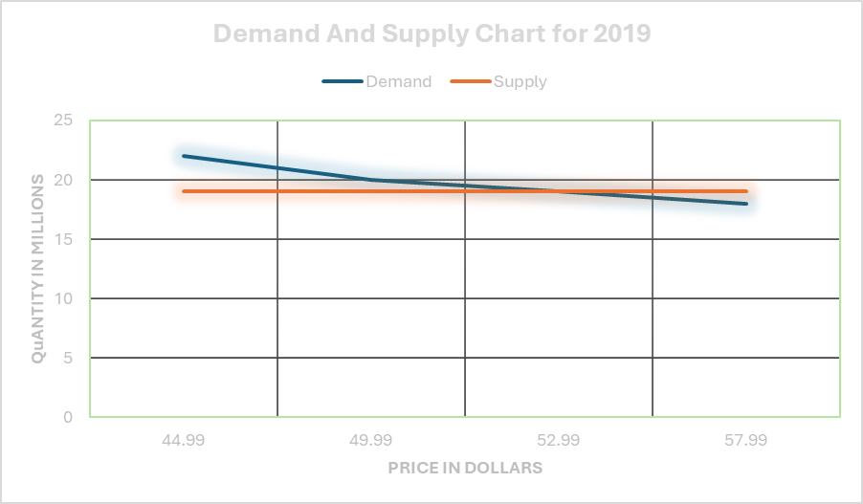
Equilibrium price also known as market clearing price, is the price at which the quantity of goods demanded by consumers is equal to the quantity of goods supplied by producers. It is the price where the plans of consumes, and producers agree. In 2019, the equilibrium price for adobe is 52.99$ because demand and supply curve cross at the same time in this point.

Slide 17
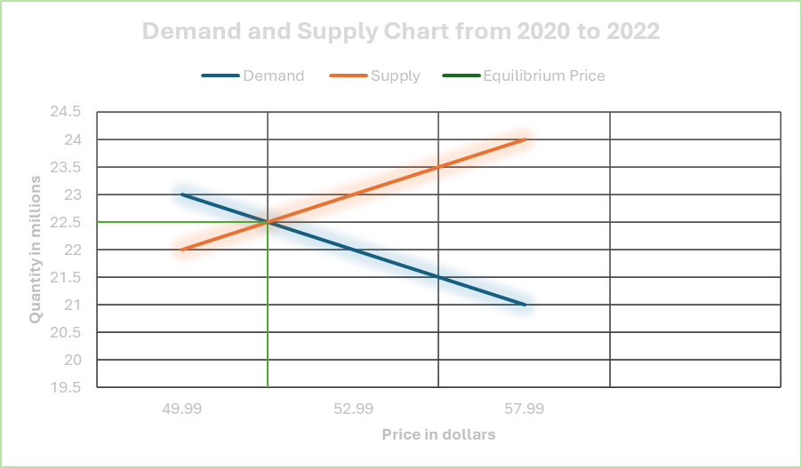
Equilibrium price for year from 2020 to 2022 is 51.49$

Slide 18
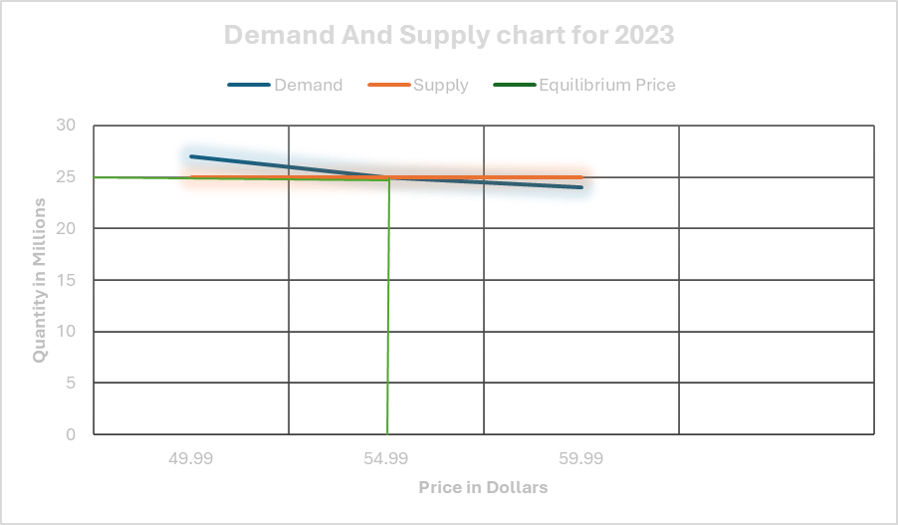
Equilibrium price for year 2023 is $54.99

Slide 19
An Analysis of Price and Demand Before, During, and After the Pandemic
The effects of the COVID-19 pandemic on Adobe Inc. will be discussed here, with a focus on how price, demand, and supply interacted during three distinct phases: before, during, and after the pandemic. It will be analyzed how Adobe adjusted its pricing strategies and product offerings in response to shifting market dynamics, showcasing the company’s adaptability and strength in utilizing its subscription-based model to address changing consumer demands and navigate economic challenges.
Keeping in mind mainly two factors:
Price and quantity demanded.
Price and quantity supplied.

Slide 20
Before COVID-19 (Pre-2020)
Price and Quantity Demanded:
  The demand for Adobe products remained consistently strong, thanks to their diverse offerings like the Creative Suite, which cater to fields such as graphic design, media, and publishing.
  The demand for these products was quite inelastic, indicating that even with minor price changes, customers continued to seek out Adobe's solutions.
  Although Adobe initially sold perpetual licenses and experienced some declines in demand due to price increases, the overall interest in their brand stayed solid.

Slide 21
Before COVID-19 (Pre-2020)
Price and Quantity Supplied:
  Adobe maintained a robust and effective supply chain, delivering software through both physical and digital means.
  Their strong market presence allowed them to easily ramp up production to satisfy customer needs.
  There was a clear connection between pricing and supply, as rising prices typically encouraged Adobe to invest more in expanding their offerings, such as additional licenses or software enhancements.

Slide 22
During COVID-19 (2020-2022)
Price and Quantity Demanded:
  The demand for Adobe's software experienced a notable change, particularly as remote work and online learning became more common, leading to a rise in the need for creative tools in areas like media production and digital marketing.
  Despite the increased interest in certain products, the sensitivity to price likely grew, as both consumers and businesses dealt with financial challenges, putting pressure on Adobe to keep prices stable or even reduce them.
  Consequently, Adobe's demand curve moved to the right for various products, with online creators and businesses opting for budget-friendly subscription plans, such as Creative Cloud, instead of costly one-time purchases.

Slide 23
During COVID-19 (2020-2022)
Price and Quantity Supplied:
  Global disruptions and remote work challenges initially impacted supply chains, but Adobe faced fewer physical limitations due to its digital software offerings.
  The subscription model allowed Adobe to maintain a more consistent revenue stream, enabling flexible pricing and supply adjustments.
  To meet the rising demand for digital tools, Adobe probably expanded its offerings by providing additional cloud-based solutions and increasing the availability of licenses at different price levels.

Slide 24
After COVID-19 (Post-2022)
Price and Quantity Demanded:
  The popularity of Adobe products has surged, fueled by the persistent digital transformation in sectors such as design, marketing, and content creation.
  In the wake of the pandemic, consumers and businesses have become more price-conscious while facing economic challenges. Adobe's transition to subscription services has provided greater affordability and flexibility, keeping demand steady.
  As more users and companies appreciate the benefits of Adobe’s cloud solutions (like Creative Cloud and Adobe Stock), the demand continues to thrive, although there is a growing trend towards seeking more budget-friendly alternatives.

Slide 25
After COVID-19 (Post-2022)
Price and Quantity Supplied:
  After the pandemic, Adobe became more flexible in its offerings by enhancing its cloud infrastructure and rolling out software updates, allowing for better scalability across various customer groups, including individuals, small businesses, and large enterprises.
  The shift towards subscription models likely pushed the supply curve upward, enabling Adobe to modify pricing strategies according to demand for different plans.
  By offering tiered pricing and extra features, Adobe effectively met the needs of both budget-conscious customers and those seeking premium services.

Slide 26
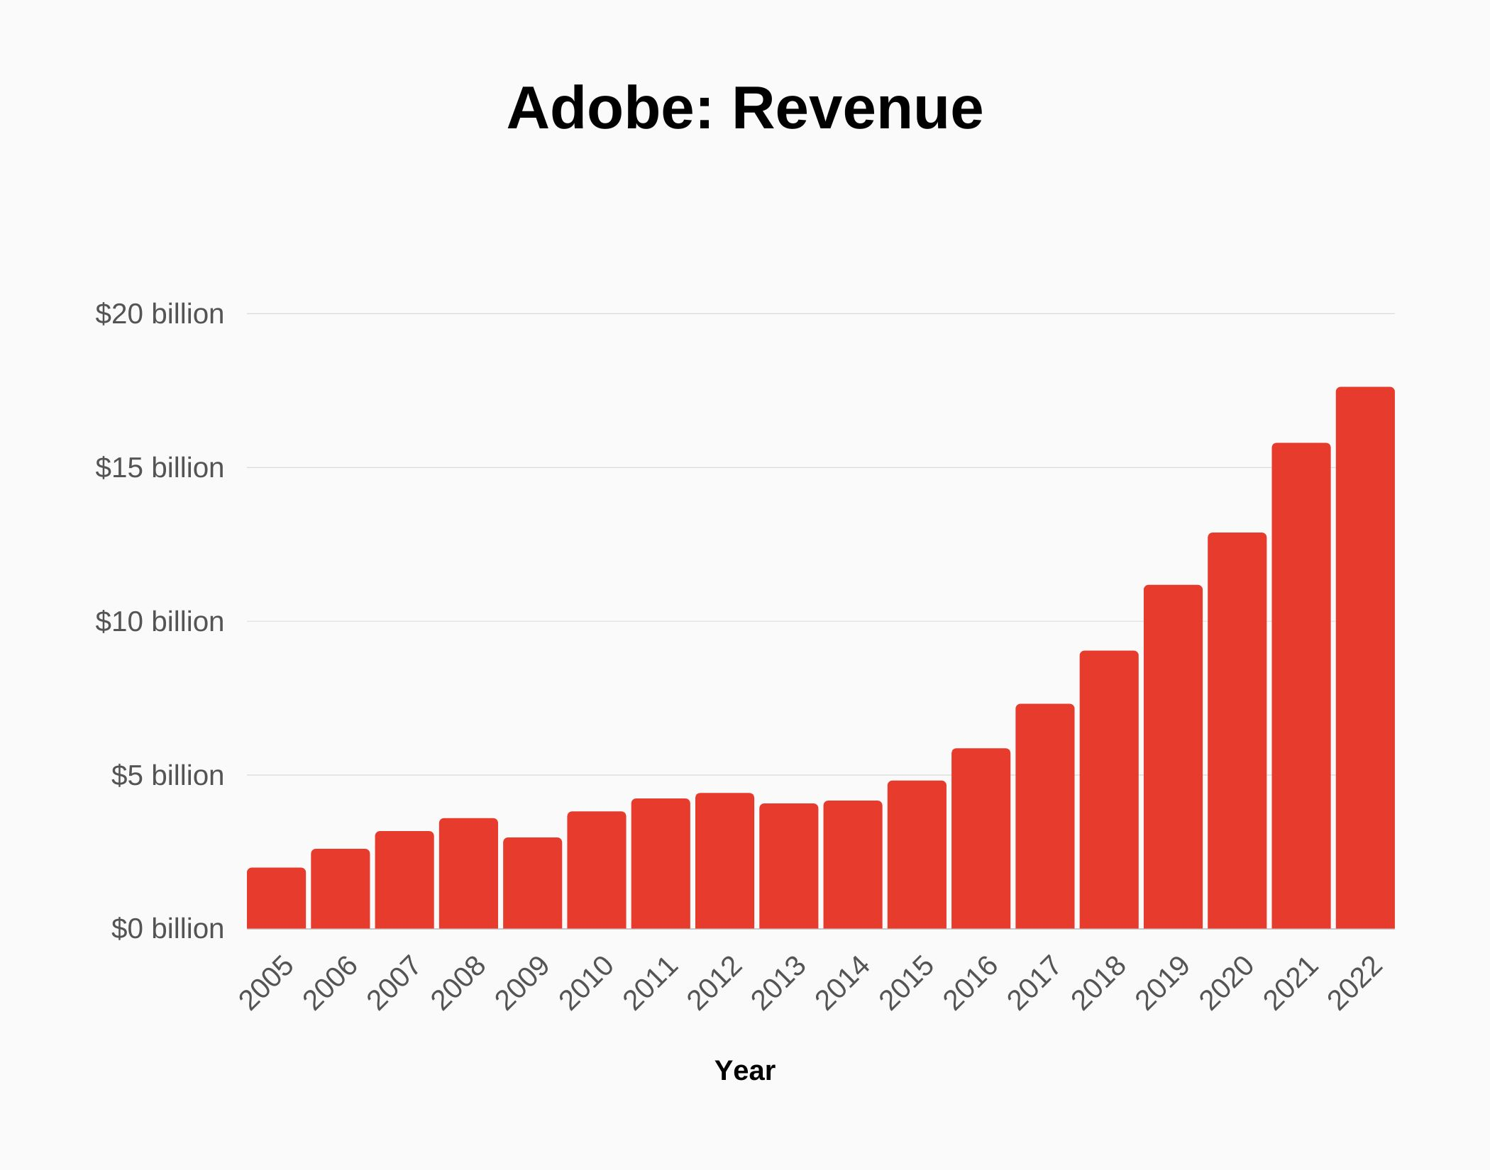

Slide 27
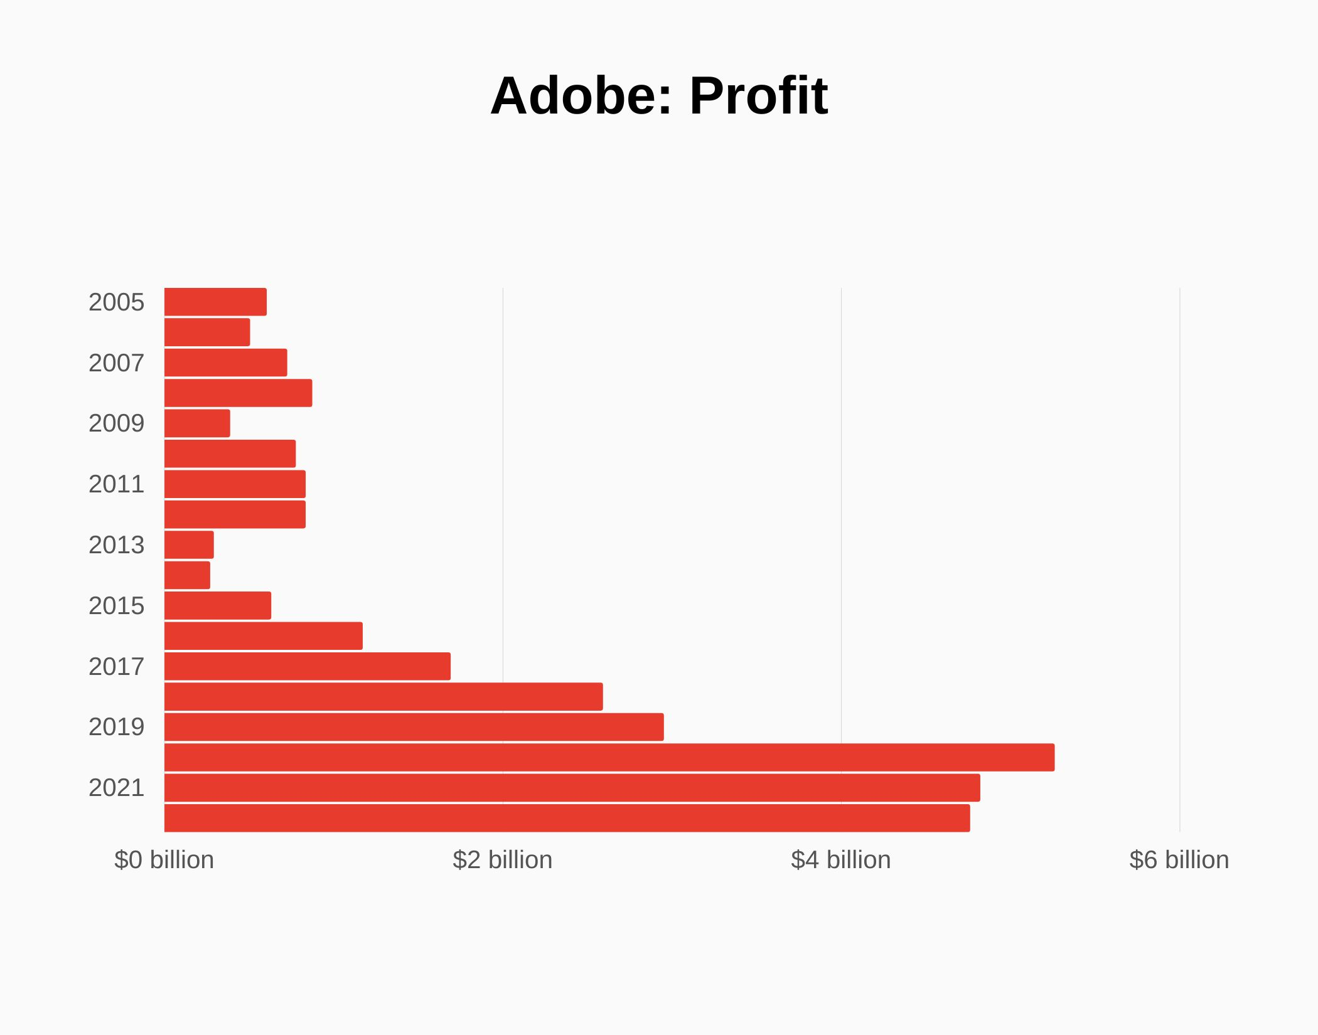

Slide 28
Macroeconomic factors changed in Adobe Inc.
To understand this better let’s look at four different factors in the various time zones with respect to the 2008 financial crisis and the Covid-19 pandemic. The main factors being:
Inflation
Recession
Unemployment
Taxes on industry
The various time zones being:
Pre-2008 Financial Crisis (2000–2007)
During the 2008 Financial Crisis (2008–2009)
Post-2008 Recovery & Subscription Transition (2010–2024)

Slide 29
Pre-2008 Financial Crisis (2000–2007)
Inflation - Stable Inflation (2-4%): Provided a predictable environment for Adobe to set prices for products like Adobe Creative Suite and software costs are generally impacted less by inflation compared to physical goods.
Recession - Economic Growth: Strong expansion, particularly in the tech sector and the rising adoption of digital media solutions benefited Adobe’s business model.
Unemployment - Low Unemployment (4.5-5%): high employment meant more disposable income for premium software products and Adobe benefited from a skilled labour force, especially in tech and creative sectors.
Taxes on the Industry - Stable Corporate Tax Rates: high corporate tax rates, but favourable treatment for R&D spending and Adobe’s global presence allowed for effective tax strategies.

Slide 30
During the 2008 Financial Crisis
Inflation - Initial Inflation Spike, Then Deflation: Commodity prices surged before the downturn; later, deflationary pressures affected consumer spending and reduced demand for premium software in a recessionary environment.
Recession - Global Contraction: Adobe faced a significant slowdown as companies cut non-essential spending, impacting software sales and decreased demand from key sectors like advertising, publishing, and media.
Unemployment - Rising Unemployment (10% Peak): High unemployment led to reduced discretionary spending, affecting Adobe’s customer base and creative professionals still needed software, but companies were cautious with spending.
Taxes on the Industry - Government Stimulus: Some tax relief measures, but overall reduced corporate profits and government spending and reduced opportunities for Adobe in public sector contracts.

Slide 31
Post-2008 Recovery & Subscription Transition (2010–2024)
Inflation - Stable Inflation, with COVID-related Spike (2020-2021): Post-crisis, inflation remained moderate, but surged during the pandemic due to supply chain disruptions and Adobe managed inflationary pressures through its subscription model.
Recession - Pandemic Recession (2020): Adobe benefited from increased demand for digital tools as remote work, online education, and content creation grew and the shift to a cloud-based, subscription model proved resilient during economic downturns.
Unemployment - Gradual Recovery, Pandemic Spike: Unemployment rates gradually decreased, but the pandemic caused a temporary spike and Adobe’s transition to a more flexible, remote-work model helped retain a skilled workforce.
Taxes on the Industry - Corporate Tax Cuts (2017): U.S. corporate tax rates reduced from 35% to 21%, providing tax savings for Adobe and tax savings allowed for increased investment in innovation and global expansion.

Slide 32
Main Insights
Pre-2008: A strong and stable economy fostered consistent growth, with Adobe benefiting from low inflation, low unemployment, and supportive tax policies.
2008 Financial Crisis: The recession prompted Adobe to quickly adapt as demand for high-end products declined. However, the company’s shift to subscription-based models started to generate more stable, recurring revenue.
Post-2008 Recovery: Adobe’s transition to a cloud-based subscription model (Creative Cloud) positioned the company for long-term success, enabling it to remain resilient even through economic challenges such as the COVID-19 pandemic.

Slide 33
Factors | Pre-2008 | During crisis (2008-2009) | Post crisis (2010-2024)
Inflation | Stable 2-4% | Deflationary pressures | Moderate with pandemic spike
Recession | Tech boom growth | Economic contraction | Resilient due to cloud shift
Unemployment | Low 4.5-5% | High 10% | Gradual recovery, pandemic impact
Taxes on the Industry | Stable, favorable for R&D | Stimulus but high corporate tax | Lower taxes 21% corporate

Slide 34
International Issues and Developments that Affected Adobe Inc
There are some international issues and developments that could potentially affect Adobe and are noted below for reference.
Geopolitical Uncertainties
Regulatory Changes
Economic Conditions
Competition

Slide 35
Geopolitical Uncertainties
Here are some examples of geopolitical uncertainties that have affected companies like Adobe.
    US-China Trade War: US-China trade tensions, with tariffs and restrictions, have disrupted Adobe's sales in China and supply chain, creating uncertainty for future revenue planning.
    Russia-Ukraine Conflict: The Russia-Ukraine conflict has disrupted supply chains and raised energy prices, increasing Adobe's operational costs and reducing consumer spending on software.

Slide 36
    Cybersecurity Threats: Geopolitical tensions have increased cyberattacks, with Adobe facing threats that could compromise customer data and harm its reputation.
    Economic Sanctions: Sanctions on countries like Russia and Iran limit Adobe's market access and create legal and financial challenges.
    COVID-19 Pandemic: The global pandemic disrupted Adobe's operations, with travel restrictions, lockdowns, and shifting consumer behavior affecting sales in multiple markets.

Slide 37
Regulatory Changes
Adobe has had to navigate various regulatory changes across different regions, which have impacted on its operations and compliance efforts. Here are a few examples:
General Data Protection Regulation (GDPR): Adobe has had to ensure compliance with GDPR, which imposes strict rules on data protection and privacy for individuals within the European Union. This has required Adobe to implement robust data protection measures and provide transparency in how it handles user data.
California Consumer Privacy Act (CCPA): Like GDPR, the CCPA grants California residents’ new rights regarding their personal information. Adobe has had to update its privacy policies and practices to comply with these regulations, ensuring that users have control over their data.

Slide 38
Digital Services Act (DSA): Adobe has adapted to comply with the EU's Digital Services Act, which aims to create a safer digital space with more accountability for online platforms. This has involved updating terms of use and implementing measures to combat illegal content and protect user rights.
Health Insurance Portability and Accountability Act (HIPAA): For Adobe's healthcare-related products, compliance with HIPAA is crucial. This involves ensuring that protected health information (PHI) is handled securely and in accordance with regulatory requirements.
Terms of Use Updates: Adobe has faced backlash and had to revise its terms of use to clarify how it handles user content and addresses concerns about privacy and data usage. These updates are part of Adobe's efforts to maintain transparency and build trust with its users.

Slide 39
Economic Conditions
Economic instability can have various impacts on companies like Adobe. Here are some ways it might affect them:
COVID-19 Pandemic: The pandemic caused significant economic disruptions globally. Adobe saw a surge in demand for its digital solutions as businesses and individuals shifted to remote work and online collaboration. However, the economic uncertainty also led to budget constraints for some customers, affecting their purchasing decisions. During economic downturns, both individuals and businesses tend to cut back on spending. This can lead to a decrease in sales of Adobe's products and services, as customers may delay or cancel their purchases.

Slide 40
Supply Chain Disruptions: Economic instability can disrupt supply chains, affecting the availability and cost of materials and components needed for Adobe's products. This can lead to increased production costs and potential delays in product delivery.
Currency Fluctuations: Changes in currency exchange rates can impact Adobe's revenue, especially since it operates globally. A stronger US dollar can make Adobe's products more expensive in other countries, potentially reducing sales.
Investment and Growth: Economic instability can affect Adobe's ability to invest in new projects and technologies. Uncertainty in the market can lead to cautious spending and reduced investment in research and development.

Slide 41
Competition
Adobe faces competition from various international companies across different segments of its product offerings. Here are some notable competitors:
Microsoft: With products like Microsoft Office and Adobe Creative Cloud alternatives, Microsoft is a significant competitor.
Autodesk: Known for its design software like AutoCAD and Maya, Autodesk competes with Adobe in the design and creative industries.
Corel: CorelDRAW and other Corel products compete with Adobe's graphic design software.
Canva: This online design platform offers tools for graphic design, presentations, and other creative tasks, competing with Adobe's suite of design tools.
Google: With tools like Google Workspace and Google Photos, Google competes with Adobe in productivity and creative software space.

Slide 42
Fiscal and Monetary Changes
During the COVID-19 pandemic, both fiscal and monetary policy changes had significant impacts on various industries, including Adobe. Here's how:
Fiscal Policy Changes
  Government Stimulus Packages: Governments around the world, including the US, implemented stimulus packages to support businesses and individuals. These packages provided financial relief to companies, helping them navigate the economic downturn.
  Tax Relief and Deferrals: Many governments offered tax relief and deferrals to businesses, reducing their financial burden and allowing them to allocate resources more effectively.

Slide 43
Monetary Policy Changes
  Interest Rate Cuts: The Federal Reserve cut interest rates to near zero to stimulate economic activity. This made borrowing cheaper for businesses, including Adobe, allowing them to invest in new projects and technologies.
  Emergency Lending Programs: The Fed introduced emergency lending programs to provide liquidity to businesses and financial markets. This helped companies like Adobe maintain cash flow and continue operations during the economic uncertainty.

Slide 44
Impact on Adobe
Increased Demand for Digital Solutions: The pandemic accelerated the shift towards remote work and digital solutions, boosting demand for Adobe's products like Adobe Creative Cloud and Adobe Acrobat.
Operational Adjustments: Adobe had to adapt its operations to comply with new regulations and support remote work for its employees. This required investments in technology and infrastructure.
Financial Resilience: The combination of monetary and fiscal policy measures helped Adobe maintain financial stability and continue its growth trajectory despite the challenging economic environment.
These policy changes played a crucial role in helping Adobe navigate the pandemic and emerge stronger.

Slide 45
Bibliography
https://usesignhouse.com/blog/adobe-stats/
https://photutorial.com/adobe-statistics/
https://www.adobe.com/investor-relations/financial-documents.html
https://www.geeksforgeeks.org/adobe-company-overview-history-products/
https://www.statista.com/statistics/266399/revenue-of-adobe-systems-worldwide-since-2004/

