Slide 1
BRFSS Diabetes Risk Factors Week 1 Daniel-Kast/Daniel-Kast-ANA-500-BRFSS-Project: Using BRFSS to examine the risk factors in Diabetes
Daniel Kast
October 3, 2025

Slide 2
Problem Statement
What factors are associated with diabetes risk among U.S. adults?
Using the Behavioral Risk Factor Surveillance System (BRFSS) dataset, this project explores demographic, behavioral, and health-related variables to identify patterns and predictors of diabetes diagnosis.

Slide 3

Hypothesis
Adults with lower physical activity, higher BMI, and limited access to healthcare are more likely to report a diabetes diagnosis.
Demographic factors such as age, income, and education may also influence risk

Slide 4

Acquire
Data Sources:
CDC BRFSS 2014 survey
Three datasets: data_categorical.csv, data_numeric.csv, data_ordinal.csv
Steps Taken:
Merged datasets using PERSONID
Referenced CDC codebook for variable definitions
Verified completeness and structure of merged data (5000 respondents, 35+ variables)

Slide 5

Prepare
Identified 17 variables with missing data
KNN Imputation applied to 7 variables:
_BMI5CAT, FLUSHOT6, RENTHOM1, INCOME2, EMPLOY1, NUMADULT, DRVISITS
Mode Imputation applied to 5 variables:
DECIDE, BLIND, USEEQUIP, MARITAL, RACE
MSCODE Imputation:
Used a state-wise mode strategy: filled missing MSCODE values using the most frequent value within each _STATE
Applied a national fallback mode when state-level data was unavailable
Converted metric weights to pounds in WEIGHT2, preserving original values and flagging conversions
Consolidated MARITAL.1 into MARITAL after confirming match
Removed redundant diabetes variables: DIABETE3_x, DIABETE3_y, DIABETE3.1
Created audit flags for all imputed values to preserve interpretability

Slide 6
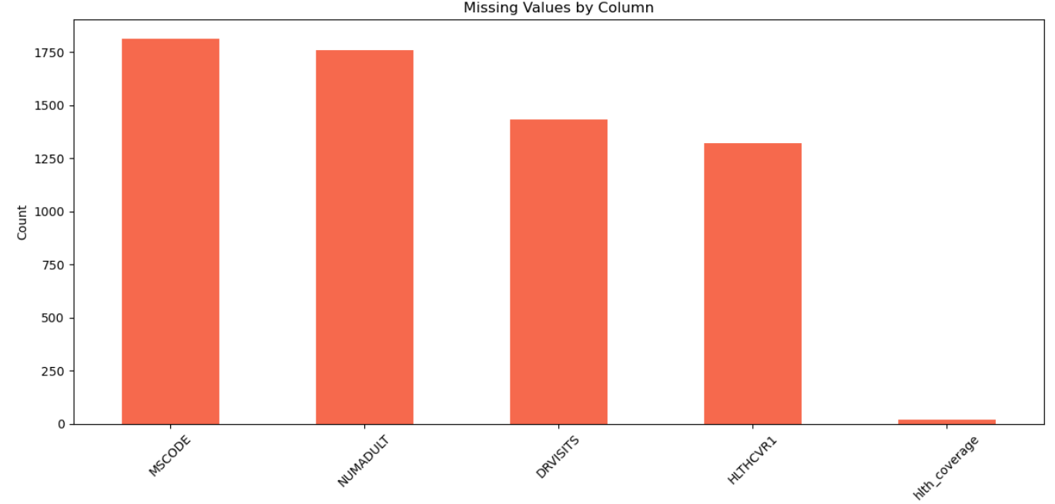
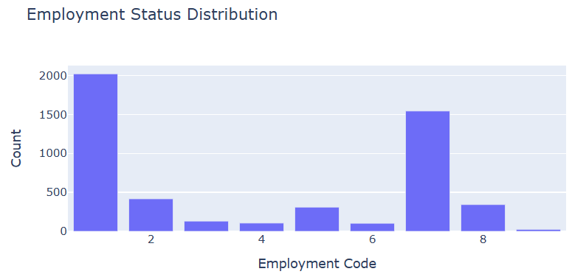
Analyze data
MSCODE, NUMADULT, HLTHCVR1, and DRVISITS have the most missing values. These were imputed using domain-aware strategies (state-wise mode, KNN, and conditional logic). Remaining gaps are flagged for post-EDA handling.
Employment codes 1 and 7 dominate, representing full-time workers and retirees. This variable may influence health access and lifestyle indicators.

Slide 7
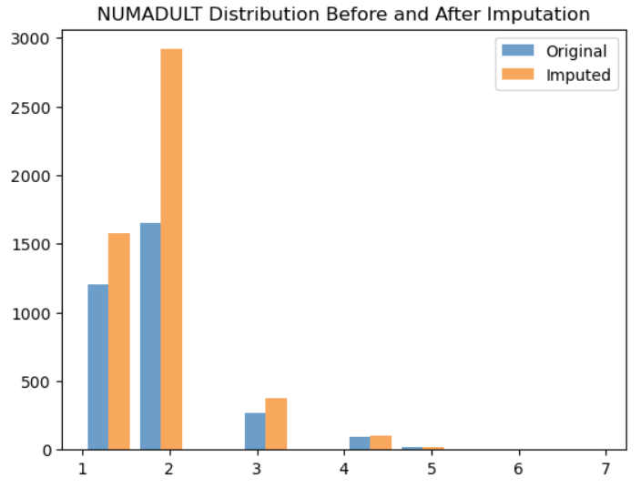
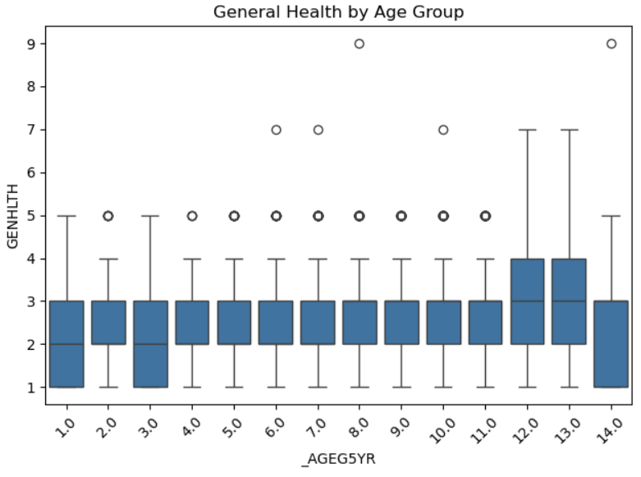
Analyze Data
Health ratings decline with age, confirming `_AGEG5YR` as a strong predictor of perceived health. GENHLTH will be retained as ordinal for interpretability.
KNN imputation preserved the original distribution shape, avoiding artificial inflation of zeros and maintaining realistic household sizes.

Slide 8
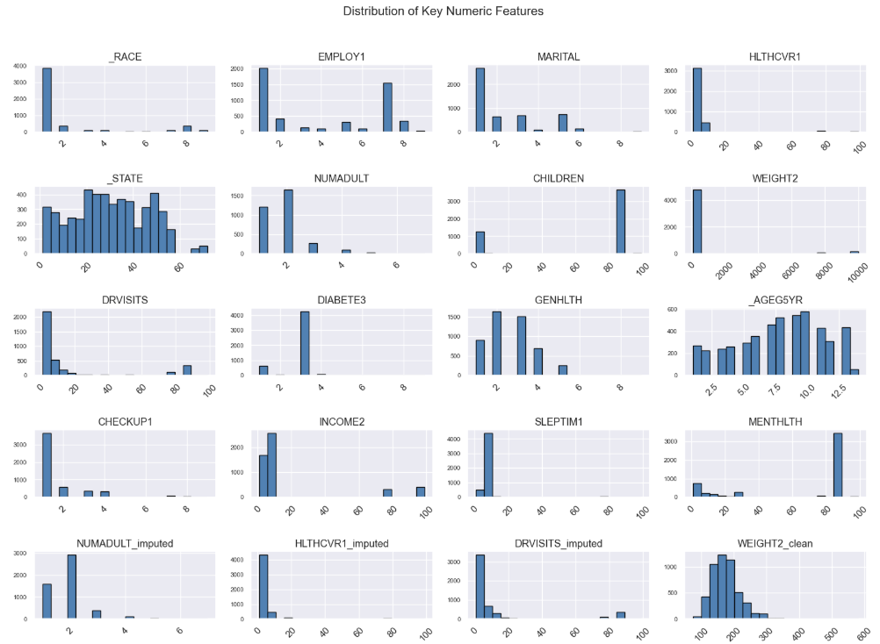
Analyze Data
This histogram grid visualizes the distribution of numeric features with sufficient variability. X-axis labels were rotated for clarity, and layout spacing was adjusted to prevent overlap. Features like `WEIGHT2`, `DRVISITS`, and `MENTHLTH` show wide spread and potential outliers, while others like `HLTHPLN1` and `EXERANY2` are tightly clustered.

Slide 9
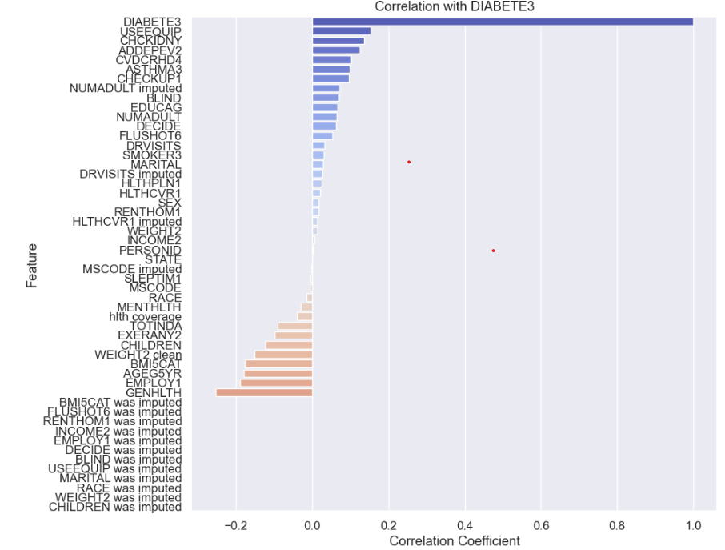
Analyze Data
GENHLTH (general health rating) shows the strongest negative correlation, suggesting that individuals with diabetes tend to report poorer overall health.
DRVISITS (doctor visits) and WEIGHT2 (weight) show moderate positive correlations, indicating that diabetes status may be linked to increased healthcare usage and higher body weight.
BMI5CAT and AGEG5YR also show meaningful associations, reinforcing known risk factors. These insights support the inclusion of health perception, weight, and age-related variables in the predictive model. Categorical variables will be encoded later to complete the feature set.

Slide 10
Report
<communicate results>

Slide 11
Act
<apply results, connect results with the chosen problem statement or business question>

