Slide 1
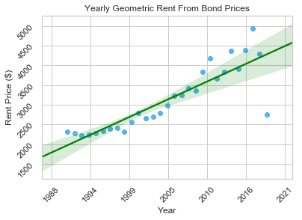
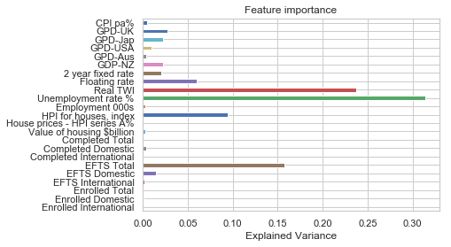
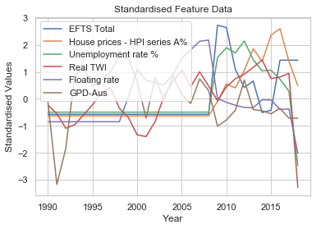
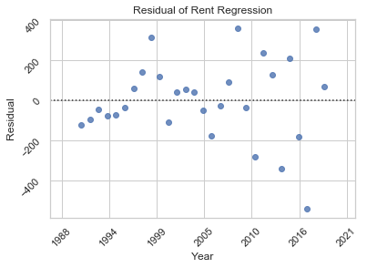
R2 SCORE: 0.927
Many datasets were selected and manipulated to concatenate them into one large dataset of features.
Out of 23 features, however, only a few were found to be influential on rent prices.
Rent prices have been increasing in Wellington for over 20 years.
Our residual graph shows mostly random variation. Slight pattern on the left. Overall, a good model fit
The data was standardized and the dimensions were reduced to only significant features before regression was applied.

