Slide 1
DIFFUSION PROJECT
Interpolation
Learning a transformation between breast-phantom volumes with flow matching.
Daniel Kozin
215550260
Notes:
Title. Diffusion project on interpolation.

Slide 2
CONTENTS
Overview
Data
01
Part A, interpolation between our data
02
Part B, 180° rotation
03
02
Notes:
Three parts: the data, Part A interpolation, Part B rotation.

Slide 3
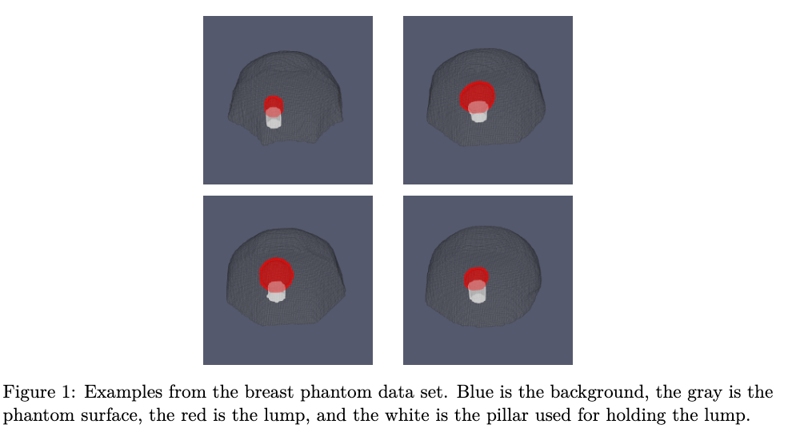
DATA
The dataset
984 distinct data points, each of size 128 × 128 × 26 voxels.
background
phantom surface
lump
pillar holding the lump
Fig. 1, examples from the breast phantom dataset.
03
Notes:
984 volumes, 128 by 128 by 26 voxels.

Slide 4
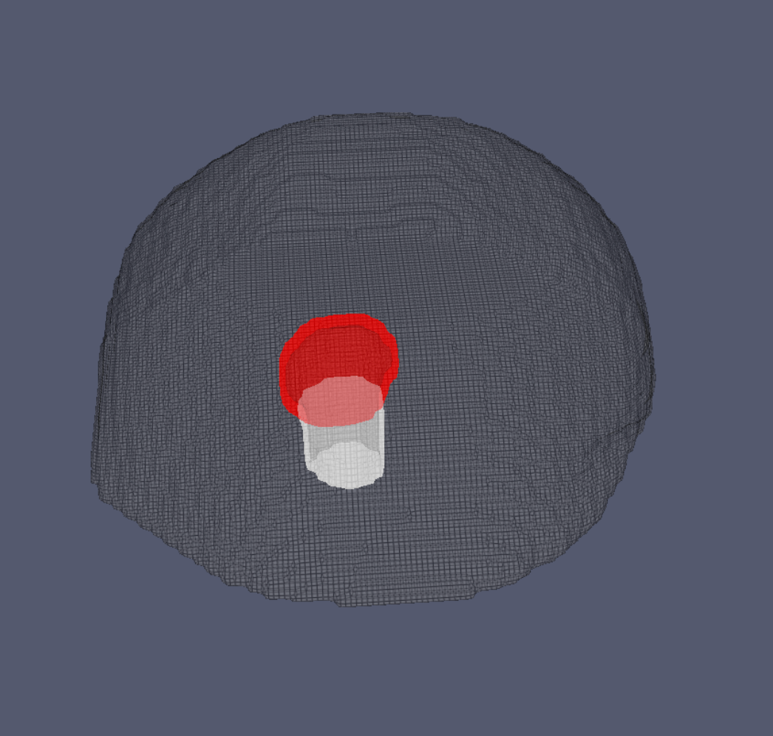
DATA
Our voxels are imbalanced
Background
50.8%
Insert
48.0%
Lump
0.94%
Pillar
0.32%
The two classes we care about make up barely 1% of every volume.
04
Notes:
The classes are severely imbalanced, pillar and lump are a fraction of a percent.

Slide 5
PART A
Interpolation between our data
05
Notes:
Part A begins.

Slide 6
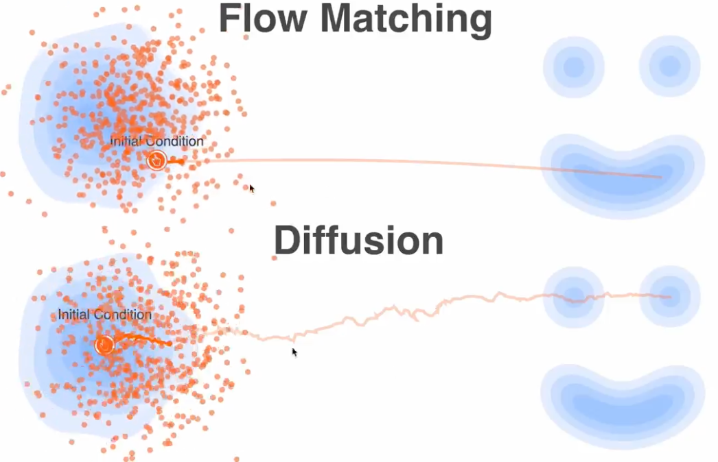
PART A
The goal
Take two different data points and generate a new one that interpolates between them.
Formally, we have data points x₁ and x₀ ∼ N(0, I ), and we want to learn a transformation between them.
To do this, we use a flow matching model.
Fig. 2, flow matching learns a straight path; diffusion wanders.
06
Notes:
Goal: take two data points and generate a new one between them, using flow matching.

Slide 7
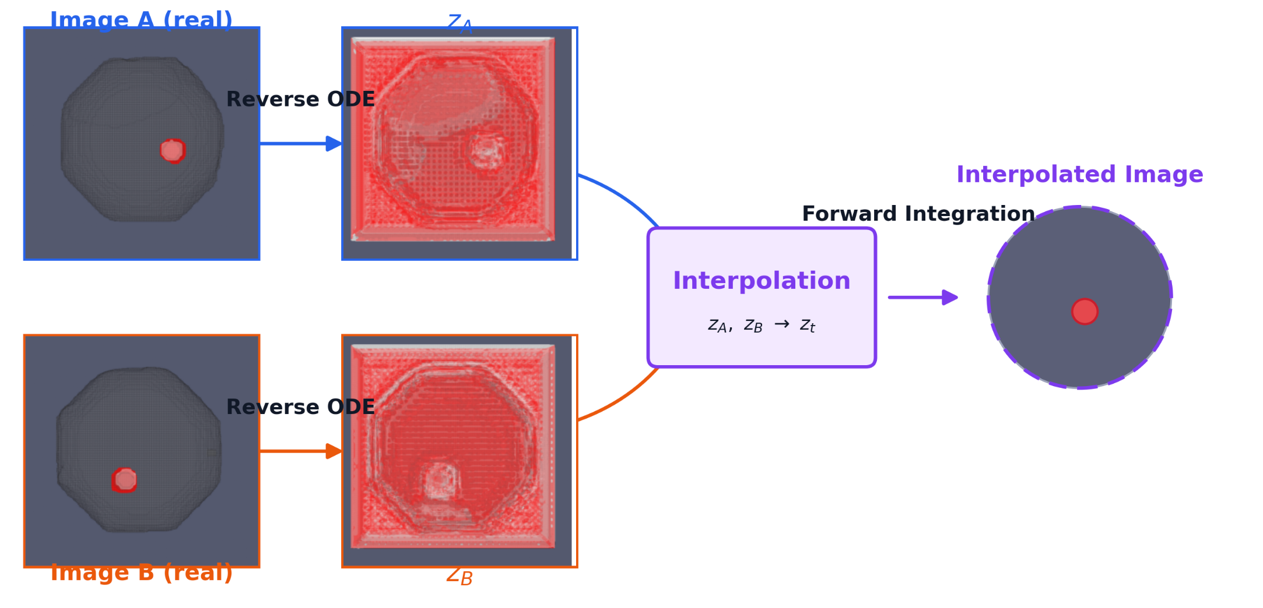
PART A
The pipeline
Fig. 3, two images are inverted to noise, interpolated with slerp, then integrated forward.
07
Notes:
The pipeline: invert both images to noise, slerp, then integrate forward.

Slide 8
PART A
Slerp
Linear interpolation between two Gaussians doesn’t work well: it doesn’t preserve length.
Linear interpolation is like drilling in a straight line through the globe. Slerp takes the curved, and correct, path along its surface.
sin((1−α) θ)
sin(α θ)
slerp(a, b, α) =
a
+
b
sin θ
sin θ
a · b
θ = arccos
(
)
‖a‖ ‖b‖
08
Notes:
Linear interpolation between Gaussians doesn't preserve norm; slerp follows the sphere.

Slide 9
RESEARCH QUESTION
Given our data and this interpolation method, we ask ourselves:
Can we interpolate between two different data points?
09
Notes:
The research question.

Slide 10
PART A
Our loss
We started with a standard MSE loss between voxels, but because of the enormous class imbalance we switched to a class-weighted MSE:
[
1
C
Σ
]
ℒ_{weighted}(θ) = 𝔼
Σ
w_{c}
(v_{θ} − v*)²_{c, voxel}
C · D
voxels
c = 1
WHERE THE WEIGHTS ARE
w = (1.0, 1.03, 12.57, 7.36) for (background, insert, pillar, lump)
10
Notes:
Standard MSE failed on the imbalance, so we weighted it per class.

Slide 11
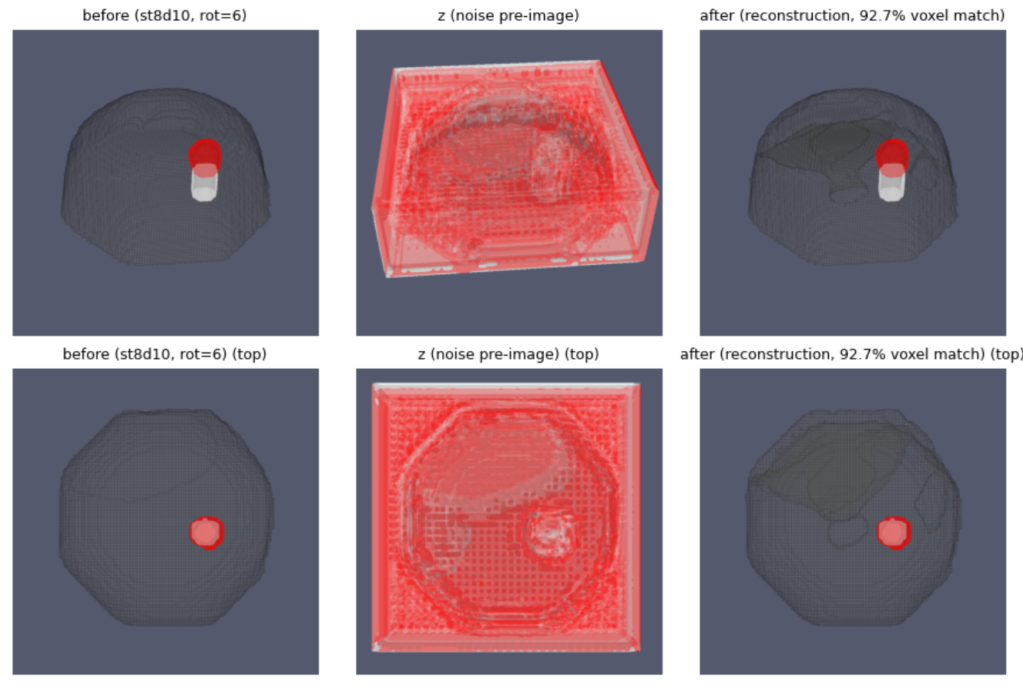
PART A
Sanity check
Before testing interpolation at all, we tested the model itself: we reversed the ODE and integrated the data forward again.
98.3%
reconstruction accuracy on the lump and pillar classes
Fig. 4, before inversion, the noise pre-image, and the reconstruction.
11
Notes:
Sanity check: invert the ODE and integrate forward, 98.3% on lump and pillar.

Slide 12
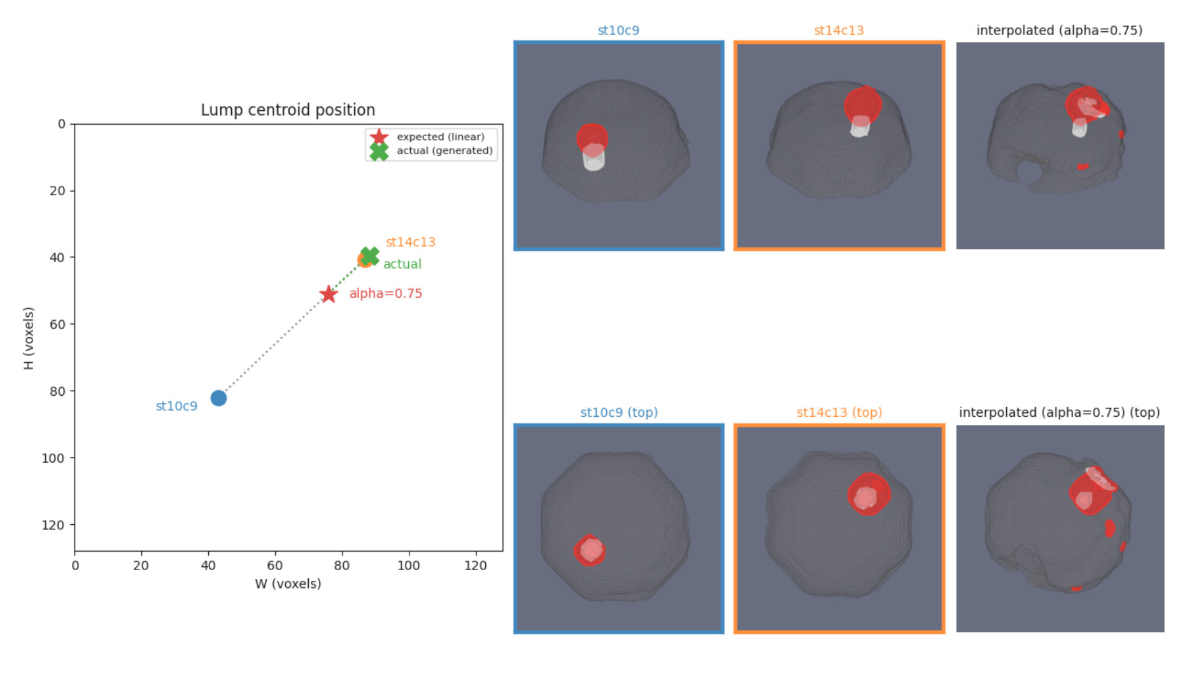
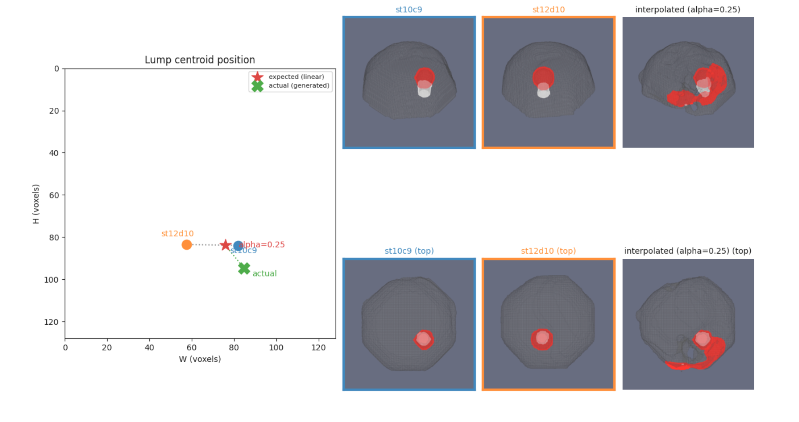

PART A
Disappointing results
The generated volume collapses onto one endpoint.
12
Notes:
On the actual interpolation task the results were disappointing.

Slide 13
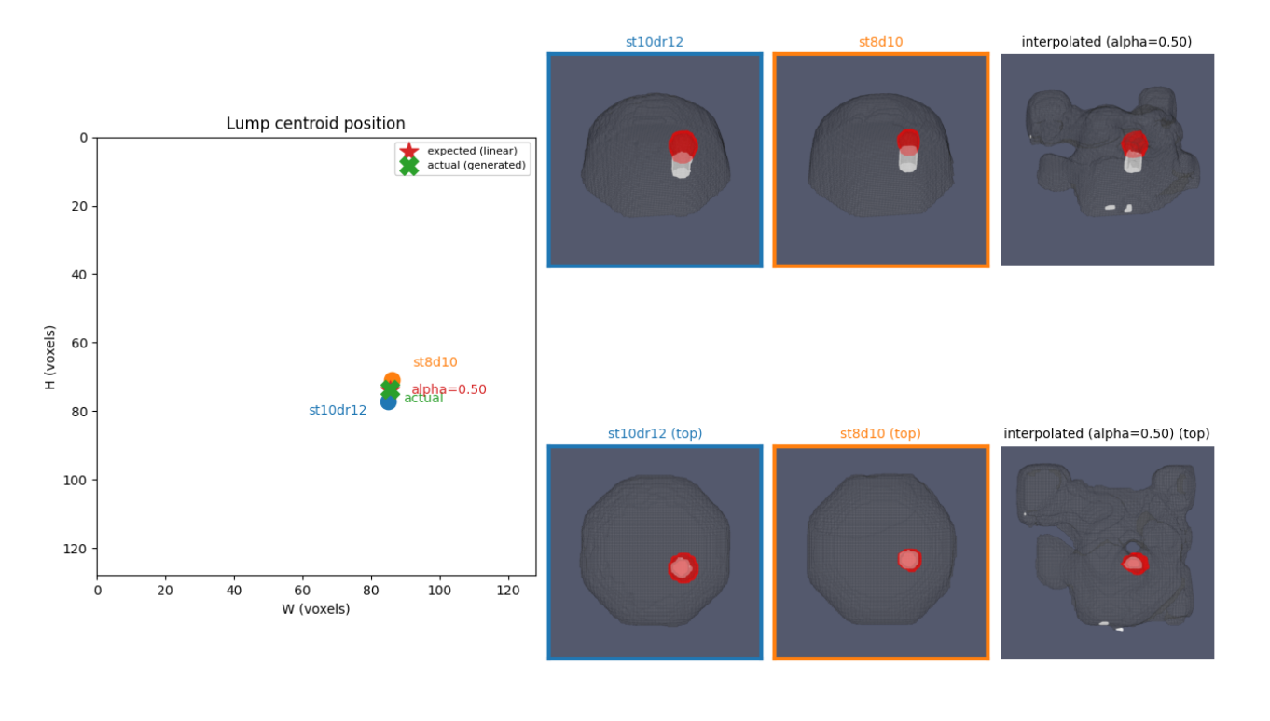
PART A
Some predictions were good
At least in terms of the lump.
13
Notes:
Some predictions were genuinely good for the lump.

Slide 14
PART A
A different approach
We tried many things, longer training, different losses, hyperparameter tuning, and none of them worked. So we rethought the setup.
14
Notes:
More training, other losses, tuning, nothing worked. Time for a different approach.

Slide 15
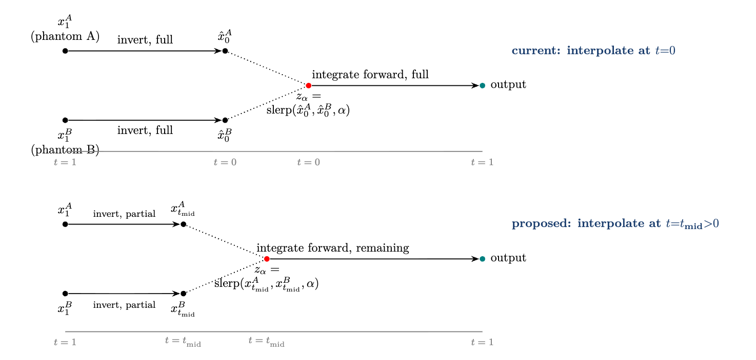
PART A
The new formulation
15
Notes:
The reformulated setup.

Slide 16
PART A
Metrics
01 CENTROID MAE
02 COMPONENT COUNTS
1
N
Average lump-component and average anatomy-component metrics track how many connected components a prediction contains.
centroid MAE =
Σ
‖p_{expected}^{(i)} − p_{actual}^{(i)}‖₂
N
i = 1
WHERE
LUMP COMPONENTS
ANATOMY COMPONENTS
p_{expected}(α) = (1 − α) p_{A} + α p_{B}
p_{A} and p_{B} are the real lump centroids; p_{actual} is the centroid the model predicted.
1
4
target
target
16
Notes:
Two families of metrics: centroid MAE, and connected-component counts. We want one lump component and four anatomy components.

Slide 17
The numbers look fine
RESULTS
The metrics suggest a decent model, but when we look at the actual predicted images, we see something different.
t_{mid}
centroid MAE (voxels)
avg. anatomy components
avg. lump components
0.1
10.81
22.78
7.18
0.2
7.93
25.82
5.32
0.3
6.86
26.57
2.97
0.4
6.80
23.50
2.23
0.5
6.86
17.67
2.62
0.6
6.55
7.73
3.12
0.7
6.40
5.77
5.15
0.8
7.10
5.07
3.78
0.9
7.15
6.17
1.72
17
Notes:
Metrics look reasonable, but the images say otherwise.

Slide 18
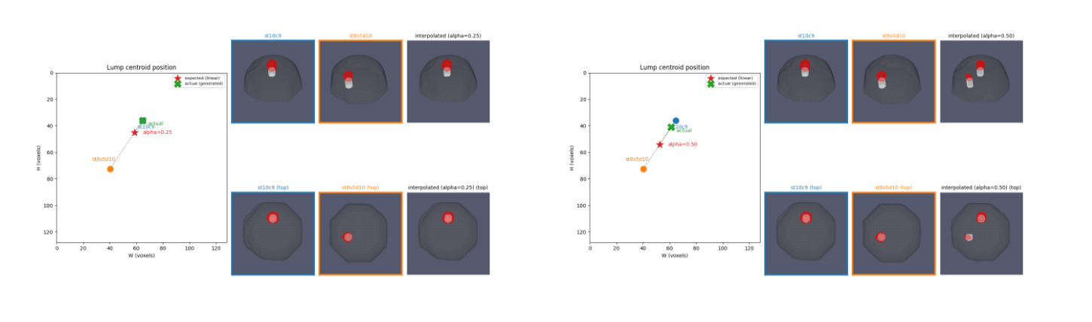

RESULTS
What the images actually show
18
Notes:
And here is what the predictions actually look like.

Slide 19
PART B
180° rotation
19
Notes:
Part B begins.

Slide 20
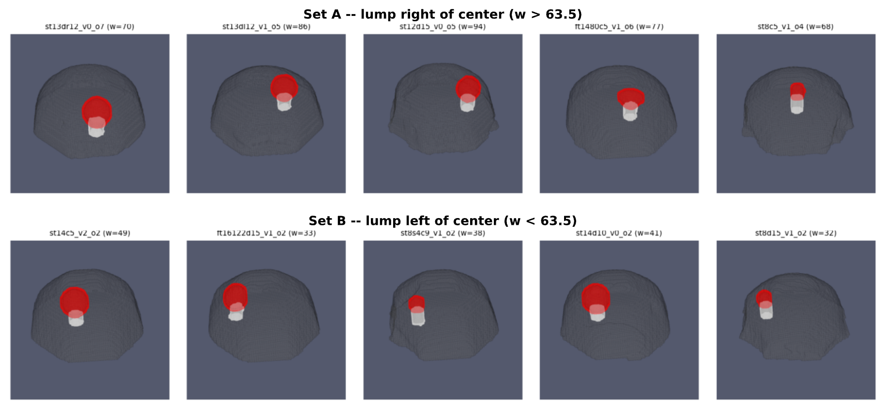
PART B
The task
Given a volume, generate the same volume rotated by 180°.
20
Notes:
Task: given a volume, generate the same volume rotated 180 degrees.

Slide 21

PART B
Our model
We took the model from Part A and trained it on this task with our new ground-truth data.
And as you will see, it just worked.
21
Notes:
We retrained the same model on the new ground truth. And as you can see, it just worked. (It did not.)

Slide 22
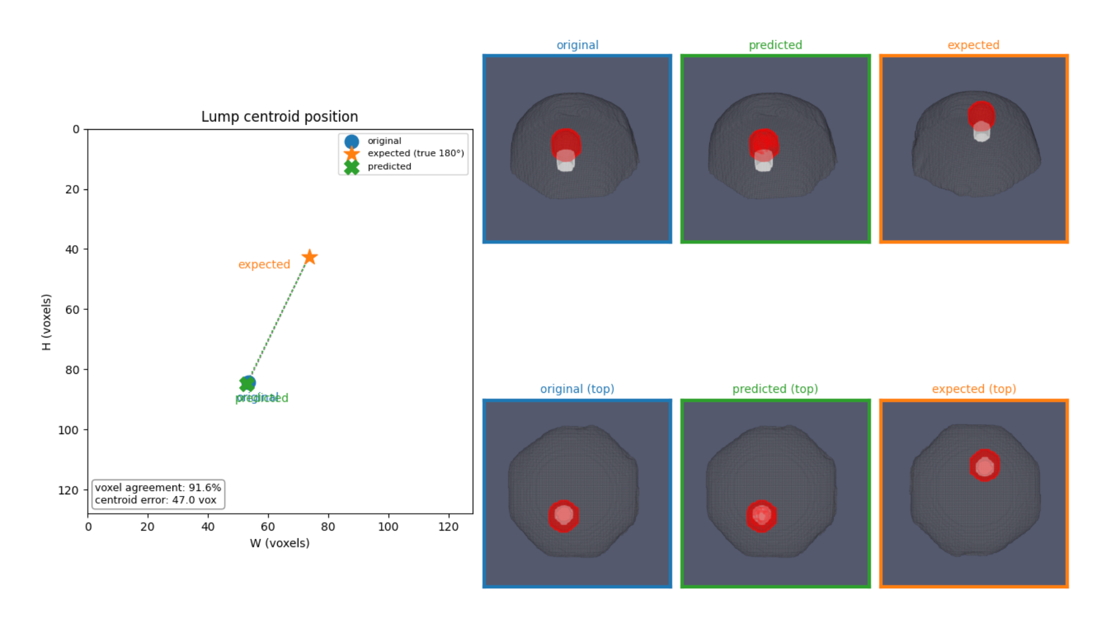
RESULTS
The loss went down
But the predictions stayed identical to the original image.
22
Notes:
Loss went down, but the prediction is just a copy of the input.

Slide 23

IDEA 01
A pixel loss
We added a weighted cross-entropy term over pixels to our loss:
ℒ_{pixel} = CE(x̂₁, argmax(x₁))
ℒ = ℒ_{velocity} + λ_{pixel} ℒ_{pixel}
We trained a new model. Do you think it worked?
23
Notes:
First idea: add a weighted cross-entropy term over pixels. Do you think it worked?

Slide 24
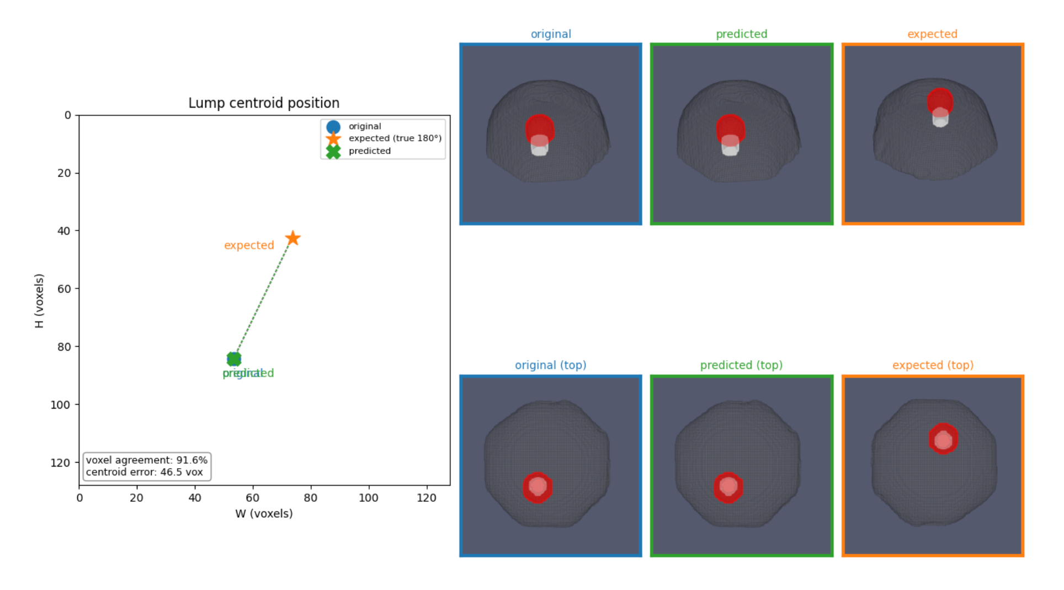
RESULTS
Exactly the same problem
The image doesn’t move at all.
24
Notes:
Same problem: the image doesn't move at all.

Slide 25
IDEAS 02 & 03
Two more attempts
02
Dice loss
Optimise overlap directly instead of per-voxel error.
03
Decaying λ term
Anneal the interpolation between the two losses over training.
Neither worked.
25
Notes:
Dice loss and a decaying lambda. Neither worked.

Slide 26
METRICS
Mask overlap
We realised the centroid isn’t the right metric, so we swapped it for a mask-overlap metric:
2 |A ∩ B|
Dice =
|A| + |B|
A = predicted mask · B = ground-truth mask
26
Notes:
The centroid was the wrong metric, we moved to mask overlap (Dice).

Slide 27
IDEA 04
Rollout loss
THE PROBLEM
Standard losses are only ever computed on points taken directly from the real data pair, states the network never had to reach on its own.
WHY IT HURTS
At inference the model must integrate its own predictions step by step. Small errors at step 1 push it off the ideal path, so by step 2 it faces a state it never trained on.
THE FIX
Let the model take a few self-directed steps from x₀ , feeding its own output back in just like at inference, then apply the loss wherever it actually ended up.
27
Notes:
Rollout loss: let the model take its own steps, then apply the loss where it lands.

Slide 28
Fine-tuning with rollout
RESULTS
Rollout was unstable for a fresh network, so we used it to fine-tune our previous model. Measured over 50 validation pairs.
Checkpoint
lump Dice
pillar Dice
combined Dice
epoch 1250 (raw)
0.451
0.153
0.422
epoch 1250 (fine-tuned)
0.498
0.268
0.478
epoch 1500 (raw)
0.470
0.262
0.448
epoch 1500 (fine-tuned)
0.381
0.120
0.354
28
Notes:
Rollout was unstable from scratch, so we fine-tuned. 50 validation pairs.

Slide 29
Final results
RESULTS
Across the entire dataset.
Split
lump Dice
pillar Dice
combined Dice
Validation (176 pairs)
0.472
0.267
0.453 ± 0.151
Train (176 pairs)
0.429
0.247
0.405 ± 0.203
Validation slightly ahead of train, the fine-tuned model generalises rather than memorises.
29
Notes:
Final numbers across the full dataset.

Slide 30
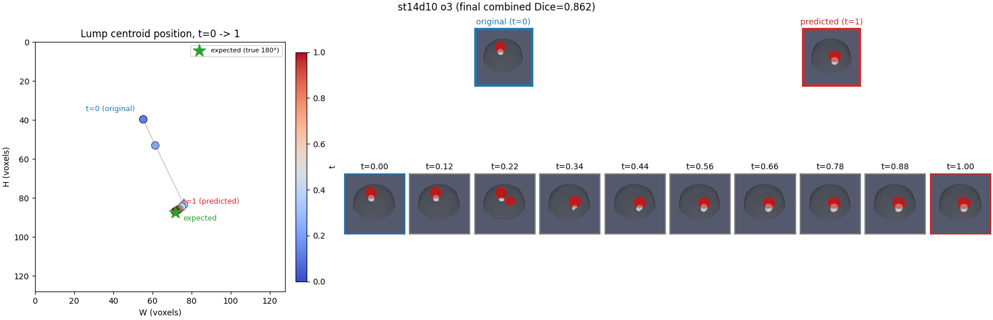
RESULTS
Examples 01
30
Notes:
Example rollouts, first pair.

Slide 31
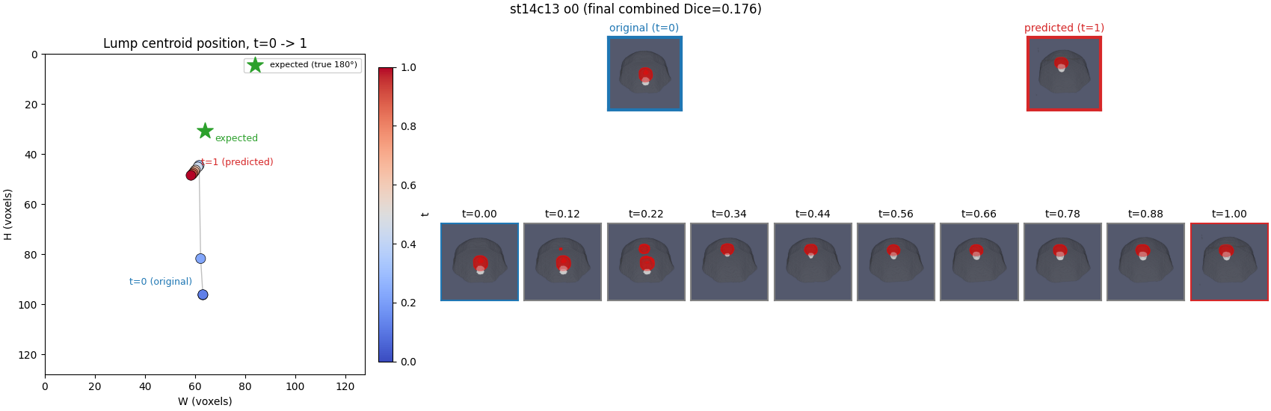
RESULTS
Examples 02
31
Notes:
Example rollouts, second pair.

Slide 32
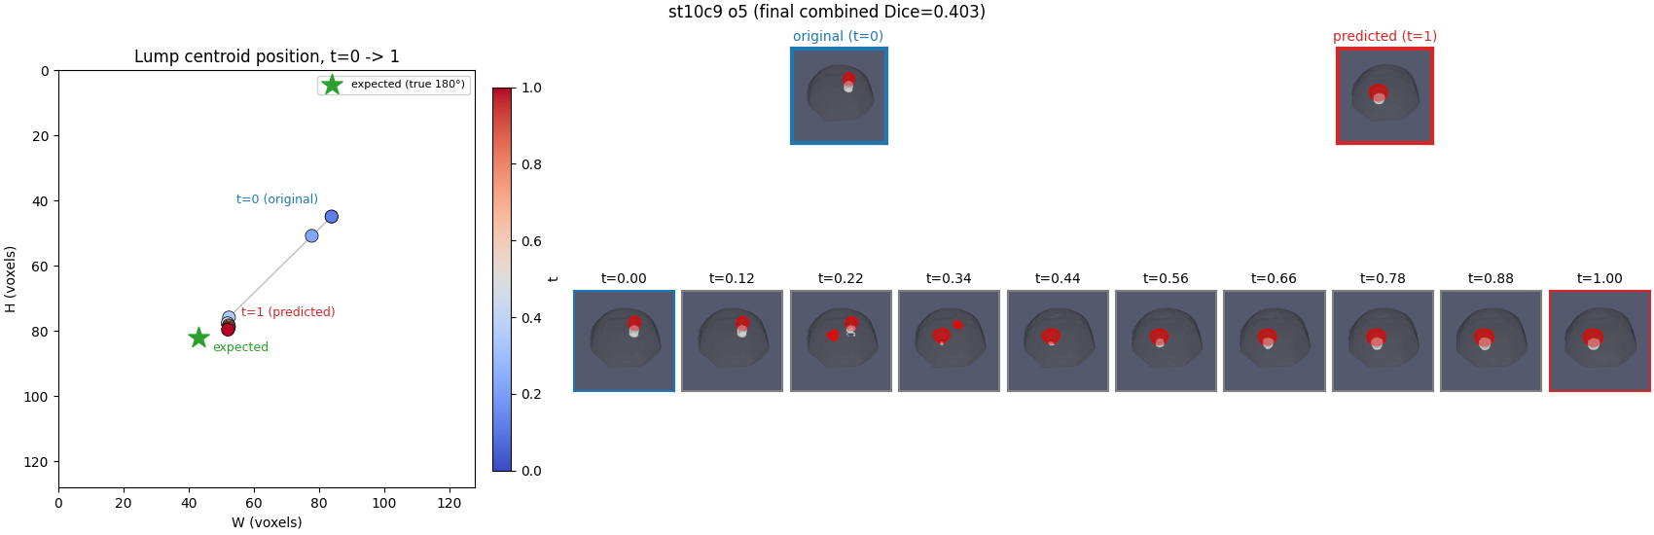

RESULTS
Examples 03
32
Notes:
Last example, and that's the project. Thank you.

