Slide 1

What can NLP teach us about fake covid-19 news
June 30, 2020
Daniel DiNicola

Slide 2
Who Am I ? and Problem statement
Who am I ?
Problem statement
A journalist by trade.
Received a data journalism scholarship with the Dow Jones News Fund in 2018.
This sparked my interest into big data, and I came to GA to learn more.
Technical Skills Include: NLP, Machine Learning, A/B Testing or Experiment design
Using classification we will analyze fake news data set regarding COVID-19 and a real news data set on the virus to predict the validity of a story.
Our goal is to create a model which will minimize our false positives i.e. news stories predicted real but were actually fake.
Our goal will also be accuracy and then we will analyze the models and uncover the words/language that determine classification of the respective post.

Slide 3

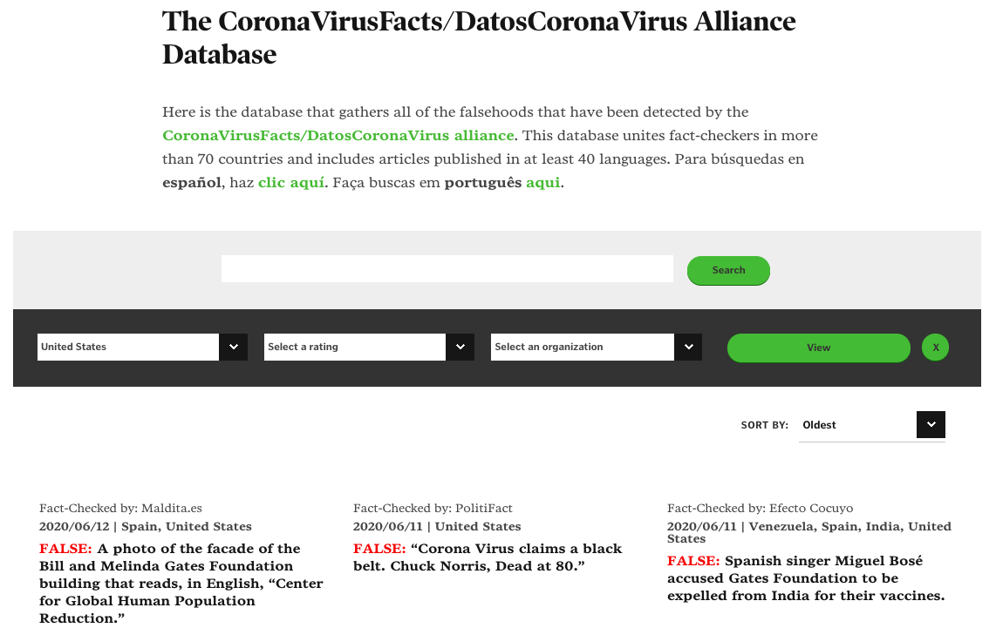
How did i get this data?
News api
Poynter institute
Notes:
1) News API is a very straightforward tool. You can specify which news sources you want to draw from and specify the headlines or new topics.
2) The International Fact-Checking Network at the Poynter Institute united over 100-fact checkers around the world to create a database which coalesced country by country fake news stories about COVID-19.

Slide 4
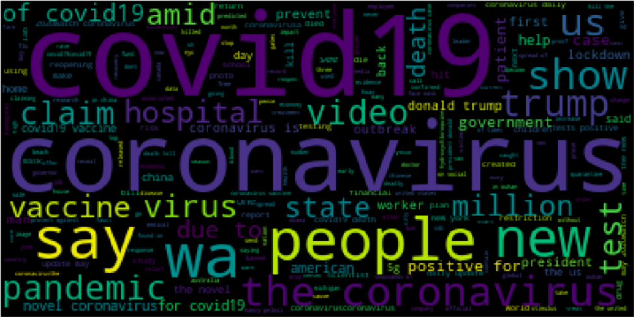
What does this data look like?
Notes:
Is it really a natural language processing data science project without a word cloud? Of course not! So, not much here to really share. Obviously, many of the words in this corpus you could imagine, coronavirus, hospital, virus, trump, government and other conspicuous terms.

Slide 5
Modeling
 | Logistic Regression | Decision Tree | Random Forrest | XGB
TFIDF Train Score | 93.4% | 99.9% | 98.9% | 87.2%
TFIDF Test Score | 85.6% | 82.1% | 84.9% | 85.1%
CVEC Train Score | 96.2% | 99.9% | 99.3% | 87.2%
CVEC Test Score | 89.9% | 84.9% | 86.1% | 85.1%
Specificity | 83.5% | 83.5% | 91.0% | 92.5%
Sensitivity | 87.8% | 80.7% | 78.7% | 77.7%
True Negatives | 167 | 167 | 182 | 185
True Positives | 173 | 159 | 155 | 153
False Negatives | 24 | 38 | 42 | 44
False Positives | 33 | 33 | 18 | 15
AUC Score | 85.7% | 82.1% | 84.8% | 85.1%
Features: Stop Words | NONE | NONE | NONE | NONE
Notes:
We really get some amorphous results from the four different types of models I created for this project. I think the first thing which must be noted is that all of these models are overfit to training data by varying degrees. The second thing to note is I set out on this project trying to create a model which would minimize false positive, and maximize our accuracy score unfortunately, and expectedly that happened in two different models. The first being Logistic Regression which had an AUC score of 85.60%
A quick note an AUC score since one should explain these things before just throwing them out there. AUC stands for area under the curve – it tells you how well the model is at distinguishing in between the classes. Higher the AUC, the better the model is at distinguishing between classes and in the models I ran we can see that the Logistic Regression model was best served in doing so.

Slide 6
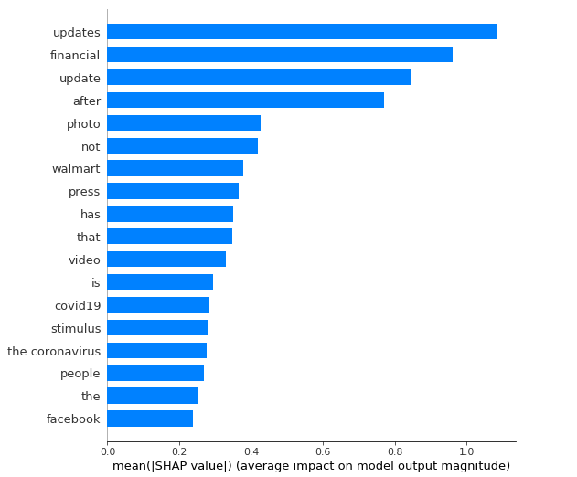
What did we learn? SHAP values
Notes:
The second part of this project was to build out SHAP, or shapley values which I’ll admit get me really excited.
This is our variable importance plot and let’s talk about it for a moment. What are you looking at here?

Slide 7
Conclusions, limitations and next steps
As mentioned, many of the models created were overfit to the training data. Unfortunately, I do not have a ton of data so doing something like cross-validation is not possible.
Interestingly each best performing model did not use classic stop word in it’s hyperparameters. Which is an interesting aspect of this project so far. What does this mean? For me it means we need more data and will get to that.
One next step is to overcome the previous conclusion is to create a specific set of stop words that might bring about different feature importance when creating SHAP values.
This project does not take in any notion of political bias between news organizations and or the fact checkers themselves, which can be problematic as simply “updating” people on the COVID-19 figures don’t really give people information about the virus itself.
I think most importantly this is just headline text and it shows in the analysis and SHAP values. Real news stories are “updating” their readers.
Lastly, as one last step would be to get more data and find a way to scrap into the fake news stories and attain the articles themselves in the News API.

