Slide 1

What can NLP teach us about fake covid-19 news
June 30, 2020
Daniel DiNicola
Notes:
Alright, good morning everyone, my name is Daniel DiNicola, and I am so excited to be here with all of you today. About a month ago I wanted to use data science to take a different angle on this pandemic, and my project is called what can Natural Language Processing teach us about fake COVID-19 news. So let’s get right into it.

Slide 2
Who Am I ? and Problem statement
Who am I ?
Problem statement
A journalist by trade.
Received a data journalism scholarship with the Dow Jones News Fund in 2018.
This sparked my interest into big data, and I came to GA to learn more.
Technical Skills Include: NLP, Machine Learning, A/B Testing or Experiment design
Using classification we will analyze fake news data set regarding COVID-19 and a real news data set on the virus to predict the validity of a story.
Our goal is to create a model which will minimize our false positives i.e. news stories predicted real but were actually fake.
Our goal will also be accuracy and then we will analyze the models and uncover the words/language that determine classification of the respective post.
Notes:
First about me a little bit – I am a journalist by trade and as a student was the recipient of the Dow Jones Data Journalism Scholarship. This experience prompted my interest in big data.
The problem I present to you all today is a classification problem where I took a data set consisting of fake and real news about COVID-19 and built out models to classify the two. The goal of this project is to minimize false positive and maximize accuracy.
The last part of this project will take a look at shapley values to uncover feature importance for our model.

Slide 3

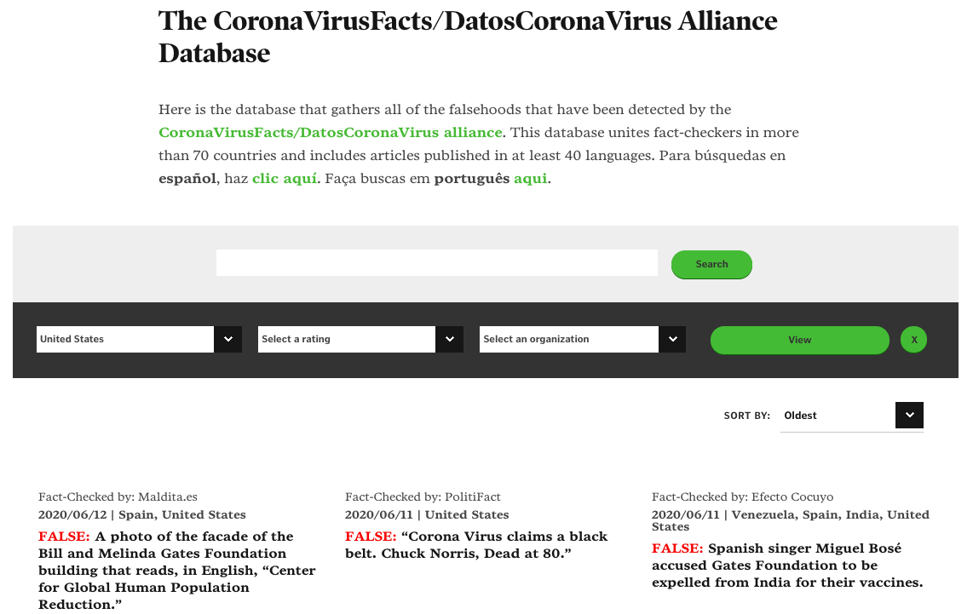
How did i get this data?
News api
Poynter institute
Notes:
Let’s now discuss where and how I got this data. I used the News API tool, where you can specify which news agencies you want to draw from and particular topics news agencies discuss. In this case I kept my search to the terms “COVID-19” and “Coronavirus.” The agencies were all run of the mill main-stream sources.
The pointer institute coalesced over 100-fact checkers around the world to create a database of fake news stories on COVID-19. With the help of my computer scientist friends we scraped this website and gathered just under 1,000 headlines of fake news stories.

Slide 4
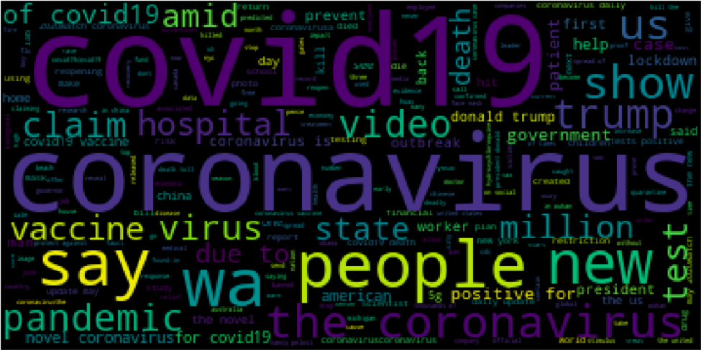
What does this data look like?
Notes:
Before we jump into modeling, one has to ask is it really a natural language processing project without a word cloud? Of course not!
So, we see here that many of the words in this corpus you could have guessed before hand , coronavirus, hospital, virus, trump, government and other conspicuous terms.

Slide 5
Modeling results
 | Logistic Regression | Decision Tree | Random Forrest | XGB
TFIDF Train Score | 93.4% | 99.9% | 98.9% | 87.2%
TFIDF Test Score | 85.6% | 82.1% | 84.9% | 85.1%
CVEC Train Score | 96.2% | 99.9% | 99.3% | 87.2%
CVEC Test Score | 89.9% | 84.9% | 86.1% | 85.1%
Specificity | 83.5% | 83.5% | 91.0% | 92.5%
Sensitivity | 87.8% | 80.7% | 78.7% | 77.7%
True Negatives | 167 | 167 | 182 | 185
True Positives | 173 | 159 | 155 | 153
False Negatives | 24 | 38 | 42 | 44
False Positives | 33 | 33 | 18 | 15
AUC Score | 85.7% | 82.1% | 84.8% | 85.1%
Accuracy | 85.6% | 81.4% | 86.2% | 85.1%
Precision | 83.9% | 81.5% | 91.0% | 91.1%
Features: Stop Words | NONE | NONE | NONE | NONE
Notes:
So now let’s talk about the modeling results. I created multiple grids, and multiple pipes all using the same set of parameters with one difference being the use of CountVectorizer and TFIDF vectorizer as a way to evaluate the corpus.
The first thing which I’ll note is that these models are overfit to training data by varying degrees, with the exception of the XGBoost model which I highlighted. Remember the goal of this project was to build a model with the highest accuracy score and minimizes false positives. Expectedly that occurred in two separate models, The Random Forrest model had the highest accuracy, and the XGBoost model minimized false positives. Furthering my belief that the XGBoost model best satisfied my goals for this problem is the high precision score seen at the second to last row.
One more metric to highlight which is AUC which distinguishes separability amongst the classes, a score of 1, or 100% denotes a high level of separability. If you have a score of .5 or 50% the model has no degree of separability. So you will note that all of our models are again in a range of low 80 percentage points to mid 80 percentage points with the logistic regression model performing the best.
All and all I came to the semi-conclusion that with the highest precision score, lowest amount of false positives and accuracy scores which were the second of four that the XGBoost model was the one to examine further.

Slide 6
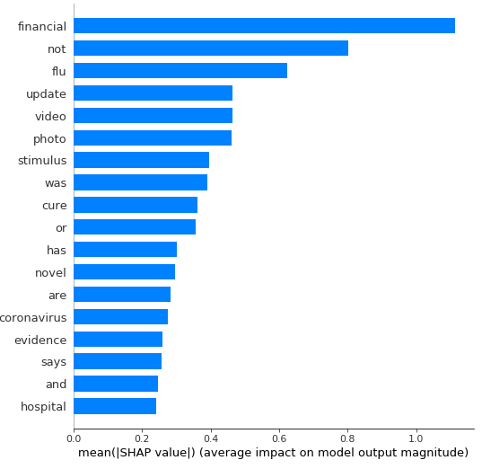
What did we learn? SHAP values
A shapely value is the average of the marginal impact across different combinations.
Think of this as which player on the basketball team contributes the most to the team’s success. In this case the model’s decision.
Notes:
The second part of this project was to build out SHAP, or shapley values which I’ll admit get me really excited.
For the reasons mentioned in the previous slide I chose the XGBoost model to visualize. This is our variable importance plot and let’s talk about it for a moment. What are you looking at here?
What we see our the features, or words which have the highest average impact on the model’s output magnitude. The first word “financial” has extremely high correlation with the desired output of a real news classification.
What does that mean in English? Articles with the word ”financial “greatly impact the decision making of the model to classify that story as real. Furthermore words like update and stimulus also rank high up on the list as affecting the model’s decision making. Back to English what can we learn from this and how do we use this to inform the public. Basically, that if a news story contains words that are giving you an “update” or “financial” then you are more than likely reading a story whose information you can trust.
This is not to say these words are CAUSING the model to classify a story as real or false, but that is a more technical conversation I will leave to after.

Slide 7
Conclusions, limitations and next steps
This project does not take in any notion of political bias between news organizations and or the fact checkers themselves, which can be problematic as simply “updating” people on the COVID-19 figures don’t really give people information about the virus itself.
The most critical limitation is this is just headline text and it shows in the SHAP values. One way to get more data would be to find a way to scrap into the fake news stories and attain the articles themselves in the News API, and on pointer.
The fact stop words were not used confirms again that there isn’t a lot of textual data to deal with.
Next step …. ALWAYS GET MORE DATA!!!
Notes:
First limitation is this project doesn’t take in any notion of political bias between news organizations or the fact checkers themselves.
Most critically the textual data we are working with here just comes from headlines and extended headlines. This shows in the SHAP values and with each model excluding normal stop words it shows they were really pulling at strings to put up distinctions in between the classes.

Slide 8
Call to action ! And what I can bring to your team
I will be posting a medium article about my project. I think it is essential people understand the distinction between FAKE and REAL news.
Find me on linkedin: https://www.linkedin.com/in/daniel-dinicola/
For employers I can bring to your organization knowledge of machine learning, NLP, python, SQL and a background in communication.
Notes:
Find me on LinkedIn because in the next few days I will be posting my findings. Share the post so people know how to distinguish between FAKE and REAL news on a continuing pandemic.
To my employer friends if you are looking for a data scientist, a data analyst or journalist I’d love to talk to you more. In an ideal world I’d like to work in the political data environment as you have seen my affinity for natural language processing and sentiment analysis. I also can conduct the full range of machine learning methods. Don’t forget about journalism I maintain a blog and do visualizations in Tableau. So I hope to hear from all of you in some capacity.

