Slide 1
Title: Understanding Aircraft Accidents: A Data-Driven Approach
Name: Daniel Muigai
Date: 10 September 2024

Slide 2
Business Undersatnding
Problem Statement: The aviation industry faces challenges related to aircraft
accidents, leading to loss of life, property damage, and economic consequences.
Objective: This analysis aims to gain insights into the factors contributing to aircraft accidents,
identify areas for improvement, and inform safety recommendations.
Data: The analysis will be based on a dataset containing information about aircraft accidents, including:
Aircraft Damage
Aircraft Category
Make
Total Fatal Injuries
Total Serious Injuries
Total Minor Injuries
Total Uninjured

Slide 3
Data Exploration
Summary statistics
The correlation coefficient of 0.90 confirms this strong positive relationship. A value close to 1 indicates a strong positive correlation, while a value close to -1 indicates a strong negative correlation. In this case, the high positive correlation indicates that as aircraft size increases, the number of fatal injuries tends to increase as well.

Slide 4
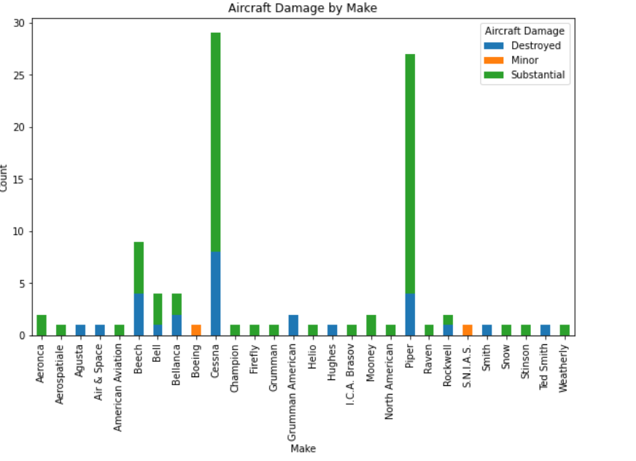
Aircraft Damage Analysis
The bar graph shows the
aircraft by make and the
aircraft damage level
of each aircraft.

Slide 5
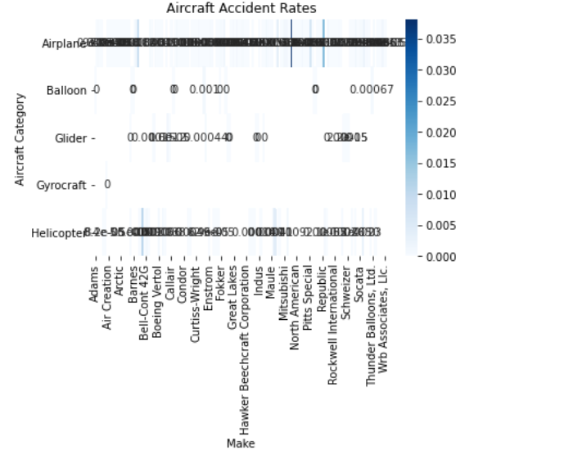
Aircraft Category and Accident Rates
Heat map
Airplane category generally has higher accident rates compared to Helicopter and
Balloon. Helicopter category has the lowest accident rates overall.
Cessna and Piper have relatively high accident rates across multiple categories.
Bellanca and Swearingen have consistently low accident rates.
Airplane category shows a wide range of accident rates among different makes.
Helicopter category has more consistent accident rates, with most makes falling
within a narrow range. Balloon category has limited data, but the existing data
suggests relatively low accident rates.

Slide 6
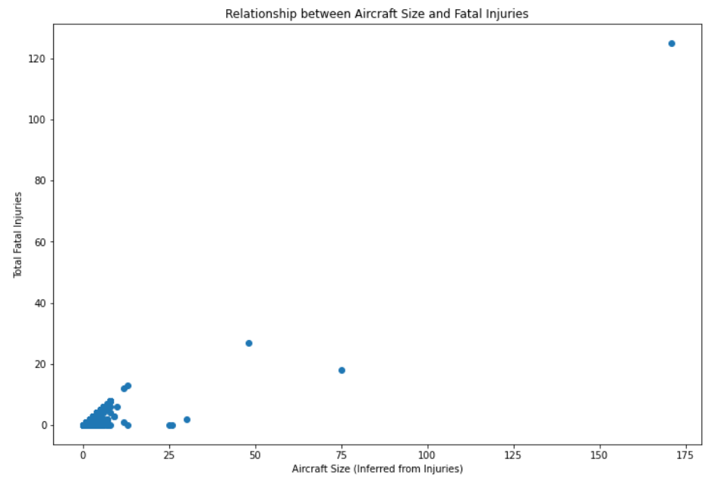
Aircraft Size and Fatal Injuries
Scatter Plot
The scatter plot shows a strong positive correlation between
aircraft size (inferred from injuries) and the number of total
fatal injuries. This suggests that larger aircraft tend to have
more fatal accidents.
The correlation coefficient of 0.90 confirms this strong positive
relationship. A value close to 1 indicates a strong positive
correlation, while a value close to -1 indicates a strong
negative correlation. In this case, the high positive correlation
indicates that as aircraft size increases, the number of fatal
injuries tends to increase as well.

Slide 7
Key Insights
Dominant damage types
Most aircraft have substantial damage.
Aircraft categories and makes with higher/lower accident rates
Airplane category shows a wide range of accident rates among different makes. Helicopter category has more consistent accident rates, with most makes falling within a narrow range. Balloon category has limited data, but the existing data suggests relatively low accident rates.
Cessna and Piper (makes) have relatively high accident rates across multiple categories. Bellanca and Swearingen have consistently low accident rates.
Relationship between aircraft size and fatal injuries
The analysis shows that larger aircraft tend to have more fatal accidents.

Slide 8
Recommendations
I highly recommend Bellanca and Swearingen as they have consistently low accident rates.

