Slide 1
Terminology Standards 2/3
BDK16-2 | Semantic Data Interoperability
William Hersh, MD | Department of Medical Informatics & Clinical Epidemiology
Oregon Health & Science University

Slide 2
ICD-10
Adopted by WHO in 1990, usually modified some in each country, which can reduce comparability of data
Makes significant changes in structure from ICD-9; also adds inpatient procedure codes
Augmentation of ICD-10 in US includes
ICD-10-CM for diagnosis codes – 3-7 levels
ICD-10-PCS for procedure codes – 7 levels
General Equivalence Mappings (GEM) for translation from ICD-9
(Jette, 2010), (Dickhudt, 2010; James, 2014), (CMS, 2010)

Slide 3
Differences between ICD-9-CM and ICD-10-CM
ICD-9-CM
ICD-10-CM
13,000+ codes
3-5 characters
First character numeric or V/G/E
Characters 1-3 – category
Characters 4-5 – etiology, anatomic site, or other clinical detail
69,000+ codes
3-7 characters
First character alpha
Character 2-3 numeric
Character 4-7 alphanumeric
Characters 1-3 – category
Characters 4-6 – etiology, anatomical site, or other clinical detail
Character 7 – extension

Slide 4
Major difference is increased granularity … on a massive scale
T360X5A Adverse effect of penicillin's, initial encounter
T361X5A Adverse effect of cephalosporins and other beta-lactam antibiotics, initial encounter
T362X5A Adverse effect of chloramphenicol group, initial encounter
T363X5A Adverse effect of macrolides, initial encounter
T364X5A Adverse effect of tetracyclines, initial encounter
T365X5A Adverse effect of aminoglycosides, initial encounter
T366X5A Adverse effect of rifampicins, initial encounter
T367X5A Adverse effect of antifungal antibiotics, systemically used, initial encounter
T368X5A Adverse effect of other systemic antibiotics, initial encounter
Plus 170 additional codes
995.29 Unspecified adverse effect of other drug, medicinal and biological substance

Slide 5
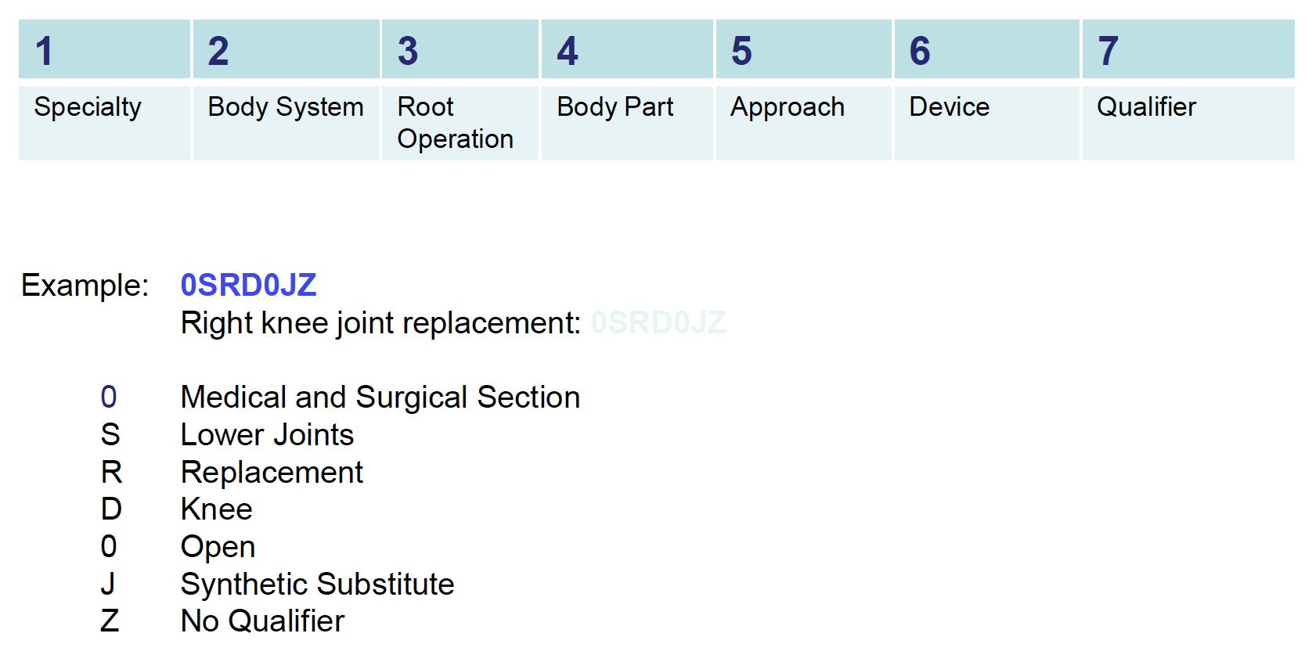
ICD-10-PCS increases from 3,838 to 71,957 codes

Slide 6
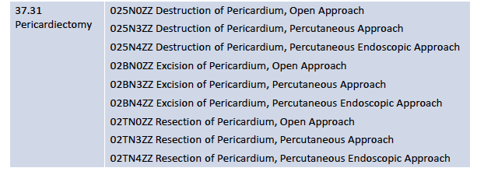
Granularity also an issue for ICD-10-PCS
ICD-9 ICD-10-PCS

Slide 7
Some excess granularity reaching absurdity?
Struck by falling object on board a watercraft
V93.40 – Merchant ship
V93.41 – Passenger ship
V93.42 – Fishing boat
V93.43 – Powered watercraft
V93.44 – Sailboat
V93.48 – Unpowered watercraft
V93.49 – Unspecified
(Mathews, 2011)

Slide 8
More about ICD-10-CM
50% of all codes are related to musculoskeletal system, primarily injuries
25% of all codes are related to fractures
36% of all codes distinguish laterality, i.e., left vs. right
Most impacted are Orthopedics, Obstetrics/Gynecology, and Behavioral Health
Primary care has medium level of impact
Medical specialties have low level of impact

Slide 9
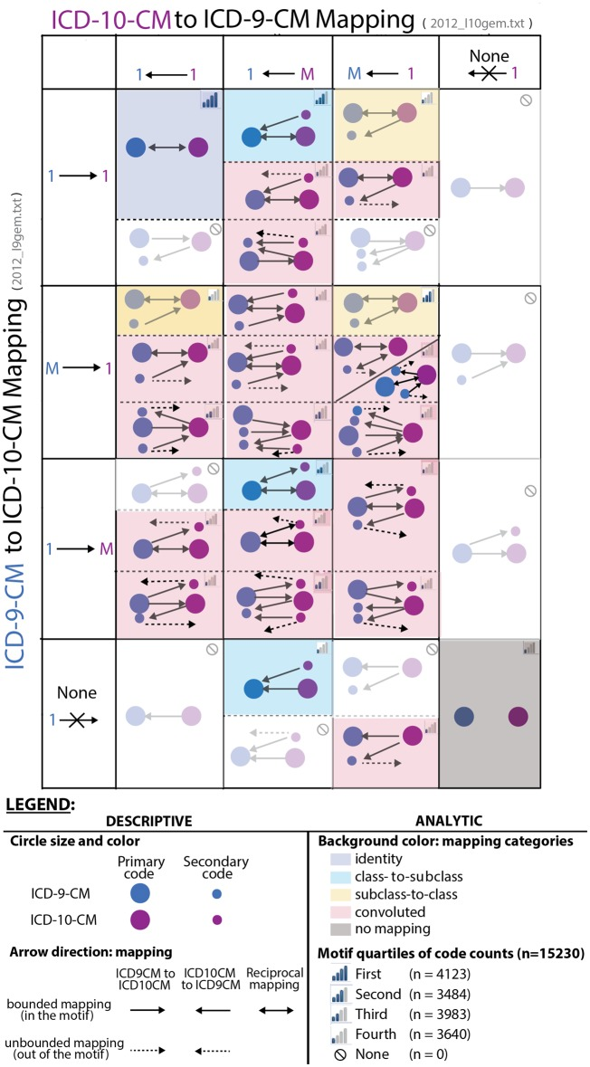
Informatics concerns about ICD-10-CM
Excess granularity of ICD-10-CM
Would transition to a more compositional terminology system, such as SNOMED or even ICD-11 (to be derived from SNOMED), be a better approach ?
Although ICD-11 not slated for completion until 2017
36% of all mappings between ICD-9-CM and ICD-10-CM are convoluted, ranging by specialty from 5% (hematology) to 60% (obstetrics and injuries)
(Chute, 2012), (Boyd, 2013)

Slide 10
Diagnosis-related groups (DRG)
Original intent was to aggregate ICD-9-CM codes into groups for health services research
Set of several hundred codes that “lump” hospital illnesses
Adopted by HCFA (now CMS) in 1980s for prospective payment for hospitalization in Medicare
DRG categories will stay same initially for ICD-10-CM but may change later
(Mills, 2015)

Slide 11
DRG examples for respiratory diseases
Respiratory disease w/ major chest operating room procedure, no major complication or comorbidity 75
Respiratory disease w/ major chest operating room procedure, minor complication or comorbidity 76
Respiratory disease w/ other respiratory system operating procedure, no complication or comorbidity 77
Respiratory infection w/ minor complication, age greater than 17 79
Respiratory infection w/ no minor complication, age greater than 17 80
Simple Pneumonia w/ minor complication, age greater than 17 89
Simple Pneumonia w/ no minor complication, age greater than 17 90
Respiratory disease w/ ventilator support 475
Respiratory disease w/ major chest operating room procedure and major complication or comorbidity 538
Respiratory disease, other respiratory system operating procedure and major complication 539

Slide 12
Drug terminology
A number of different code sets, mostly led by US government
FedMed is interagency collaboration on agreed set of standard, comprehensive, and freely accessible Federal Medication Terminologies (FMT)
Includes
National Drug Codes (NDC)
Unique Ingredient Identifier (UNII)
National Drug File Reference Terminology (NDF-RT)
NCI Thesaurus (NCIt) Structured Product Labeling (SPL)
RxNorm, RxTerms

Slide 13
National Drug Codes (NDC)
There is an 11-digit code for each and every pharmaceutical preparation
First 5 digits for manufacturer, assigned by Food & Drug Administration (FDA), e.g., Merck, Pfizer, etc.
Next 4 digits for product name, strength, dose form
One code for all variants of these
Problem: Not unique for same drug from different manufacturer
Final 2 digits are code for packaging
e.g., number of tablets in bottle
Map into other terminology systems in FedMed

Slide 14
Other drug terminology standards
Unique Ingredient Identifier (UNII) specifies ingredients in drugs and other compounds
National Drug File Reference Terminology (NDF-RT, produced by VA) maintains mechanism of action, physiological effect, and structural class
NCIt SPL maintains pharmaceutical dosage form, route of administration, and potency
RxNorm provides semantic structure for formulations and their components
RxTerms provides interface terminology to RxNorm
RxNorm/RxTerms emerging as standard into which other drug terminologies must map
RxNav provides API for term look-up
(NLM, 2012), (Fung, 2008)

Slide 15

Relationships in RxNorm
Figure from Bodenreider, O and Nelson, SJ (2004). RxNav: a semantic navigation tool for clinical drugs. MEDINFO 2004 - Proceedings of the Eleventh World Congress on Medical Informatics, San Francisco, CA. IOS Press. 1530.
(Bodenreider, 2004)

Slide 16
Relationship of federal drug terminologies
Figure from http://www.ncvhs.hhs.gov/040730p1.pdf

Slide 17
Thank you
Please download the resource list with useful links from the “Resources” tab in the upper right of the player.
This course was made possible under a grant from the NIH (# 1R25GM114820-01)

