Slide 1
Terminology Standards 3/3
BDK16-3 | Semantic Data Interoperability
William Hersh, MD | Department of Medical Informatics & Clinical Epidemiology
Oregon Health & Science University

Slide 2
Logical observations, identifiers, and numerical codes (LOINC)
Started as standard for laboratory tests and names but being extended into other types of measures and languages beyond English
For each observation, specify
Component (analyte) – substance or entity measured or observed
Property – e.g., mass concentration, numeric fraction
Time – point in time
Specimen (system) – e.g., blood, cerebrospinal fluid
Scale – e.g., qualitative, quantitative, ordinal, nominal
Method – optional, procedure used to make observation
Regenstrief LOINC Mapping Assistant (RELMA) is Windows program for searching LOINC database and helping map local codes to LOINC codes
(Vreeman, 2012)

Slide 3
LOINC Examples
Blood glucose GLUCOSE:MCNC:PT:BLD:QN:
Serum glucose GLUCOSE:MCNC:PT:SER:QN:
Urine glucose concentration GLUCOSE:MCNC:PT:UR:QN:
Urine glucose by dip stick GLUCOSE:MCNC:PT:UR:SQ:TEST STRIP
Ionized whole blood calcium CALCIUM.FREE:SCNC:PT:BLD:QN:
24 hour calcium excretion CALCIUM.TOTAL:MRAT:24H:UR:QN:
Automated hematocrit HEMATOCRIT:NFR:PT:BLD:QN:AUTOMATED COUNT
Manual spun hematocrit HEMATOCRIT:NFR:PT:BLD:QN:SPUN
Erythrocyte MCV ERYTHROCYTE MEAN CORPUSCULAR VOLUME:ENTVOL:PT:RBC:QN:AUTOMATED COUNT
ESR by Westergren method ERYTHROCYTE SEDIMENTATION RATE:VEL:PT:BLD:QN:WESTERGREN

Slide 4
Current Procedural Terminology (CPT-4)
Classification of procedures performed by physicians
Usually required for reimbursement by government and private insurance companies in U.S.
Evaluation/management (E/M) portion documents clinical encounters
Developed and maintained by AMA

Slide 5
HCFA Common Procedure Coding System (HCPCS)
HCPCS Level One is CPT-4
HCPCS Level Two adds items and supplies and non-physician services
HCPCS Level Three added local codes
Abolished in 2003 under HIPAA rules

Slide 6
SNOMED Clinical Terms (SNOMED CT)
Systematized Nomenclature of Medicine (SNOMED)
Originally developed by College of American Pathologists (CAP)
Originally a classification for pathologists (SNOP) but extended to all of medicine as SNOMED in 1980s
Merged with English Clinical Terms Project to form SNOMED CT in 2000
In 2007, ownership transferred to International Health Terminology Standards Development Organisation (IHTSDO)
Multilingual – currently available in US English, UK English, Spanish, Danish and Swedish; being translated to others
(Cote, 1993), (Spackman, 2000)

Slide 7
SNOMED CT license
In 2003, CAP and NLM negotiated five-year license for all of US
Continued with transfer to IHTSDO
Can be freely used by all public and private entities within US (or other countries that license) for any healthcare, public health, research, educational, or statistical use
Can encode patient level data sets and redistribute them as long as users do not extract significant portions

Slide 8
SNOMED CT
Starter Guide and other documentation
Richest vocabulary for describing clinical observations and findings
Coverage is extensive
Key feature is “multi-axial” or compositional approach
Allows terms to be combined, e.g., lung + inflammation
Allows modifiers to be added, e.g., severe, worsening
Contains
> 300,000 concepts
> 1M “descriptions” (terms) expressing concepts
> 1M relationships between concepts
(Wasserman, 2003; Elkin, 2006)

Slide 9

SNOMED CT design
Figure from http://ihtsdo.org/fileadmin/user_upload/doc/download/doc_StarterGuide_Current-en-GB_INT_20141202.pdf

Slide 10
SNOMED CT descriptions
Figure from http://ihtsdo.org/fileadmin/user_upload/doc/download/doc_StarterGuide_Current-en-GB_INT_20141202.pdf

Slide 11
SNOMED CT attributes
Clinical finding concepts
Procedure concepts
Evaluation procedure concepts
Specimen concepts
Body structure concepts
Pharmaceutical/biologic product concepts
Situation with explicit context concepts
Event concepts
Physical object concepts

Slide 12
SNOMED CT concept model
Clinical finding
Procedure
Situation with explicit context
Observable entity
Body structure
Organism
Substance
Pharmaceutical / biologic product
Specimen
Special concept
Physical object
Physical force
Event
Environments and geographical locations
Social context
Staging and scales
Qualifier value
Record artifact
SNOMED CT Model Component

Slide 13
Additional details for some top-level concepts
Clinical finding – result of a clinical observation, assessment or judgment and includes normal and abnormal clinical states (e.g., asthma, headache, normal breath sounds)
Procedure – activities performed in provision of healthcare (e.g., appendectomy, physiotherapy, subcutaneous injection)
Body structure – represents normal and abnormal anatomical structures (e.g., mitral valve structure, adenosarcoma)
Organism – represents organisms of significance in human and animal medicine (e.g., Streptococcus pyogenes, texon cattle breed)
Substance – represents general substances, chemical constituents of pharmaceutical/biological products, body substances, dietary substances and diagnostic substances (e.g., methane, insulin, albumin)
Physical object – represents natural and man-made physical objects (e.g., vena cava filter, implant device, automobile)

Slide 14
SNOMED CT expression – some are pre-coordinated
Figure from http://ihtsdo.org/fileadmin/user_upload/doc/download/doc_StarterGuide_Current-en-GB_INT_20141202.pdf

Slide 15
Nursing vocabularies
Many of same issues impeding of other clinical terminologies
Irreconcilable information models
Terms not always the way clinicians express themselves
Tedious to use in patient documentation
Question of whether data is transferable across settings

Slide 16
Nursing vocabularies – a variety to choose from
Nomenclatures | Diagnoses | Interventions | Outcomes
National Nursing Diagnosis Association (NANDA) | X
Nursing Interventions Classification (NIC) |  | X
Nursing Outcomes Classification (NOC) |  |  | X
Omaha System | X | X | X
Clinical Care Classification | X | X | X
International Classification for Nursing Practice | X | X | X
All are approved by the ANA; included in the UMLS Metathesaurus

Slide 17
Efforts at reconciliation of vocabularies
The Unified Medical Language System (UMLS) Project of the NLM is an attempt at reconciliation
Consists of three components
Metathesaurus – focus here
Semantic network – generic relationships between semantic types of concepts, e.g., diseases and treatment
Specialist lexicon – based on Metathesaurus words and terms, designed to assist in natural language processing applications
(Humphreys, 1998)

Slide 18
UMLS Metathesaurus
From documentation
The Metathesaurus is “a database of information on concepts that appear in one or more of a number of different controlled vocabularies and classifications used in biomedicine”
Is a “meta”-thesaurus among terms across the major vocabularies
Synonymous terms from different vocabularies are given same concept identifier
Each distinct term can have different lexical variants, aka strings

Slide 19
Limitations and use of UMLS Metathesaurus
Limitations
Only one-to-one relationships are mapped
Only terms from source vocabularies present; no new terms added
No unifying hierarchy is present, only those that exist in source vocabularies
Not extensible (i.e., in the SNOMED sense)
Use
Modest at this point
More of a “repository” for vocabularies

Slide 20
Some other healthcare vocabularies (Giannangelo, 2015)
Common Dental Terminology (CDT)
Medical Subject Headings (MeSH)
Universal Medical Device Nomenclature (UMD)
Diagnostic and Statistical Manual of Mental Disorders (DSM) – has its controversies
International Classification of Functioning, Disability, and Health (ICF)
International Classification of Primary Care (ICPC)
(Giannangelo, 2015), (Kupfer, 2013)

Slide 21
Other terminology activities
Development by NIH of common data elements (CDEs) for research studies, e.g.,
Patient Reported Outcome Measurement System (PROMIS)
National Institute of Neurological Disorders and Stroke Common Data Elements Project
Global Rare Diseases Registry (GRDR)
Consensus Measures for Phenotypes and Exposures (PhenX)

Slide 22
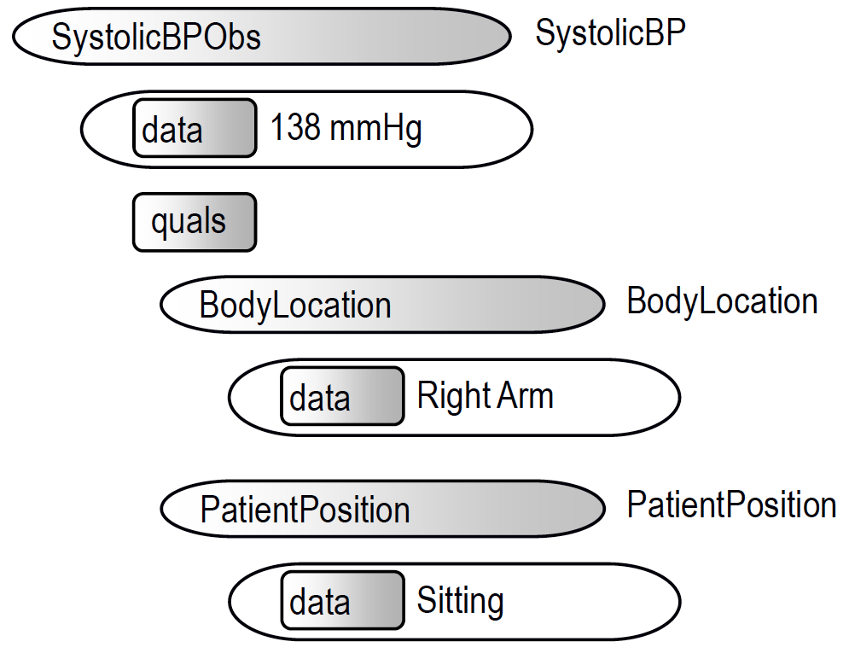
Clinical element model (CEM)
“Stack of coded items” can be ambiguous, need model for clinical elements
Clinical Information Modeling Initiative (CIMI) aims to create CEMs for clinical data
Used in ONC SHARPn Project for secondary uses of clinical data
Most experience at Intermountain Healthcare
(Coyle, 2008), (Tao, 2013), (Oniki, 2014)

Slide 23
Some commercial terminology systems
Intelligent Medical Objects (IMO) – provides mapping, updates, and access to terminology
Medcin (Medicomp) – focused on documentation at point of care in EHR
HDD Access – terminology system developed by 3M, moved to open-source model

Slide 24
Bringing it all together
Toward semantic interoperability – “computer utterance” in one system has same effect in any other
Likely direction? From ONC Interoperability Roadmap, JASON Task Force Report, Argonaut Project Charter, etc.
RESTful architecture
FHIR-based API
OAuth2 security
Types of data
Documents – IHE specifications, CCDA
Discrete – Meaningful Use Common Data Set, SNOMED CT and other terminologies
(Dolin, 2011)

Slide 25
Thank you
Please download the resource list with useful links from the “Resources” tab in the upper right of the player.
This course was made possible under a grant from the NIH (# 1R25GM114820-01)

