Slide 1

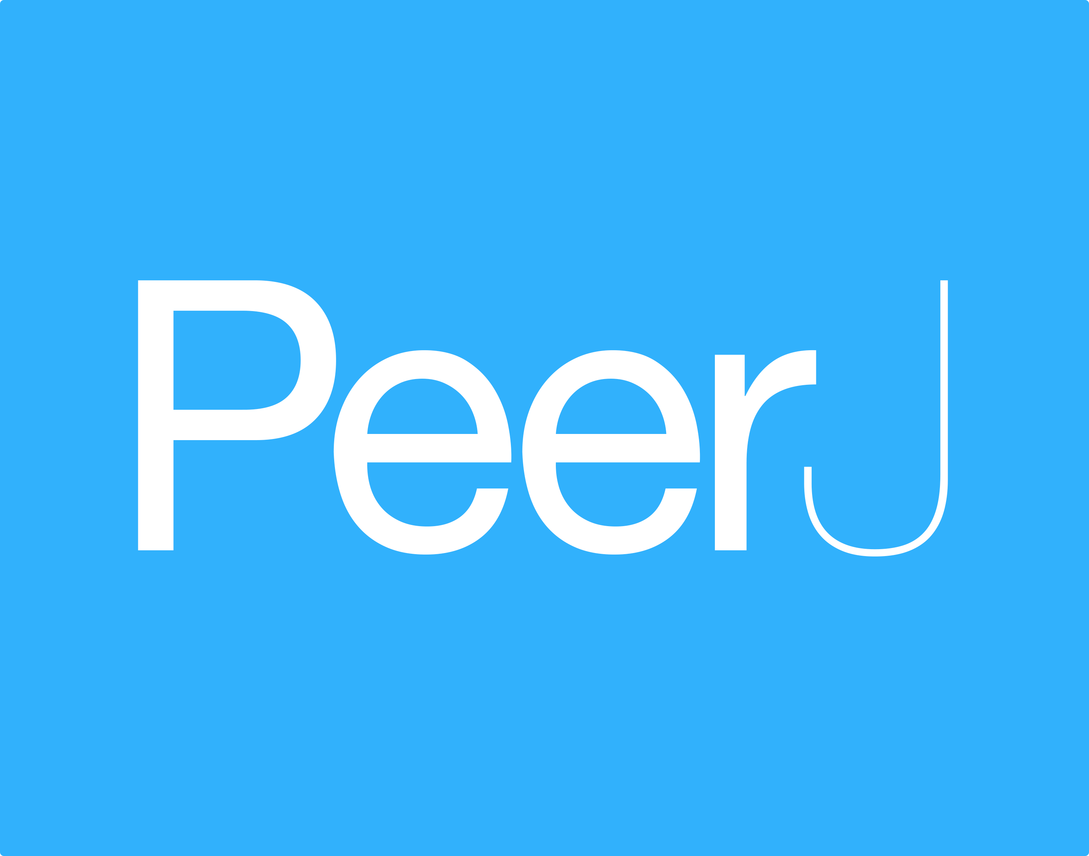


Being open doesn't have to break the bank!
~70% of OA journals do not charge.
Many OA journals have low-cost fees.
Most OA journals have fee waivers.
Some institutions have OA publisher memberships.
Some institutions have OA publishing funds.
Some funders provide OA publishing fee support.
Self-archiving openly costs nothing.

