Slide 1
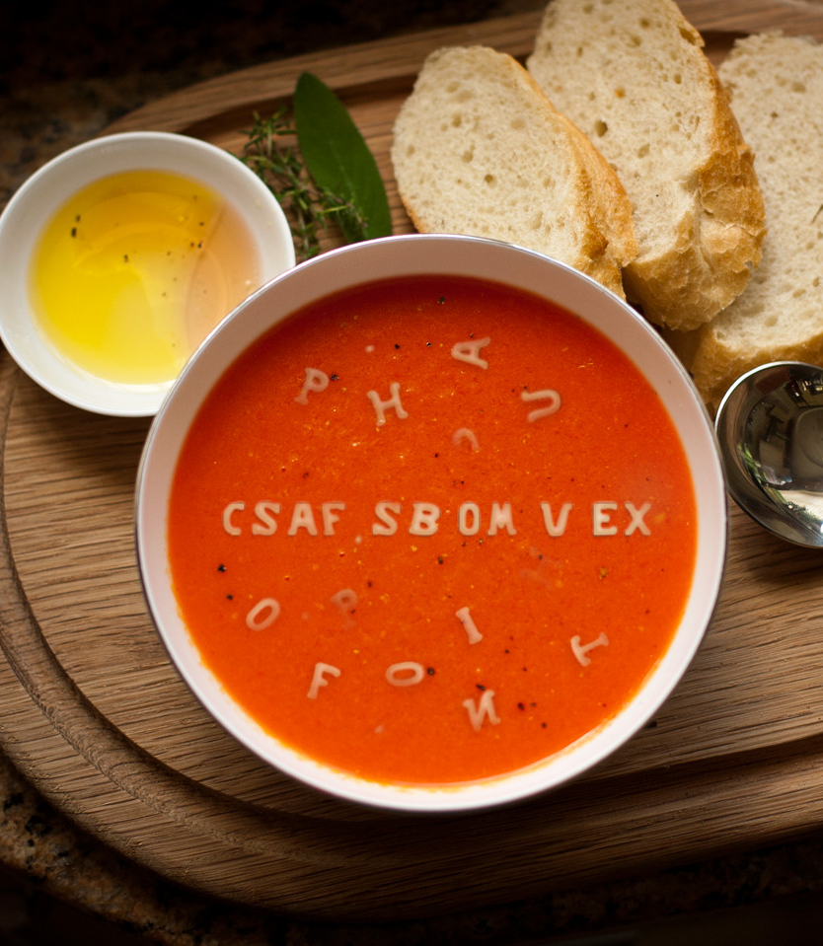
CSAF, VEX, and SBOMs a Today's Cybersecurity Acronym Soup
TLP:CLEAR
Omar Santos
Cybersecurity Peasant @ Cisco PSIRT // CSAF Chair
@santosomar

Slide 2

Agenda
An Update and Overview of the Common Security Advisory Framework (CSAF) 2.0
Traditional and New CSAF Use Cases
The Relationship between SBOMs and CSAF and the Vulnerability Exploitability eXchange (VEX)
VEX Justifications in Advisories?
Informational Security Advisories?
Dynamic vs. "Static" Security Advisories
APIs, ROLIE Feeds, etc.
CSAF Open-Source Tools
An Interactive Discussion of the Future of Security Advisories
TLP:CLEAR

Slide 3





The Common Security Advisory Framework (CSAF)
An open and definitive reference for the language which supports the creation, update, and interoperable exchange of security advisories as structured information on products, vulnerabilities and the status of impact and remediation among interested parties.
Spec, Docs, Tools, Presentations, FAQs:
https://csaf.io
TLP:CLEAR

Slide 4
Early Adopters
Many of you are already using it.
CERTs (including VINCE support).
Government organizations such as BSI.
Recommended in CISA and NTIA references.
Support in other standards (i.e., SPDX, CycloneDX, etc.)

Slide 5
Is CSAF a Replacement or Alternative to CVE?
NO

Slide 6
CSAF vs. CVRF
CSAF is the replacement for the Common Vulnerability Reporting Framework (CVRF).
However, it introduces a completely new ecosystems and several additional features.

Slide 7

CSAF Traditional Security Advisories
CSAF Advisory
Vulnerability
CSAF Advisory
Multiple Vulnerabilities

Slide 8
Profiles
CSAF Base
Security Advisory
Informational Advisory
Security Incident Response
Vulnerability Exploitability Exchange (VEX)

Slide 9
CSAF Base
This profile defines the default required fields for any CSAF document.
A "catch all" for CSAF documents that do not satisfy any other profiles.
Furthermore, it is the foundation all other profiles are build on.

Slide 10
Security Advisory Profile
Traditional Security Advisories Similar to CVRF
This profile is used to provide information which is related to vulnerabilities and corresponding remediations.

Slide 11

Informational Security Advisory Profile
This profile is used to provide information which are not related to a vulnerability.
For example: misconfigurations, security responses to an "external" event or disclosure, etc.

Slide 12

Security Incident Response Profile
This profile can be used to provide a response to a security breach or incident.
May also be used to convey information about an incident that is unrelated to the issuing party's own products or infrastructure.
For example: Company X might use a CSAF document satisfying this profile to respond to a security incident at ACME Inc. and the implications on its own products and infrastructure.

Slide 13
VEX Profile
The Vulnerability Exploitability eXchange (VEX) allows a software supplier or other parties to assert the status of specific vulnerabilities in a particular product..
References:
CISA’s VEX Use Cases: https://www.cisa.gov/sites/default/files/publications/VEX_Use_Cases_Aprill2022.pdf
CISA’s VEX Justifications: https://www.cisa.gov/sites/default/files/publications/VEX_Status_Justification_Jun22.pdf

Slide 14
How does CSAF relates to SBOMs?

Slide 15
Recap on SBOM Standards
The two “most popular” or “widely-adopted” SBOM machine readable formats are:
Software Package Data Exchange (SPDX®): an ISO/IEC standard introduced as a Linux Foundation Project.
CycloneDX: a lightweight SBOM specification and an open-source OWASP standard.
Note: Check out the “Survey of Existing SBOM Formats and Standards”, created by the NTIA and other collaborators, to learn more about how these standards (along with others) are used in the industry.

Slide 16
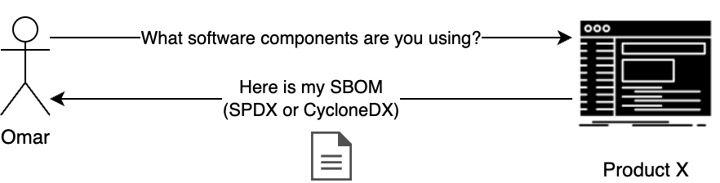
How Does This Work?

Slide 17
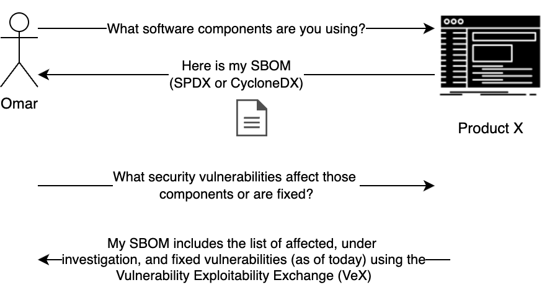
How Does This Work?

Slide 18
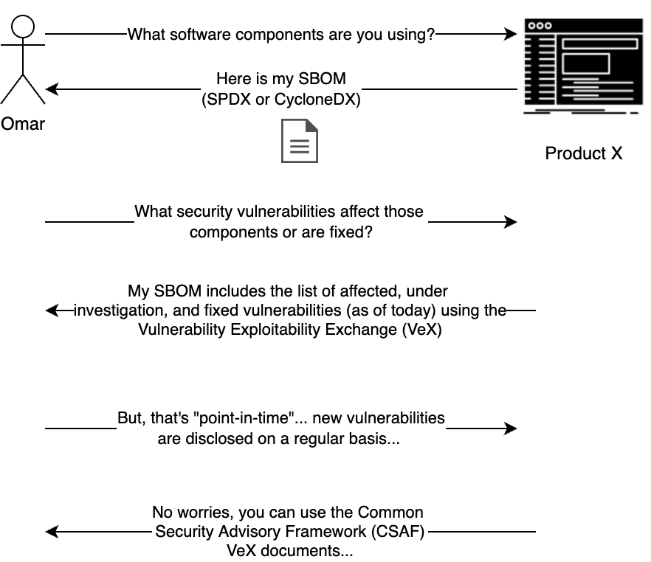


Slide 19
CSAF in SPDX and CycloneDX
CSAF is Supported in SPDX and CycloneDX
SPDX 2.3: https://spdx.github.io/spdx-spec/v2.3-RC1/how-to-use/
"externalRefs" : [ {
"referenceCategory" : "SECURITY",
"referenceLocator" : "https://github.com/oasis-tcs/csaf/blob/master/csaf_2.0/examples/csaf/csaf_vex/2022-evd-uc-01-a-001.json",
"referenceType" : "advisory" } ]
CycloneDX: https://cyclonedx.org/capabilities/vex/#cyclonedx-and-third-party-advisory-formats and https://cyclonedx.org/use-cases/#security-advisories
"externalReferences": [
{
"type": "advisories",
"url": "https://example.org/.well-known/csaf/advisory1.json"
}

Slide 20
VEX Statuses and Justifications
component_not_present
inline_mitigations_already_exist
vulnerable_code_cannot_be_controlled_by_adversary
vulnerable_code_not_in_execute_path
vulnerable_code_not_present
under_investigation
known_affected
fixed
known_not_affected
VEX Justifications: https://www.cisa.gov/sites/default/files/publications/VEX_Status_Justification_Jun22.pdf

Slide 21


You Don’t Need an SBOM to VEX

Slide 22
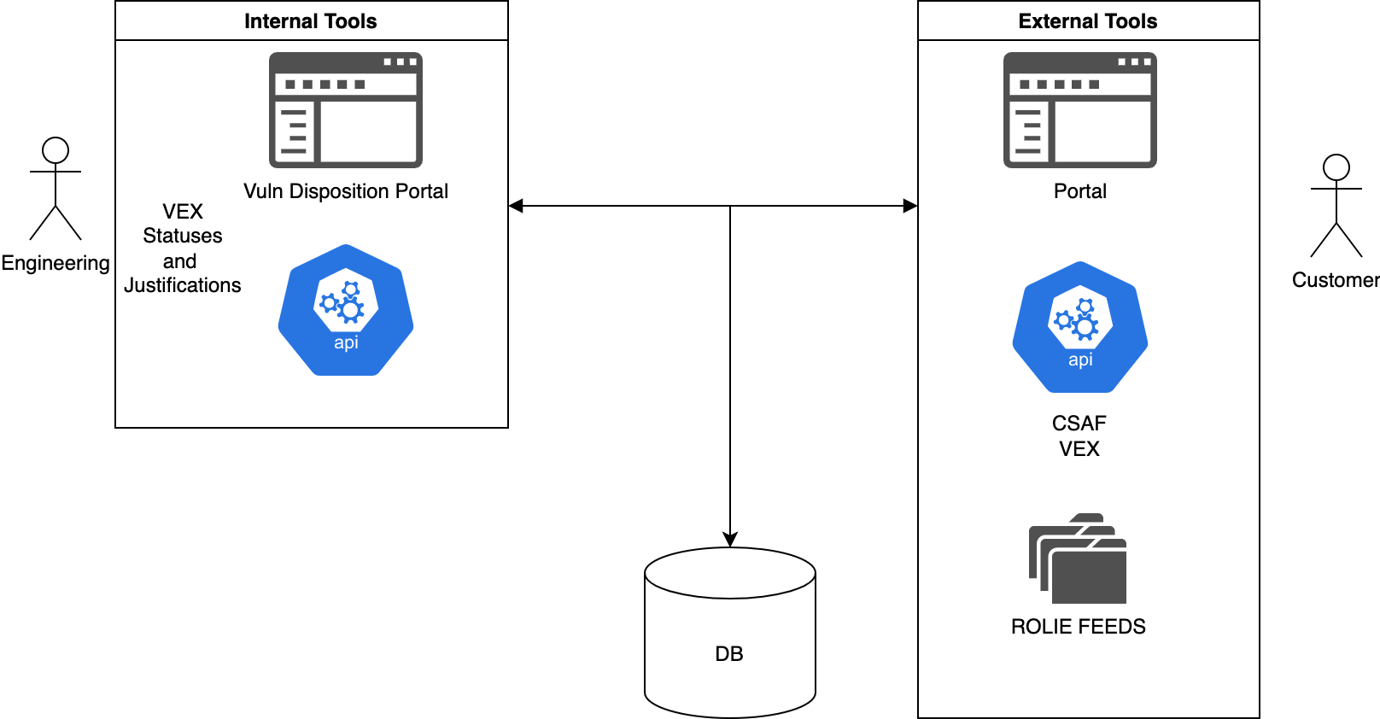
”Dynamic vs Static” Advisories
Scan Reports
Rumors
Compliance
Product Certification

Slide 23

ROLIE Feeds?
CSAF Supports the Resource-Oriented Lightweight Information Exchange (ROLIE), as defined in RFC 8322: https://www.rfc-editor.org/rfc/rfc8322.html

Slide 24

CSAF Open-Source Tools
- Secvisogram - CSAF Parser - CSAF Visualizer - CSAF Trusted Provider - CSAF Uploader - CSAF Aggregator - CSAF Checker - CSAF Validator Library - CSAF Validator Service - CSAF Content Management System - CSAF Downloader - vulnrep
* and more in development!

Slide 25



An Interactive Discussion of the Future of Security Advisories

