Slide 1
Simulation and evolutionary training of object collecting agents
Project work by Daniel Schembri

Slide 2
Contents
Project task
The concept of agents
Basics of artificial neural networks
Evolutionary algorithms
OpenGL
The Box2D physics engine
The simulator
Conclusion

Slide 3
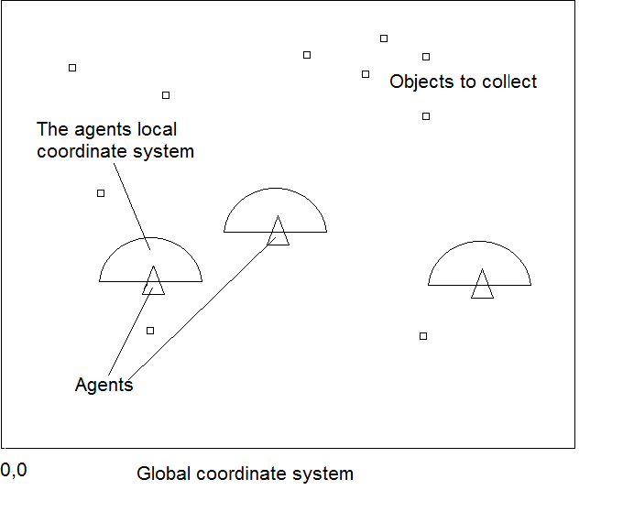
Project task
Collect as much objects as possible in a given time
Optimize the agents and find good parameters

Slide 4
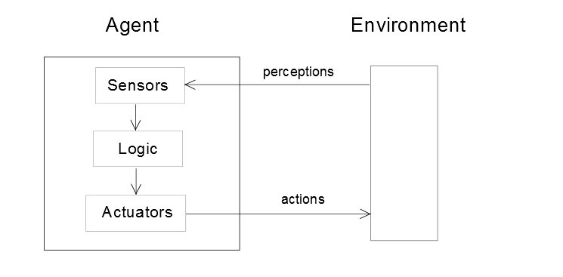
The concept of agents

Slide 5
The concept of agents - types of agents
Simple reflex agent
Just the actual perceptions are processed!
Model-based reflex agent
Expands the simple reflex agent by a memory
Has a internal model of the environment to predict further states
Goal-based agent
Generalization of the agents task
Example: Get from point A to B

Slide 6
The concept of agents - types of agents
Utility-based agent
Expands the goal based agent by multiple solutions
Has a rating function to choose a sulution
Learning agent
Learns by “experiments“ => no complex rules needed

Slide 7
The task environment
The performance
The rating criteria of the agent
Sensors
Actuators
The environment

Slide 8
The task environment - properties
Fully observeable vs Partially observerable vs Unobservable
Singleagent-based vs Mulitagent-based
Cooperation or competition
Deterministic vs stochastic vs non-deterministic
Episodic vs sequential
Static vs dynamic vs semidynamically

Slide 9
Evolutionary Algorithms
Optimization inspired by nature
Why evolutionary optimization?
Animals seem to solve problems easily
Finding the correct solution can be hard, time-consuming and expensive
Just a partially foreknowledge is necessary

Slide 10
Evolutionary Algorithms - Basics
Search Space
Define the general form of a solution
Keep it simple or it will explode
Rating function
Fitness function (maximization)
or error function (minimization)
Constraints
Evolutionary algorithm
No-free-lunch-theorem
Choose specific algorithm

Slide 11
Evolutionary Algorithms – The Hillclimber method
Also called: “Creepy random search“
Easy implementation
Main issue: Gets stuck in local optimum

Slide 12
Evolutionary Algorithms – Simulated annealing
Variation of the Hillclimber method
Inspired by the annealing of metal in industry
Annealing => heating and cooling down metal
Doesn‘t get stuck in local optimum
Finds mostly a optimum near the global one

