Slide 1
Simulation and evolutionary training of object collecting agents
Project work by Daniel Schembri

Slide 2
Contents
Project task
The concept of agents
Basics of artificial neural networks
Evolutionary algorithms
The Box2D physics engine
The simulator
Conclusion

Slide 3
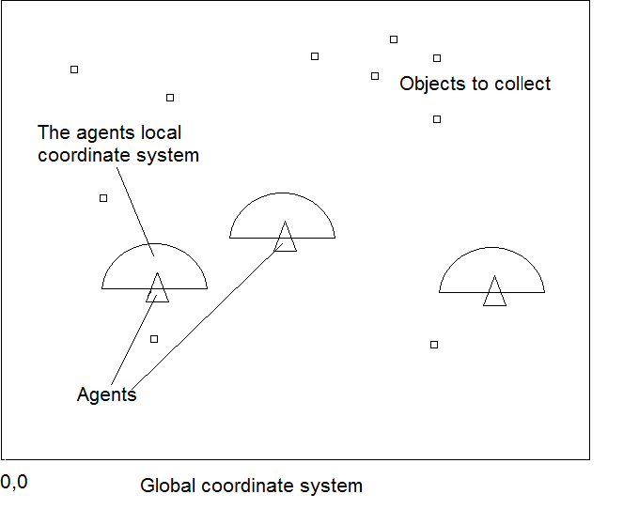
Project task
Collect as much objects as possible in a given time
Optimize the agents and find good parameters

Slide 4
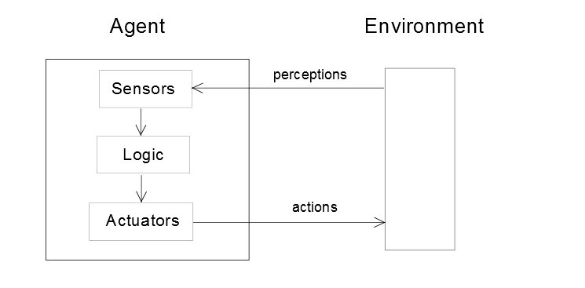
The concept of agents

Slide 5
The concept of agents - types of agents
Simple reflex agent
Just the actual perceptions are processed!
Model-based reflex agent
Expands the simple reflex agent by a memory
Has a internal model of the environment to predict further states
Goal-based agent
Generalization of the agents task
Example: Get from point A to B

Slide 6
The concept of agents - types of agents
Utility-based agent
Expands the goal based agent by multiple solutions
Has a rating function to choose a sulution
Learning agent
Learns by “experiments“ => no complex rules needed

Slide 7
The task environment
The performance
The rating criteria of the agent
Sensors
Actuators
The environment

Slide 8
The task environment - properties
Fully observeable or partially observerable or unobservable
Singleagent-based or mulitagent-based
Cooperation or competition
deterministic or stochastic
Episodic or sequential
Static or dynamic
Known or unknown

Slide 9
Evolutionary Algorithms
Optimization inspired by nature
Why evolutionary optimization?
Animals seem to solve problems easily
Finding the correct solution can be hard, time-consuming and expensive
Todays computation power
Just a partially foreknowledge is necessary

Slide 10
Evolutionary Algorithms - Basics
Optimization task
Search Space
Define the general form of a solution
Keep it simple or it will explode
Rating function
Fitness function (maximization)
or error function (minimization)
Constraints
Evolutionary algorithm
In general all algorithms are equal in effectivness
Choose specific algorithm

Slide 11
Evolutionary Algorithms - Basics
Chromosome

Slide 12
Evolutionary Algorithms – The Hillclimber method
1.Generate a randomly initialized chromosome.
2.Change the chromosome parameter by limited random delta-values.
3. Prove if the chromosome has a better fitness than the old one and replace it. Otherwise
refuse the new chromosome.
4. If the optimization-condition is reached abort, otherwise go to step 2.

Slide 13
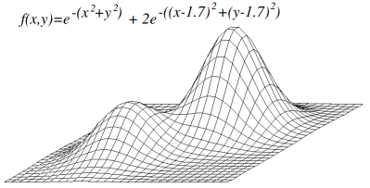
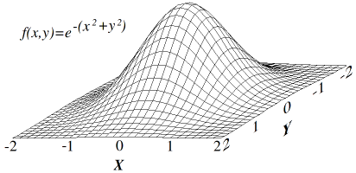
Evolutionary Algorithms – The Hillclimber method
Easy implementation
Main issue: Gets stuck in local optimum

Slide 14
Evolutionary Algorithms – Simulated annealing
Variation of the Hillclimber method
Inspired by the annealing of metal in industry
Annealing => heating and cooling down metal
Doesn‘t get stuck in local optimum
Finds mostly an optimum near the global one

Slide 15
The Box2D physics-engine

Slide 16
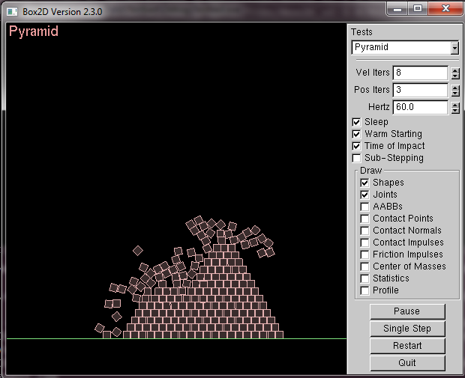
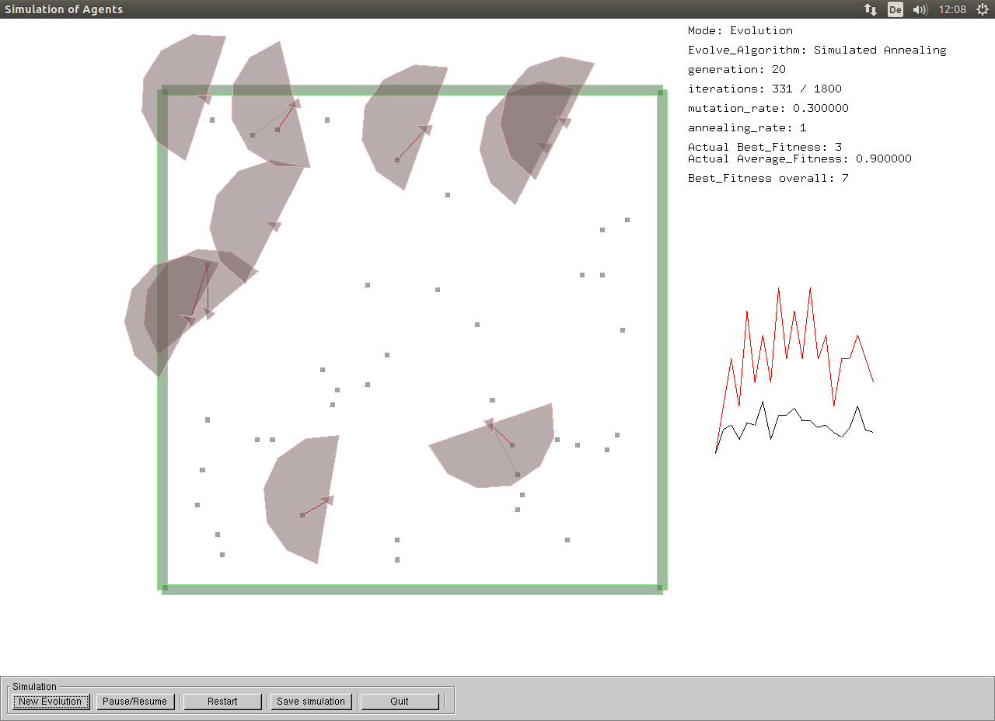
The simulator
Uses OpenGL to accelerate graphics
GLUT and GLUI
Based on Box2D Testbed-program of Erin Catto

Slide 17
The simulator -
Simple Reflex Agents
Feed Forward network

