Slide 1
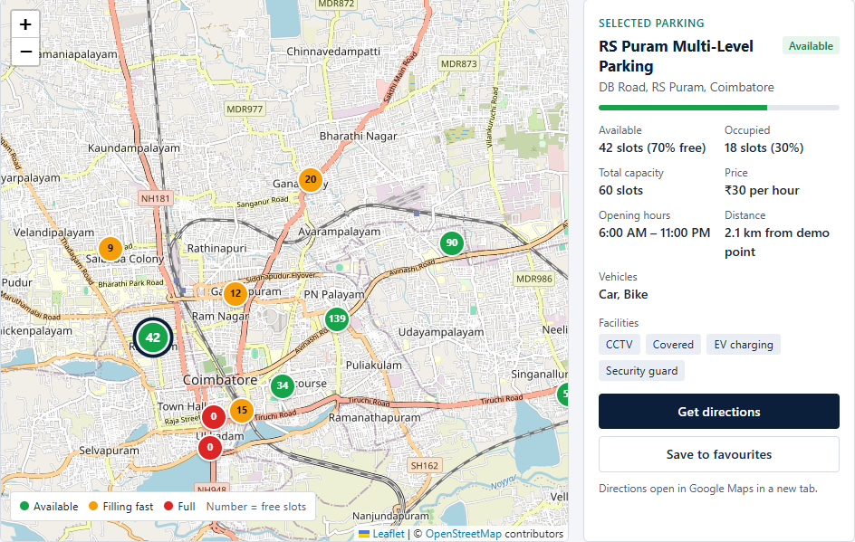
WEB TECHNOLOGY MICRO-PROJECT
PARKFINDER
Smart Parking Discovery and Availability Monitoring System
Find a parking spot before you arrive.
TEAM
DANIEL S
URK26CS1083
GLADYS JOYSELIN W
URK26CS1063
MONICA S
URK26CS1068
SARAVANAN M
URK26CS1090
Actual ParkFinder interface: map markers show free slots; the panel shows the selected parking.
TECHNOLOGY STACK
HTML5
CSS3
JavaScript (ES6)
Leaflet.js
OpenStreetMap
Browser LocalStorage
Student demonstration project · parking availability is simulated in the browser, not from real sensors
Notes:
Good morning. We are DANIEL, GLADYS, MONICA and SARAVANAN, and our Web Technology micro-project is ParkFinder – a Smart Parking Discovery web page for Coimbatore.
Our tagline is "Find a parking spot before you arrive." The picture on the right is a real screenshot of our app: the coloured circles on the map are parking places, and the number inside each one is how many slots are free.
We built it with only HTML5, CSS3 and plain JavaScript, plus the Leaflet library for the map, OpenStreetMap for the map pictures, and the browser's LocalStorage to remember favourites. There is no backend or database.
One honest point to remember: the parking numbers are simulated by JavaScript for demonstration. They do not come from real sensors.
Transition: First, let us explain what the name ParkFinder means and what problem it solves.

Slide 2





What is ParkFinder?
The name
The problem
How it helps
Objective
Park + Finder: a tool that finds a place to park. It shows parking locations on a map before you drive there.
In busy areas like Gandhipuram and RS Puram, drivers circle the streets looking for a free slot. This wastes time and fuel and adds traffic.
One screen shows every parking location with its free slots, price per hour and distance, so there is no need to visit each place to check.
A responsive web page to locate available parking using an interactive map, search, filters and Google Maps directions.
User journey
1
2
3
4
5
6
7
Open ParkFinder
Search an area, e.g. Gandhipuram
Parking spots appear on the map
Check free slots and price
Apply filters to narrow down
Select a suitable parking
Get directions in Google Maps
Student demonstration project: the 12 parking locations and their changing availability are simulated by JavaScript in the browser. No real parking sensors are used.
Notes:
ParkFinder simply means "park finder" – something that finds a place to park.
The problem: in crowded places like Gandhipuram or RS Puram, people drive around again and again looking for an empty slot. That wastes time and fuel and makes traffic worse.
Our idea: show all parking places on one screen – how many slots are free, the price per hour and how far away each one is – so you decide before you leave.
Walk through the journey at the bottom, left to right: open the page, type an area, see the spots on the map, compare free slots and prices, use filters, pick one, and press Get directions, which opens Google Maps.
Remember to say clearly: this is a demonstration. The numbers are simulated by JavaScript; we did not connect real sensors.
Transition: Now let us look at how the page is built, starting with HTML.

Slide 3
HTML Structure and Tags
199
35
Group | Tag name and count | Purpose | Where in ParkFinder
Structural 10 types · 49 | <html> 1, <head> 1, <body> 1, <header> 1, <nav> 1, <main> 1, <section> 6, <aside> 1, <footer> 1, <div> 35 | Build the page skeleton and group content | Navbar, hero, statistics, dashboard, details panel, About footer
Text and content 10 types · 91 | <h1> 1, <h2> 6, <p> 25, <span> 26, <strong> 1, <ul> 5, <li> 12, <dl> 1, <dt> 7, <dd> 7 | Headings, paragraphs, lists and label–value pairs | Page heading, panel titles, nav links, parking details (Available, Price…)
Form and input 8 types · 32 | <form> 2, <label> 10, <input> 9, <fieldset> 3, <legend> 3, <select> 1, <option> 3, <output> 1 | Collect what the user wants | Search bar, availability checkboxes, vehicle choice, price slider, Sort by
Interactive 2 types · 15 | <button> 6, <a> 9 | Things the user clicks | Menu, Near me, Search, Reset filters, Pause updates, Save; links, Get directions
Media and external resources 5 types · 12 | <meta> 3, <title> 1, <link> 3, <script> 4, <img> 1 | Page information, styles, scripts and images | Charset and viewport, tab title, Leaflet CSS + style.css + icon, 4 scripts, logo
total HTML element occurrences
unique HTML tag types
Counted with an HTML parser on index.html, the project's only HTML file. <!DOCTYPE html> is a declaration, not an element. The 12 parking cards are added later by JavaScript, so they are not in this count.
Check: 49 + 91 + 32 + 15 + 12 = 199 elements · 10 + 10 + 8 + 2 + 5 = 35 tag types
Notes:
HTML gives the page its structure – like the walls and rooms of a house.
We counted the tags with an HTML parser, not by guessing. index.html has 199 HTML elements in total, made from 35 different tag types. "Total" means every time a tag appears; "unique" means how many different tags we used.
The chart shows the most repeated tags: div 35 times, span 26, p 25. The table groups all 35 tags into five groups, and the check line at the bottom shows that the groups add up to exactly 199 and 35.
Two points to remember: the DOCTYPE line is a declaration, not an element, so it is not counted; and the 12 parking cards are made later by JavaScript, so they are not in this count either.
Transition: Next, let us look at the most important tags in our actual code.

Slide 4
Important HTML Elements in ParkFinder
Semantic tags (header, nav, main, section, aside, footer) say what the content is, which helps screen readers and keeps the code readable. Generic tags (div, span) are plain boxes used only for layout and styling.
<head> <meta> <title> <link>
<header> <nav> <h1>
Browser information, not shown on the page: mobile viewport, tab title, stylesheet.
Sticky top bar with logo, section links and Near me; h1 is the one main page heading.
<meta name="viewport" content="width=device-width, initial-scale=1.0">
<title>ParkFinder | Smart City Parking Finder</title>
<link rel="stylesheet" href="css/style.css">
<header class="navbar">
<nav class="container navbar-inner" aria-label="Main navigation">
<h1 class="hero-title" id="hero-title">Find a parking spot in Coimbatore</h1>
<main> <section> <aside>
<form> <input> <button>
main = page content; section = one area; aside = the selected-parking panel.
The search bar. JavaScript reacts to typing and to the submit event (Enter or Search).
<main id="top">
<section class="hero" aria-labelledby="hero-title">
<aside class="panel info-panel" id="info-panel" aria-labelledby="info-title">
<form class="search-bar" id="search-form" role="search">
<input type="search" id="search-input" class="search-input"
<button type="submit" class="btn btn-accent">Search</button>
<fieldset> <legend> <label> <output>
<script defer> <footer>
fieldset + legend group filters; each input has a label; output shows the price.
defer: scripts run in order after the HTML loads. footer: About, team, map credit.
<legend class="filter-label">Availability</legend>
<input type="checkbox" name="status" value="available" checked>
Max price: <output id="price-output" for="price-range">&#8377;100/hr</output>
<script src="js/data.js" defer></script>
<script src="js/map.js" defer></script>
<script src="js/script.js" defer></script>
Notes:
These are the tags that matter most in ParkFinder. Every code example here is copied from our index.html.
Head: the viewport meta tag makes the page fit phone screens; title is the text on the browser tab; link loads our stylesheet.
Header and nav: the top bar with our logo and links. h1 is the single main heading: "Find a parking spot in Coimbatore".
main, section and aside are semantic tags – they describe what the content is. aside is our "Selected parking" panel. Compare this with div: a div means nothing by itself, it is just a box for layout.
form, input and button make the search bar; fieldset, legend, label and output make the filters. Every input has a label, which helps screen-reader users.
Finally, script with defer loads data.js, then map.js, then script.js, after the HTML is ready.
Transition: HTML gives structure – now let us see how CSS makes it look good on every screen.

Slide 5
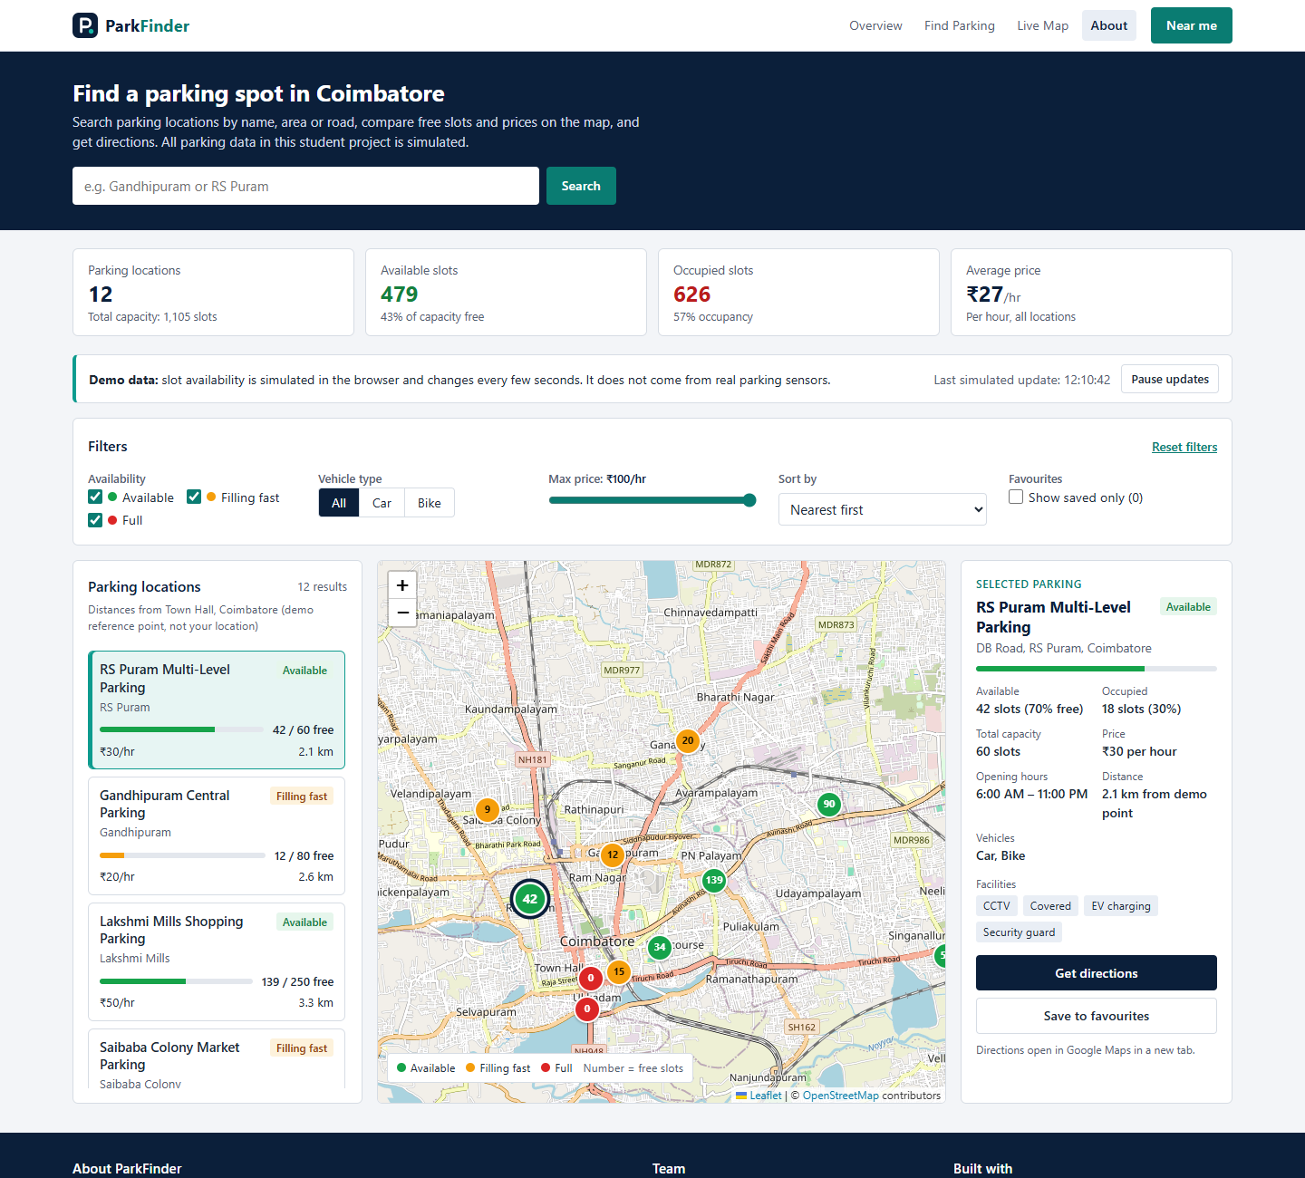
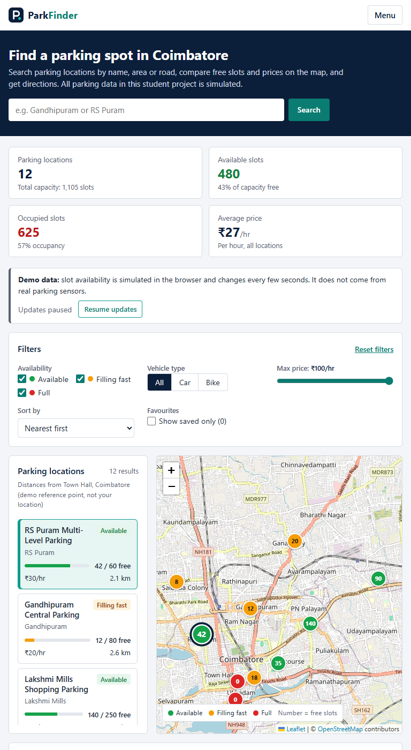
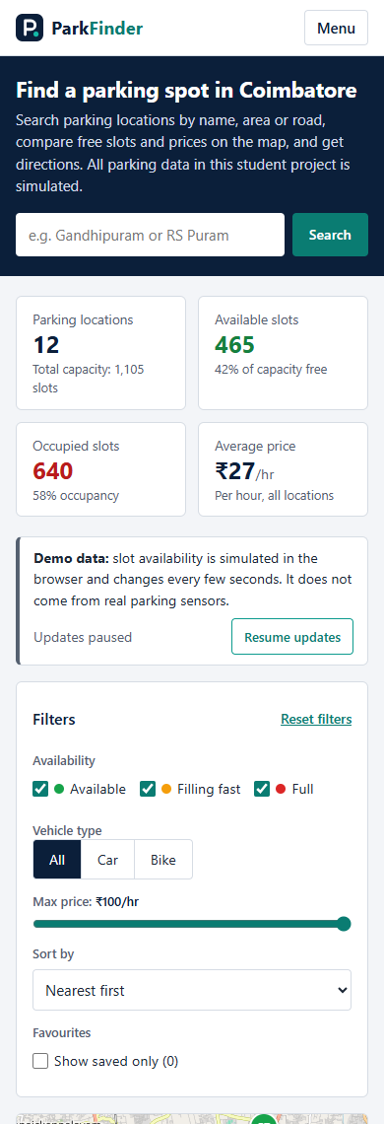
CSS Styling and Responsive Design
1
Colour variables – one palette for the whole site
:root {
--navy: #0b1f3a; /* primary colour */
--teal: #0d9b8e; /* accent colour */
--green: #16a34a; /* Available */
--orange: #f59e0b; /* Filling fast */
--red: #dc2626; /* Full */
2
CSS Grid – list | map | details
.dashboard-grid {
display: grid;
grid-template-columns: 320px minmax(0, 1fr) 300px;
3
Media queries – the layout changes with width
@media (max-width: 959px) {
.stats { grid-template-columns: repeat(2, 1fr); }
@media (max-width: 767px) {
.map-card { order: 1; height: 360px; }
Desktop · 1440 px
Tablet · 768 px
Mobile · 390 px
Desktop
3 columns (list | map | details), 4 statistics in one row, full navigation links
≤ 1199 px
Details panel moves below the list and the map
4
Status colours and interactive states
≤ 959 px
Links hide behind a Menu button; statistics become 2 × 2
.marker-available { background: var(--green); }
.marker-full { background: var(--red); }
.btn-primary:hover { background: #17345d; }
≤ 767 px
One column: map first, then details, then list; bigger (about 40 px) tap targets
Also used: Flexbox (display: flex in 23 rules) · sticky navbar · :focus-visible outlines · --fill occupancy bars
Notes:
CSS decides how everything looks. All code here is from our style.css.
1. Colour variables: we define each colour once in :root – navy, teal, and green, orange and red for the three parking states – and reuse it everywhere, so the whole site stays consistent.
2. CSS Grid: one line, grid-template-columns, creates the three columns: list 320 pixels, map takes the remaining space, details 300 pixels.
3. Media queries: rules that apply only below a certain width. At 959 pixels the links go behind a Menu button and the statistics become 2 by 2. At 767 pixels, for phones, everything becomes one column and the map comes first.
4. States: markers get their status colour; buttons change colour on hover; keyboard users see a clear focus outline.
Point to the three real screenshots: the same HTML, arranged differently by CSS for desktop, tablet and mobile.
We also used Flexbox for rows like the navbar, and a sticky navbar that stays on top while scrolling.
Transition: The page looks good, but it would do nothing without JavaScript – let us see how it works.

Slide 6

How JavaScript Makes ParkFinder Work
One function refreshes the screen: updateParkingList()
Feature | JavaScript that makes it work | What changes on screen
Parking data | PARKING_SPOTS array in data.js; validateDataset() checks it at start-up | 12 records feed cards, statistics and map
Search | matchesSearch(): name + area + address, toLowerCase() and includes() | Cards and markers update while typing
Availability, vehicle and price filters | filterParkingSpots() uses filter(); a spot must pass every condition | Non-matching cards and markers disappear
Sorting | sortParkingSpots() sorts a copy with SORT_COMPARATORS | Nearest / Cheapest / Most available first
Favourites + LocalStorage | toggleFavourite() updates a Set; saveFavourites() → JSON.stringify → localStorage | "♥ Saved" on cards; kept after refresh
Map, markers, popups | initMap(), createMarkerIcon() with L.divIcon, createPopupHTML() in map.js | Coloured markers showing free slots
Near me | requestUserLocation() → navigator.geolocation; haversineDistanceKm() | Blue "You" marker, nearest first; demo point if refused
Simulation, pause / resume | simulateAvailabilityUpdate(); startSimulation() / stopSimulation() (clearInterval) | Numbers and colours change; button text switches
Directions | getDirectionsURL() builds a Google Maps URL | Google Maps opens in a new tab
Empty and selected states | getEmptyMessage(), getSyncedSelectionId(), renderInfoPanel() | "No parking locations match…" or the details panel
User action
typing, clicking a filter, or the 5-second timer
getFilterValues()
reads search box, checkboxes, slider, sort
filterParkingSpots()
keeps only spots that pass every filter
sortParkingSpots()
orders a copy: [...spots].sort()
renderParkingList() · renderInfoPanel() · updateMapMarkers()
cards, details panel and map change together
Status rule (script.js)
function getAvailabilityStatus(spot) {
if (spot.availableSlots === 0) return "full";
if (getFreeRatio(spot) > AVAILABLE_THRESHOLD) return "available";
return "limited";
}
Simulated, not real: simulateAvailabilityUpdate() runs every 5 s with setInterval and changes 3 random spots by 1–3 slots, kept between 0 and capacity with clamp().
73 functions in total: map.js 12 + script.js 61. data.js holds only data (APP_CONFIG and PARKING_SPOTS).
Notes:
This is the heart of the project. JavaScript connects the parking data to the screen.
All the data lives in one array, PARKING_SPOTS, in data.js – 12 parking records. validateDataset() checks them when the page starts.
Look at the flow on the left. Whatever the user does – types, ticks a filter, or the timer fires – we call one function, updateParkingList(). It reads the controls, filters the array, sorts a copy, and then redraws the cards, the details panel and the map markers together. So the list, the map and the panel can never disagree.
The status rule: zero free slots is Full, more than 40 percent free is Available, anything else is Filling fast.
The table maps every feature to the real function names. A few to explain: favourites are kept in a Set and saved to LocalStorage as JSON, so they survive a refresh. Near me asks the browser for location only when clicked; distances use the Haversine formula. If the user refuses, we say so and measure from a labelled demo point – we never pretend to know their location.
Very important: availability changes are simulated. Every 5 seconds setInterval changes three random spots. Pause uses clearInterval.
Transition: Now let us see the actual output.

Slide 7
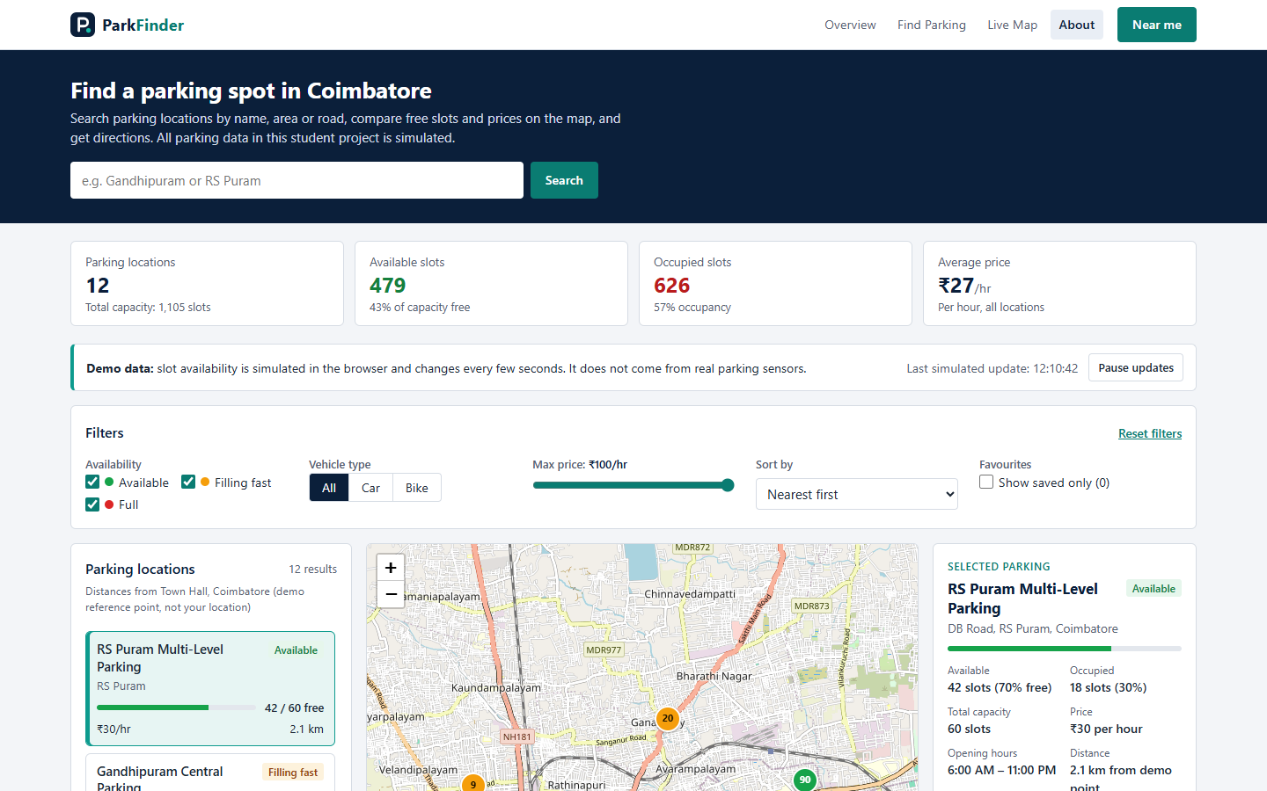
ParkFinder Desktop Interface
8
Interface sections
1
Search bar: name, area or road
2
Statistics calculated from the data
1
3
Demo-data notice + Pause updates
2
4
Filters: status, vehicle, price, sort
5
Parking list (cards)
3
6
Interactive Leaflet map
7
Selected parking details
4
8
Near me button
Availability status (starting values)
6
7
5
Available
RS Puram Multi-Level
42 / 60 free · ₹30/hr
Filling fast
Gandhipuram Central
12 / 80 free · ₹20/hr
Full
Town Hall Street
0 / 40 free · ₹15/hr
Screenshot: desktop, 1440 × 900 px. Numbers change every 5 s because availability is simulated.
Map markers use the same colours and show the free-slot number, e.g. a red “0” = Full.
Notes:
This is a real screenshot of ParkFinder on a desktop browser. Follow the numbers.
1 – the search bar in the dark hero section. 2 – four statistics: locations, available slots, occupied slots and average price, all calculated from the data, not typed in. 3 – the demo-data notice, which honestly says the availability is simulated, with a Pause button. 4 – the filter bar. 5 – the parking list; each card shows status, free slots, price and distance. 6 – the Leaflet map with OpenStreetMap. 7 – the details of the selected parking. 8 – the Near me button.
On the right are three real examples from our data: RS Puram is Available with 42 of 60 free at 30 rupees per hour; Gandhipuram Central is Filling fast with 12 of 80; Town Hall Street is Full with 0 of 40.
The numbers in the screenshot may differ slightly from these because the simulation keeps changing them.
Transition: Now let us see the features in action.

Slide 8
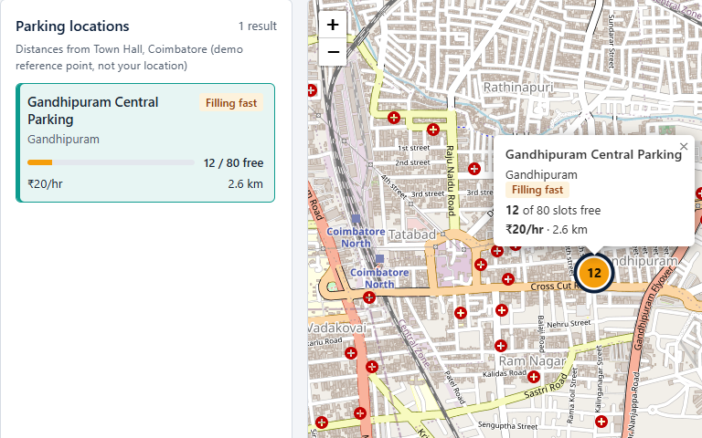
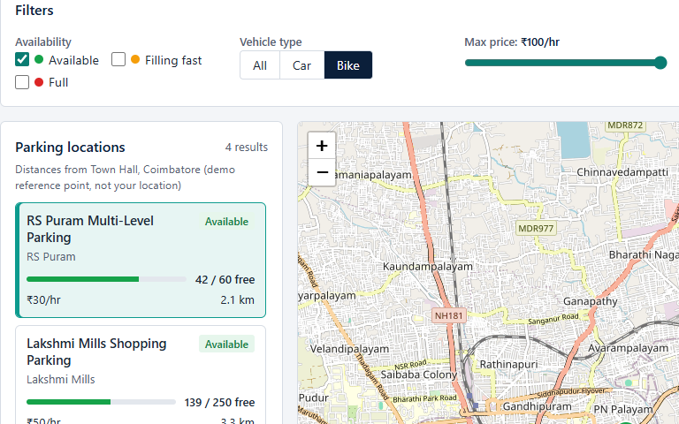
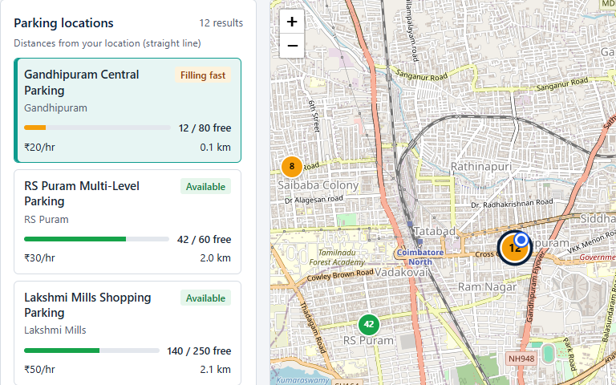
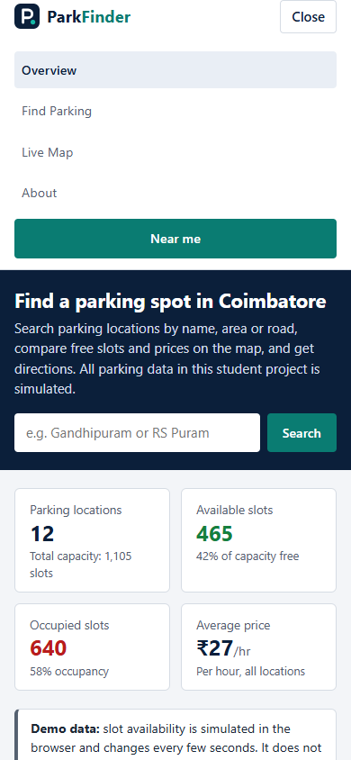
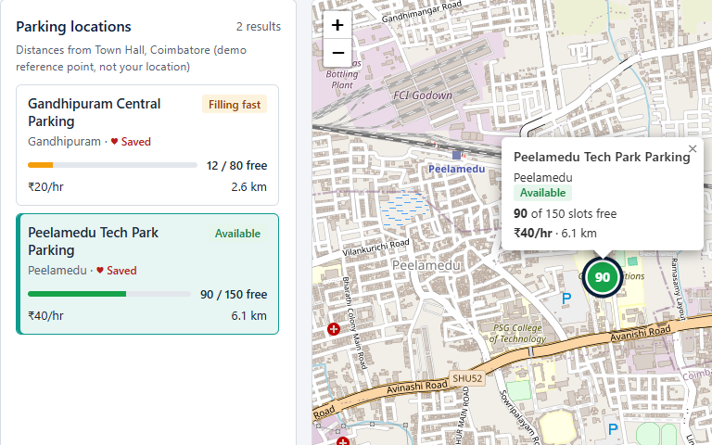
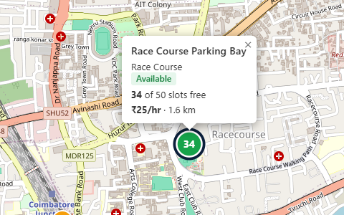
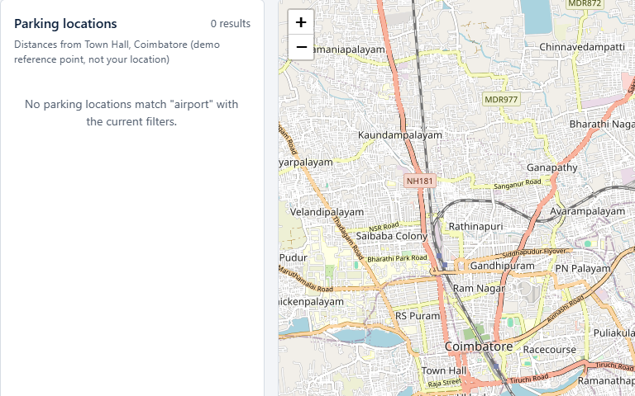
Features in Action
1
Search “Gandhipuram”
1 result; list, map popup and details agree
2
Filter: Available + Bike
Only the 4 matching spots remain
3
Near me
Blue “You” marker; distances now from your location
Favourites
“♥ Saved” on cards; Show saved only → 2 results
Marker popup
Name, status, free slots, price and distance
Empty result
“airport”: 0 results and a clear message
7
Mobile · 390 px
Menu opens and pushes the page down
4
5
6
Notes:
Here are the main features working, all real screenshots.
1 – We typed Gandhipuram. Only one result remains, and the list, the map popup and the details panel all show the same parking.
2 – We kept only Available and chose Bike. Four spots remain, and the map shows only those four markers.
3 – Near me: after allowing location, a blue "You" marker appears and the list says distances are from your location, nearest first. If location is refused, the app clearly says it is using a demo point instead.
4 – Favourites: saved spots show a heart on the card, and "Show saved only" lists just those two. The button changes to "Remove from favourites" to remove one. Favourites stay after a refresh because of LocalStorage.
5 – Clicking a marker opens a popup with name, status, free slots, price and distance.
6 – If nothing matches, like "airport", we show a clear message instead of an empty screen.
7 – On a phone the layout becomes one column and the Menu button opens the links, pushing the page down.
Transition: Let us conclude.

Slide 9

Thank You
FUTURE ENHANCEMENTS
Not part of the current project – ideas for the next version
Questions?
1
Real parking sensors
Connect sensors through a backend server
ParkFinder – Find a parking spot before you arrive.
2
Live availability
Real-time slot counts instead of simulation
WHAT WE BUILT
A simple solution to an everyday city problem
Online reservation
Book a slot before arriving
3
Interactive parking discovery on one page
Search, filtering and sorting
Payment integration
Pay for parking online
4
Map-based parking view with Leaflet + OpenStreetMap
Responsive layout for desktop, tablet and mobile
5
Operator dashboard
Parking owners update slots and prices
JavaScript-based simulated availability (not real sensors)
ParkFinder · DANIEL S (URK26CS1083) · GLADYS JOYSELIN W (URK26CS1063) · MONICA S (URK26CS1068) · SARAVANAN M (URK26CS1090)
Notes:
To conclude: ParkFinder is a simple answer to an everyday city problem – finding parking.
We built an interactive page where users can search, filter and sort parking places, see them on a Leaflet map, save favourites and get Google Maps directions, and it works on desktop, tablet and phone.
We were careful to be honest: the availability is simulated with JavaScript, not real sensor data.
On the right are future enhancements – these are NOT in the current project. With a backend, ParkFinder could use real sensors and live availability, let users reserve and pay online, and give parking operators a dashboard to update their slots.
Thank you for listening. We are happy to answer your questions.

