Slide 1
DOS Batch Programming
Damian Gordon

Slide 2
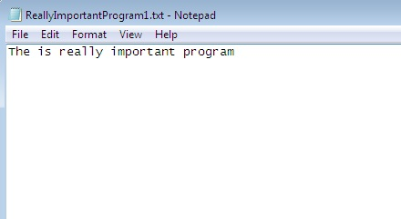

Slide 3
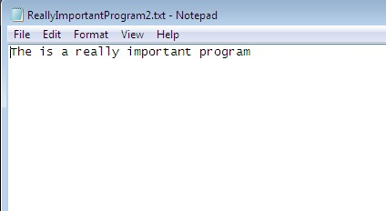

Slide 4
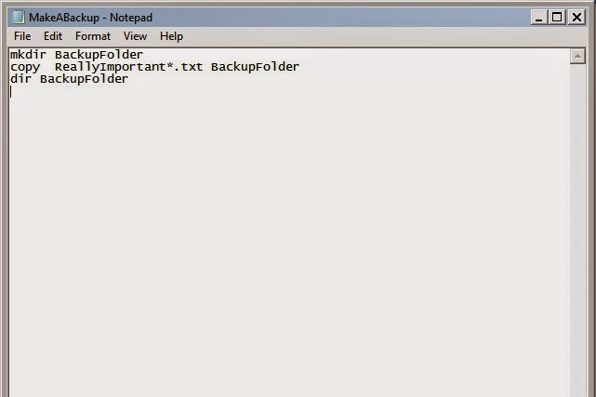

Slide 5
