Slide 1
Shell Script Creation
Damian Gordon

Slide 2
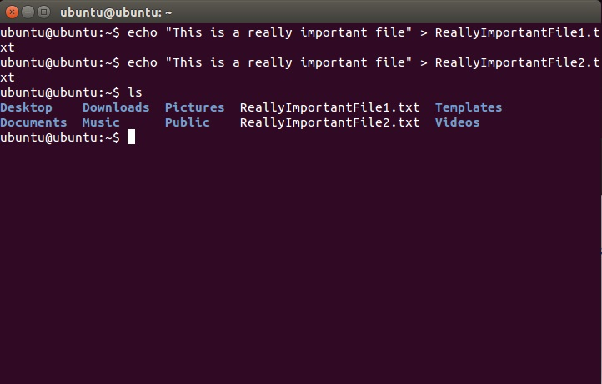

Slide 3
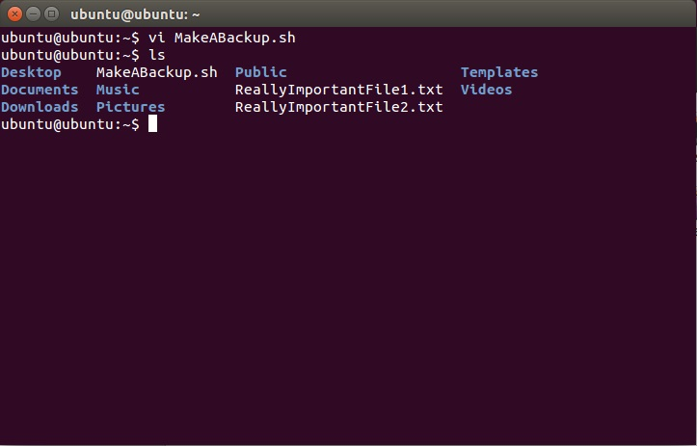

Slide 4
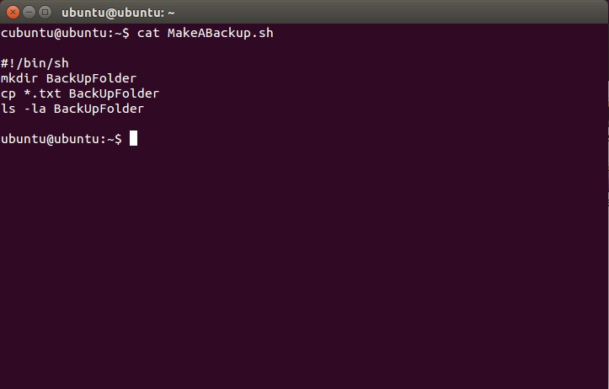

Slide 5
