Slide 1

GLaDOS
The Hash Experience
Haashim Bari, Karen Kilroy, Alex Sweeny, Bryan Nyondo & Connor Duignan

Slide 2
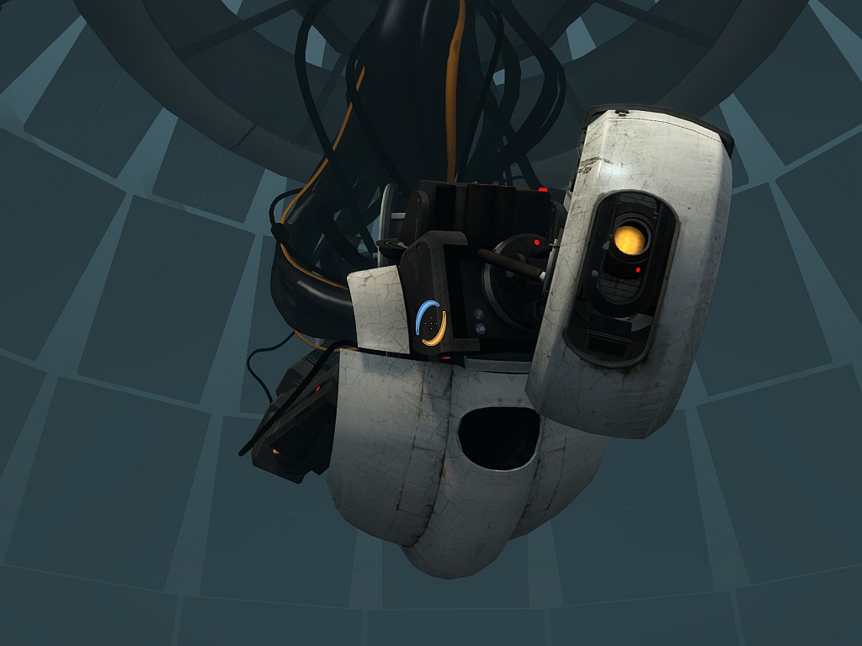
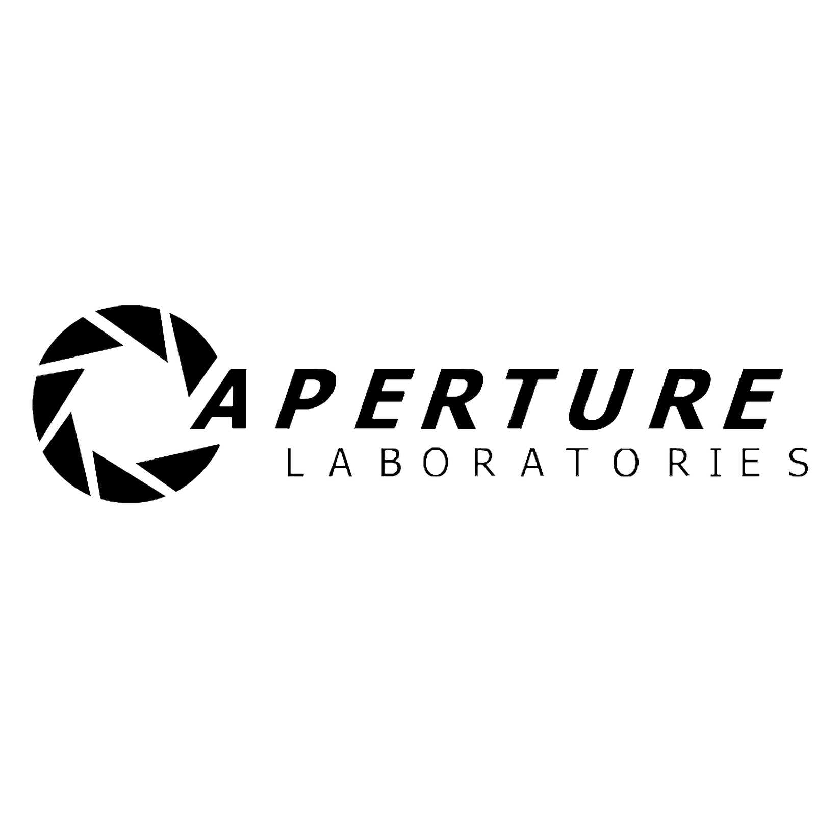
Table of Contents
What is GLaDOS
History of GLaDOS
Capabilities & Requirements of GLaDOS
Problems with GlaDOS
Personality Cores

Slide 3

What is GLaDOS?
The Genetic Lifeform and Disk Operating System
Created to manage the Aperture Enrichment centre

Slide 4
Aperture Science
A cutting-edge Science Facility
Creators of the Hand-held Quantum tunneling Device
Number #1 in robotic employees

Slide 5
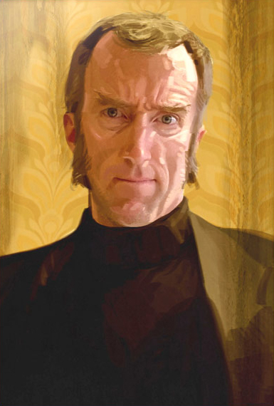
History of GLaDOS
Brainchild of our founder:
Cave Johnson

Slide 6

Cave Johnson
Born in the 1920's, he became an entrepreneur at an early age
Founded Aperture Science in 1947
Stoically continued to lead Aperture through financial ruin
Conceived of GLaDOS on his deathbed in 1982
Cave and his assistant Caroline

Slide 7
History of GLaDOS
GLaDOS has been worked on constantly since 1982
Version 1.0 came online in 1986
Neither operated disks or genetic life-forms
Successfully organized Aperture notice-board

Slide 8
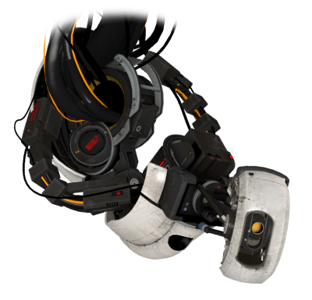
History of GLaDOS
Version 2.0 came online in 1990
Unfortunately displayed murderous intent
Unfortunately had access to deadly neurotoxin
Still unable to operate disks

Slide 9
History of GLaDOS
Version 3.0 came online in 1996
Disk operating aspect of system was somewhat operational
Work began on Genetic life-form aspect

Slide 10
History of GLaDOS
Current Version: 3.11
Work has begun on reining in Psychotic tenancies
Notice board management efficiency increased by 13%

Slide 11
Capabilities and Requirements
Operator of the Aperture Science Enrichment Centre
Autonomously manages:
The computer system
Robotics
Assembly lines
Monitoring test subjects
Multiple test areas

Slide 12
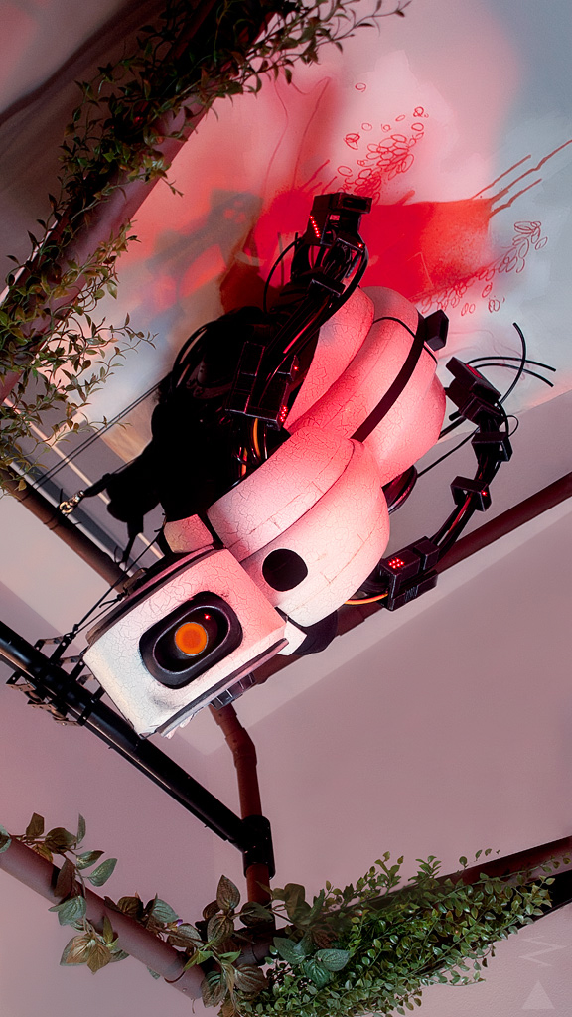
A True AI
The result of implanting a human consciousness into a computer
Capable of independent thought
Unique and original ideas

Slide 13
Creation
Improves her own components
Replacements are new, sleek and black
Designs various testing chambers for multiple experiments

Slide 14
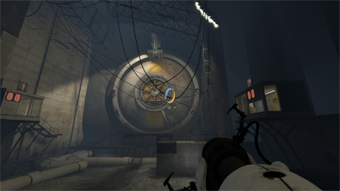
Housing
Requires a large central mainframe for maximum functionality
A robotic armature is her central housing in the Aperature Enrichment Centre
Capable of functioning with extremely low voltages, albeit with limitations

Slide 15
I/O
Designed for voice commands as only input
Various outputs:
Personal voice
Screen messages
Robotic movements
FAX

Slide 16
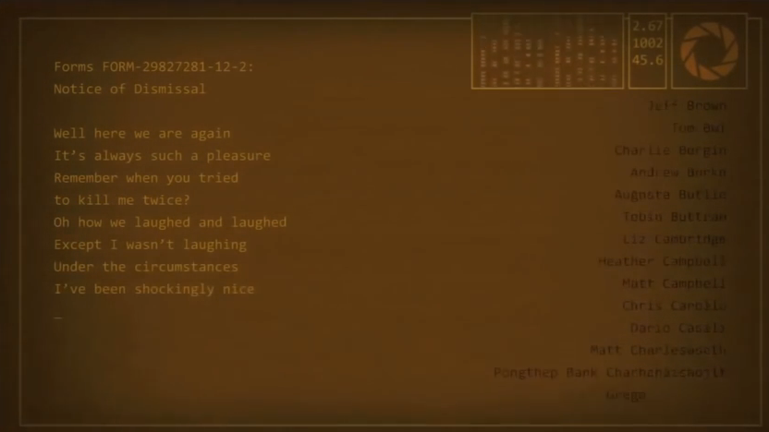
Output screen

Slide 17
Problems with GLaDOS Version 2.0
Launched in 1990
Rejected all voice commands
Floods labs with neurotoxin
Ruins “bring you daughter to work day”

Slide 18
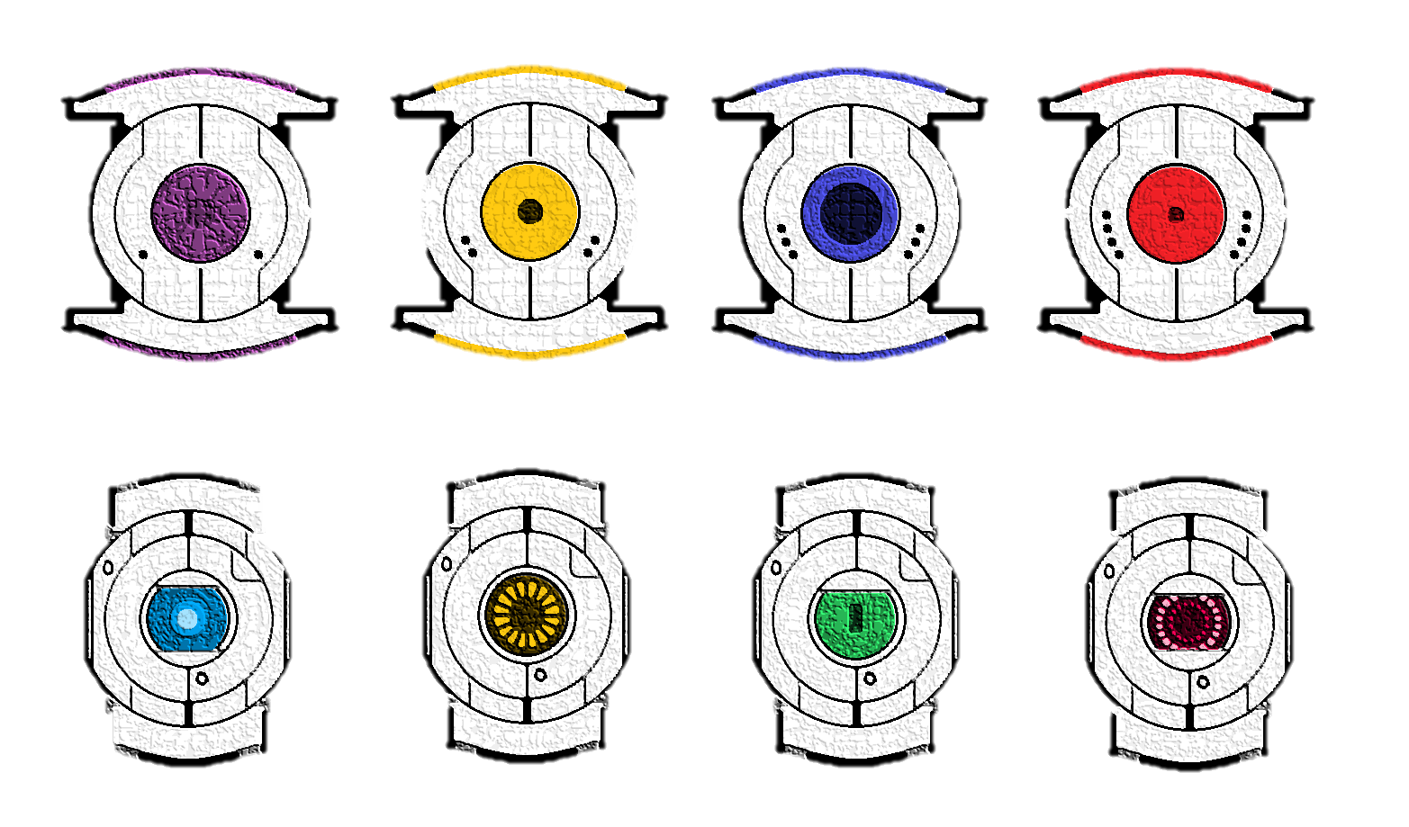
Personality cores
2002, separate cores added in an attempt to impede GLaDOS’ homicidal tendencies
Each core has different effect on GLaDOS

Slide 19
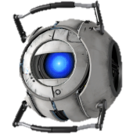
Wheatley
AKA: Intelligence Dampening Sphere
Created to slow GLaDOS down
Generates infinite stream of flawed suggestions to distract GLaDOS

Slide 20
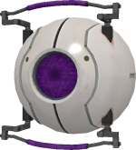
Morality Core
Most important core
Installed to stop releasing Neurotoxin
Also controlled rocket turrets.

Slide 21
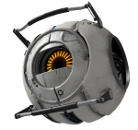
Corrupted Cores – Space Sphere
Technical difficulties over time can lead to a corrupted core
Space sphere really wants to go to space

Slide 22
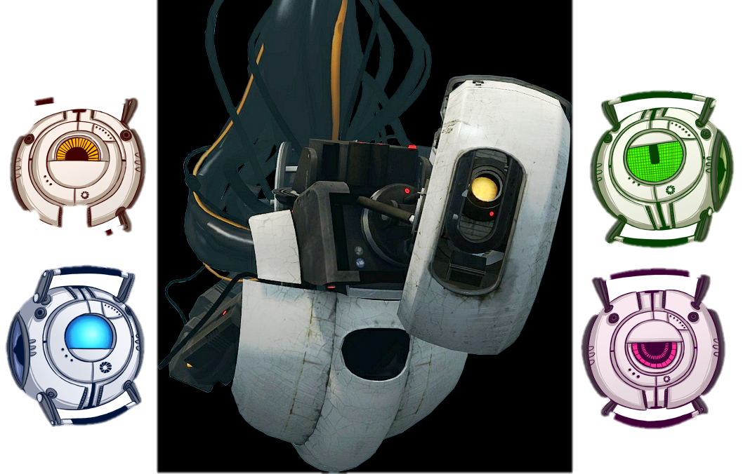
Final Architecture

Slide 23
Version 3.11
GLaDOS updated, to allow separate cores to be added
2003, GLaDOS finds loophole in new update
Ruins “bring your cat to work day”

Slide 24
Conclusion
The Genetic Lifeform and Disk Operating System is:
Complex and interesting
Has evolved over many years
Has many capabilities and has achieved different personality traits

Slide 25
THE END

