Slide 1
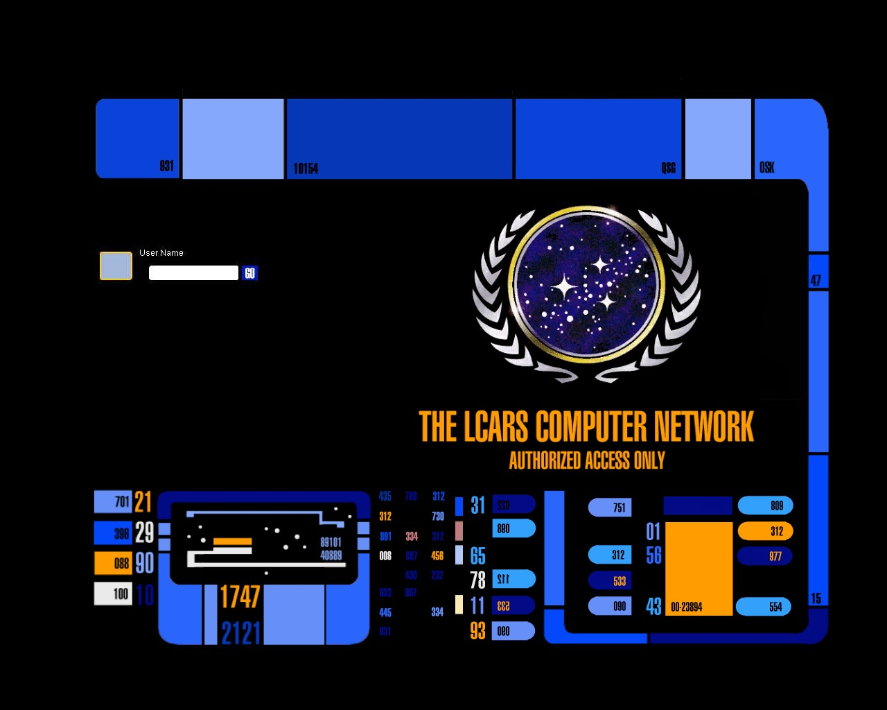
GROUP 1:
THE REDSHIRTS

Slide 2
GROUP MEMBERS
Acquah, Kewbina, Charles
Djoussa, Kevin, J.
Kearney, Edel.
Murray, Amber.
Sharma, Vardaan.

Slide 3
TABLE OF CONTENTS
OUR TOPIC
ABOUT LCARS
ARCHITECTURE
OPERATING LCARS
BRIEF HISTORY
THE MAKING
CONCLUSION

Slide 4
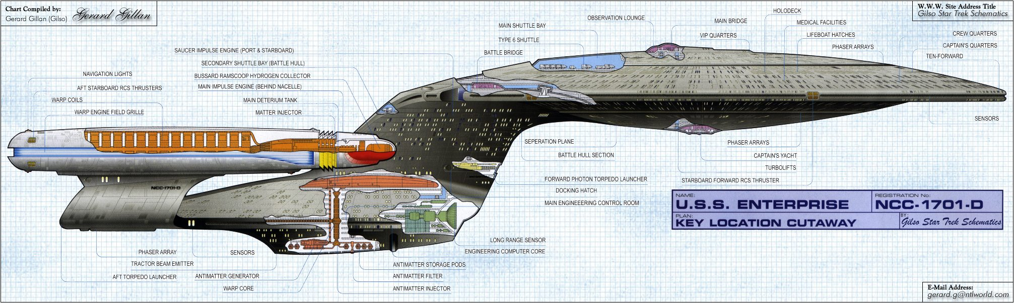
ABOUT LCARS
Lcars is the operating system in U.S.S Enterprise-D which featured in star trek- the next generation and was taken command by jean-luc pickard on stardate 41148
SHIP LAYOUT

Slide 5
ARCHITECTURE
3 main cores
Transfers data faster than the speed of light
Every input control is connected directly to the data network or subprocessor
These subprocessors combine to form the nervous system
Short ranges RF links located throughout the ship to provide crew with handheld devices with data

Slide 6
WARP
DRIVE

Slide 7
WARP DRIVE –
Powered by third core
Propels the enterprise
powers essential systems like the computer cores, deflectors, tractor beam, and defensive shields.

Slide 8
MAIN BRIDGE

Slide 9
“Conn”- operated by the flight control officer, although most of the navigational aspects of the ship are automated an officer is required to moitor these actions due to the importance.
Ops”- coordinates the scheduling of resources and hardware being used aboard the starship
Tactical”- responsible for defensive systems and starship internal security. Responsibilty ranges from crew safety to full counter intelligence measures. e.g. Against sabotage

Slide 10
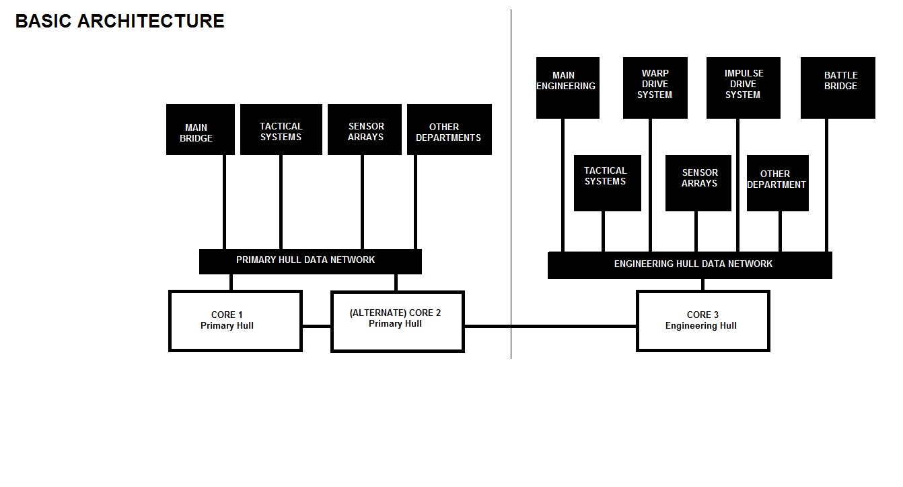

Slide 11
OPERATING LCARS
LCARS has 7 Operating Panels :
Right Engineering panel
Science Auxiliary panel
Conn Main Panel
Engineering Main panel
Left Master Back panel
Main Ops panel
Science Main panel

Slide 12
INTERFACE
PADDs
tricorders
control panels
vocal natural language commands.
.

Slide 13
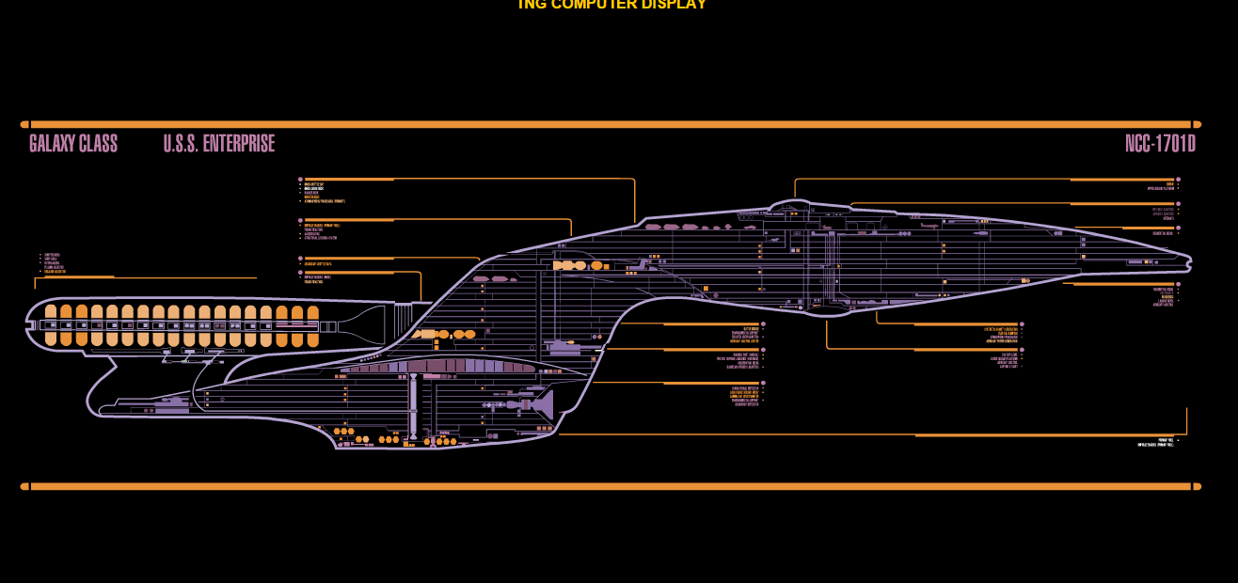

Slide 15
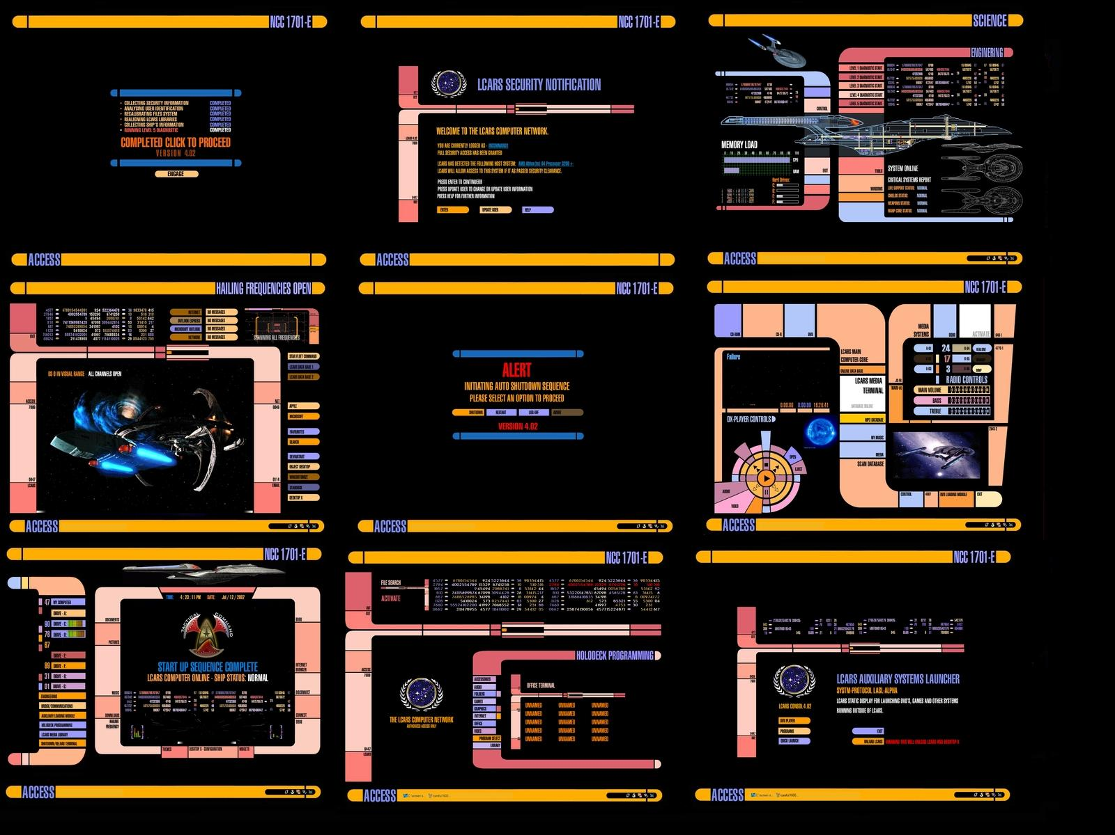

Slide 16
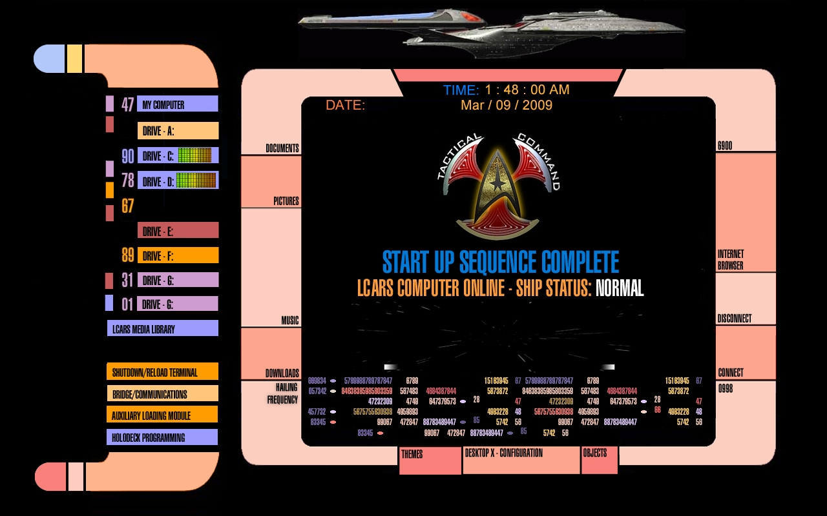

Slide 17
HISTORY
LCARS was first seen in 2363
By 2363, interface was very common
First called LCARS on ‘The Next Generation
Customized computer to almost perfect efficiency
Programming more sophisticated and advanced
Allowed artificial intelligence programs and voice interface systems

Slide 18
Enterprise was given advanced Calligar technology
Enhanced computers and allowed voice interactions

Slide 19
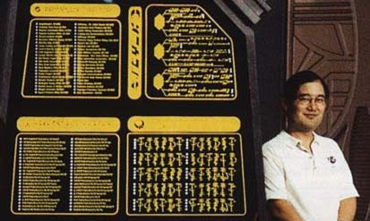
Michael Okuda
Born in Tokyo, raised in Honolulu
Scenic Art Supervisor + Technical Consultant
Worked on every live-action production after The Original Series
Worked for NASA

Slide 20
REVIEWS
CAPTAIN JEAN PICARD- “a beauty to fly with”
SHIPS DAILY- “masterpiece of its time”
COMMANDER DATA- “if I was capable of love, I would fall for this ship”
WEEKLY FLEET- “beauty of a machine”

Slide 21
CONCLUSION
We thank you for your time and hope that our presentation was informative and entertaining, we have had our ups and downs and this was a great team building experience. If you want to know anymore information regarding LCARS feel free to speak to any one of us or google it. Once again, thanks and “Live long and prosper”

