Slide 1
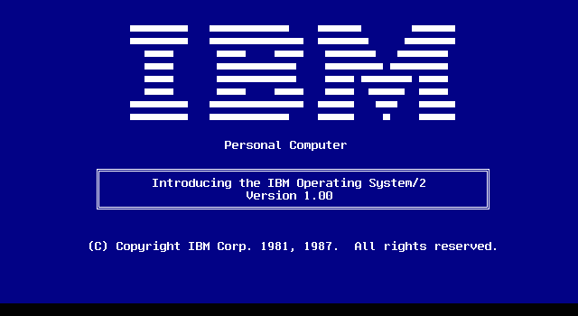
OS/2
A group presentation by Something Cool!!!
Bernard Mc Donnell, Caoimhe Harvey, Mark Twomey, Graham Byrne, Yahia Ragab,

Slide 2
Table Of Contents
Who was responsible?
A brief history
How/why did it fail?
A look at the architecture
Conclusion

Slide 3
Who Was Responsible?
Bill Gates – Microsoft
Ed Iacobucci - IBM

Slide 4
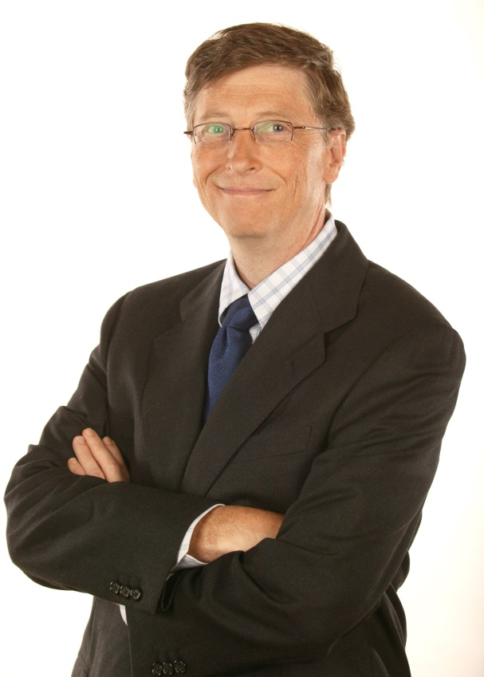
William Henry "Bill" Gates III
Born 28 Oct 1955
1973: Harvard
1975: Left Harvard and co-founded Micro-Soft
The rest is history!!
“640k ought to be enough for anybody!” ????

Slide 5
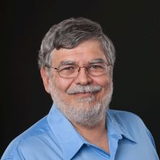
Edward "Ed" E. Iacobucci
Born 26 Sep 1953 Argentina
Died 21 Jun 2013
Graduated from Georgia Tech with a BSc in Systems Engineering
1979: Started in IBM
Leadership Responsibilities for OS2

Slide 6

Edward "Ed" E. Iacobucci (2)
1989: co-founded Citrix Systems
1998: Top Entrepreneur
2002: co-founded DayJet Corporation
2013: Retired for health reasons

Slide 7
OS/2 History

Slide 8
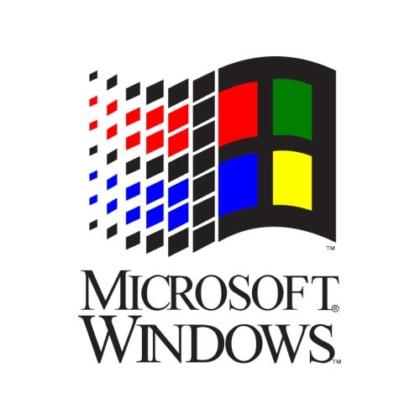

The collaboration
Joint Development Agreement, Aug 1985
code name: CP/DOS
2 years for the first product

Slide 9
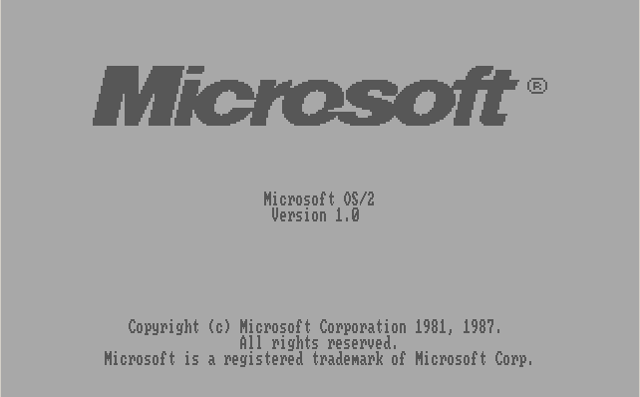
In The Beginning
Announced in Dec 1987
Original release in text-mode only
OS/2 1.1 released with GUI in Oct 1988
Similar UI to Windows 2.1
Code name: Trimaran
Could handle keyboard and mouse events

Slide 10
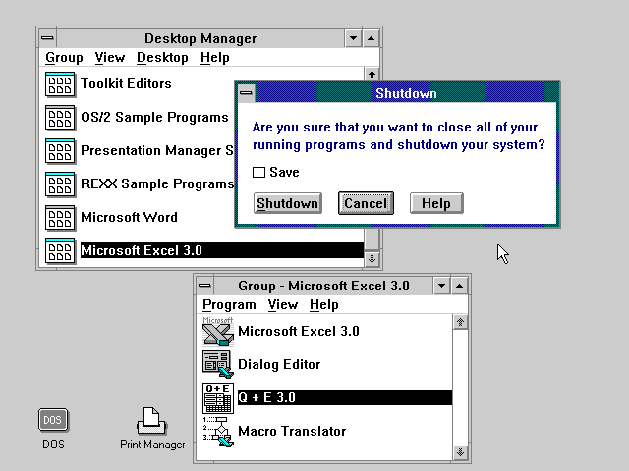
Version 1.2
Sold only through IBM channels (LA)
Installable file systems
HPFS file systems
TCP/IP and Ethernet Support
code name: Cruiser

Slide 11
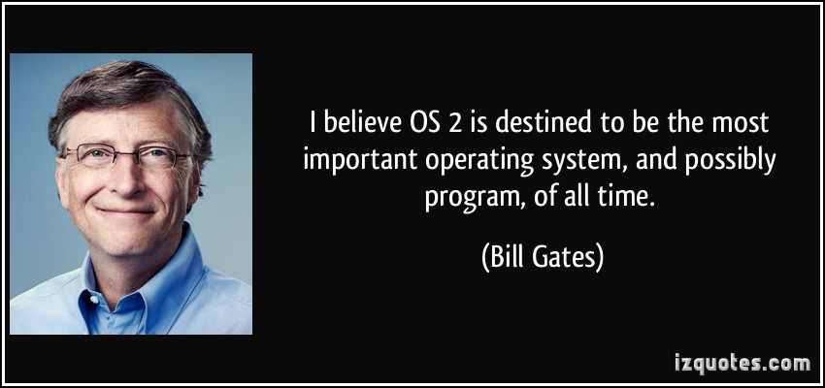
Why OS/2 Failed

Slide 12
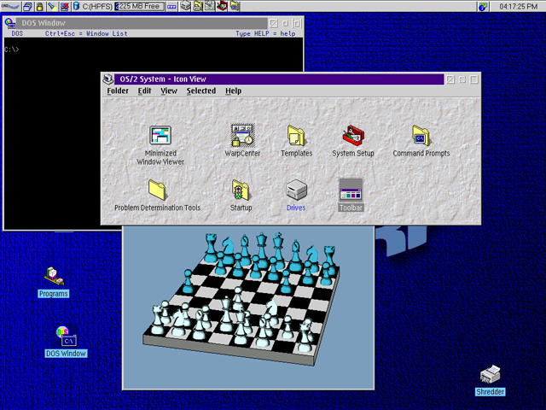
IBM Hardware
Multiple reasons for failure
Varying opinions
Only runs on IBM-pc
Limited driver support early on

Slide 13
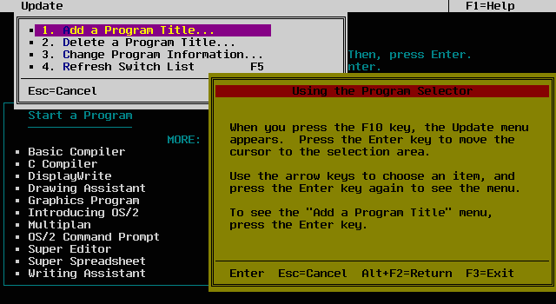
Too Similar!
Very similar to DOS
Later versions look like Windows

Slide 14
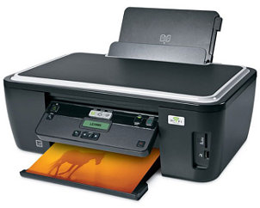

Poor Device Support
Lacked sufficient driver support early on.
Early problems gave a negative impression.

Slide 15

User Layer
Compatibility with OS/2, Windows 3.0 and DOS applications
Achieved using a Virtual DOS Machine (VDM)
VDM allowed apps to run alongside another OS

Slide 16
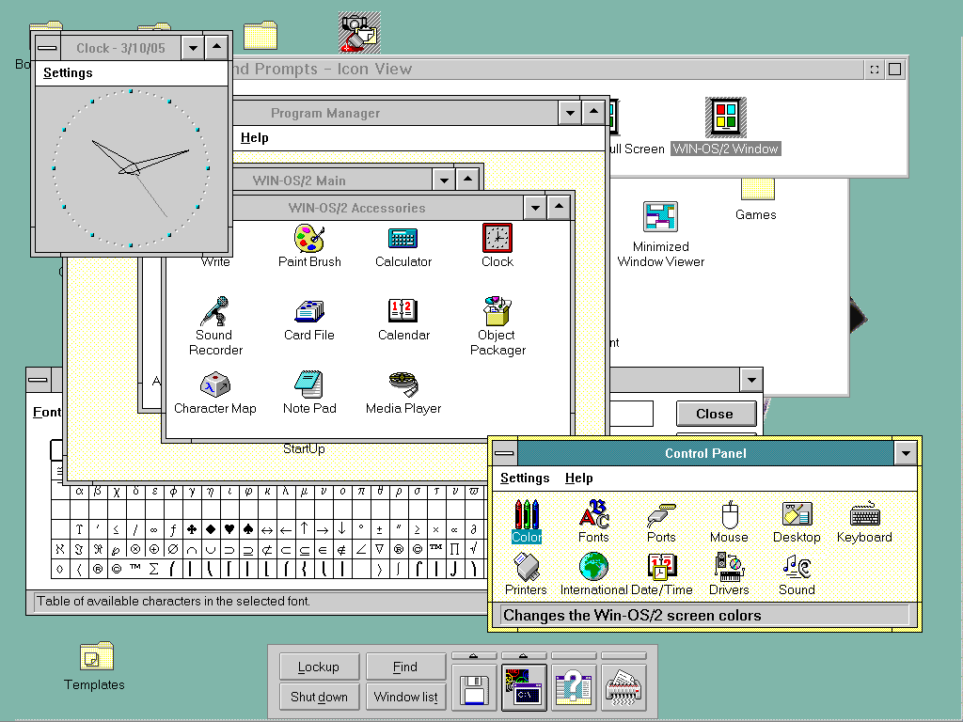
Presentation Manager
The GUI of OS/2
Supports mouse chording
IBM’s Common User Access (CUA) interface standard
Operates using a Single Input Queue (SIQ)

Slide 17

Issues with Single Input Queue
Blocked by a single unresponsive application
Caused the user interface to freeze
Never properly addressed and fixed

Slide 18
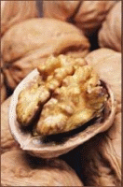
Kernel Layer
Boot manager handles improper boot procedures
Process switching by rewriting and reallocating memory
Memory allocated in 64Kb pieces
Virtual device drivers exist outside the kernel
Shut down occurs in two parts

Slide 19
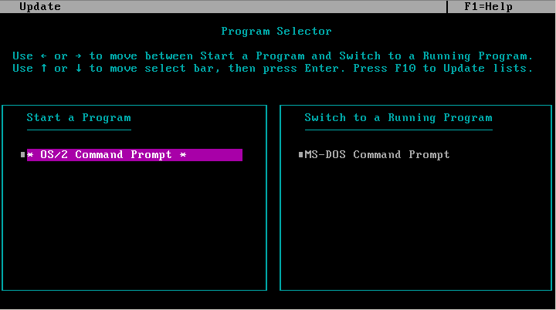
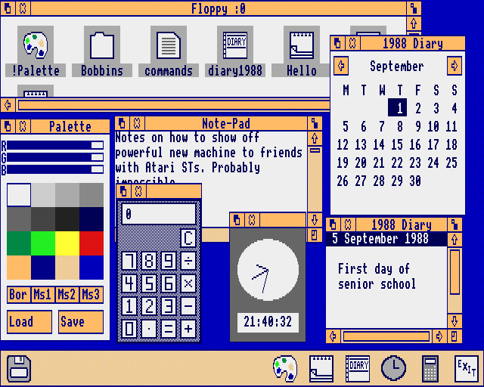
Conclusion
OS/2 was good for its time
Competition for 25 years a testament to quality

Slide 20
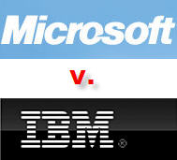
OS/2 Changed The Industry
Features introduced
Multitasking
Lots of memory
Microsoft became dominant in the PC market
IBM lost to the smaller Microsoft and gave up on PCs

Slide 21

OS/2 Weakpoints
The DOS applications compatibility
Single input queue
IBM internal problems
Marketing

Slide 22
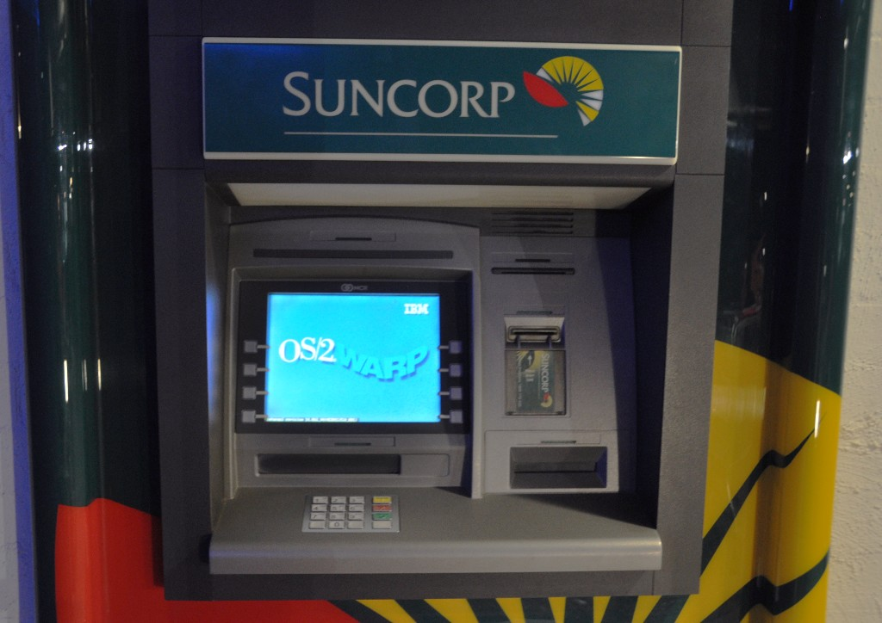
Last Time OS/2 Was Seen
ATM in Australia

