Slide 1

Open VMS
VMS team Karl Turner, Dylan Butler, Oleg Petcov, Sean Hanlon and Padraig McCarthy.

Slide 2
Table of contents
Introduction
Biography
Architecture
Open Vms Desktop
Conclusion
Any Questions?

Slide 3
Introduction
Open VMS was taken over by Hewlett-Packard
The original company was Digital Equipment Corp

Slide 4
Open VMS was developed by Digital Equipment Corp (DEC).
DEC was bought out by Compaq in 1998.
HP Bought Compaq in early 2000’s.
HP now develops its open VMS system.

Slide 5
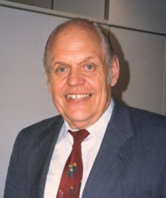
Ken Olsen
Born February 20, 1926
Died February 6, 2011
Studied at the Massachusetts Institute of Technology
Directed the building of the first transistorized research computer

Slide 6
Biography
co-founded Digital Equipment Corporation (DEC) in 1957 with colleague Harlan Anderson
Matrix Management
1986 received IEEE Engineering Leadership Recognition Award

Slide 7
Architecture
VAX(1970’s)
DEC Alpha(1990’s)
Itanium(2001-present)

Slide 8
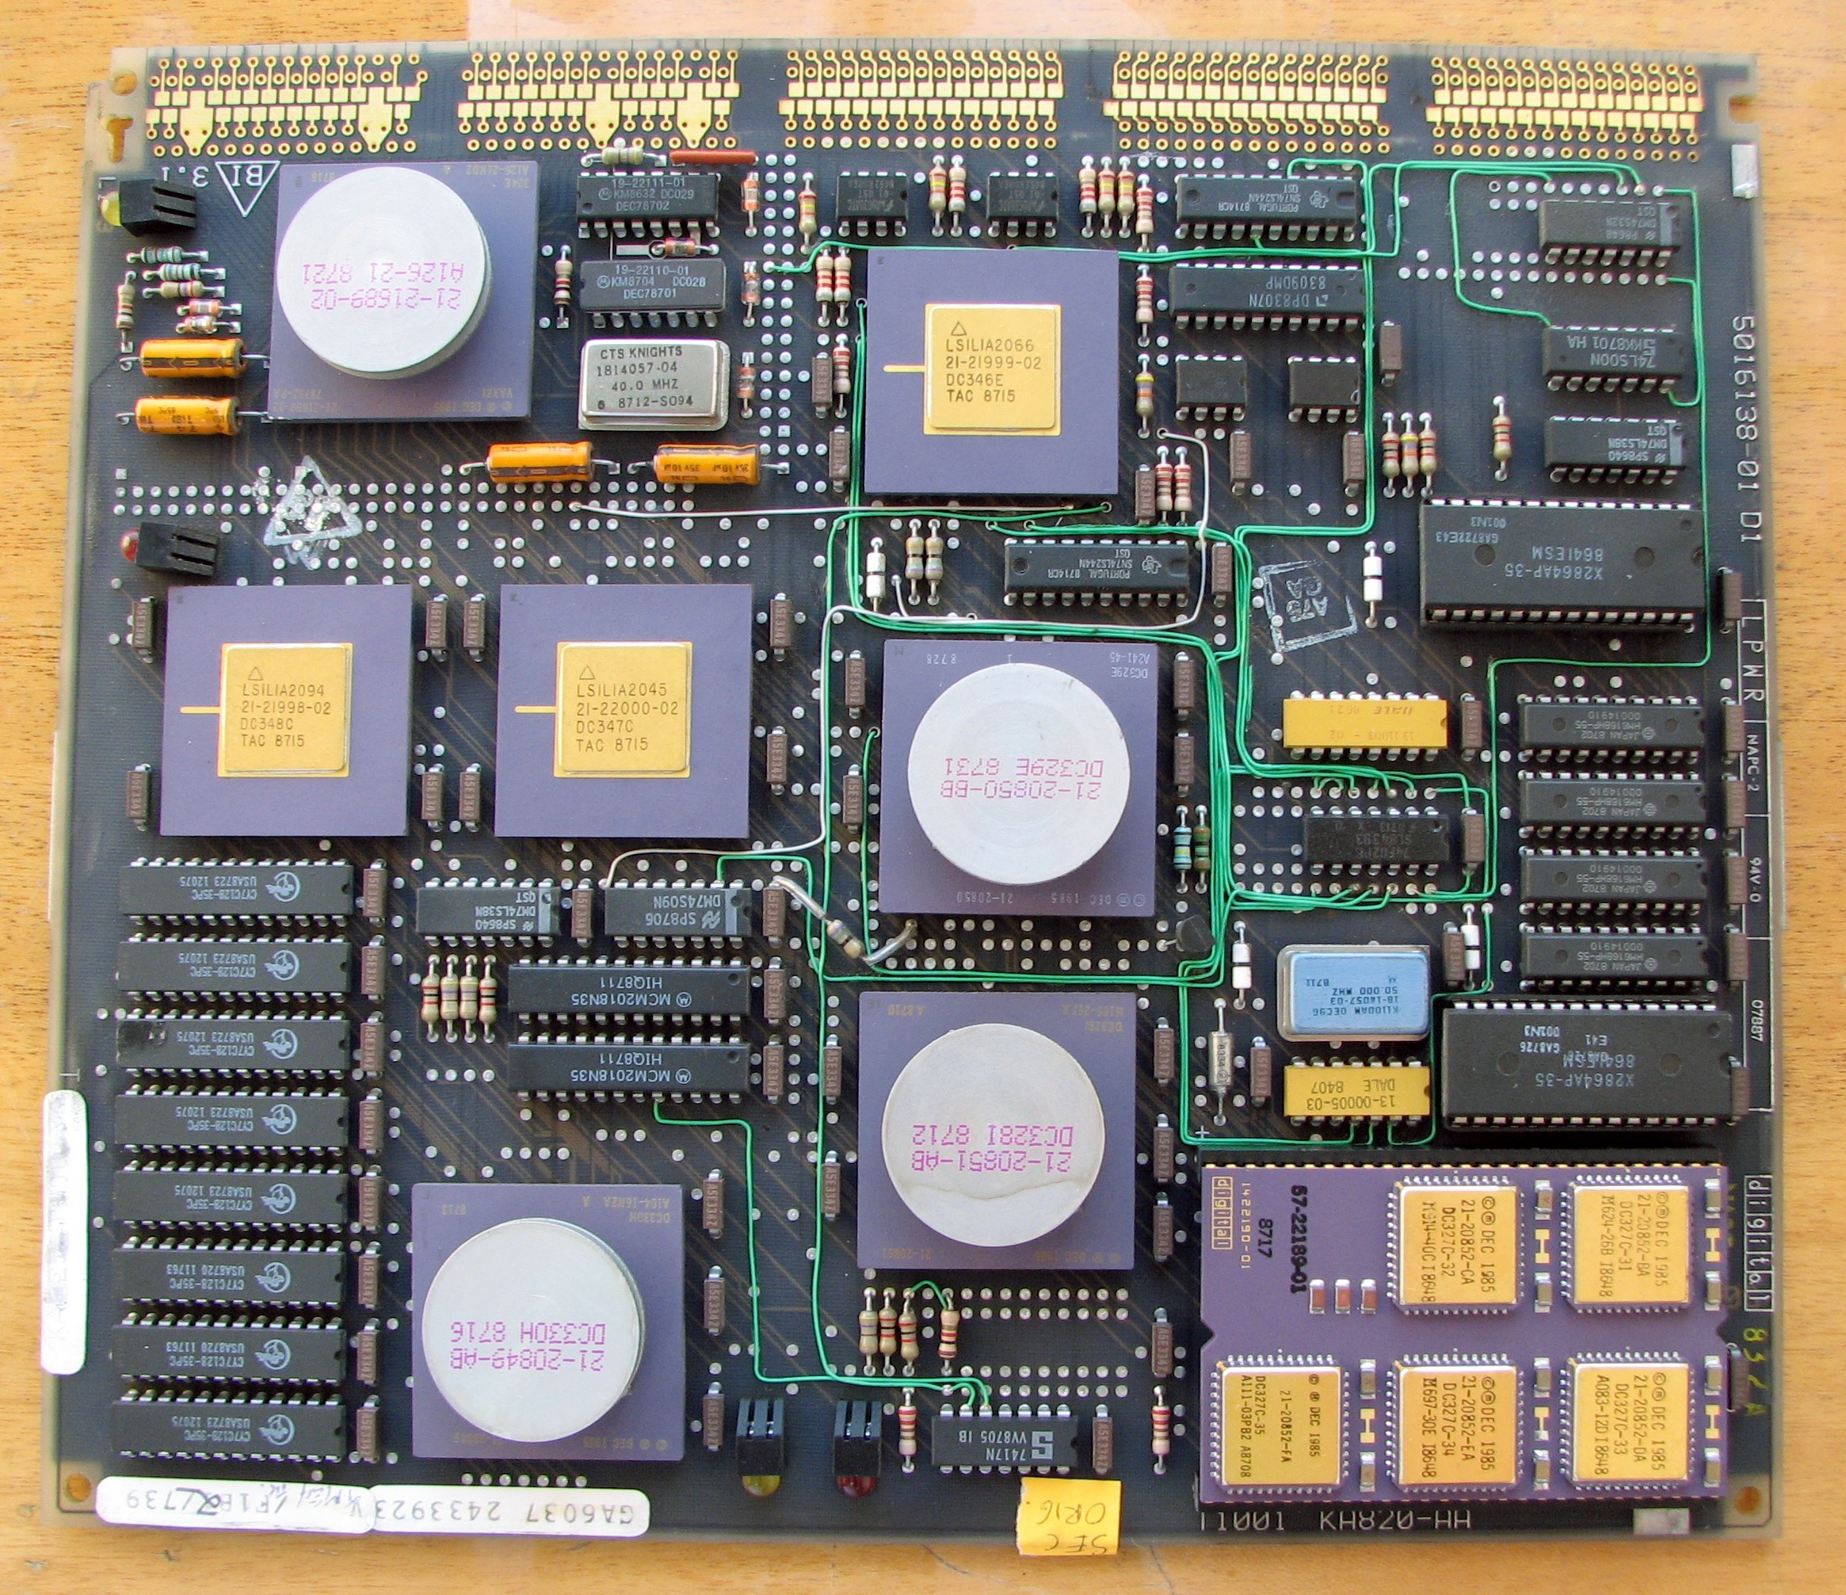
VAX

Slide 9
32 bit instruction set architecture(CISC)
Assembly language based
Programmer friendly instruction set,
Led to popularity with hacker crowd
Eclipsed by RISC processors - SPARC,MIPS

Slide 10
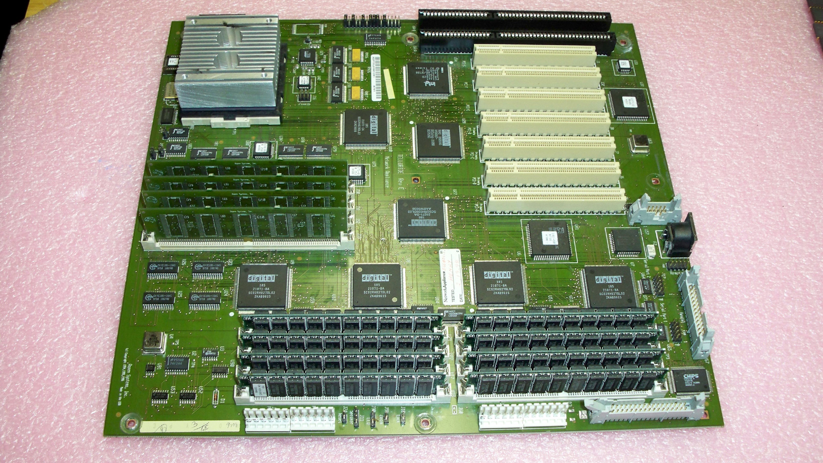
DEC Alpha

Slide 11
Went over to 64 bit instruction set in 1992(RISC)
Worked better with higher-level languages(C, Java)
Used in DEC workstations and servers
Was the fastest microprocessor at the time,
phased out after Compaq buyout in 1998

Slide 12
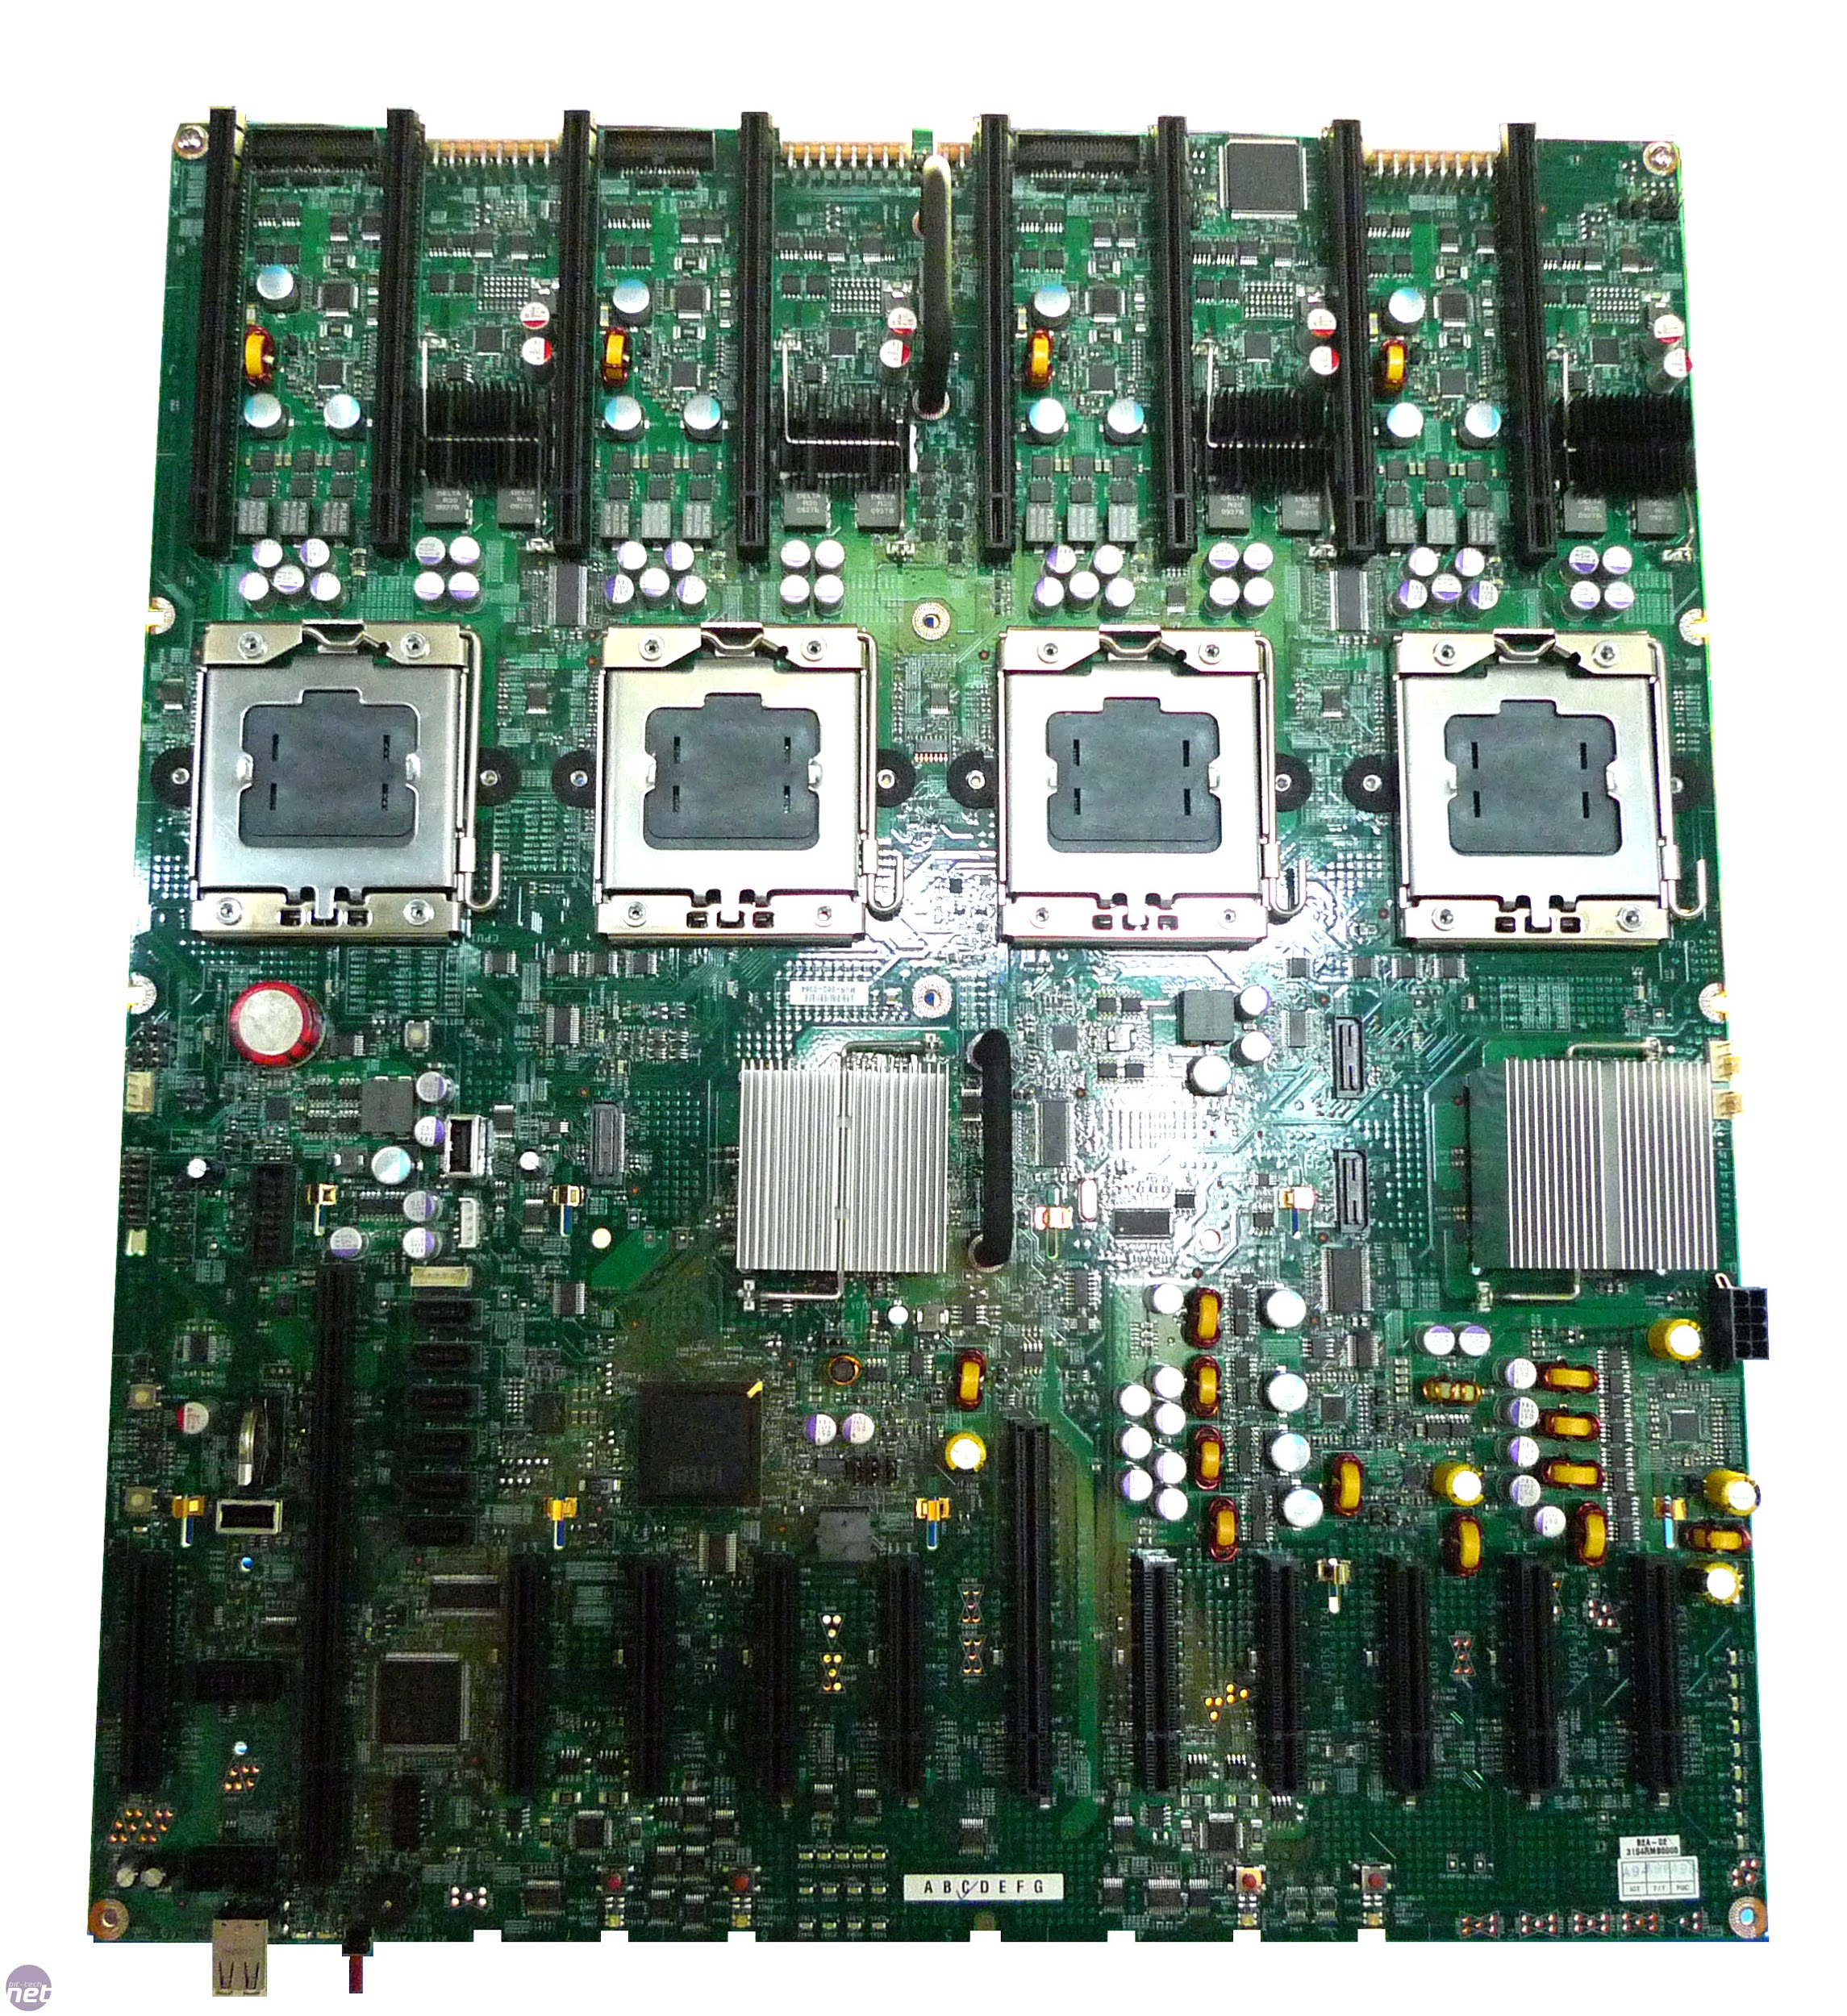
Intel Itanium

Slide 13
64 bit micro-arch
HP & Intel project, alternative to x86
Good at parallelised workloads - servers,etc
Captured ~26% of server processor market
Main buyer of chips is HP(90%)

Slide 14
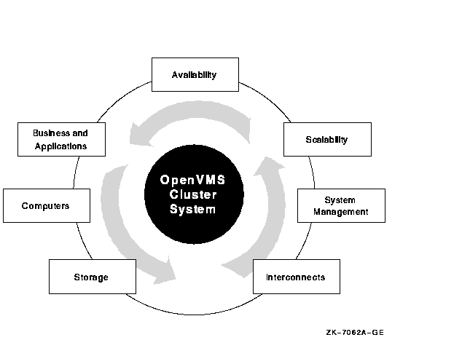
Architecture

Slide 15
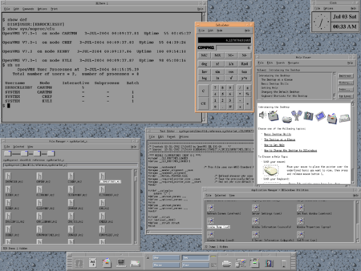
Open VMS Desktop

Slide 16
Desktop Very Similar to Windows
Easy to use and understand
Graphical user interface

Slide 17
Success stories
UK NHS
Maintained 99.9% uptime
Built disaster-tolerant solution
Ensure high uptime

Slide 18
Commerzbank
Testing disaster tolerance
Zero tolerance for downtime
Surviving the meltdown

Slide 19
South Central Power
Customer service enhanced through faster application performance
Ability to scale IT services without adding to headcount
Tenfold faster storage I/O (200 I/O per second increased to 2,000 I/O per second)

Slide 20
Conclusion
Standardized features for server OSs
Evolution through use of newer processors
Used by the NHS Commerzbank and accuweather for its reliability

