Slide 1
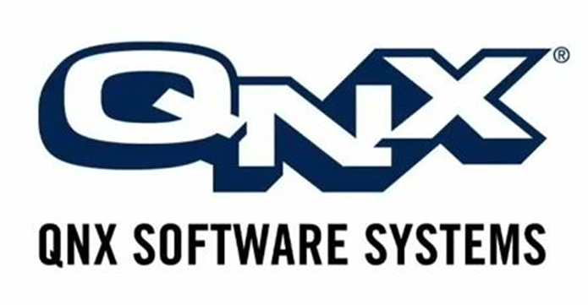
QNX Presentation
Team QNX
Shane Mac Eoin, Rob Byrne,
Dave Hunt, Derry Walsh & Paul Redmond

Slide 2
Contents
QNX Overview
Market Position
History
Technology Involved

Slide 3
What is QNX?
Embedded Systems
High Levels of Scalability
Various Versions of the OS
“True Microkernel OS”
Notes:
Embedded Systems- ARM, x86
High Levels of Scalability – Can be reduced down to meet the constrained resource requirements of realtime embedded systems
Various Versions of the OS e.g. RTOS (Real Time Operating System (an OS which prioritises scheduling using an advanced algorithm. Enables a wider orchestration of process priorities. The OS is more frequently dedicated to a narrow set of applications)), Automotive, Medical, Security, Safety
True Microkernel OS- Makes the OS very reliable as every driver, protocol stack, filesystem and application runs in the safety of memory protected space where as outside the Kernel components can fail

Slide 4
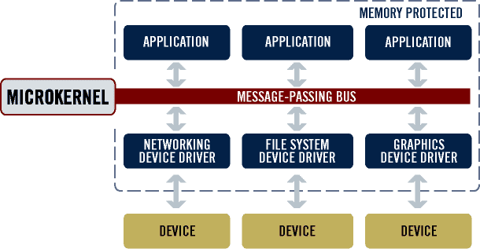
OS Architecture

Slide 5
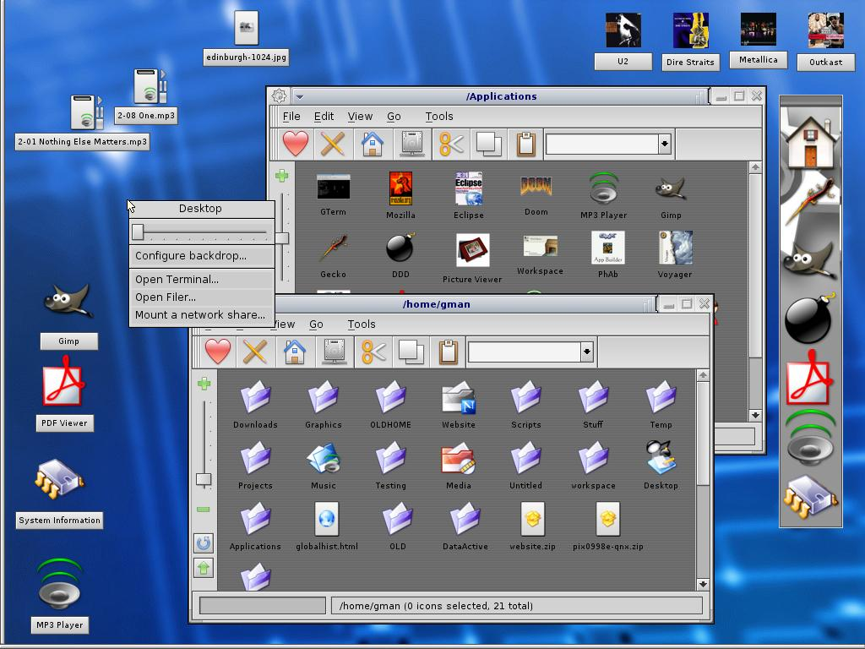
Notes:
Programs are primarily accessed through the command line (like UNIX systems), Configuration files and scripts
Allows an Integrated Development Enviroment to test embedded systems

Slide 6
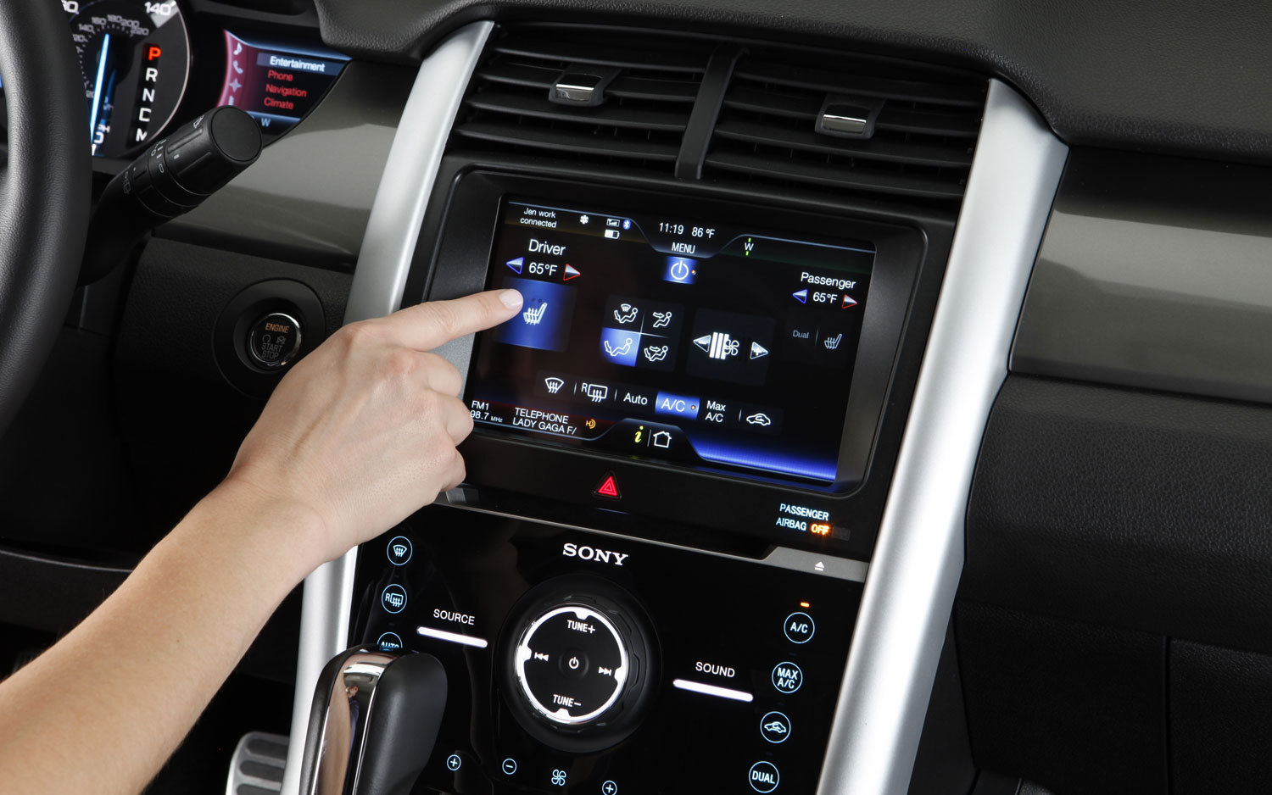
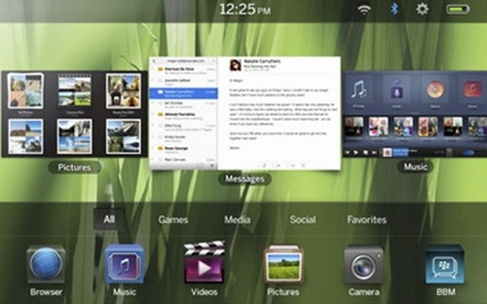
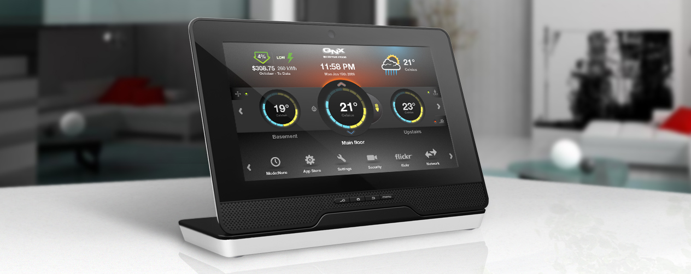

Slide 7
History behind QNX

Slide 8
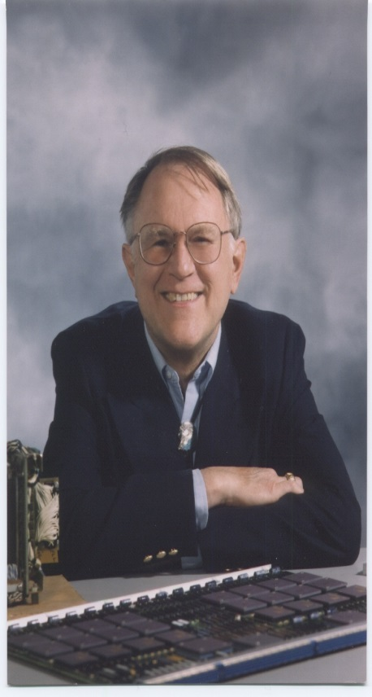
Gordon Bell
MSc in Physics, University of Waterloo
Was Chairman of QNX Software Systems Board of Directors until his retirement
One of Fortune magazines 2002 “Heroes of Manufacturing”, alongside QNX co-founder Dan Dodge.

Slide 9
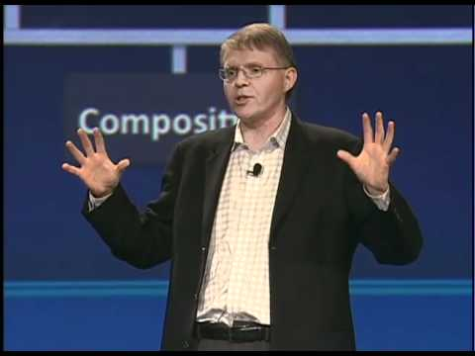
Dan Dodge
MSc in Mathematics, University of Waterloo.
Current CEO of QNX Software Systems
Awarded J.W Graham Medal in Computing and Innovation by the University of Waterloo

Slide 10
History
Bell and Dodge took an OS design course, created a basic real-time kernal as part of an assignment, and realized it’s commercial viability.
Moved to Ontario in 1980, and founded Quantum Software Systems (later renamed QNX Software Systems.)
Notes:
Started when Bell and Dodge both took an OS design course, created a basic real-time kernal as part of an assignment, and realized it’s commercial viability.
Both men moved to Ontario in 1980, where they founded Quantum Software Systems (later renamed QNX Software Systems.)
First widespread use of the QNX system was in the Ontario education systems own computer design, the Unisys ICON.
Primarily used in ‘large’ projects, as the OS was too big for the single-chip computers of the time.
It was made compatible with lower-level systems via QNX 4, developed in the late 80s as a response to the OS market moving towards the standardized POSIX model of systems.

Slide 11
History
First widespread use was the Ontario education systems own computer design, Unisys ICON.
Used in ‘large’ projects as OS was too big for single-chip computers of the time.
Made compatible with lower-level systems via QNX 4 in 80s as response to the OS market moving towards the standardized POSIX model of systems.
Notes:
First widespread use of the QNX system was in the Ontario education systems own computer design, the Unisys ICON.
Primarily used in ‘large’ projects, as the OS was too big for the single-chip computers of the time.
It was made compatible with lower-level systems via QNX 4, developed in the late 80s as a response to the OS market moving towards the standardized POSIX model of systems.

Slide 12
History
A new version was developed from scratch to be SMP capable, which took the form of QNX Neutrino released in 2001.
Primary market is in the automotive industry, which it fully broke into following acquisition by Harman.
Was bought again in 2011 by BlackBerry Limited.
Notes:
In the 90s, a new version was developed from scratch to be SMP (symmetric multiprocessing) capable, which took the form of QNX Neutrino released in 2001.
At the same time, the company became one of the founders of the Eclipse consortium.
QNX’s primary market is in the automotive industry (GPS, in-car display screens, etc), a market which it fully broke into following the company’s acquisition by Harman International Industries in 2004.
Examples include Apple’s CarPlay system, and the Ford Motor Company recently announced it was replacing all Microsoft technology with the QNX OS across it’s entire range.
It can also be found in a variety of BlackBerry devices, following BlackBerry Limited’s purchase of QNX Software Systems in 2011.

Slide 13
QNX Technology Part 1

Slide 14
QNX Technology
QNX interprocess communication - operation that sends a process to another and waits to receive a reply. Known as msgsend.
Message is copied by the kernel from an address space of the process that sends it, the copy is then sent to the address space of the receiving process
while the receiving process it left waiting on this, the control of the central processing unit is simultaneously transferred through the systems scheduler
Notes:
QNX interprocess communication is a single operation that sends a process to another process and waits to receive a reply. This is known as msgsend.
The message is copied, by the kernel from an address space of the process that sends it, the copy is then sent to the address space of the receiving process
while the receiving process it left waiting on this, the control of the central processing unit is simultaneously transferred through the systems scheduler

Slide 15
QNX Technology
Because of this similtanious action, if someone is waiting on their process’ reply they will not lose their turn.
Linux and Unix lack this, which is why QNX message passing is widely usable.
There is a user space process based off of QNX msgsend for Linux but often used incorrectly, a leading cause of why other microkernel based systems were unsatisfactory.
Notes:
Because of this similtanious action, if someone is waiting on their process’ reply they will not lose their turn.
Linux and Unix lack this skill which is why QNX message passing is so widely usable.
A user space process based off of QNX msgsend for Linux is available but it is often used incorrectly and is a leading cause of why other microkernel based systems were unsatisfactory.

Slide 16
QNX Technology
The vast majority of other operations were planned to operate in the same manner as the user space process.
QNX eventually reduced the number of separate processes and integrated the network stack into a single application as this made QNX perform more efficiently.

Slide 17
QNX Technology
Message handling is prioritized by a thread.
requests are given a value of wither high or low priority.
the high priority threads are given preference over the low priority threads and are preformed first.
This is a very important asset in the hard real time system.

Slide 18
QNX Technology
Transparent Distributed Processing is a process that makes it easier to use QNX
It means that QNX kernels on separate devices are granted access each other's system services using the same method as would be used to access a local server.
Making QNX run efficiently on local and other servers.

Slide 19
QNX Technology Part 2

Slide 20
QNX Technology
The QNX kernel contains only CPU scheduling, interprocess communication, interrupt redirection and timers.
Everything else including proc, which is process creation and memory management runs on a user process by working in conjunction with a microkernel
The QNX boot loader can load more than just the kernel with no device drivers needed

Slide 21
QNX Technology
Networking is based on NetBSD
The NetBSD Project is an international collaborative effort of a large group of people, to produce a freely available and redistributable UNIX-like operating system, NetBSD. NetBSD contains a variety of other free software, including 4.4BSD Lite from the University of California, Berkeley.
Notes:
Networking is based on NetBSD
The NetBSD Project is an international collaborative effort of a large group of people, to produce a freely available and redistributable UNIX-like operating system, NetBSD. In addition to our own work, NetBSD contains a variety of other free software, including 4.4BSD Lite from the University of California, Berkeley.
Interprocessing involved sending info from one process to another and awaiting a reply. MsgSend operation is used.

Slide 22
QNX Technology
If the receiving process is waiting, control of the CPU is transferred at the same time
QNX is the most usable example of a microkernel.
How QNX works is how all I/O systems were intended to work

Slide 23
QNX Technology
Later versions are more and more refined in terms of network stacks and other function blocks
Boot loader is the other key component in the minimal microkernel system
All support libraries for user programs are not in the kernel

Slide 24
QNX Technology
Neutrino supports strict priority-preemptive scheduling and adaptive partition scheduling (APS). APS guarantees minimum CPU percentages to selected groups of threads, even though others may have higher priority.
Can run a selected set of critical threads, even when the system is overloaded

Slide 25
QNX at Present and in the Future

Slide 26
Examples
Apples Car Play
Blackberry playbook
Cars
Mercedes-Benz S-Class
Ford Sync 3 system

Slide 27
Present
Had a market share of around 53% in 2013
Used by over 40 OEMs in tens of millions of vehicles
Not very meaningful to BlackBerry’s financial performance
2% of BlackBerry’s total sales

Slide 28
Present
IHS analysts estimate software licensing fees to be $3 per vehicle
Ford stated the company would be replacing Microsoft Auto with QNX in 2014
Competition from Google and Apple

Slide 29
Future
Has the advantage of having a large network
Competition form Google and Apple
Customizable UI makes it attractive for OEMs
Cheaper than rivals

Slide 30
Conclusion
QNX is very reliable
QNX is efficient
Used by many devices

Slide 31
Questions?

