Slide 1

RISC OS
By Riscy Business
Cliona Rogers, Colin White, Keith McLoughlin, Ka Yu Chan and James Hynes

Slide 2
Contents
History
Who is behind RISC OS?
Desktop
Architecture

Slide 3
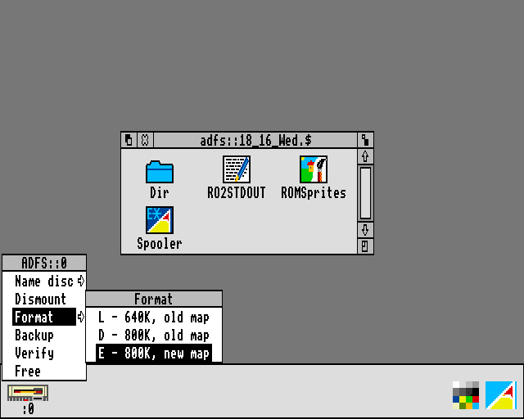
RISC OS History
Began life in 1987 as Arthur 0.20
Developed for use on Acorn’s BBC Micro and Master series of computers
Could only handle one operation at a time and as a result a successor was quickly released
Arthur 2 was released in 1989 but was renamed to RISC OS 2
This operating system could multitask

Slide 4
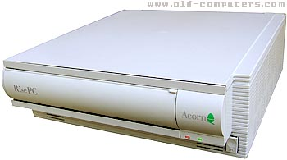

In 1991, along with the Acorn A5000 computer, came RISC OS 3.0
New OS was buggy and 3.1 was released a few months later
RISC OS 3.50 released in 1994 along with Acorn’s RISC PC
3.60 and 3.70 (and 3.71) were release in 1995 and 1996 respectively.

Slide 5

Acorn stopped making computers in 1999 and development of RISC OS was halted during the making of 4.0
In march 1999 RISCOS Ltd. was founded
RISC OS 4 was released that july
In May 2001 RISC OS Select was created
May 2002 Select 1 was launched
Nov 2002 Select 2
June 2004 Select 3

Slide 6
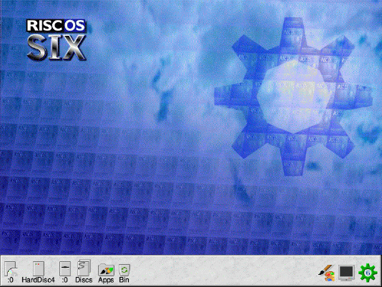
RISC OS Six was announced in October 2006
A beta release called Select 4i1 was available in 2007
Final release was in April 2008
Select 5 was released in April 2009
The final release from RISCOS Ltd was 6i1 and was released in December of 2009

Slide 7


Who is behind the System?

Slide 8

Andrew Hodgkinson
Heavily involved with RISC OS
More than 10 years of experience with the system.
Created the RISC OS Open Limited website.

Slide 9

Andrew Moyler
Founder and Executive director of RISC OS Open Limited.
Has a masters degree in Business Administration
Has led Management buyout and trade sales

Slide 10
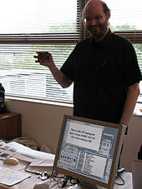
Ben Avison
He is presently a consultant for RISC OS Open Limited
Software engineer contractor for Piccolo Systems
He designed many RISC OS based products

Slide 11

Steve Revill
Managing Director of RISC OS Open Limited
Software engineer with plenty experience with embedded software engineering

Slide 12

Desktop

Slide 13
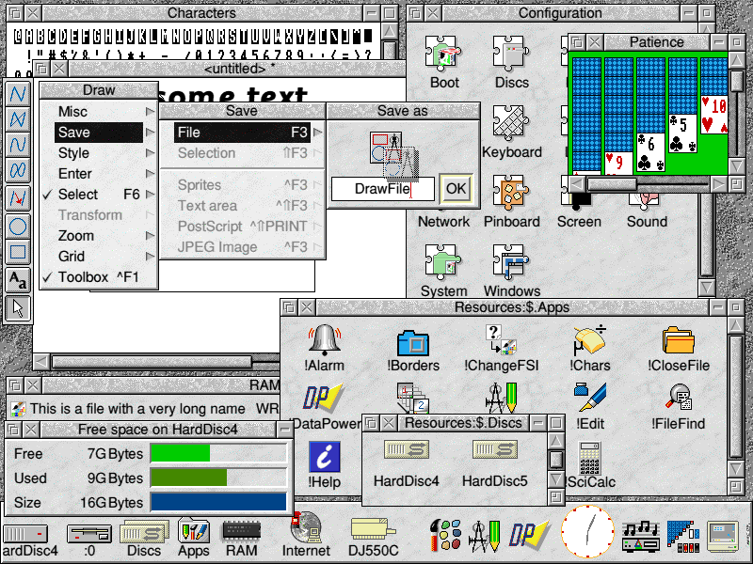
RISC GUI
A screen shot of RISC operating system

Slide 14
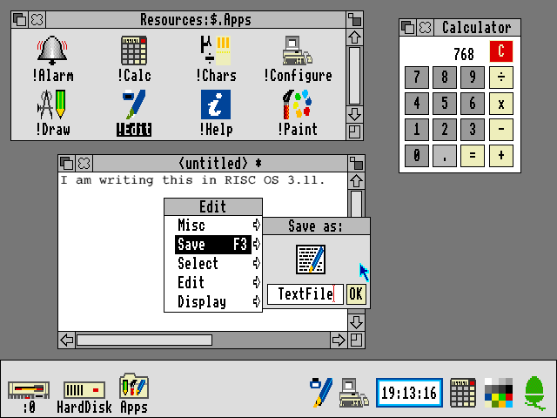
RISC GUI
Learning curve
Very user friendly
Unchanged for 14 years
Window stacking

Slide 15
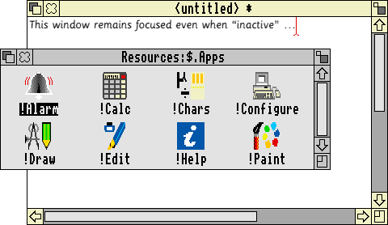
An example of RISC’s window stacking

Slide 16
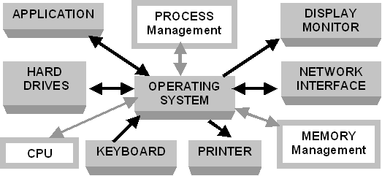
Architecture

Slide 17
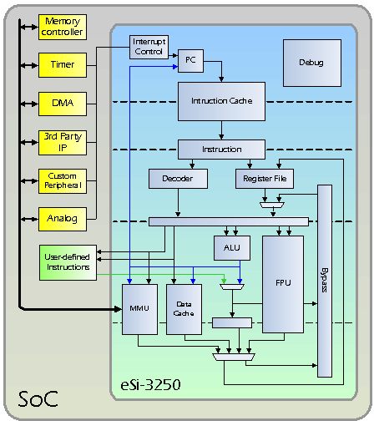

Slide 18
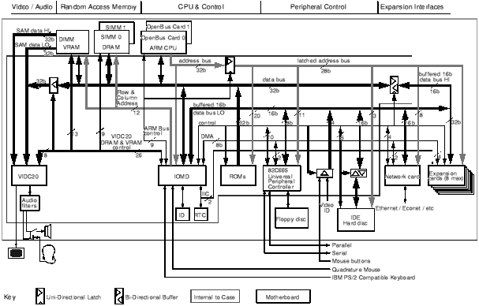

Slide 19

In Conclusion
Not very well known
User friendly
Unique display
Still being developed today

Slide 20

Questions?

Slide 21
Thank You
.

Slide 22
Aaron Timbrell, (2013), The Acorn Computers Ltd Archives
http://www.riscos.com/the_archive/acorn/index.htm, Date Accessed: April 2015
Aaron Timbrell, (2013), The RISCOS Ltd Archives
http://www.riscos.com/the_archive/rol/index.htm, Date Accessed: April 2015
Wikimedia Foundation, Inc., (2011), History of RISC OS
https://en.wikipedia.org/wiki/History_of_RISC_OS, Date Accessed: April 2015.
Wakefield RISC OS Computer Club ,(2002), A Brief History of RISC OS
http://www.wrocc.org.uk/riscos/history.shtml, Date Accessed: April 2015.
David Pilling, (2003), The RISC OS GUI
http://telcontar.net/Misc/GUI/RISCOS/, Date Accessed: April 2015.
RISCOS Limited and Rebecca Shalfield, (2006), What is RISC OS?
http://www.riscos.com/the_archive/rol/productsdb/admin/riscos.htm, Date Accessed: April 2015.
www.operating-system.org, (2009), RISC OS Operating System
http://www.operating-system.org/betriebssystem/_english/bs-riscos.htm, Date Accessed: April 2015.
Marcin Wichary, (2002), RISC OS 3.11
http://www.guidebookgallery.org/screenshots/riscos311, Date Accessed: April 2015.
RISC OS Open Limited, (2011), RISC OS Open Limited FAQ,
https://www.riscosopen.org/content/about, Date Accessed: April 2015.
LinkedIn Corporation, (2003), Ben Avison | LinkedIn,
https://www.linkedin.com/in/bavison, Date Accessed: April 2015.
LinkedIn Corporation, (2003), Steve Revill | LinkedIn,
https://www.linkedin.com/in/srevill, Date Accessed: April 2015.

