Slide 1

Presented by: Team Aaron
Aaron Renaghan
Ali Huseynov
Wan, Lok-Woon
Pearse Mclaughlin
Laurence Cervi

Slide 2
Table of contents
Introduction
Biography
Architecture
History
Goals
Features
Advantages and Disadvantages
Bibliography

Slide 3

Introduction
Free Open Source Operating System
The purpose of ReactOS

Slide 4
Biography
No one individual, Open source community project
Development began in 1996
FreeWin95
Failed
Jason Filby
ReactOS begins 1998

Slide 5
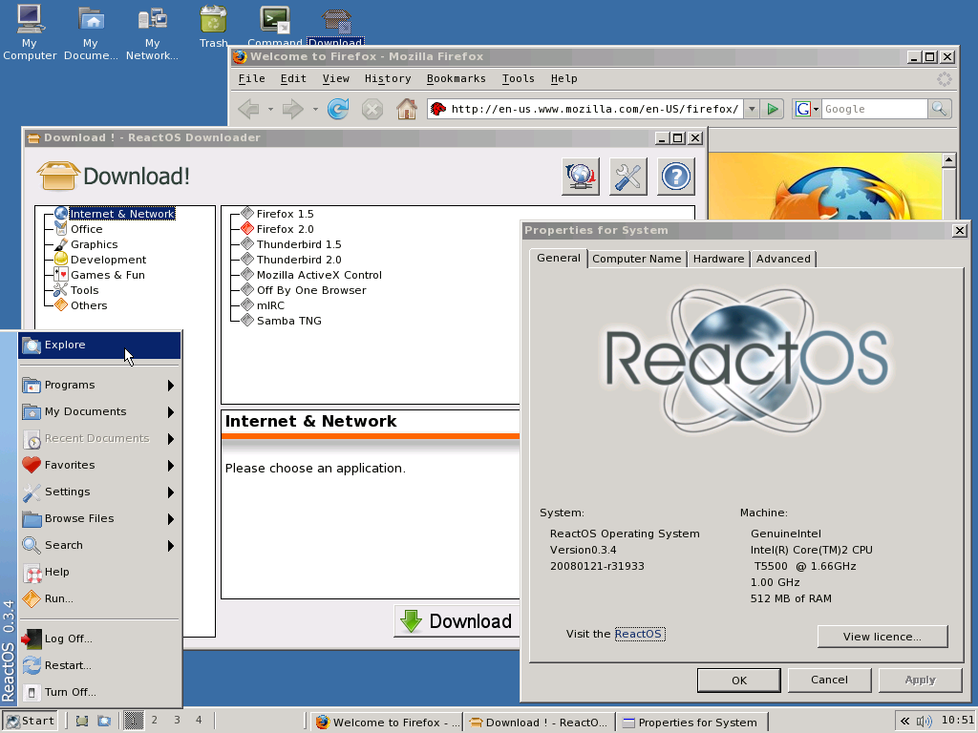

Slide 6
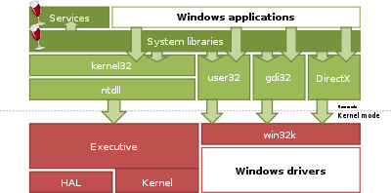
ReactOS Architecture

Slide 7

Platforms
Wine-Windows
Crossover- Linux and Mac

Slide 8

History
How did it start?
FreeWin95
Disagreements on the design
Halted in 1997
Revived by Jason Filby and team members
Windows NT

Slide 9
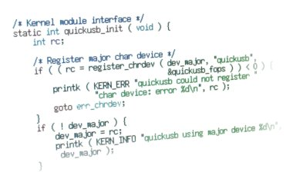
History
New project named ReactOS
Developing began in Feb 1998
Slow start
Lack of knowledge of Kernel
Kernel became more complete and stable

Slide 10
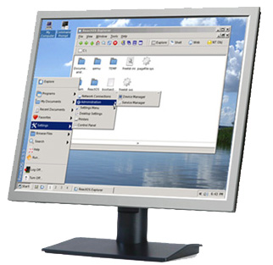
Main Goals
Compatibleness with
1.Windows Apps
2. Windows drivers
Installability
1. Simple
2. Quick

Slide 11

Outside code
Apps
Alpha status

Slide 12

Features
ReactOS is lightweight
It is open source
Reliable

Slide 13

Features
Portable- "The xp the XP successor people asked for"
Extensible
Object based

Slide 14
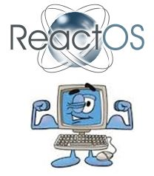
Advantages
Free open source operating system
Easy to use
Clean, lean machine

Slide 15

Disadvantages
Functionality still hit and miss
Not yet a stable platform
Very little user support

Slide 16

Support
Daily builds
Accept donations
Advertising

Slide 17

Conclusion
Explanation of ReactOS
Early Development
Preferences

Slide 18
Bibliography
https://www.reactos.org/wiki/ReactOS-Features
https://www.reactos.org/node/911 -Support
reactos.org-Introduction

Slide 19
Bibliography
http://lowendmac.com/2014/reactos-a-windows-compatible-alternative-os/-Main Goals, Outside Code
www.neosmart.net/blog/2006/reactos-the-next-windows/features.ensoftonic.com/is-reactos-a-reliable-replacement-for-windows- Advantages and Disadvantages

Slide 20


