Slide 1

Operating Systems
A Presentation by Shane Miley and Wolle llroi

Slide 2
Operating Systems
Biography
Architecture
Desktop
Conclusion

Slide 3
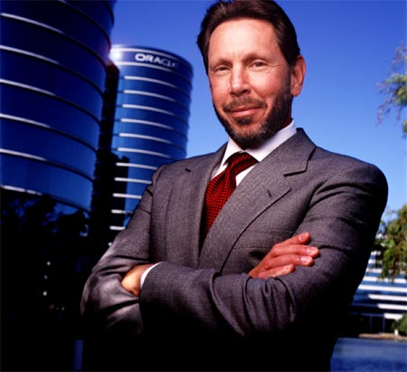
Biography
Lawrence J.Ellison
Born August 17th,1944 (Age70)
Lower East Side, New York
Net Worth: 54 billion USD
Education University of Chicago

Slide 4
Notable info
“It’s not sufficient I succeed. Everyone else must fail.” Genghis Khan
Estimated net worth of US$ 41 billion dollars

Slide 5
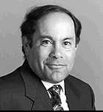
Biography
Bob Miner
Born December 23 1941
Cicero, Illinois
Died November 11 1994
Education University of lllinois

Slide 6
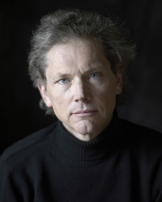
William Nelson “Bill” Joy
Born November 9,1954
Born in Michigan, USA
An American Computer Scientist Co. founder of Sun Microsystems in 1982
Role in the development of the BSD UNIX OS

Slide 7
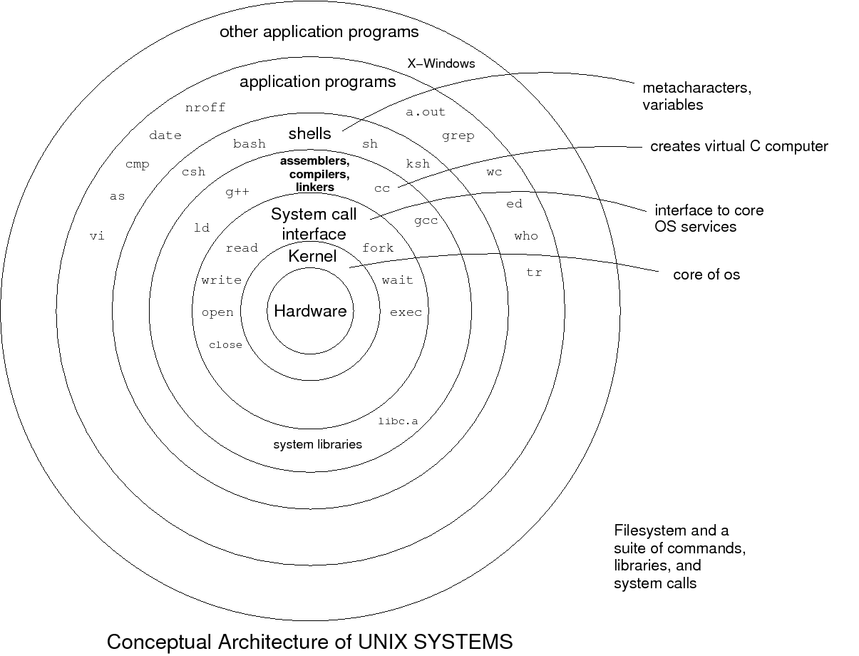
Architecture

Slide 8
Architecture
Kernel - provides the interface between the hardware and the user
Shell - the program that sits between the user and the kernel
Utilities and Application - commands, word processors, graphic programs and database management programs

Slide 9

Desktop

Slide 10
Conclusion
Oracle will tell you nothing
Larry Ellison is the devil

