Slide 1
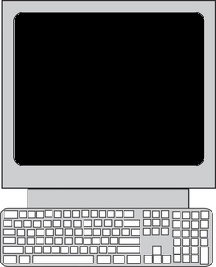
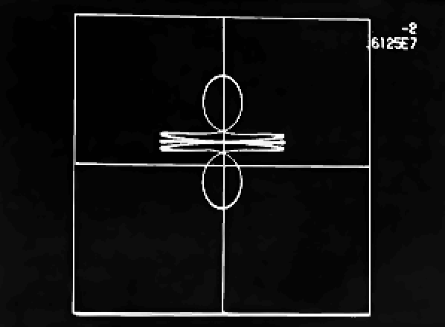
UNIX OS
By:
Desmond Dagg
Alannah Storm Mullins
Carl Kavanagh
Gareth Dunne
Behzad Sanehi

Slide 2
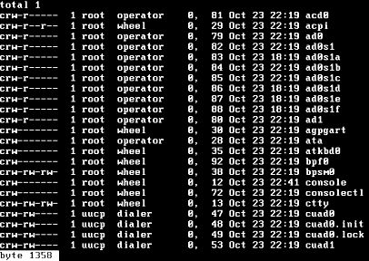
Table of Contents
Brief History of UNIX
UNIX operating system
Biography of founder’s
Release timeline
UNIX based systems
UNIX architecture
UNIX File Hierarchy
UNIX File Types
The Shell
Single UNIX Specification 1998
Conclusion

Slide 3

Brief History of UNIX
Programmers for Bell Labs were working on a project called Multics.
But Bell Labs eventually pulled out of this project as it was failing to deliver a useable system at this time.
A group of 4 programmers in AT&T’s Bell labs began to find an alternative.
By April 1969 a system called UNICS was developed and by that summer UNIX was developed.

Slide 4
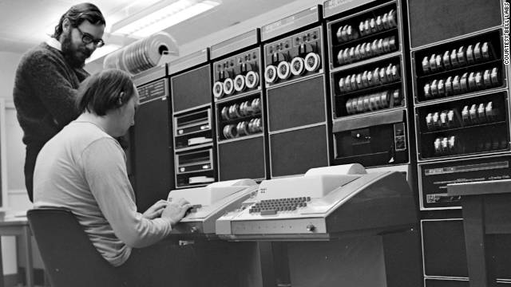
UNIX OS
The Unix operating system is a multiuser, multitasking operating system.
Developed in 1969 at AT&T’s Bell laboratories.

Slide 5
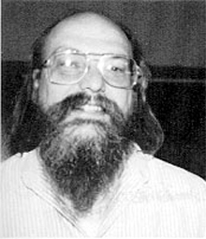
Kenneth (Ken) Thompson
Born February 4, 1943 – Present
Age 72
New Orleans, Louisiana, U.S.A.
He received a B.S. (1965) and M.S. (1966) in electrical engineering and computer science from UC Berkeley.
In 1969, Thompson and colleague Dennis Ritchie created the UNIX operating system at Bell Telephone Laboratories
Thompson won the ACM Turing Award (1983), the U.S. National Medal of Technology (1999), and the Japan Prize (2011), all with Dennis Ritchie.

Slide 6
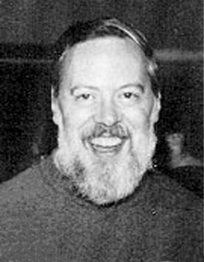
Dennis Ritchie
Born September 9, 1941
Died October 12, 2011 (aged 70)
Born in Bronxville, New York, U.S.A.
He graduated from Harvard University with degrees in physics and applied mathematics and with a Ph.D. in mathematics (1968).
He created the C programming language and co-developed (with Ken Thompson) the UNIX operating system
Ritchie won the ACM Turing Award (1983), the U.S. National Medal of Technology (1999), and the Japan Prize (2011), all with Ken Thompson.

Slide 7
Release timeline
1969
The Beginning
1973
Fourth Edition
Rewritten in C
1971
First Edition
1975
Sixth Edition
1979
Seventh Edition
1986
Ninth Edition
1985
Eight Edition
1989
Tenth Edition
1983
Unix system V
1982
Unix system IV
1981
Unix system III
1986
Unix system V Release 3
1984
Unix system V Release 2
1987
Unix system V
Release 3,2
1988
Unix system V
Release 4
1992
Novell
Unixware 1.0
1995
Novell
Unixware 2.0
2001
SCO
Open Unix 8.0
1998
SCO
Unixware 7.0

Slide 8
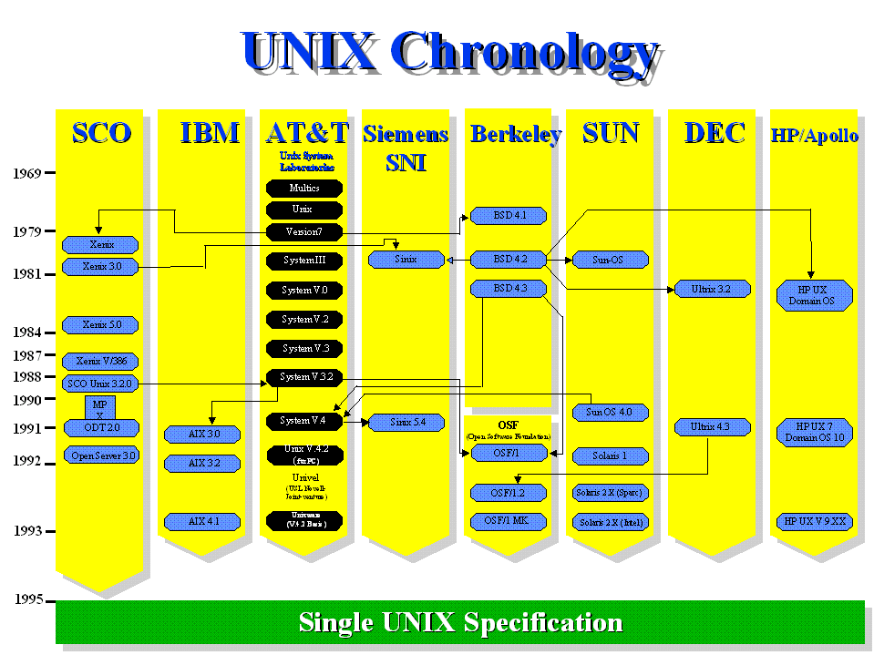
UNIX based systems

Slide 9
UNIX based systems
Since it began to escape from AT&T's Bell Laboratories in the early 1970's, the success of the UNIX operating system has led to many different versions.
Universities, research institutes, government bodies and computer companies all began using the powerful UNIX system to develop many of the technologies.
Soon all the large vendors, and many smaller ones, were marketing their own, versions of the UNIX system.

Slide 10

UNIX architecture
Shell
Kernel
Utilities

Slide 11
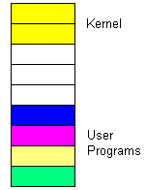
UNIX architecture
Kernel
File management
Memory management
IO management
Process management
Shell
Interprets user commands
executes user commands
Interface between the user and the kernel
Utilities
User made programs
Editors and compilers
System memory

Slide 12
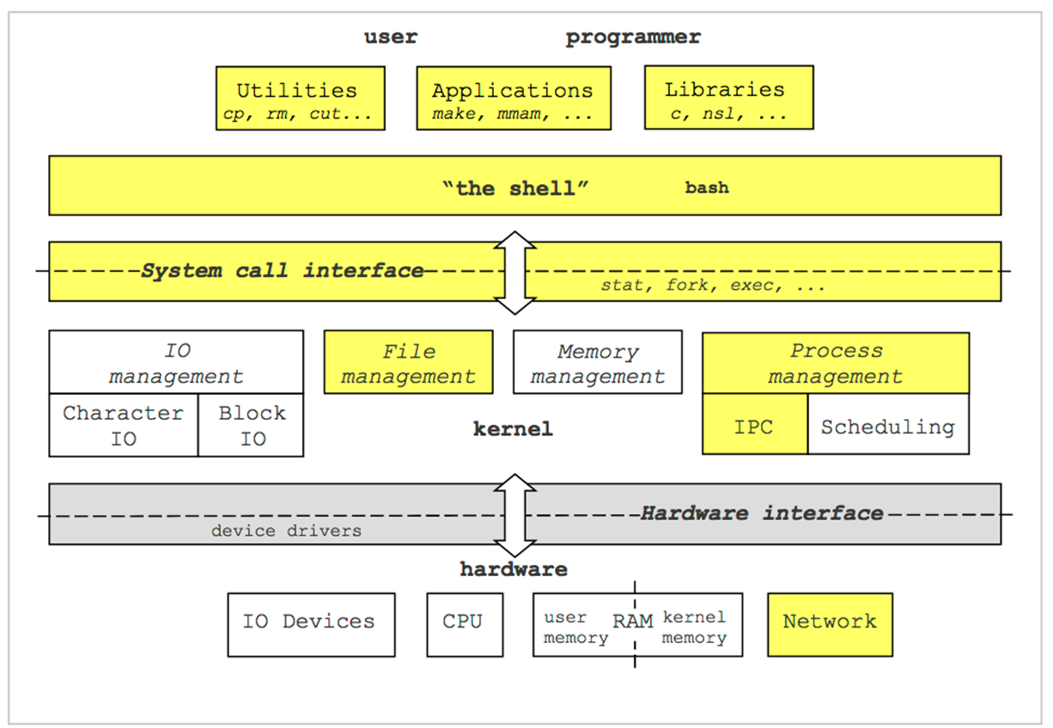
UNIX architecture

Slide 13
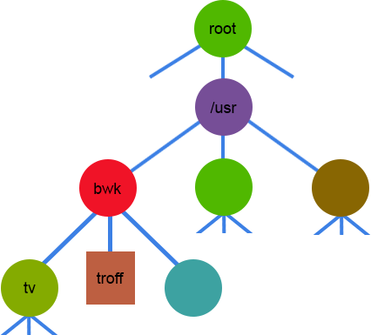
UNIX File Hierarchy
directory
"Everything is a file"
directory
All data stored in UNIX is considered
to be a file.
Parent level
Home Directory
directory
file
directory

Slide 14
UNIX File Types
Ordinary Files
written text.
located under a directory file.
Doesn’t contain other files.
Directories
Branching points to other directories.
Can contain ordinary files, special files or other directories.
Special Files
Can represent real physical devices such as a printer, keyboards, terminal.
Two types of I/O: Character and block.
Pipes
Pipes are used to link programs together.

Slide 15
The Shell
[prompt]$ <command> <flags> <args>
blk:~$ ls –l –a
(Optional) arguments
Command Prompt
Command
(Optional) flags

Slide 16
Single UNIX Specification 1998
The Single UNIX Specification is an industry standard description of the C language program and user command interfaces for a standard Unix operating system.
An operating system is allowed to use the UNIX trademark if it follows this spec.
It was developed to ensure that a program developed in one Unix operating system would run in a somewhat different Unix operating system.
The specification is owned by The Open Group, an industry group which oversees UNIX certification and branding.

Slide 17
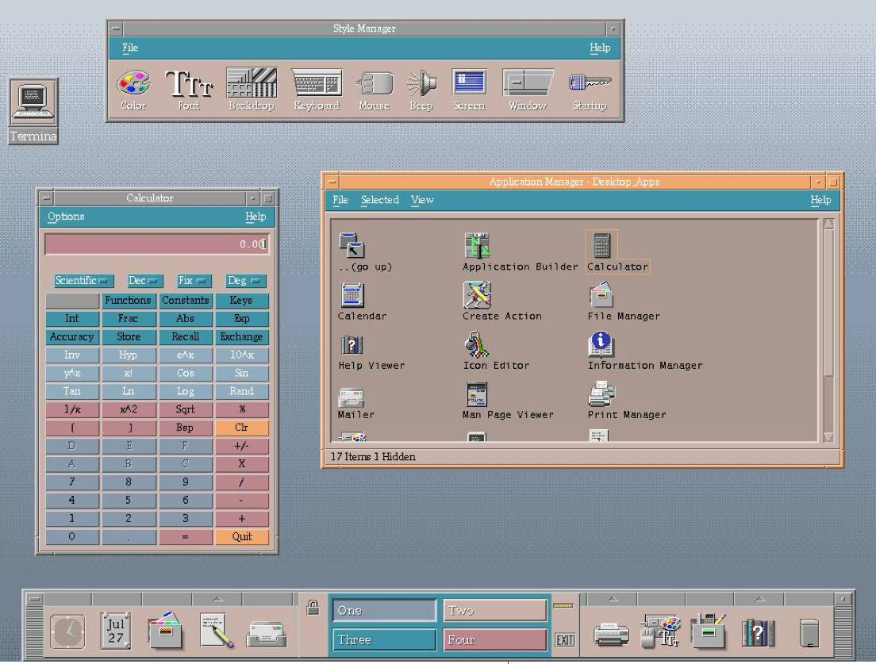
Common Desktop Environment

Slide 18
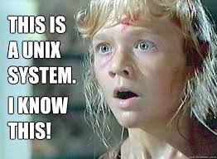
Even the Internet itself, all began life with and because of UNIX systems. Today, without UNIX systems, the Internet would come to a screeching halt. Most telephone calls could not be made, electronic commerce would grind to a halt and there would have never been "Jurassic Park"!
The Open Group 1995-2012

Slide 19
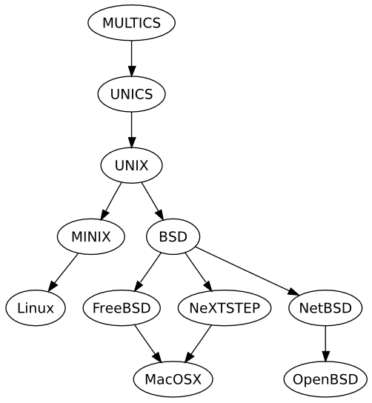
Conclusion
UNIX is a simple yet powerful operating system.
The internet wouldn’t exist.
Other operating system such as Linux wouldn’t exist.
Apple OS X based on UNIX.

Slide 20
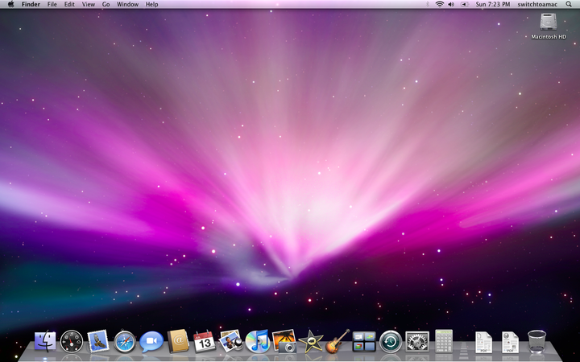
OS X

